Slide 1
Changing Opportunity
Sociological Mechanisms Underlying Growing Class Gaps and Shrinking Race Gaps in Economic Mobility
Raj Chetty, Harvard and Opportunity Insights
Will Dobbie, Harvard and Opportunity Insights
Benjamin Goldman, Cornell and Opportunity Insights
Sonya R. Porter, U.S. Census Bureau
Crystal Yang, Harvard and Opportunity Insights
July 2024
We are very grateful to Dhruv Gaur, Shipra Karan, Nico Rotundo, Austin Zheng, and other Opportunity Insights predoctoral fellows for outstanding research assistance. Any opinions and conclusions expressed herein are those of the authors and do not represent the views of the U.S. Census Bureau. The Census Bureau has ensured appropriate access and use of confidential data and has reviewed these results for disclosure avoidance protection (Project 7519874:CBDRB-FY2022-CES010-004, CBDRB-FY2023-CES005-025, CBDRB‑FY23‑0375, CBDRB-FY24-0007, CBDRB-FY24-0143, CBDRB‑FY24‑0359). For simplicity, we use “race” to refer to race and ethnicity; “White” to refer to non-Hispanic white individuals, “Black” to refer to non-Hispanic Black individuals, and so on.

Slide 2
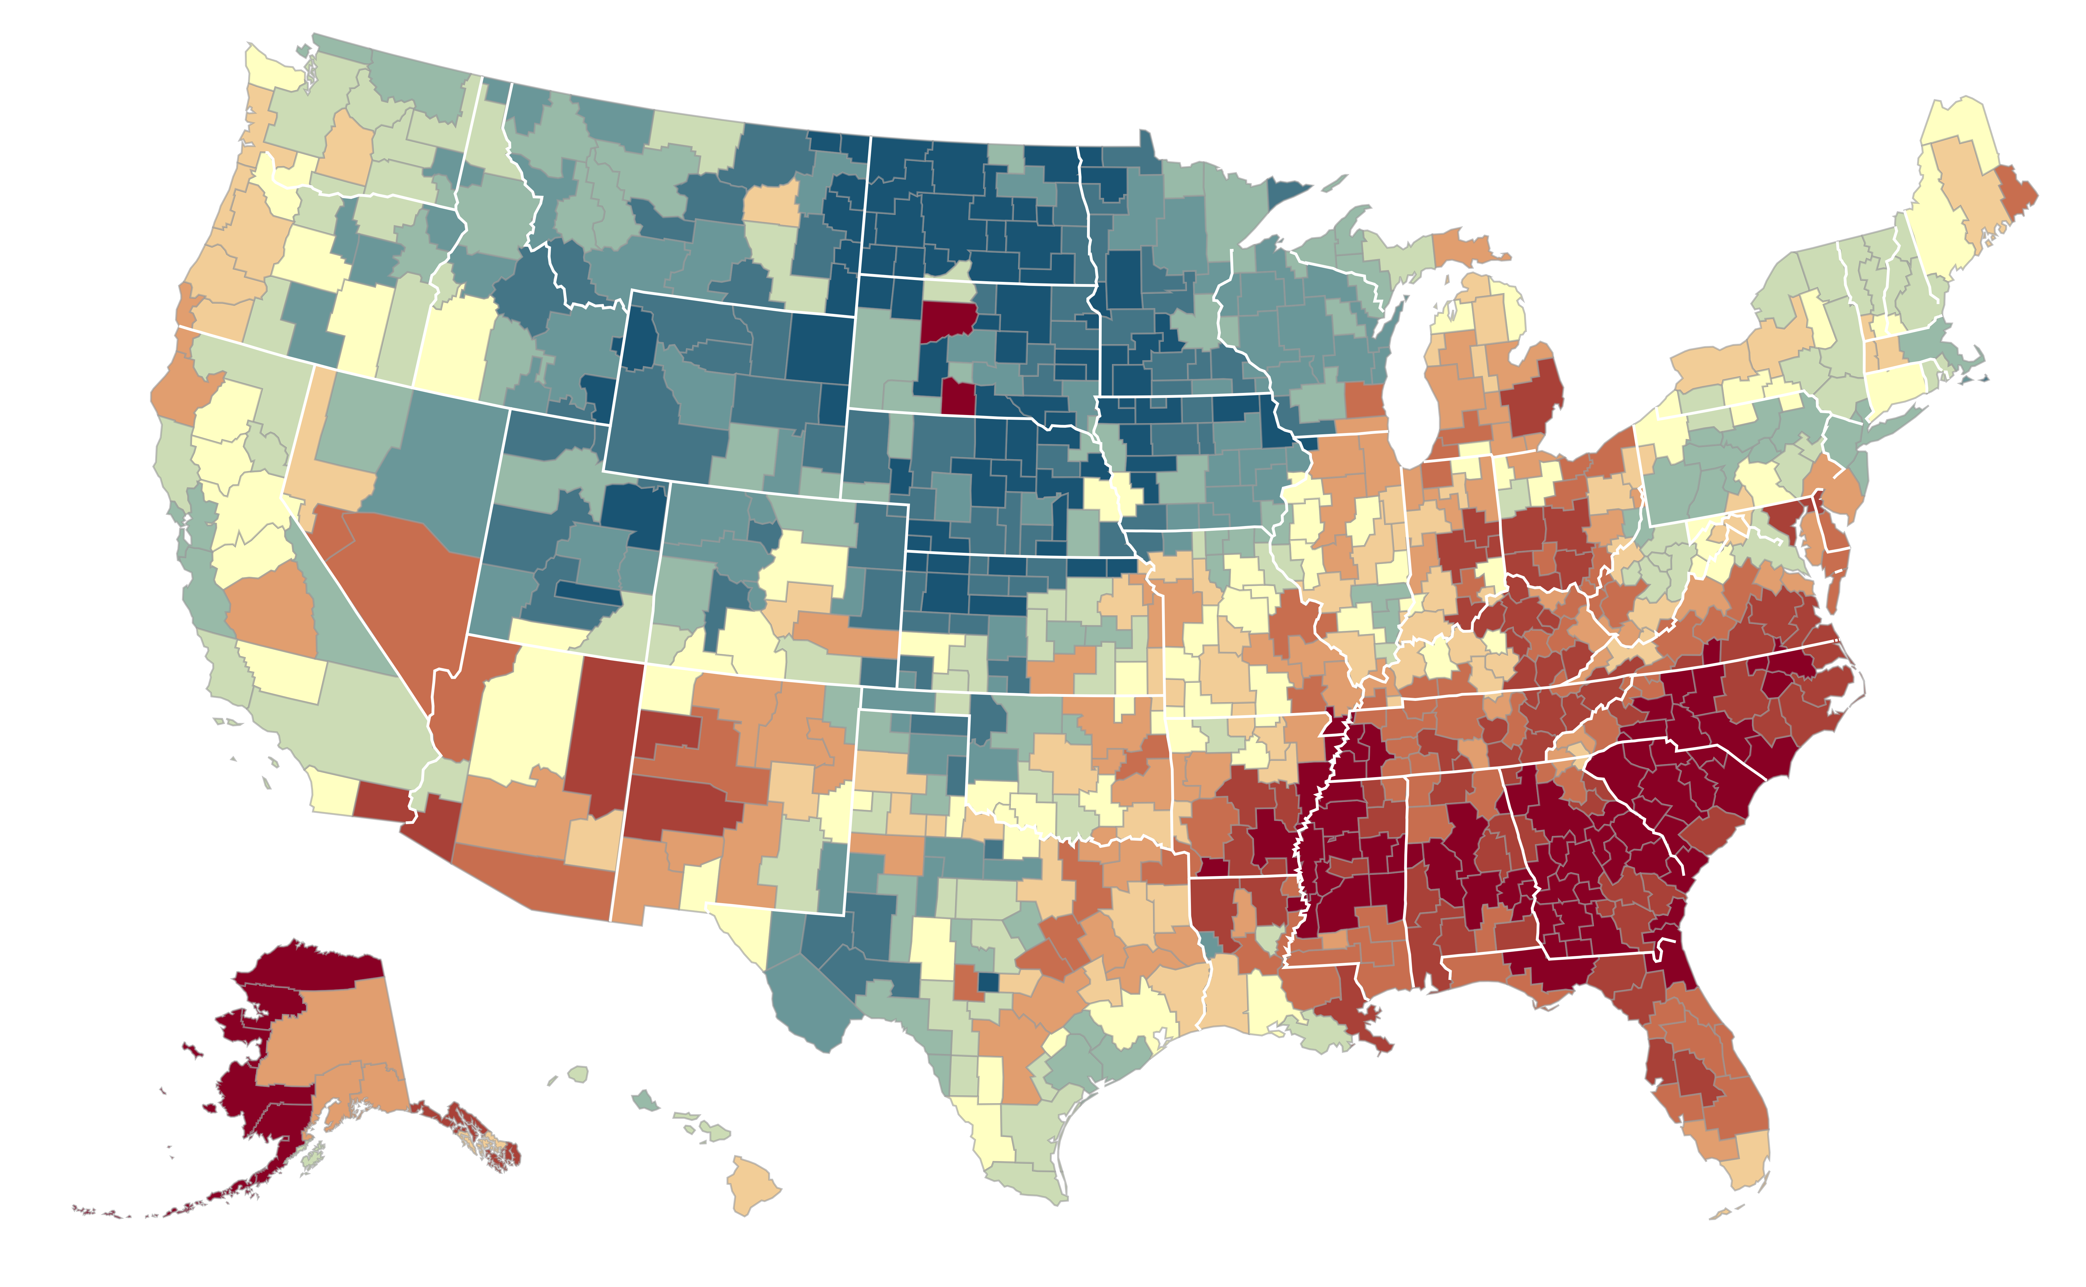
The Geography of Upward Mobility in the United States
Average Household Income at Age 35 for Children born in 1980 whose Parents Earned $27K
Salt Lake City
$37.2K
Seattle $35.2K
Cincinnati $28.3K
Dubuque $45.5K
Cleveland $29.4K
Boston
$36.8K
New York City
$35.4K
San Francisco Bay Area
$37.2K
Washington DC $33.9K
Los Angeles $34.3K
Charlotte $26.3K
<$20k
$33k
>$55k
Blue = More Upward Mobility
Red = Less Upward Mobility
Source: Chetty, Hendren, Kline, Saez (QJE 2014)

Slide 3
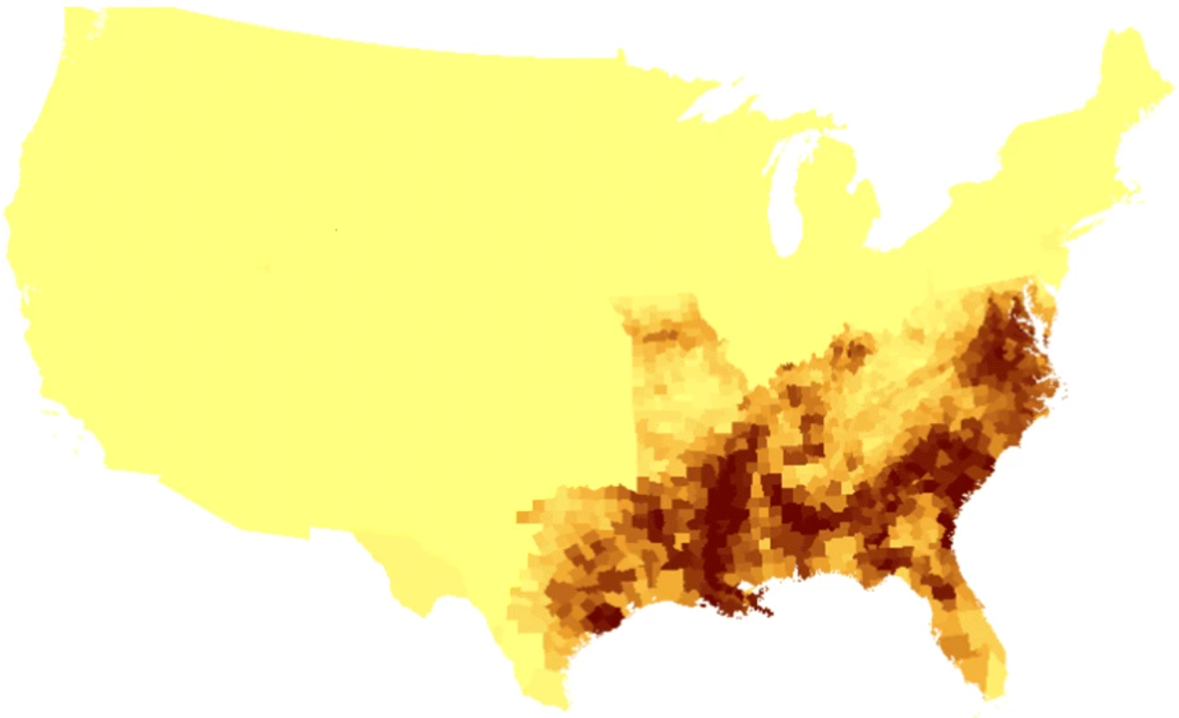
Rates of Slavery in the 1860s vs. Present-Day Upward Mobility
Rates of Slavery (1860)
Upward Mobility
Share of the Population that Were Enumerated as Slaves in the 1860 Census
Average Household Income at Age 35 for Children whose Parents Earned $27k (25th percentile)
Yellow = Lower Share of Slaves
Brown = Higher Share of Slaves
Blue = More Upward Mobility
Red = Less Upward Mobility
Source: Berger (2018); Chetty, Hendren, Kline, Saez (2014)

Slide 4
Redlining in the 1930s vs. Present-Day Upward Mobility
Oakland, CA
Redlining Boundaries (1930s)
Upward Mobility
Neighborhood grade, 1930s
Average Household Income at Age 35 for Children whose Parents Earned $27k (25th percentile)
Green = “Best”
Blue = “Still Desirable”
Yellow = “Declining”
Red = “Hazardous”
Blue = More Upward Mobility
Red = Less Upward Mobility
Source: Lane, Morello-Frosch, Marshall, and Apte (2022); Chetty, Friedman, Hendren, Jones, Porter (2018)

Slide 5
Changing Opportunity

Slide 6
New Data Give us a Lens to Study Changes in Opportunity
2014 Opportunity Insights Land of Opportunity study focused on children born around 1980
We use an additional decade of tax data to analyze changes in outcomes for children born in the 1978-1992 birth cohorts
First evidence on changes in economic mobility within places and mechanisms underlying changes in opportunity

Slide 7
Data
Census data (2000, 2010, ACS) covering U.S. population linked to federal income tax returns from 1979-2019 [extending Chetty, Hendren, Jones, Porter 2020]
Sample: children in 1978-92 birth cohorts, linked to parents via dependent claiming
57.2 million children, 92% of those in 1978-92 birth cohorts in 2000 Census

Slide 8
Variable Definitions
Parents’ pre-tax household incomes: mean Adjusted Gross Income when child is 13-17, assigning zeros to non-filers
Children’s pre-tax household incomes measured at age 27 (from 2005-2019)
Translate to percentile ranks: rank children relative to others in their birth cohort and parents relative to other parents with children in that birth cohort
Self-reported information on child’s race/ethnicity from 2000 Census

Slide 9
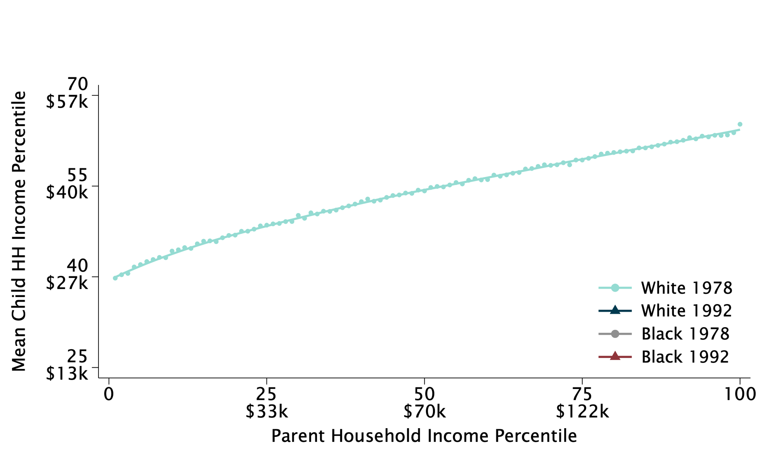
Intergenerational Mobility for the 1978 vs. 1992 Birth Cohorts, by Race and Class
Mean Child Household Income Percentile at Age 27 vs. Parent Household Income Percentile

Slide 10
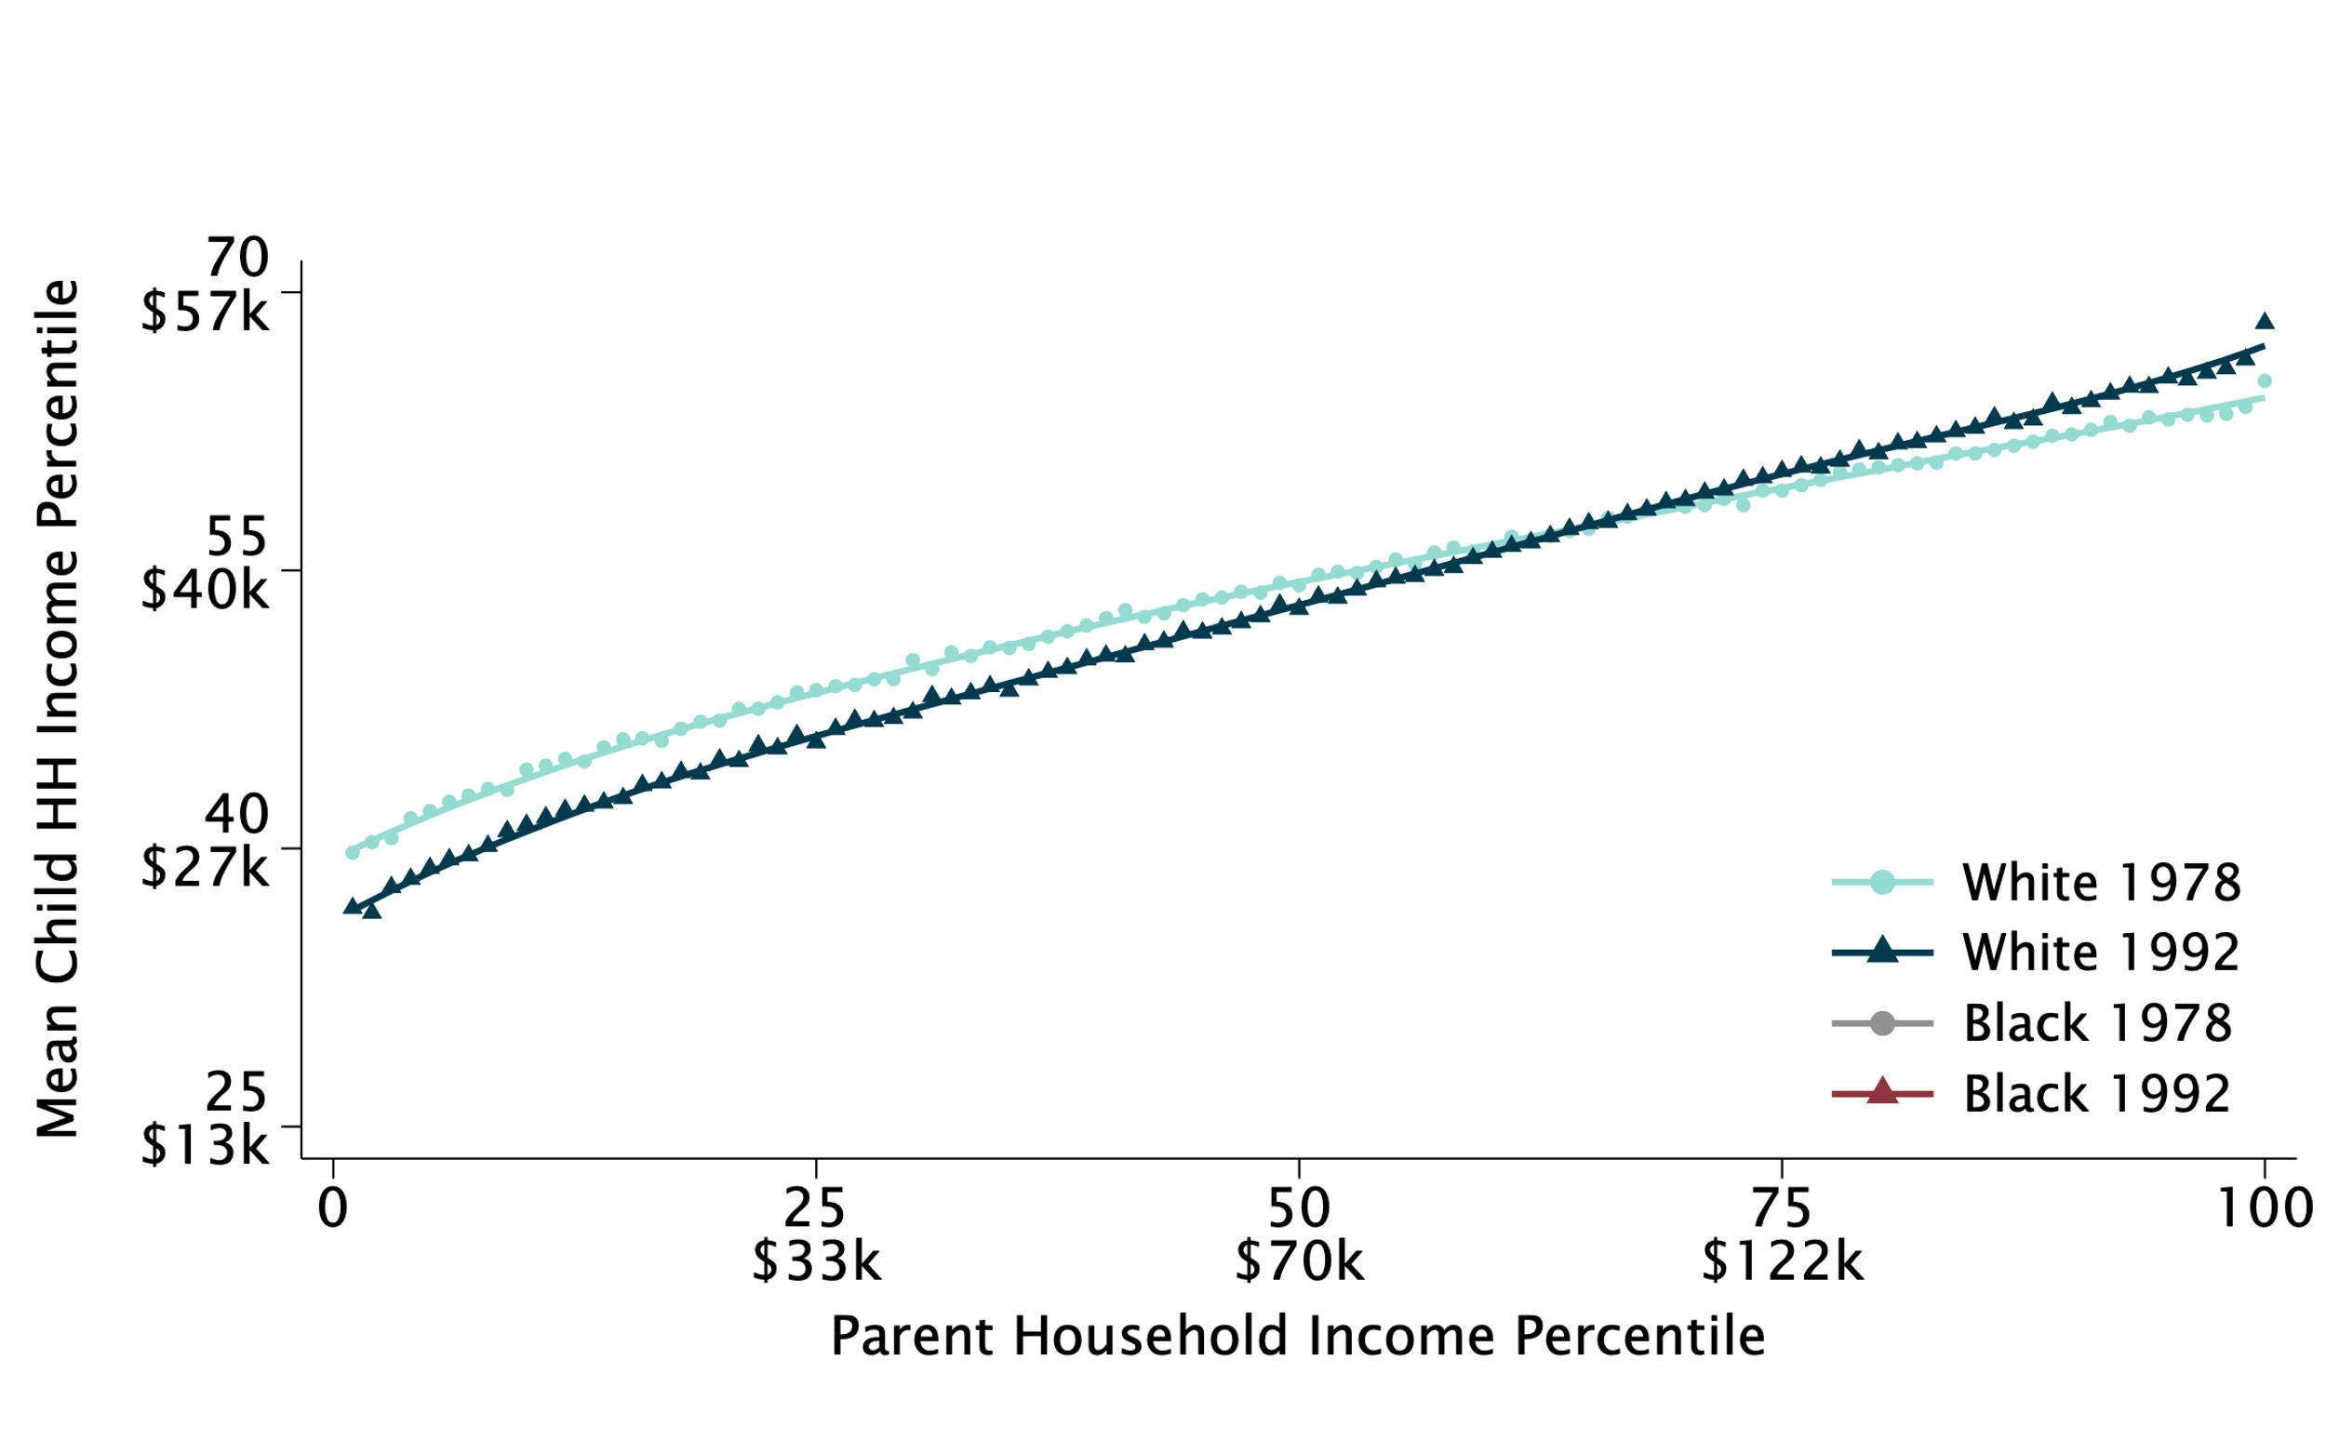
Intergenerational Mobility for the 1978 vs. 1992 Birth Cohorts, by Race and Class
Mean Child Household Income Percentile at Age 27 vs. Parent Household Income Percentile

Slide 11
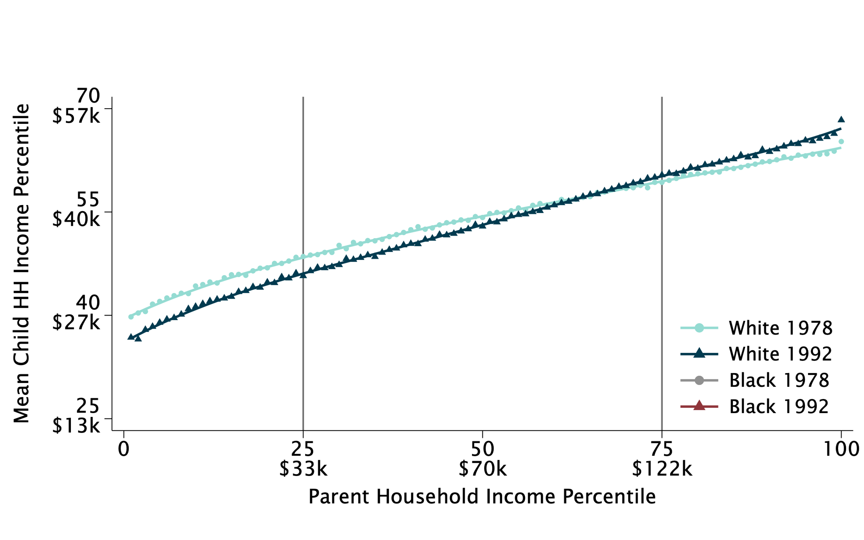
Intergenerational Mobility for the 1978 vs. 1992 Birth Cohorts, by Race and Class
Mean Child Household Income Percentile at Age 27 vs. Parent Household Income Percentile

Slide 12
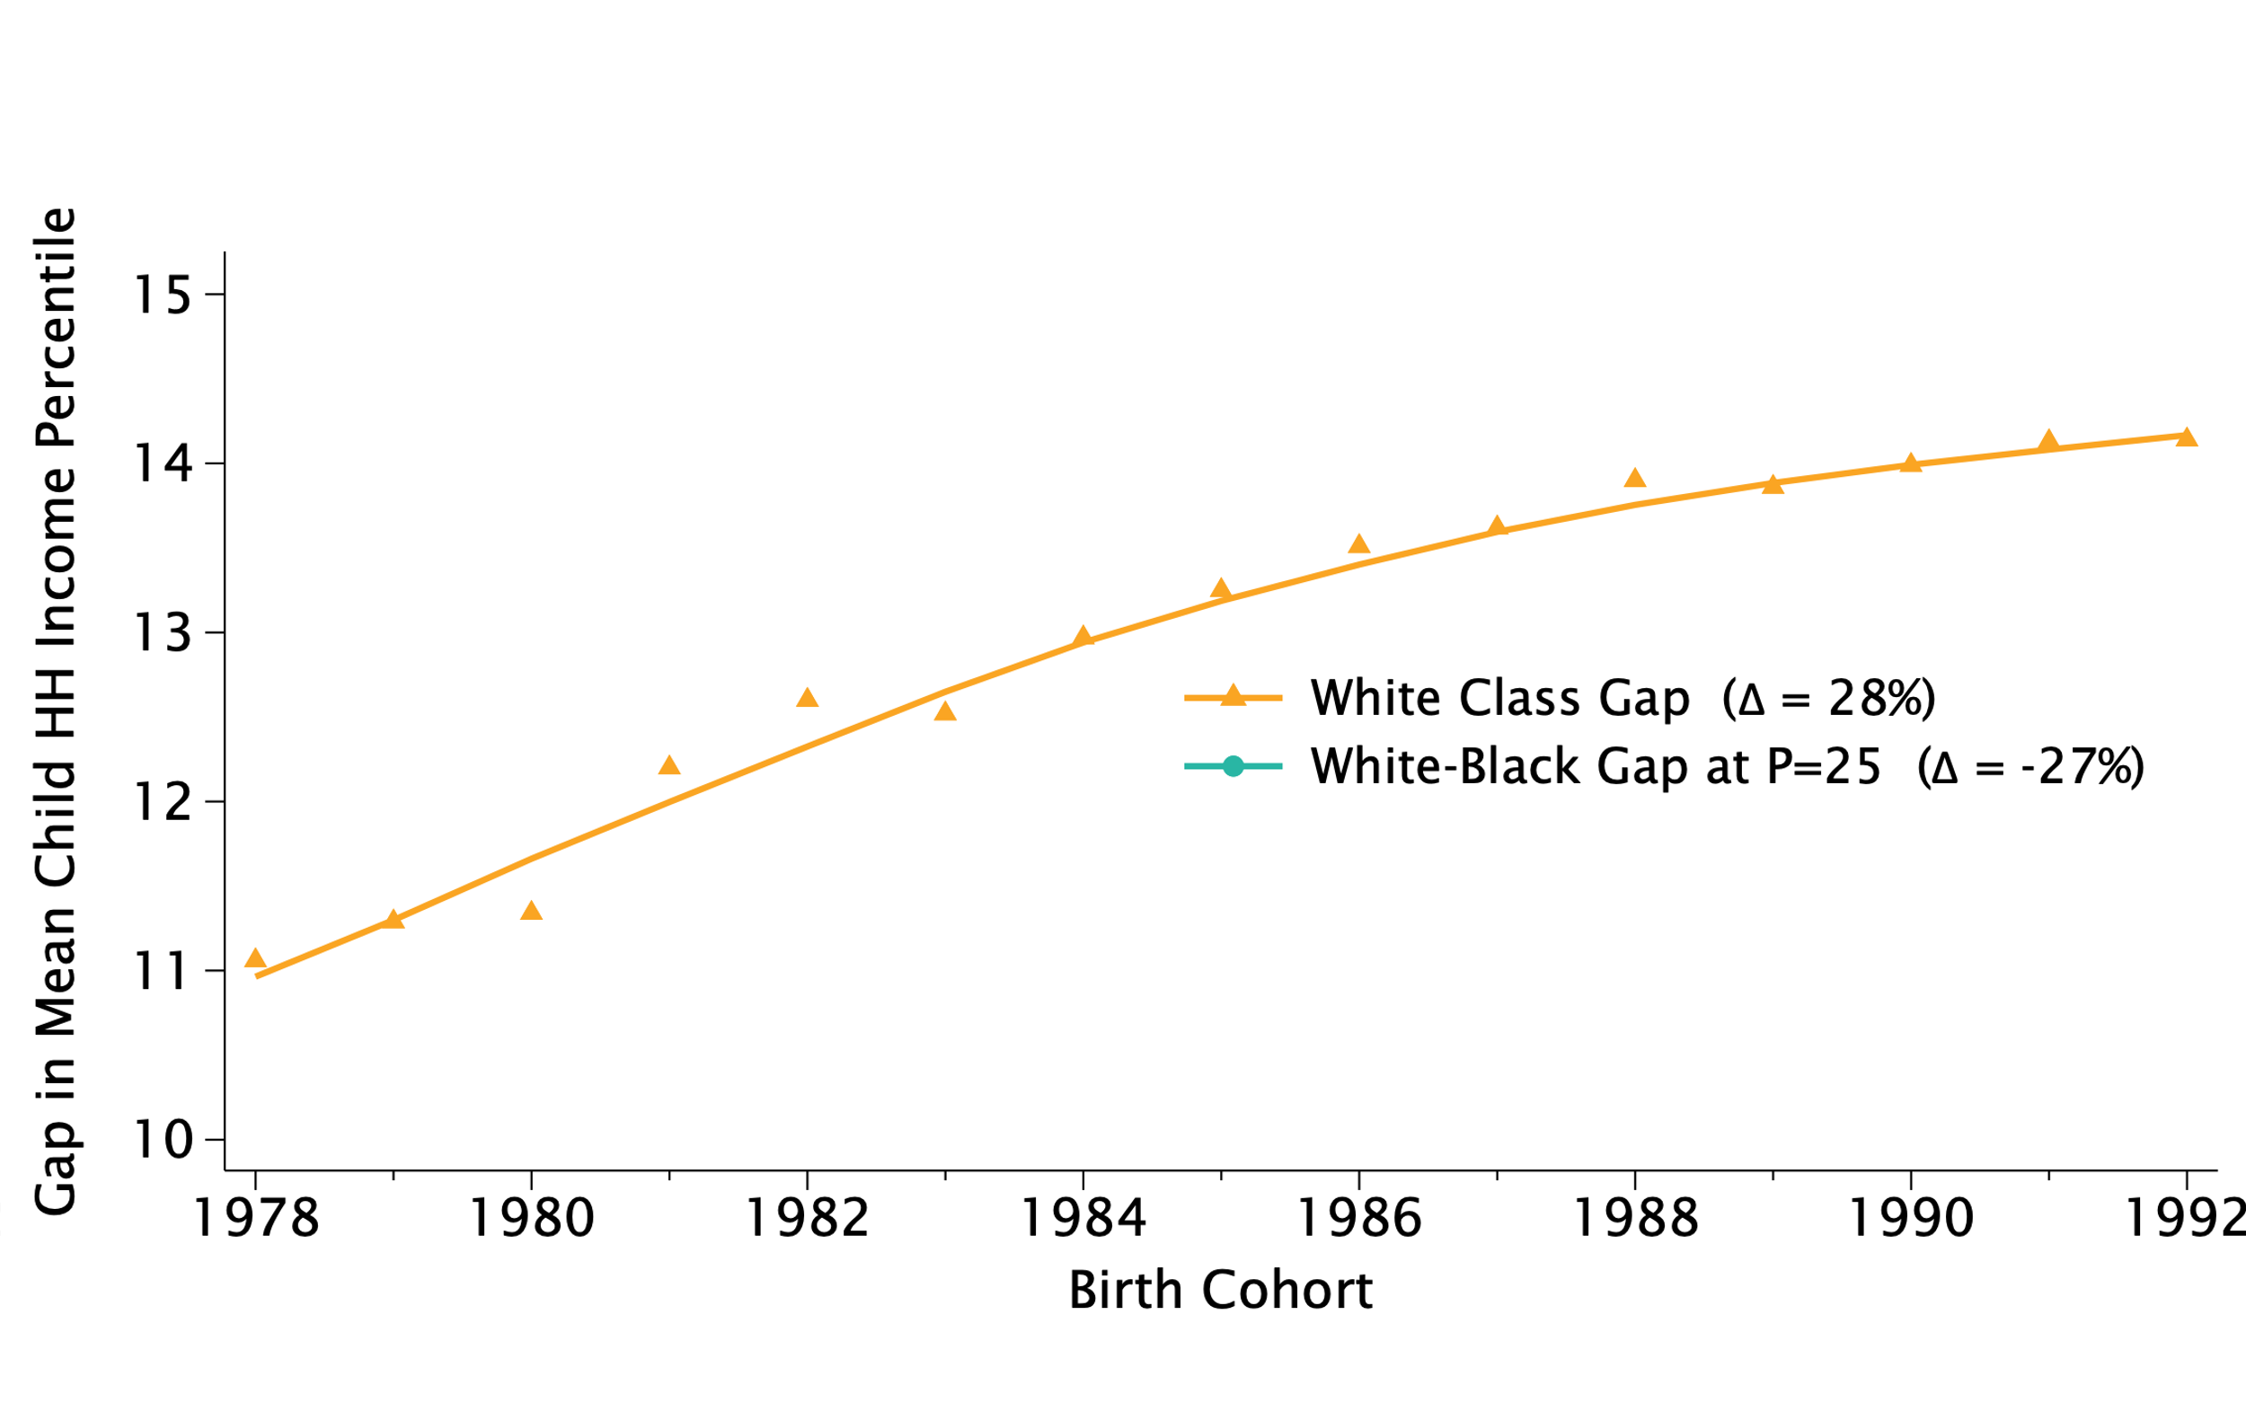
White Class Gap for Children with High vs. Low-Income Parents, by Birth Cohort

Slide 13
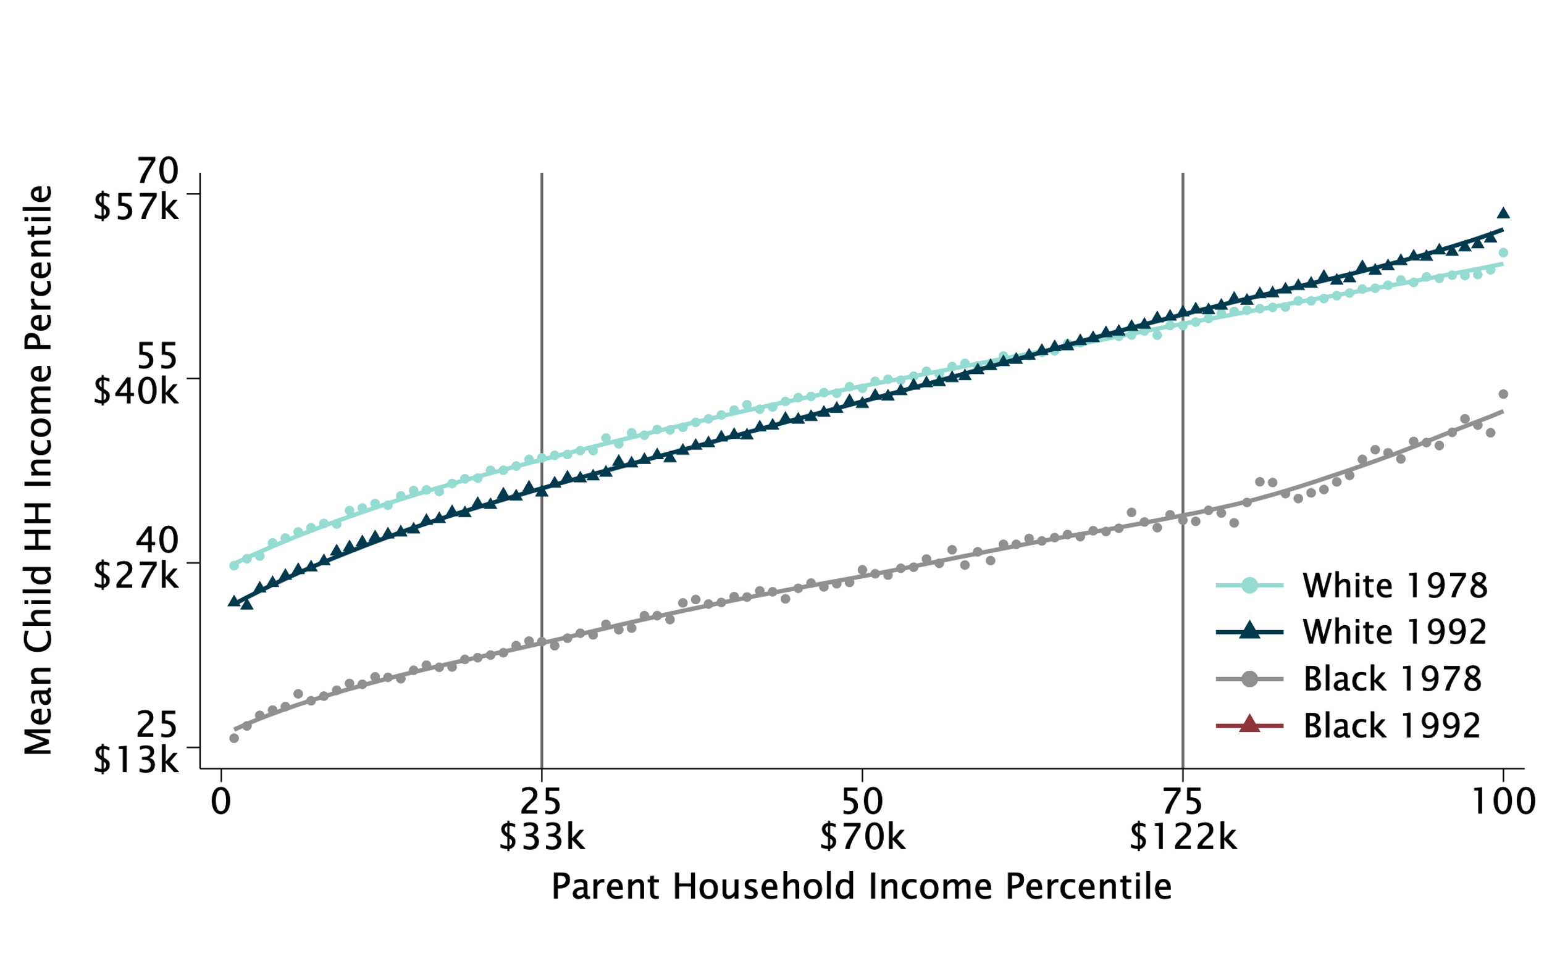
Intergenerational Mobility for the 1978 vs. 1992 Birth Cohorts, by Race and Class
Mean Child Household Income Percentile at Age 27 vs. Parent Household Income Percentile

Slide 14
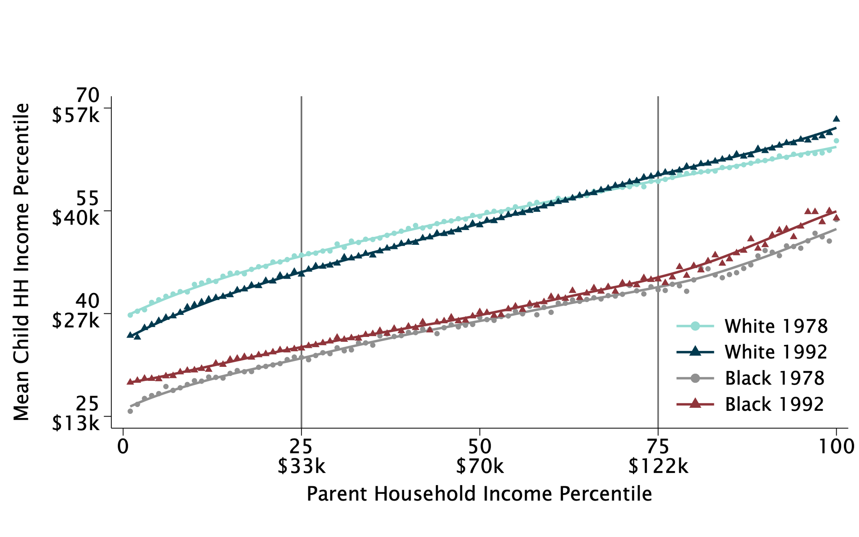
Intergenerational Mobility for the 1978 vs. 1992 Birth Cohorts, by Race and Class
Mean Child Household Income Percentile at Age 27 vs. Parent Household Income Percentile

Slide 15
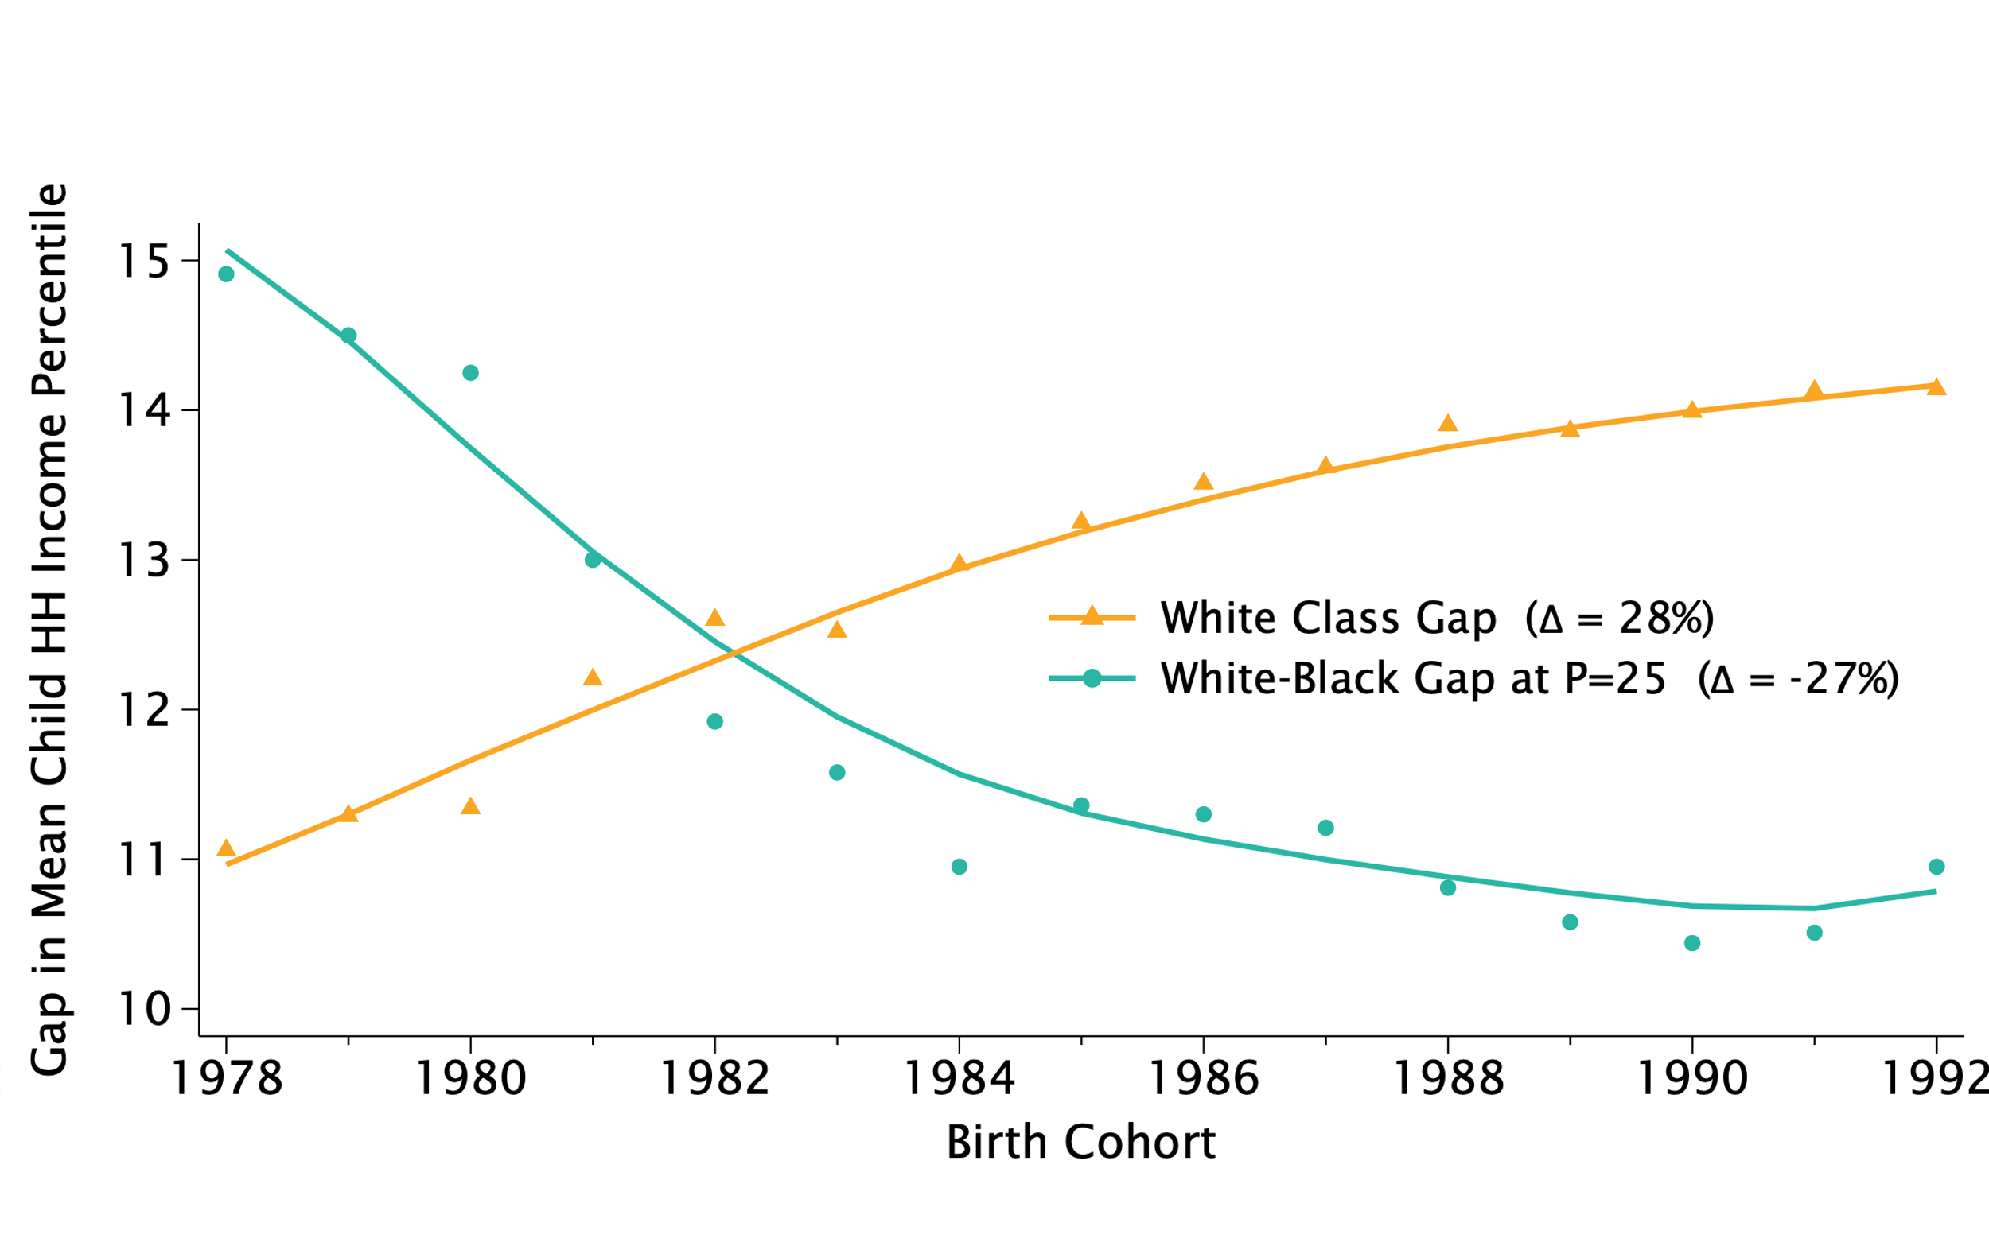
Growing Class Gaps, Shrinking Race Gaps
White-Black Gap for Children with Low-Income Parents vs. White Class Gap, by Birth Cohort

Slide 16
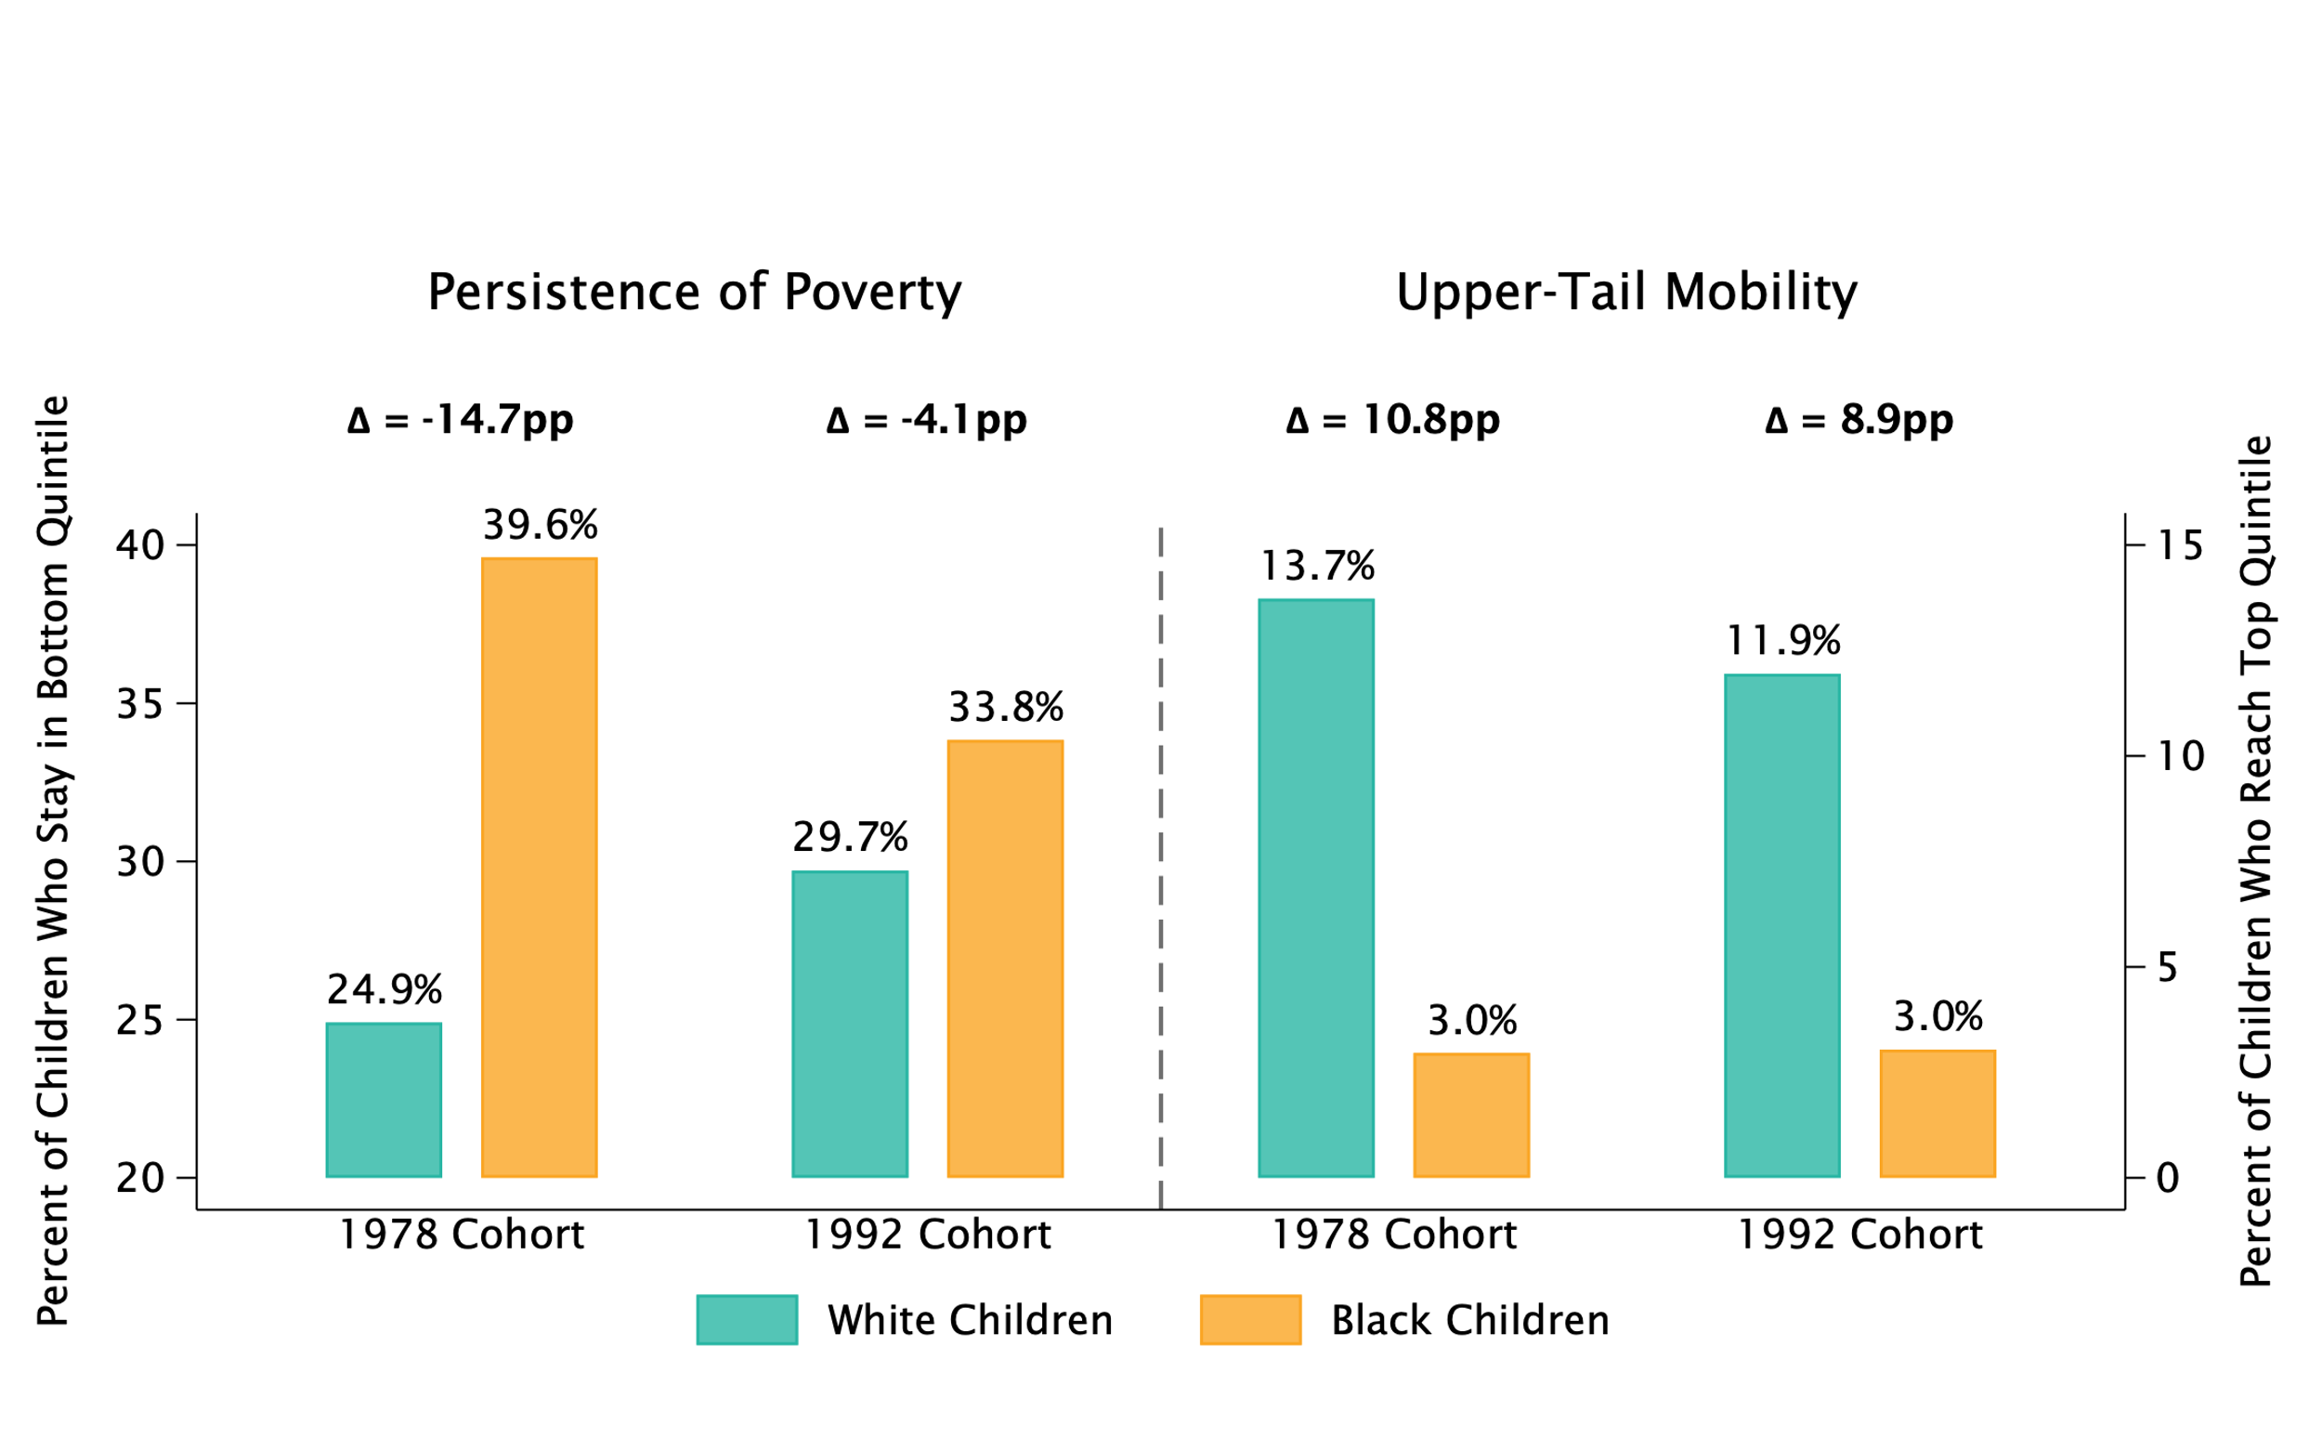
Race Gaps in Intergenerational Persistence of Poverty vs. Upper-Tail Mobility
Quintile Transition Probabilities for Children with Parents in Bottom Income Quintile

Slide 17
Race Gaps in Intergenerational Persistence of Poverty vs. Upper-Tail Mobility
Quintile Transition Probabilities for Children with Parents in Bottom Income Quintile

Slide 18
Race Gaps in Intergenerational Persistence of Poverty vs. Upper-Tail Mobility
Quintile Transition Probabilities for Children with Parents in Bottom Income Quintile

Slide 19
Race Gaps in Intergenerational Persistence of Poverty vs. Upper-Tail Mobility
Quintile Transition Probabilities for Children with Parents in Bottom Income Quintile

Slide 20
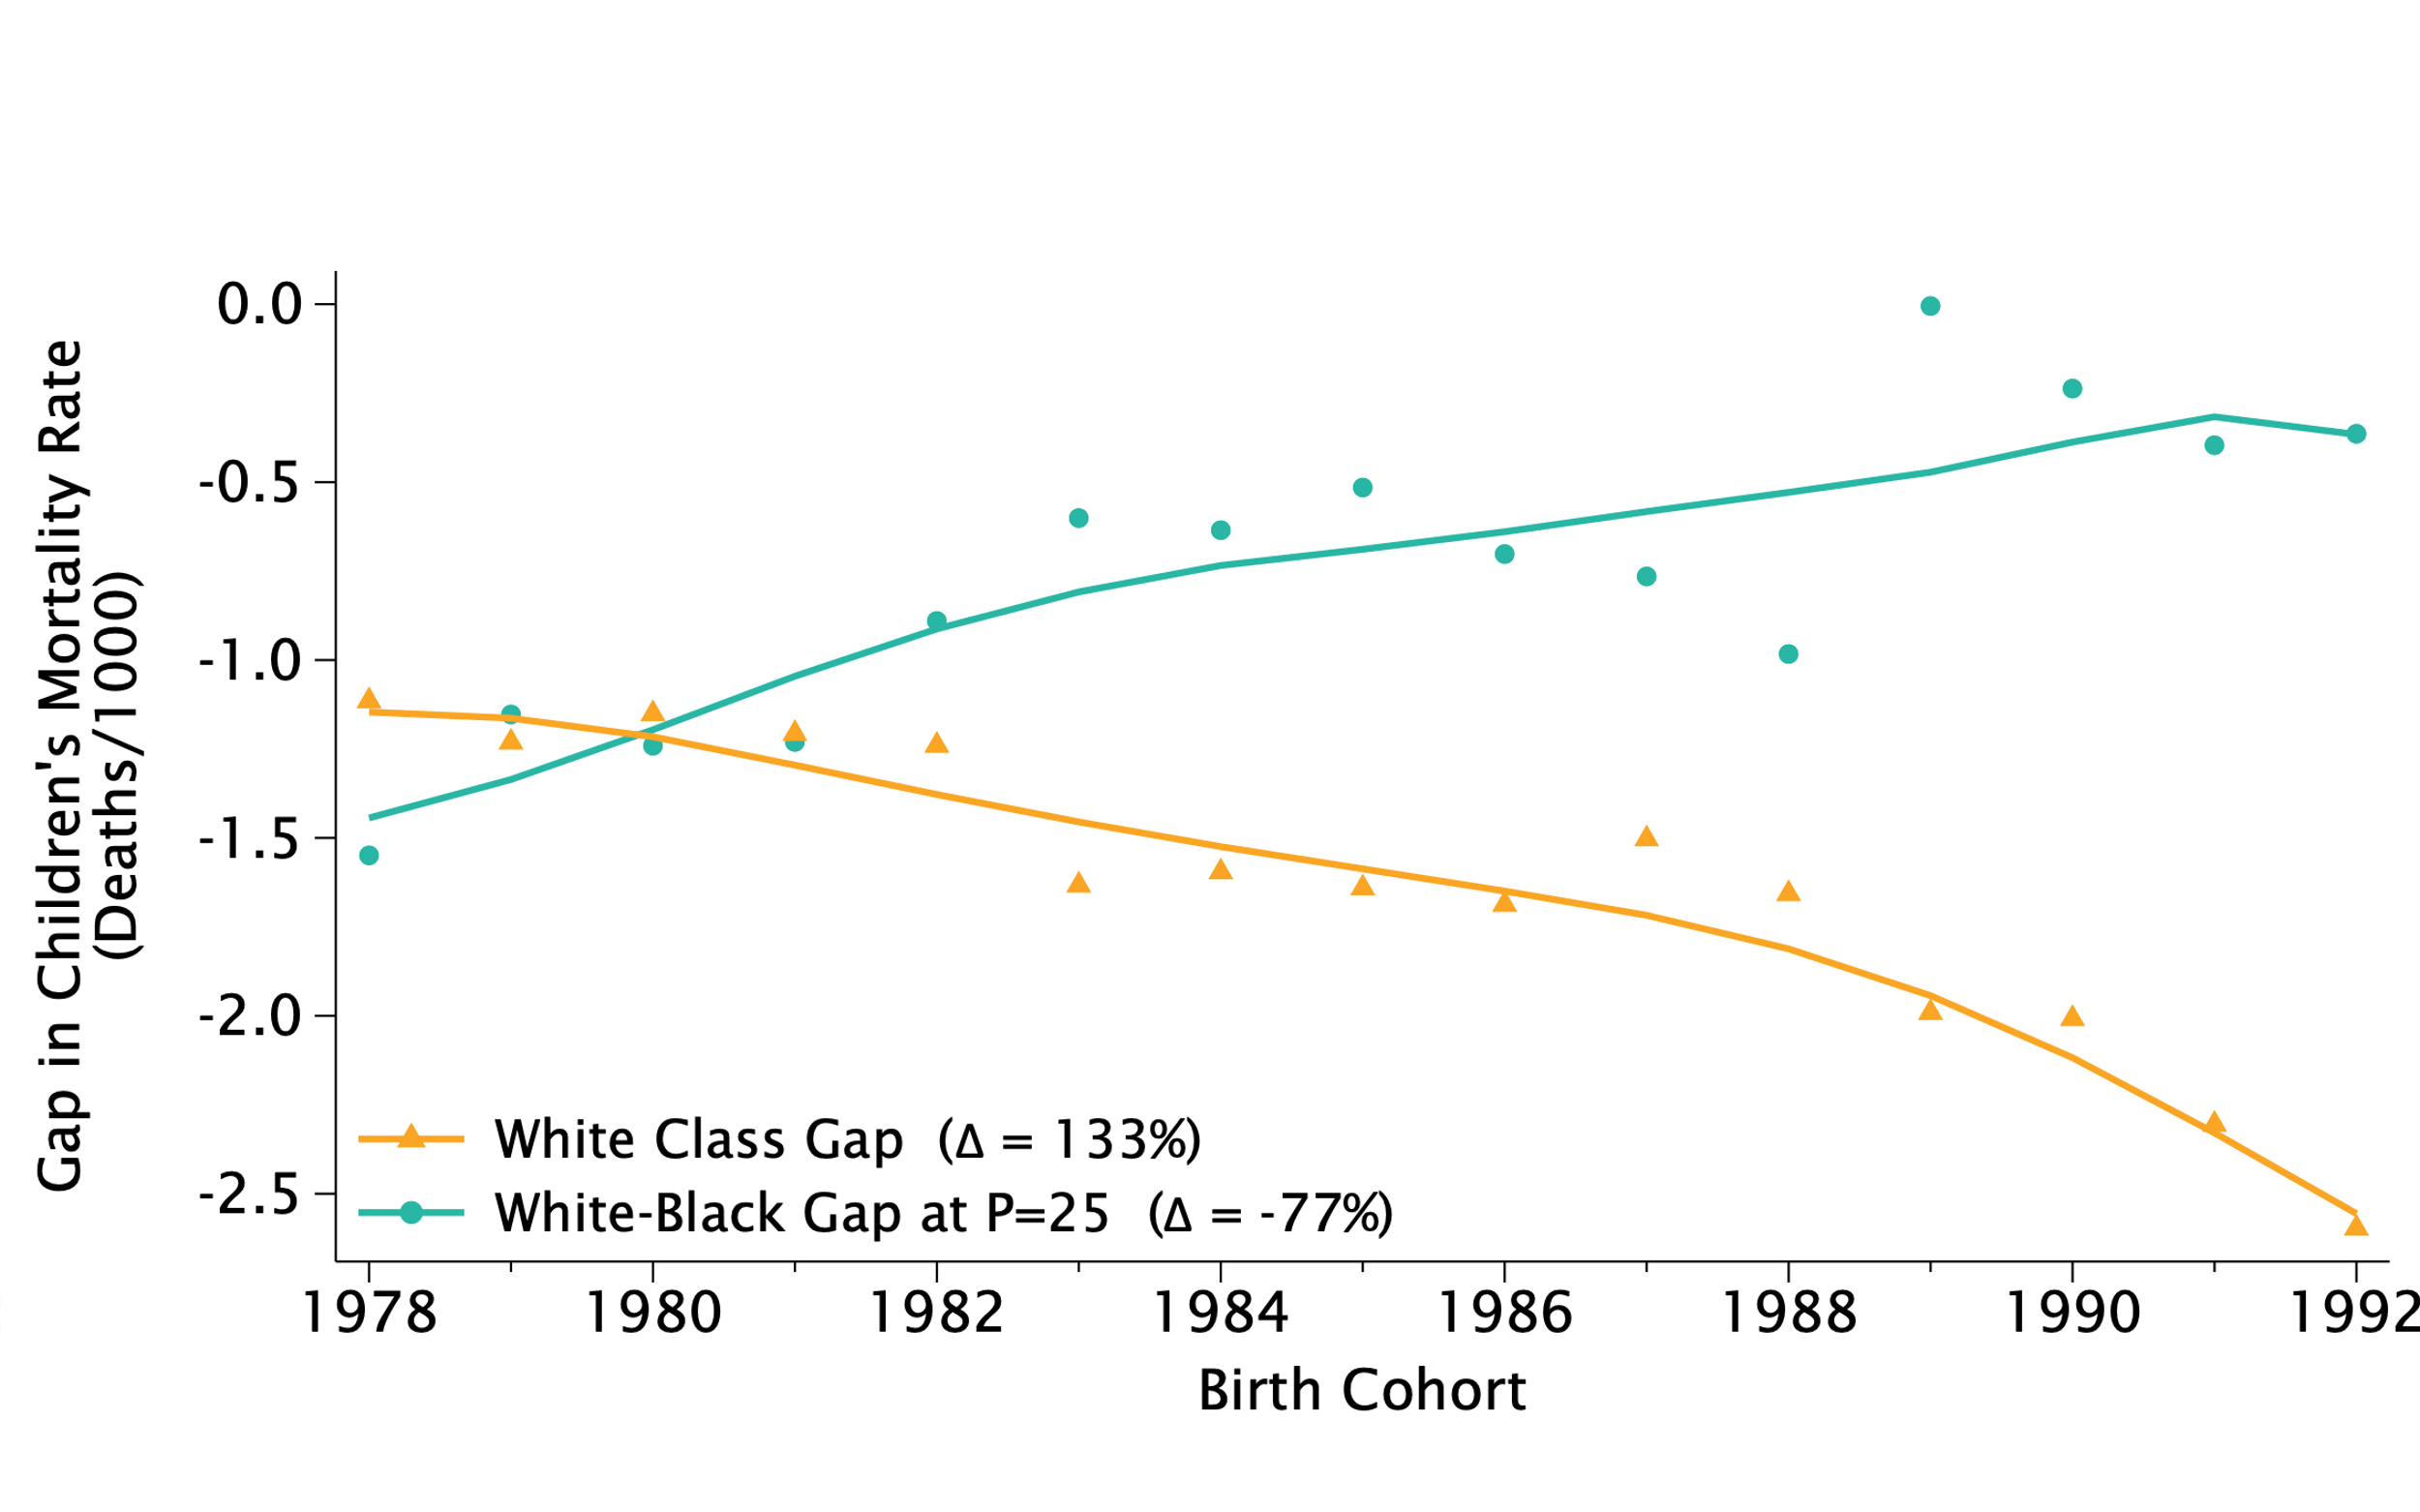
Growing Class Gaps, Shrinking Race Gaps in Mortality Rates between Ages 24-27
White-Black Gap for Children with Low-Income Parents vs. White Class Gap, by Birth Cohort

Slide 21
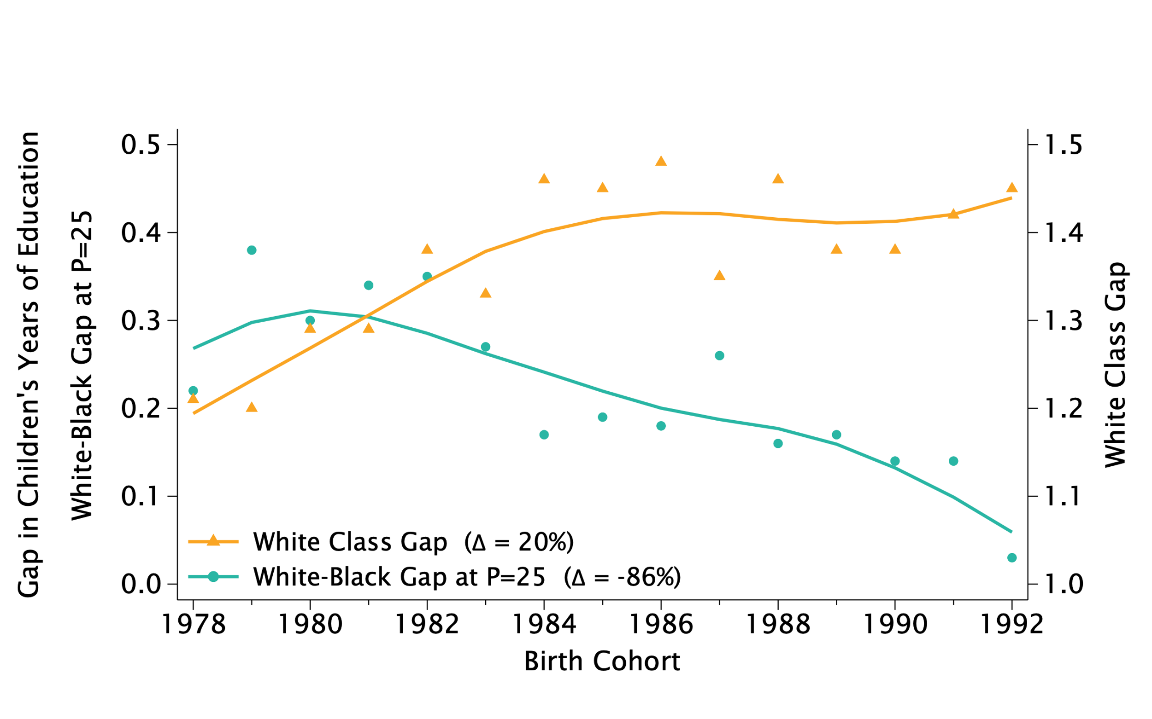
Growing Class Gaps, Shrinking Race Gaps in Educational Attainment at Age 27
White-Black Gap for Children with Low-Income Parents vs. White Class Gap, by Birth Cohort

Slide 22
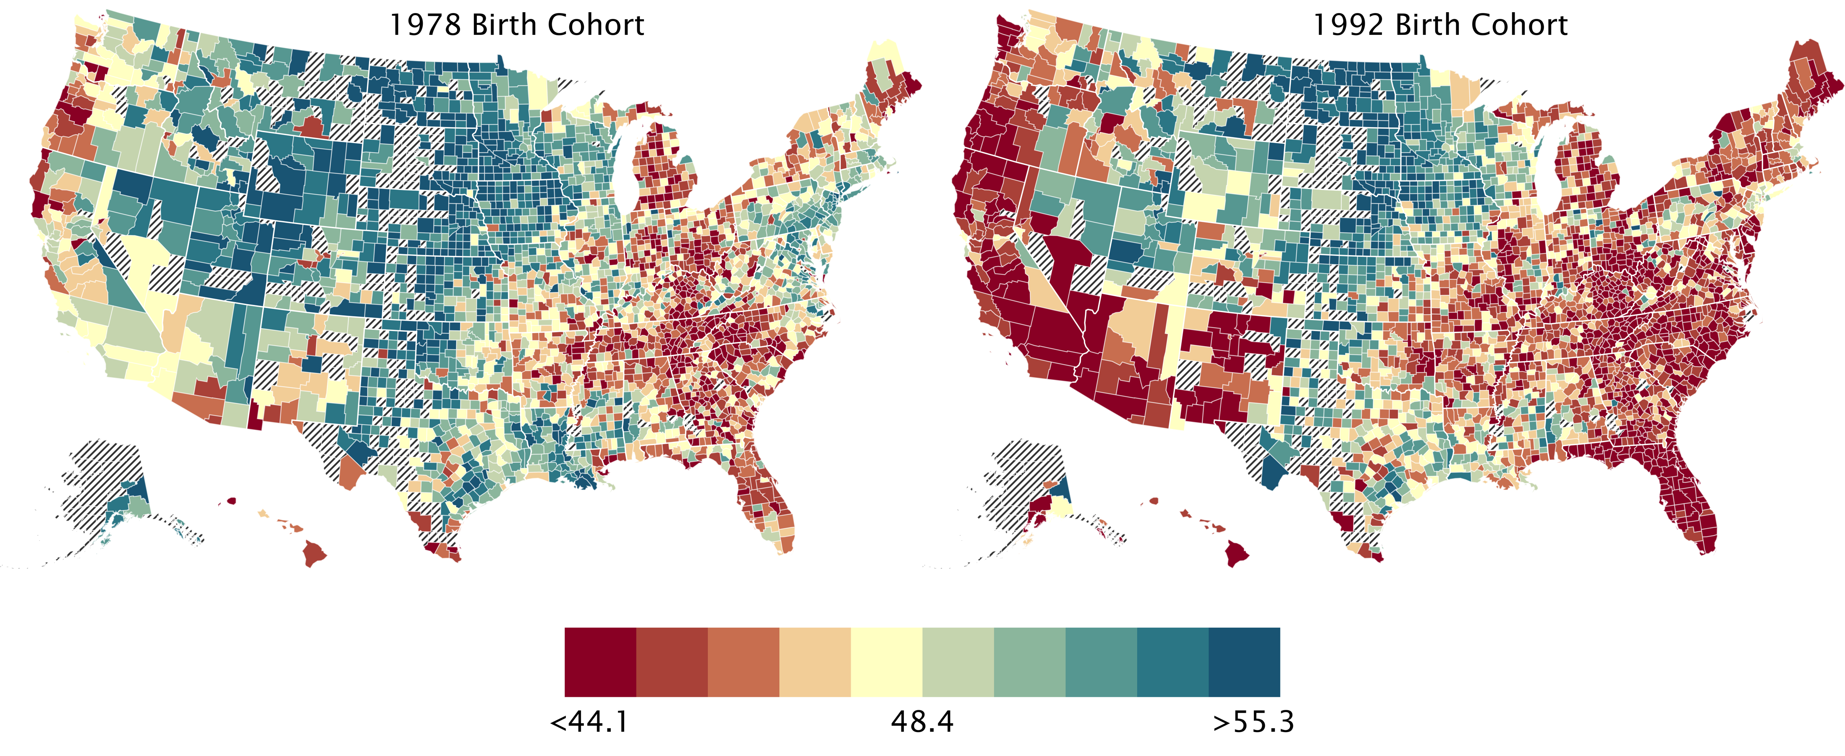
Changes in Economic Mobility for White Americans
White Children with Low-Income Parents
1978 Birth Cohort

Slide 23
Changes in Economic Mobility for White Americans
White Children with Low-Income Parents
1978 Birth Cohort
1992 Birth Cohort

Slide 24
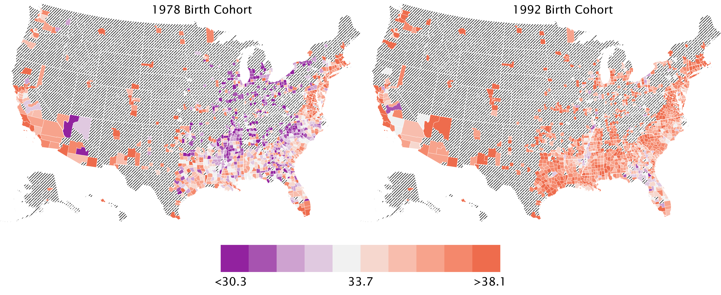
Changes in Economic Mobility for Black Americans
Black Children with Low-Income Parents
1978 Birth Cohort
1992 Birth Cohort

Slide 25
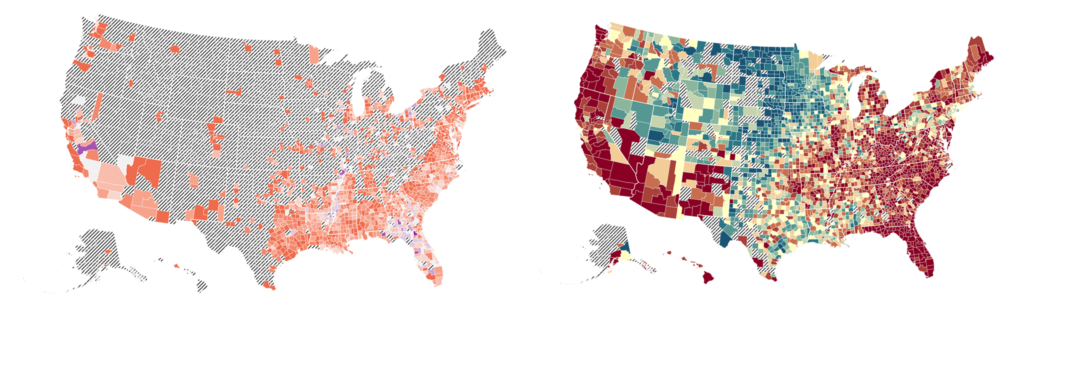
Economic Mobility for Black vs. White Children Born in 1992
Black Children
White Children

Slide 26
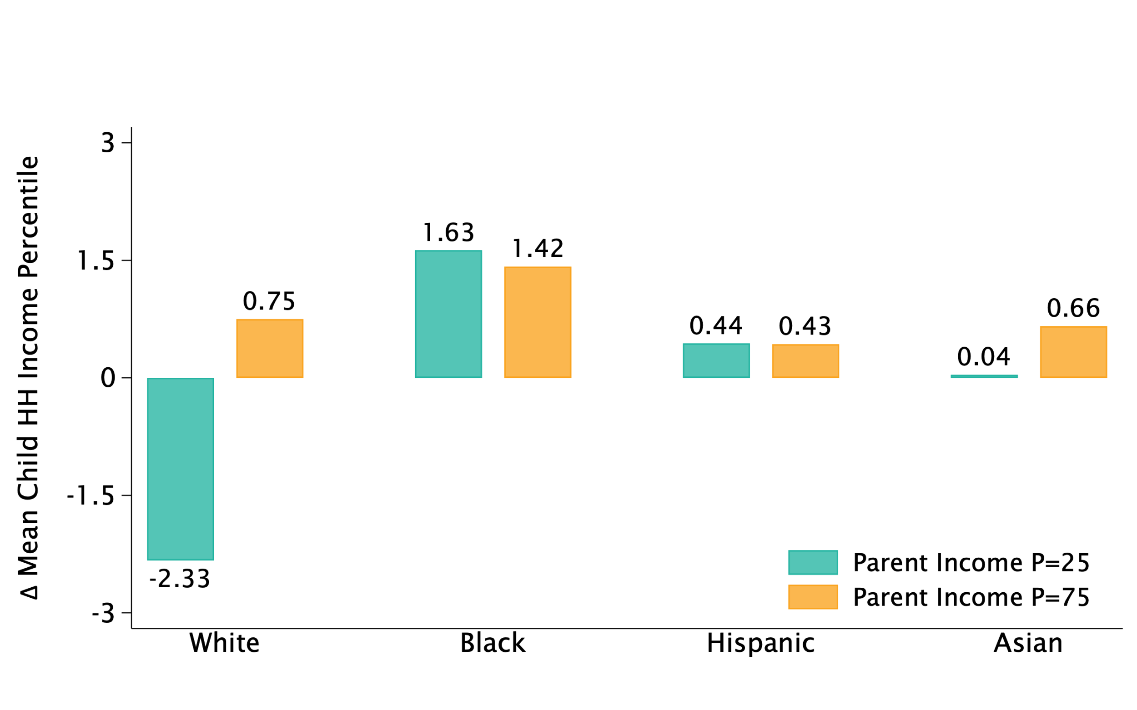
Change in Mean Child Household Income Percentile by Race and Class
Household Income Percentile at Age 27, 1992-1978 Cohort Difference

Slide 27
Mechanisms Underlying Trends in Mobility

Slide 28
Potential Explanations for Growing Class Gaps and Shrinking Race Gaps
Begin by considering two natural explanations for changes in intergenerational mobility by race and class:
Changes in family-level characteristics (e.g., education, marriage, wealth, occupation)
Differential shocks across areas (e.g., predominantly Black vs. White areas)

Slide 29
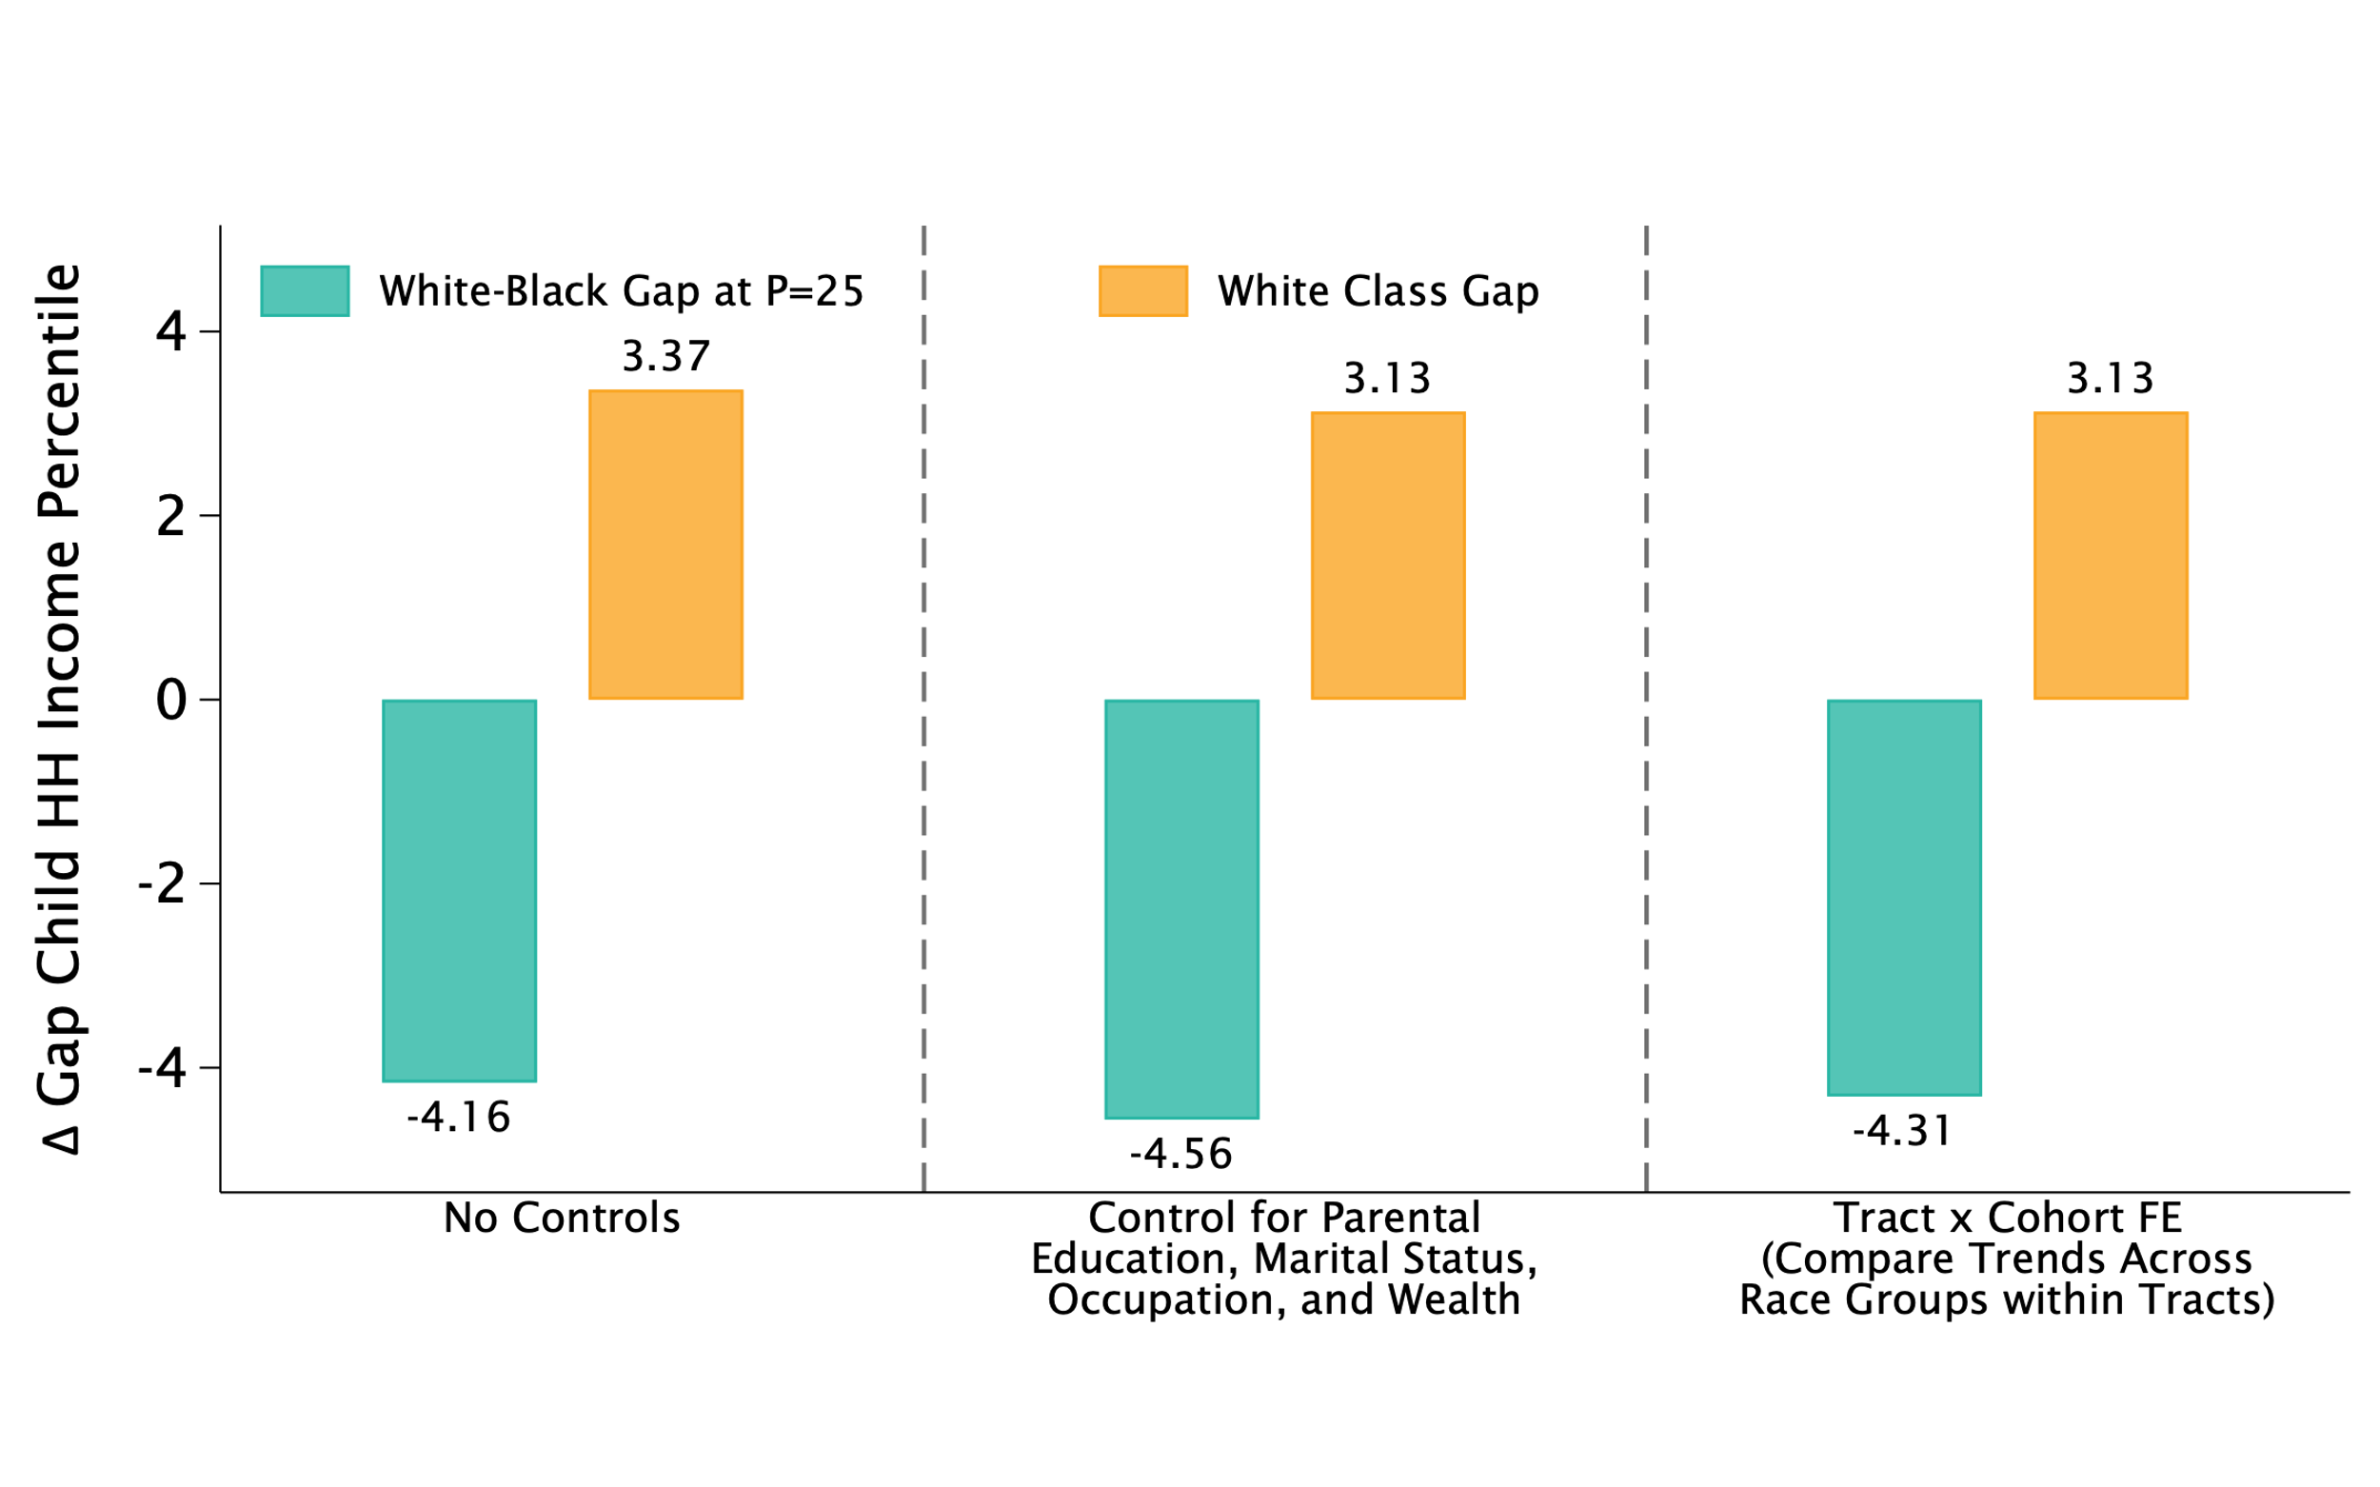
Can Family Characteristics or Neighborhoods Explain Changes in Gaps?
Household Income Percentile at Age 27, 1992-1978 Cohort Difference
$$Y=β_{1}White+β_{2}Cohort+β_{3}White×Cohort+α_{nw}+α_{nc}+ε$$

Slide 30
Can Family Characteristics or Neighborhoods Explain Changes in Gaps?
Household Income Percentile at Age 27, 1992-1978 Cohort Difference

Slide 31
What Drives the Divergence in Outcomes by Race and Class?
Changes in intergenerational mobility by race and class must be driven by differential trends within areas
One hypothesis for such changes emphasized in prior ethnographic work: changes in employment rates
Can differential changes in parental employment by race and class explain within-area divergence?
Many of today’s problems…crime, family dissolution, welfare, low levels of social organization, and so on…are fundamentally a consequence of the disappearance of work.
- William Julius Wilson When Work Disappears (1996)

Slide 32
Changes in Economic Mobility vs. Changes in Employment Rates
Examine link between changes in employment rates and economic mobility across areas
Measure race-specific change in parental employment rates across counties as change in adults’ employment rates from 1980 to 2000 Census
Use employment rates as a proxy for community-level environmental conditions more broadly, as in Wilson (1996)

Slide 33
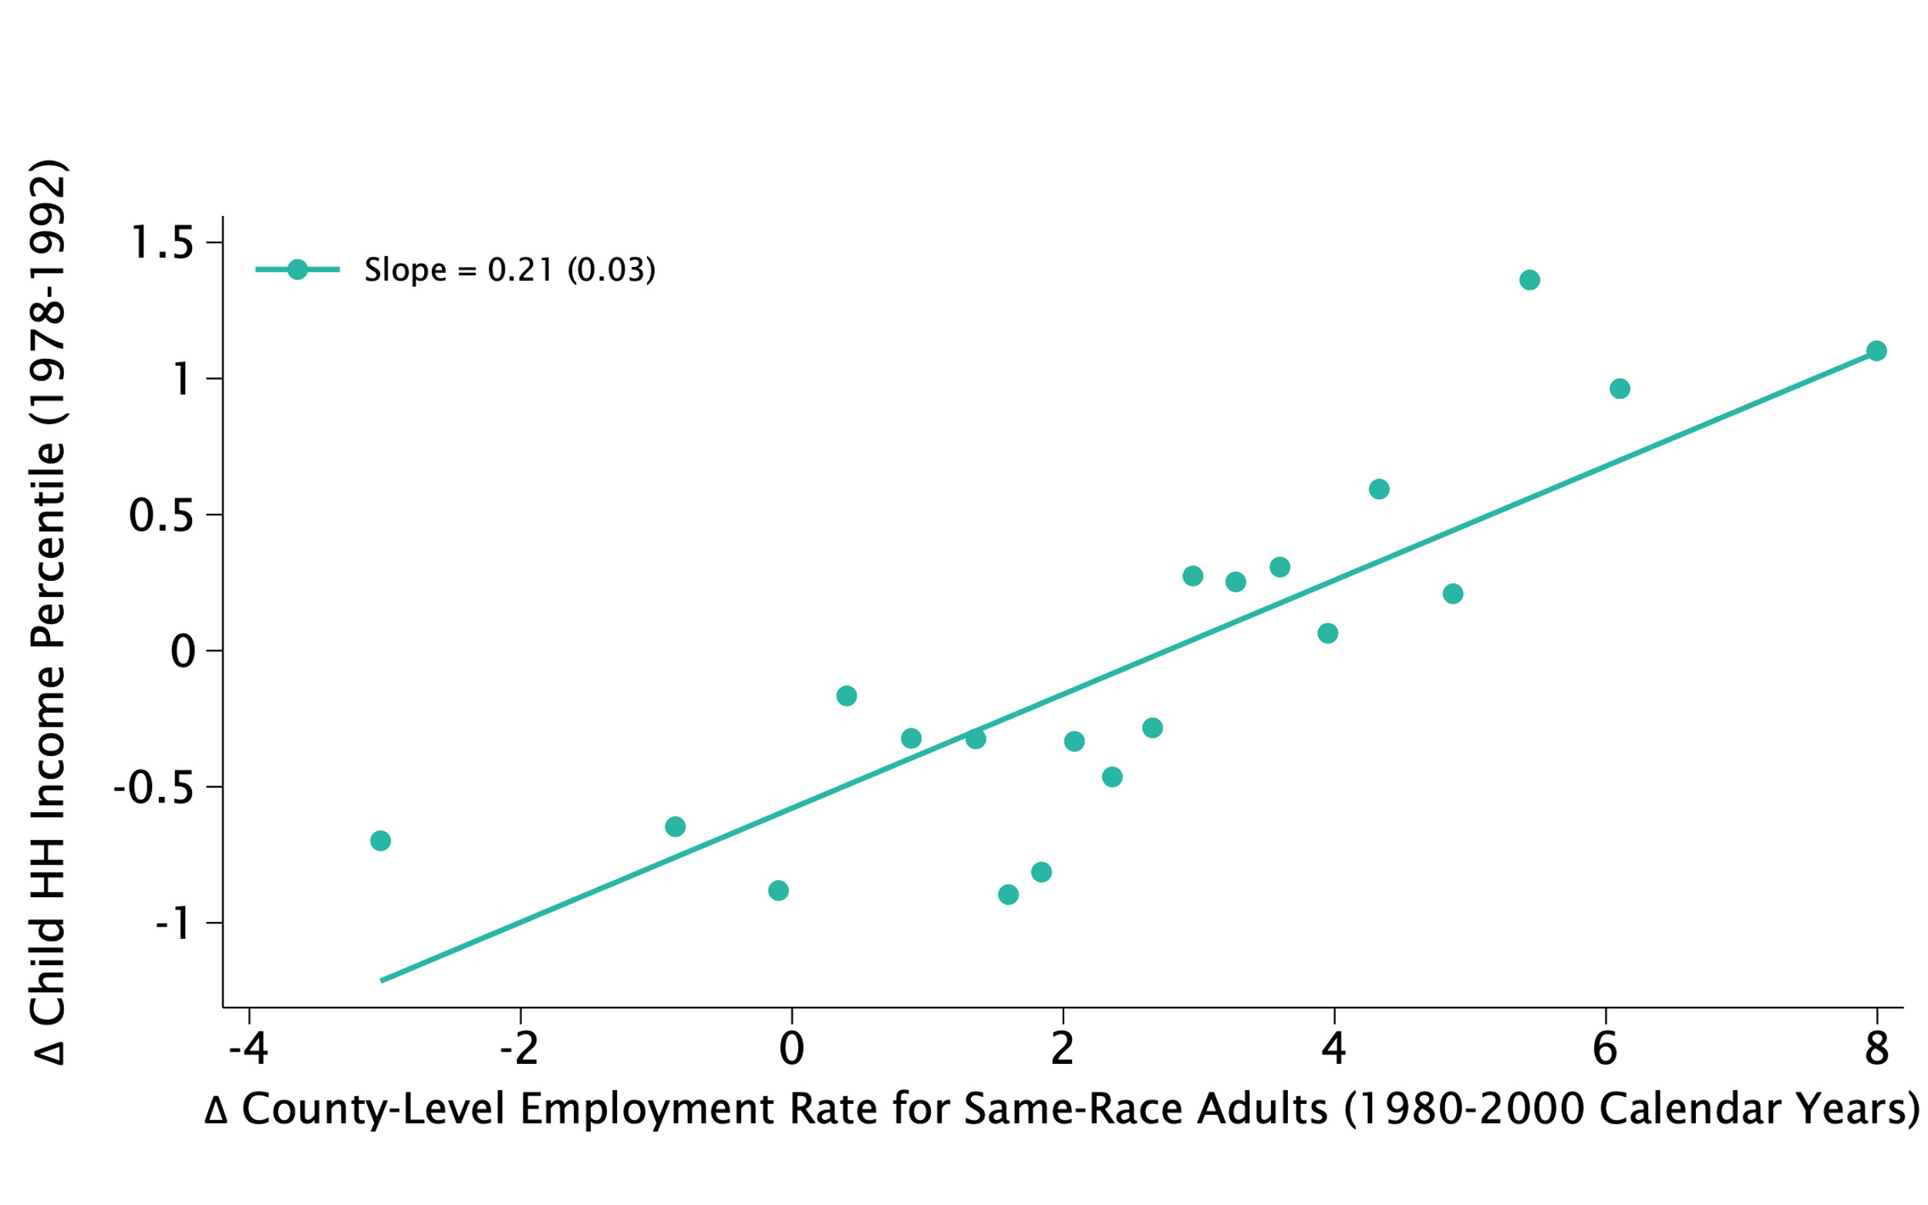
Changes in Children’s Income Percentiles vs. Adult Employment Rates, 1978-92 Cohorts
By County and Race

Slide 34
Explaining Divergence in Outcomes by Race and Class
To explain divergence by race and class, need to measure employment rates not just by race and county but also by class
Measure county-level changes in parental employment rates by race and class from 1978 to 1992 birth cohorts
Because we define “class” as parent’s income percentile during childhood (ages 13-17), need to measure employment after child is 18
In baseline analysis, measure parental employment rates when child is 27
Results insensitive to alternative points of measurement because variation in employment rates is primarily across cohorts rather than calendar years

Slide 35
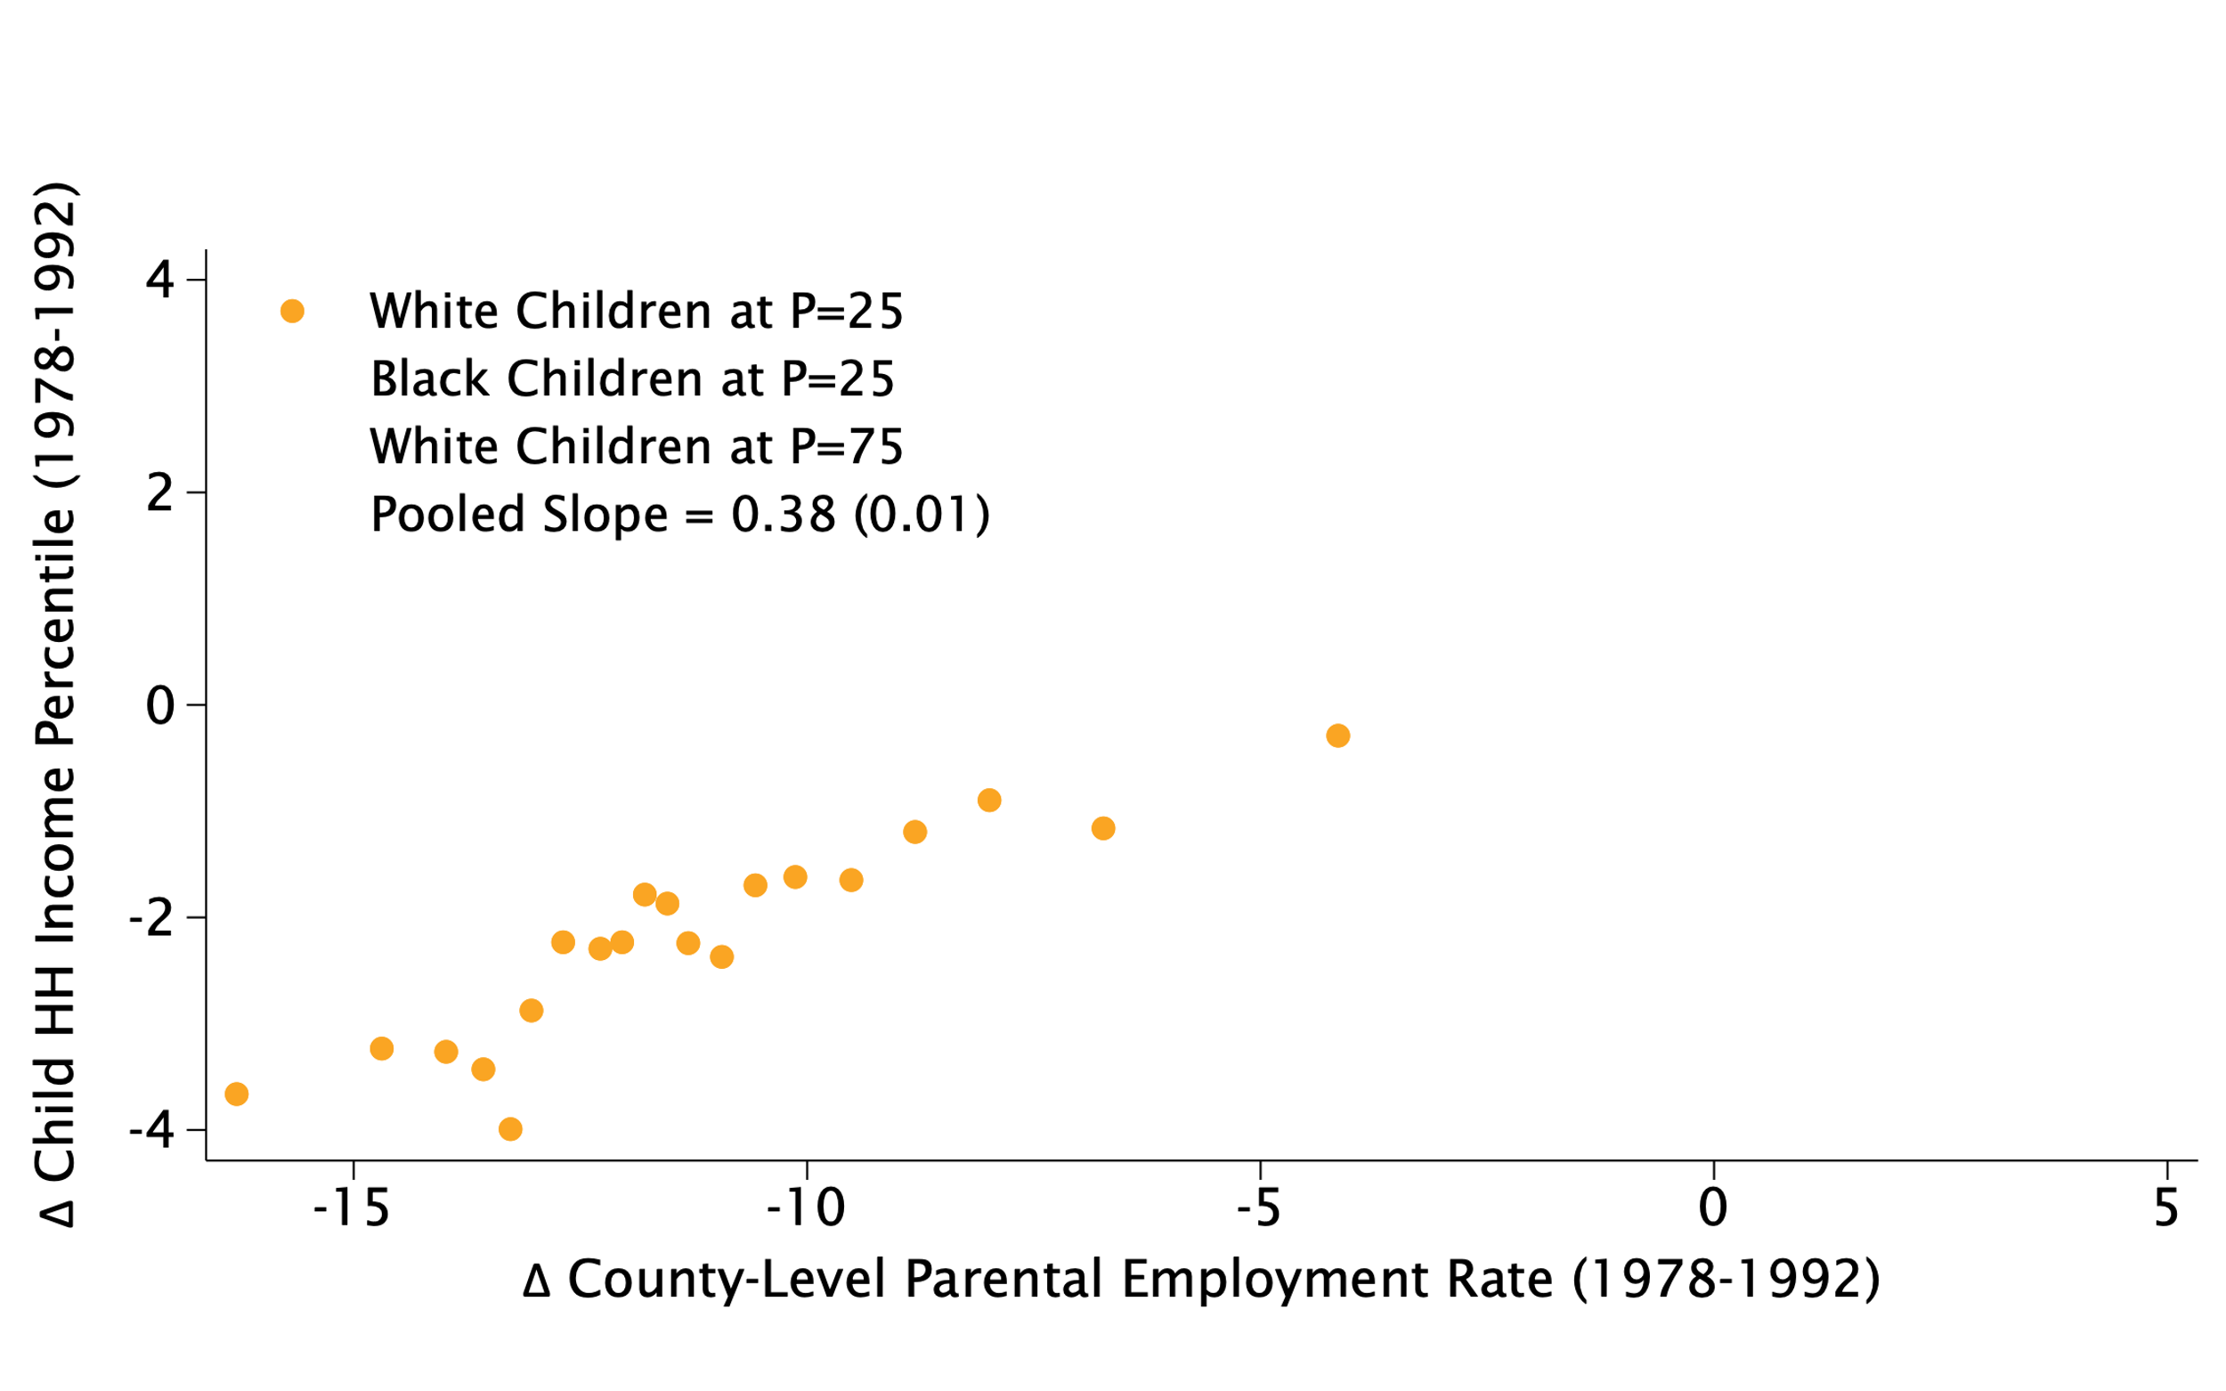
Changes in Children’s Income Percentiles vs. Parent Employment Rates, 1978-92 Cohorts
By County, Race, and Class

Slide 36
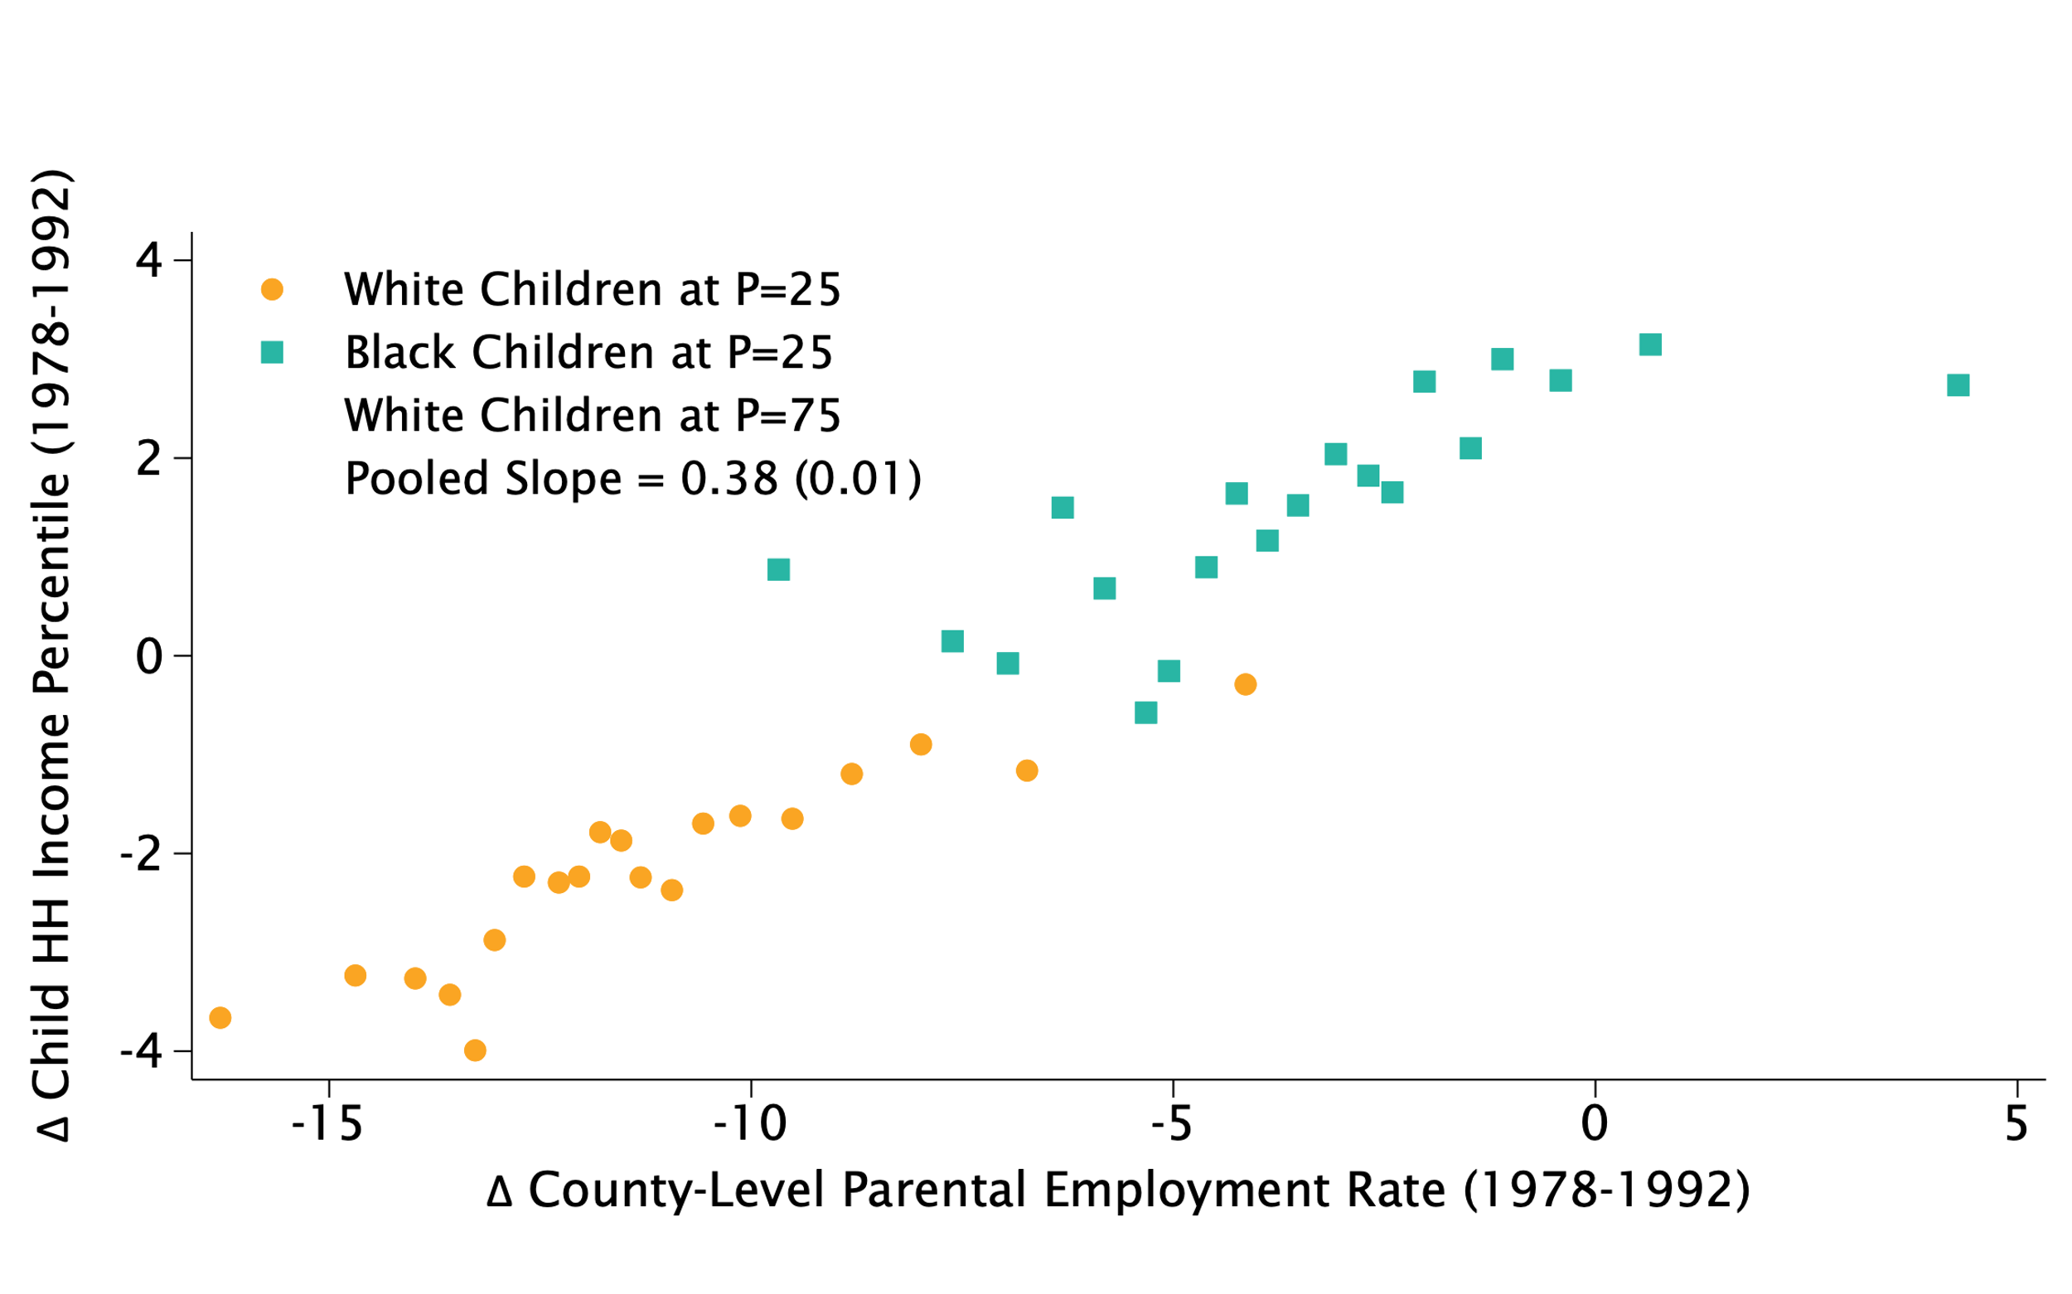
Changes in Children’s Income Percentiles vs. Parent Employment Rates, 1978-92 Cohorts
By County, Race, and Class

Slide 37
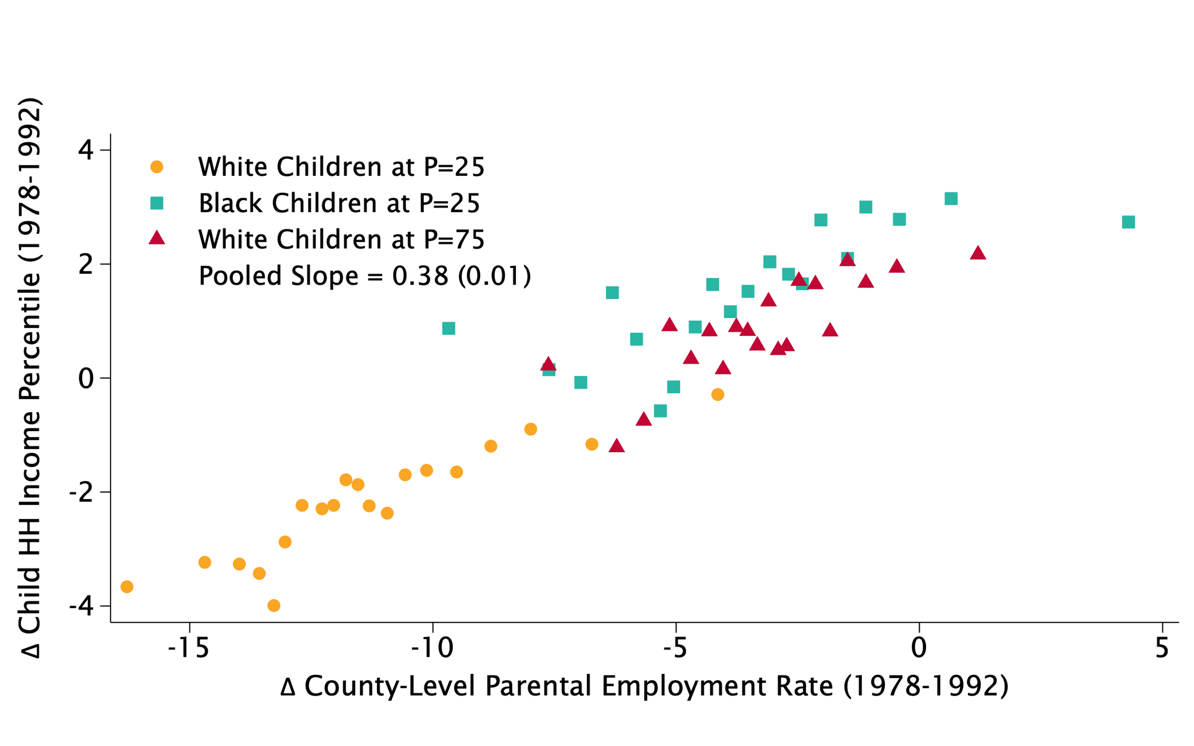
Changes in Children’s Income Percentiles vs. Parent Employment Rates, 1978-92 Cohorts
By County, Race, and Class

Slide 38
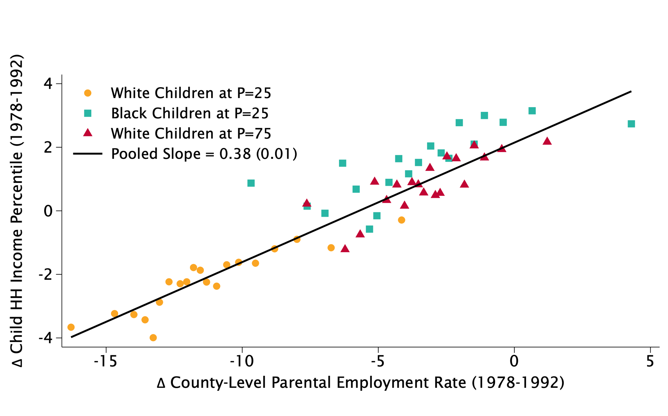
Changes in Children’s Income Percentiles vs. Parent Employment Rates, 1978-92 Cohorts
By County, Race, and Class

Slide 39
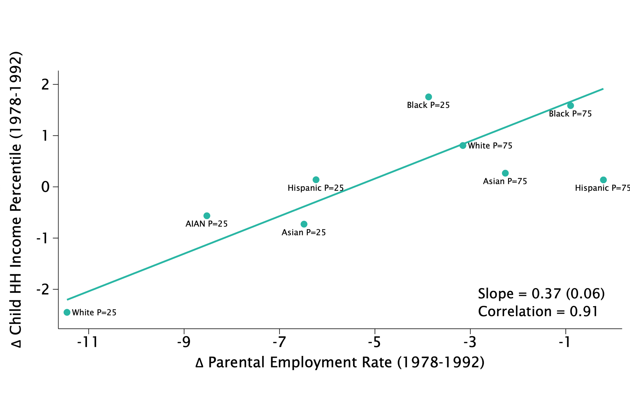
Explaining National Trends in Intergenerational Mobility Gaps by Race and Class

Slide 40
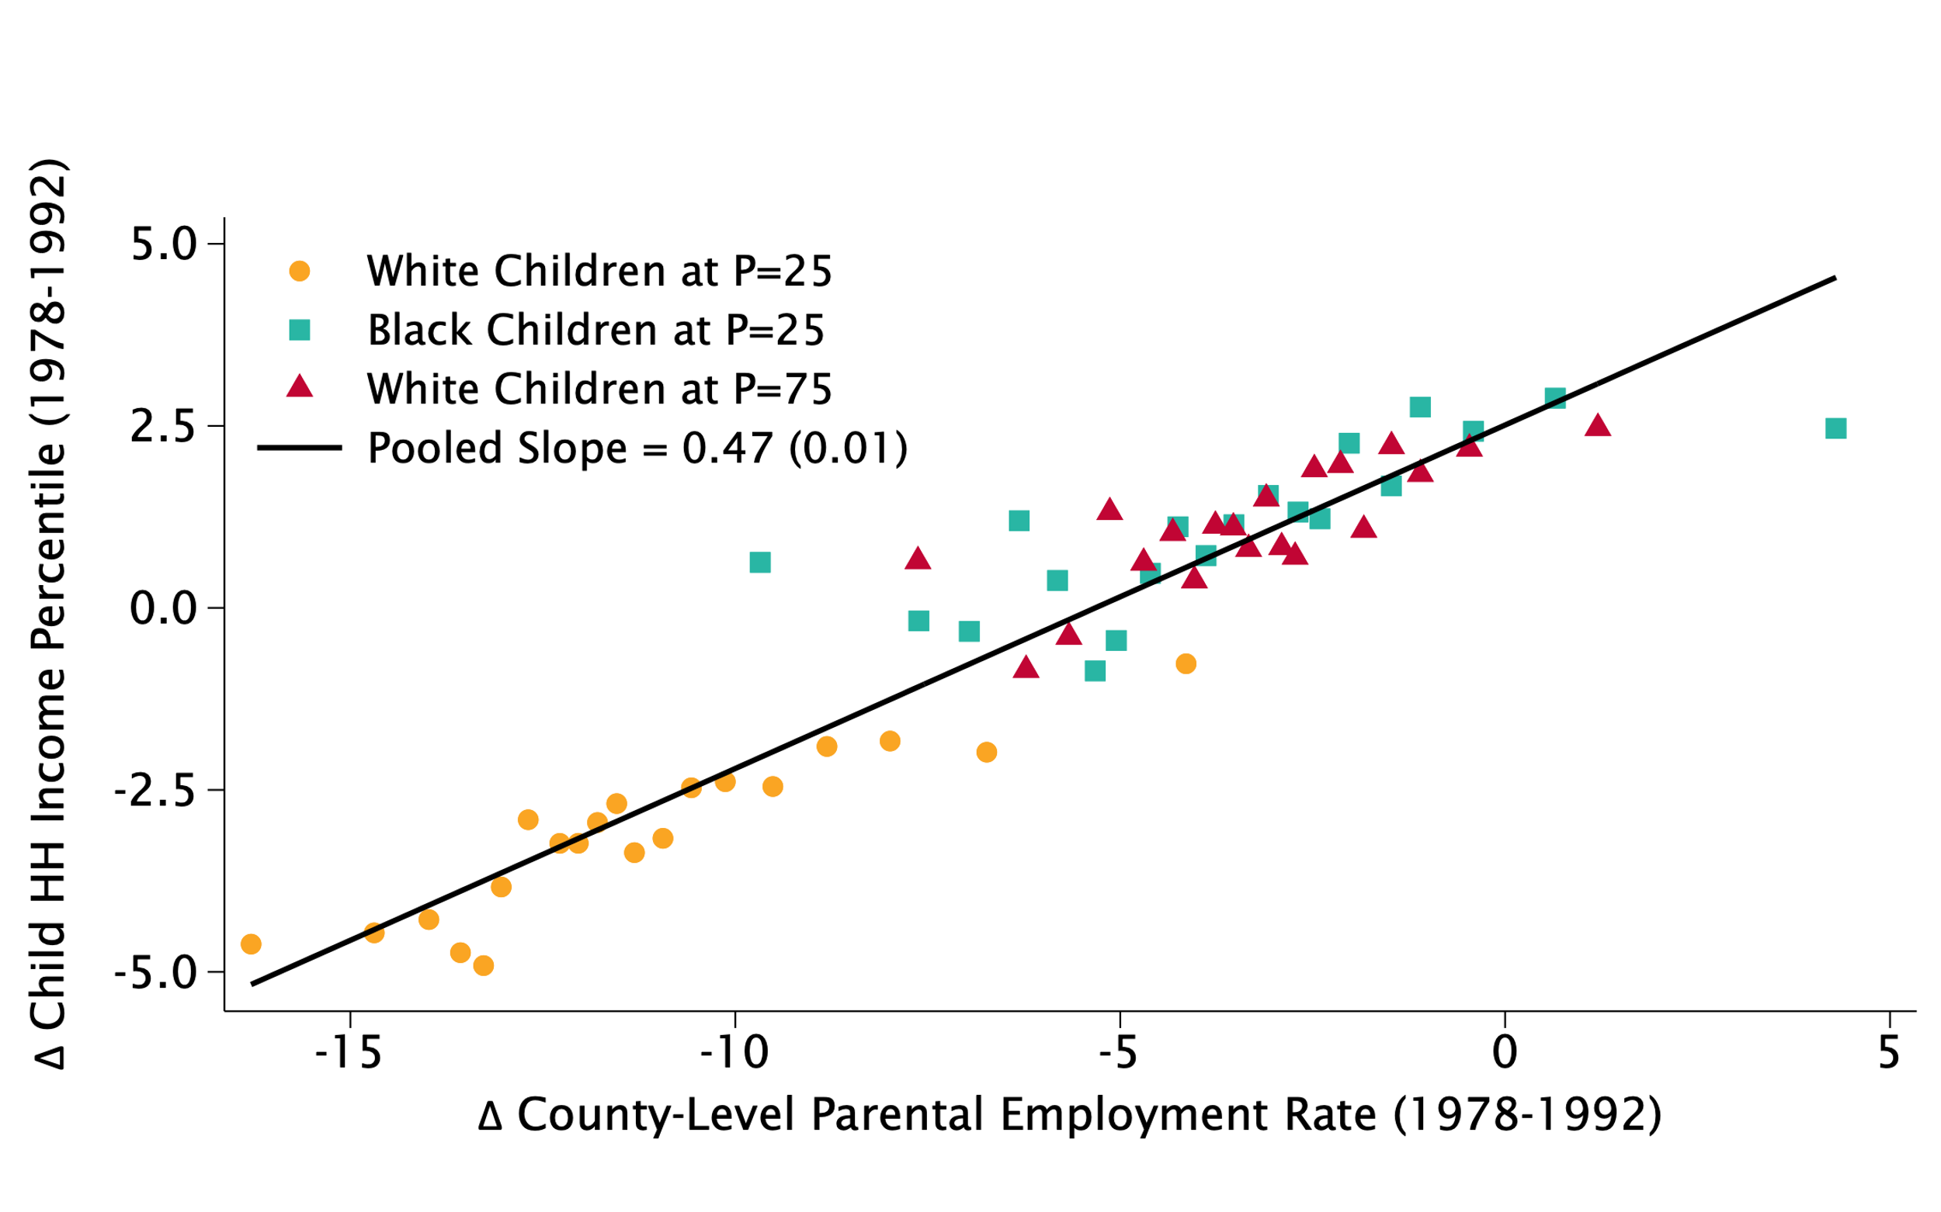
Changes in Children’s Income Percentiles vs. Parent Employment Rates, 1978-92 Cohorts
By County, Race, and Class for Children whose Own Parents Remain Employed

Slide 41
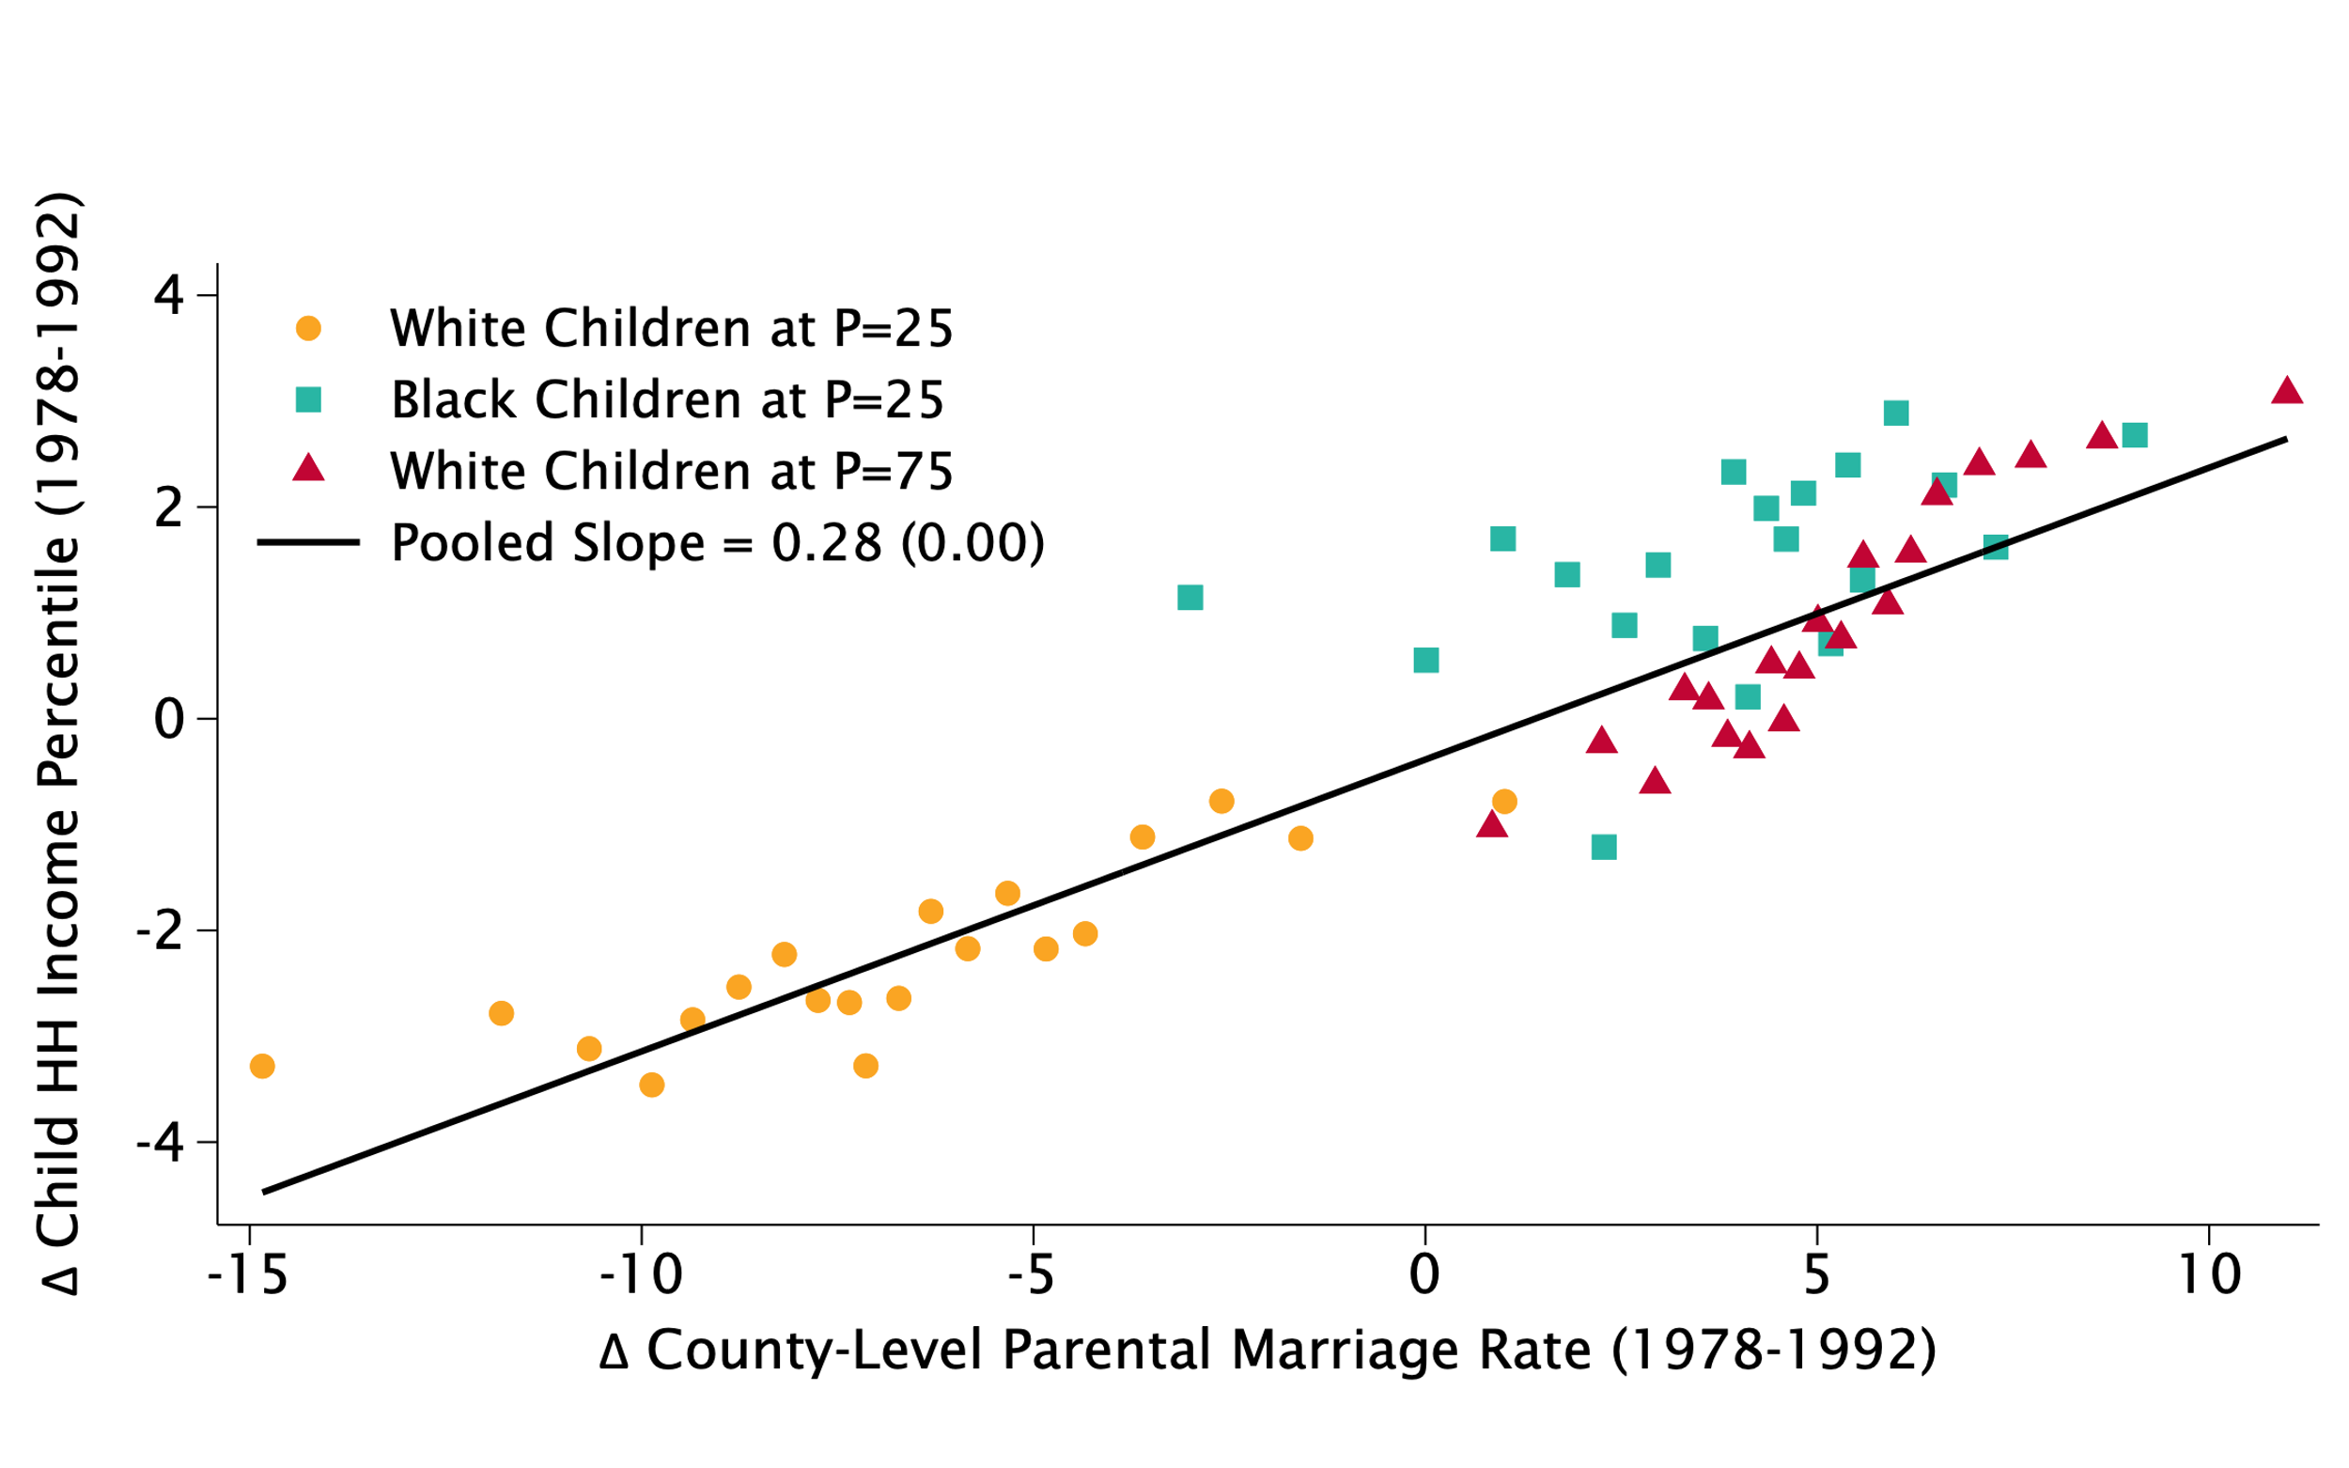
Changes in Children’s Income Percentiles vs. Mother’s Marriage Rates, 1978-92 Cohorts
By County, Race, and Class

Slide 42
Why are Changes in Mobility Related to Changes in Parent Employment Rates?

Slide 43
Why Are Changes in Parental Outcomes Correlated with Children’s Outcomes?
[Correlated Shocks]
Changes in labor demand affect both parents and children directly
[Environmental Exposure Effect]
Changes in childhood environment have a causal effect on children’s outcomes
Test between these explanations by studying children who moved to improving vs. declining areas

Slide 44
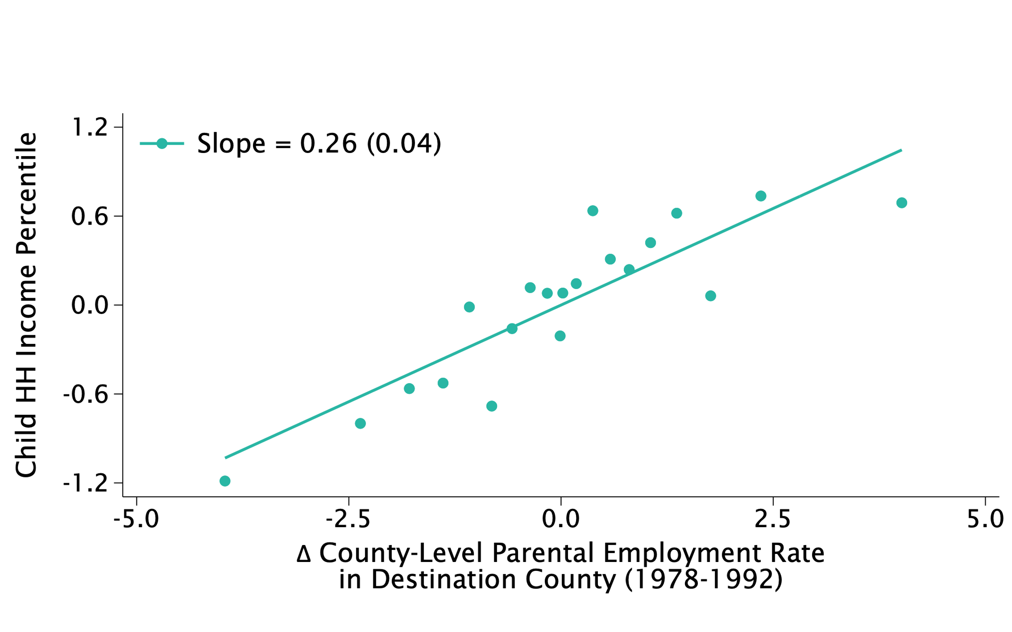
Causal Effects of Childhood Environment Changes: Evidence from Movers
Children’s Incomes vs. Trends in Parental Employment in Destination, 1992 Birth Cohort
Move Before Age 8

Slide 45
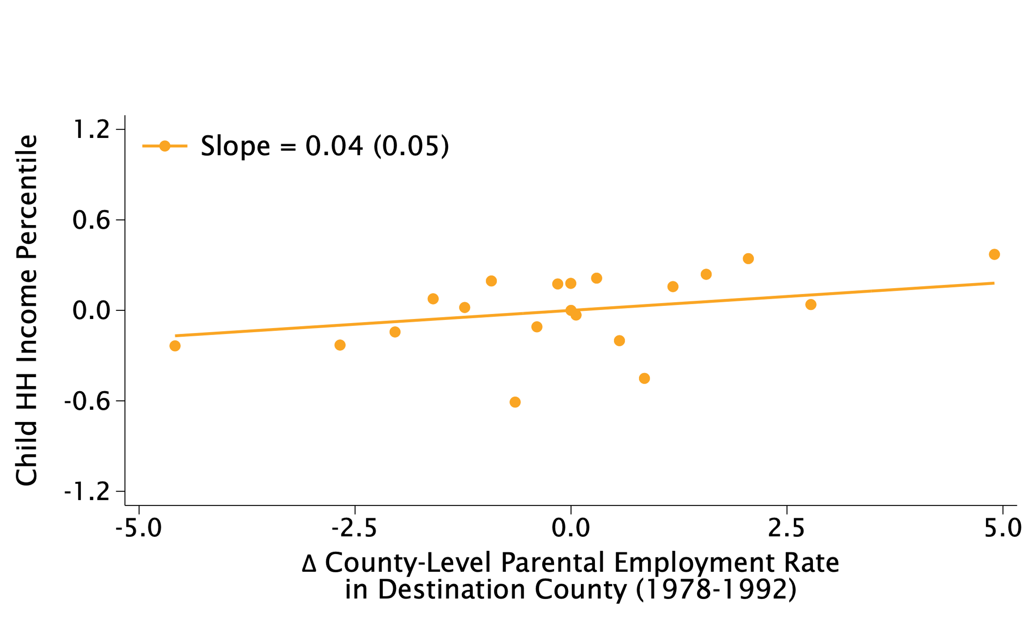
Causal Effects of Childhood Environment Changes: Evidence from Movers
Children’s Incomes vs. Trends in Parental Employment in Destination, 1992 Birth Cohort
Move Before Age 8
Move Between Ages 13-17

Slide 46
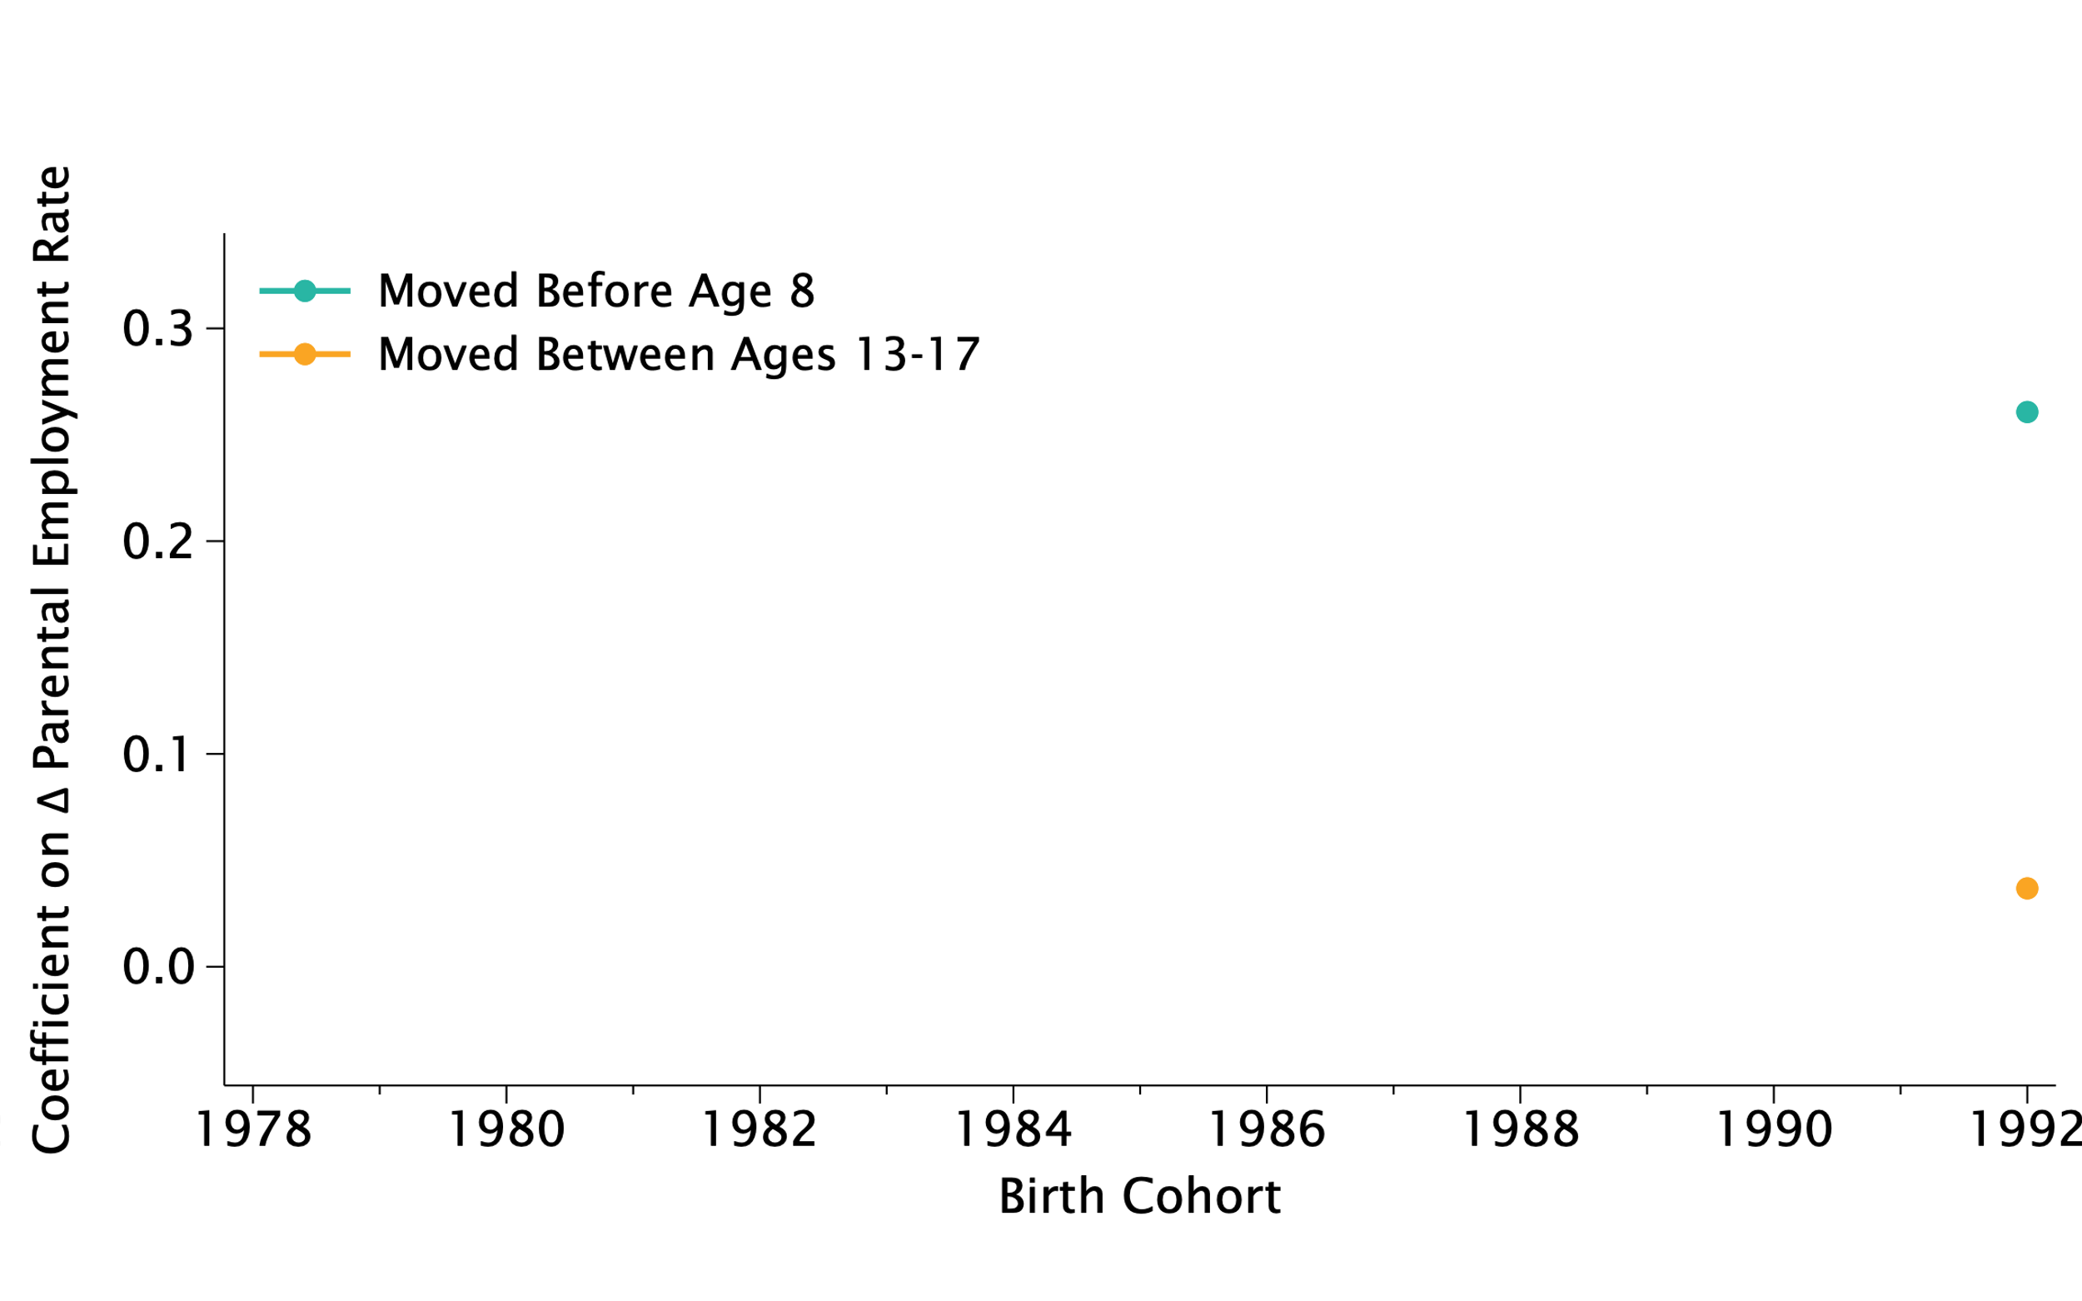
Effect of Trends in Parent Employment Rate in Destination
By Move Age and Cohort

Slide 47
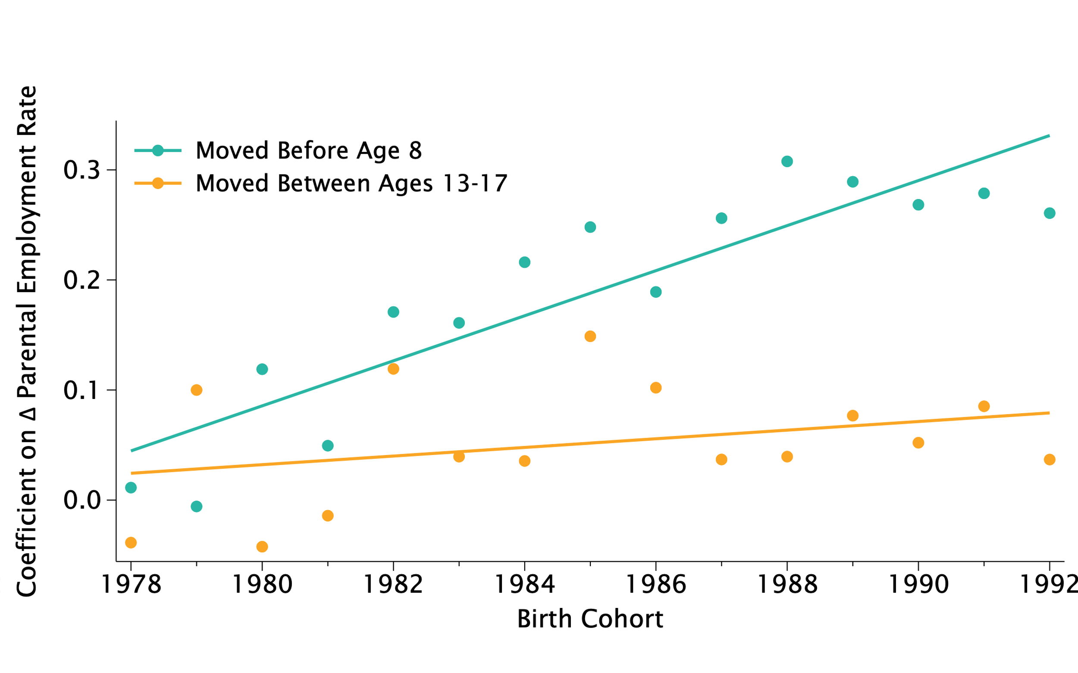
Effect of Trends in Parent Employment Rate in Destination
By Move Age and Cohort

Slide 48
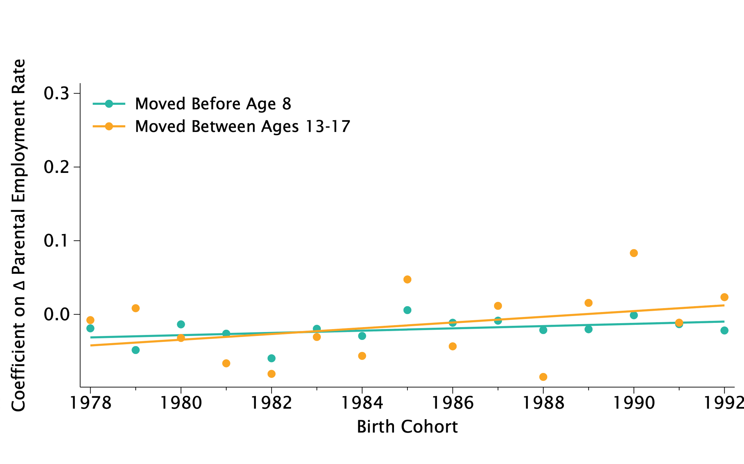
Balance Test Using Predicted Outcomes Based on Parent Characteristics

Slide 49
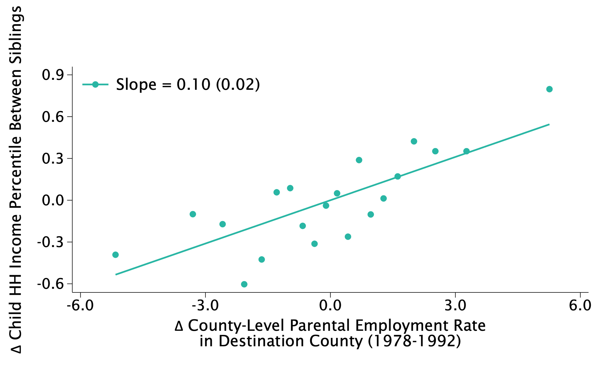
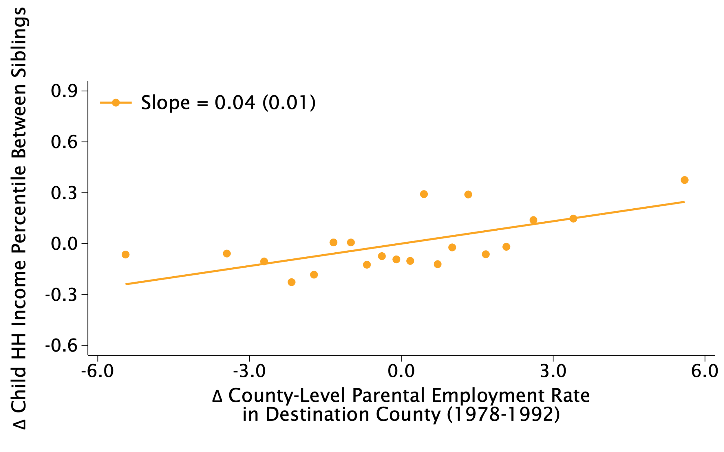
Differences in Siblings’ Outcomes vs. Trend in Parent Employment Rates
Younger Sibling’s Minus Older Sibling’s Income Percentile in Destination County
Siblings with Age Gap ≥ 4
Siblings with Age Gap < 4

Slide 50
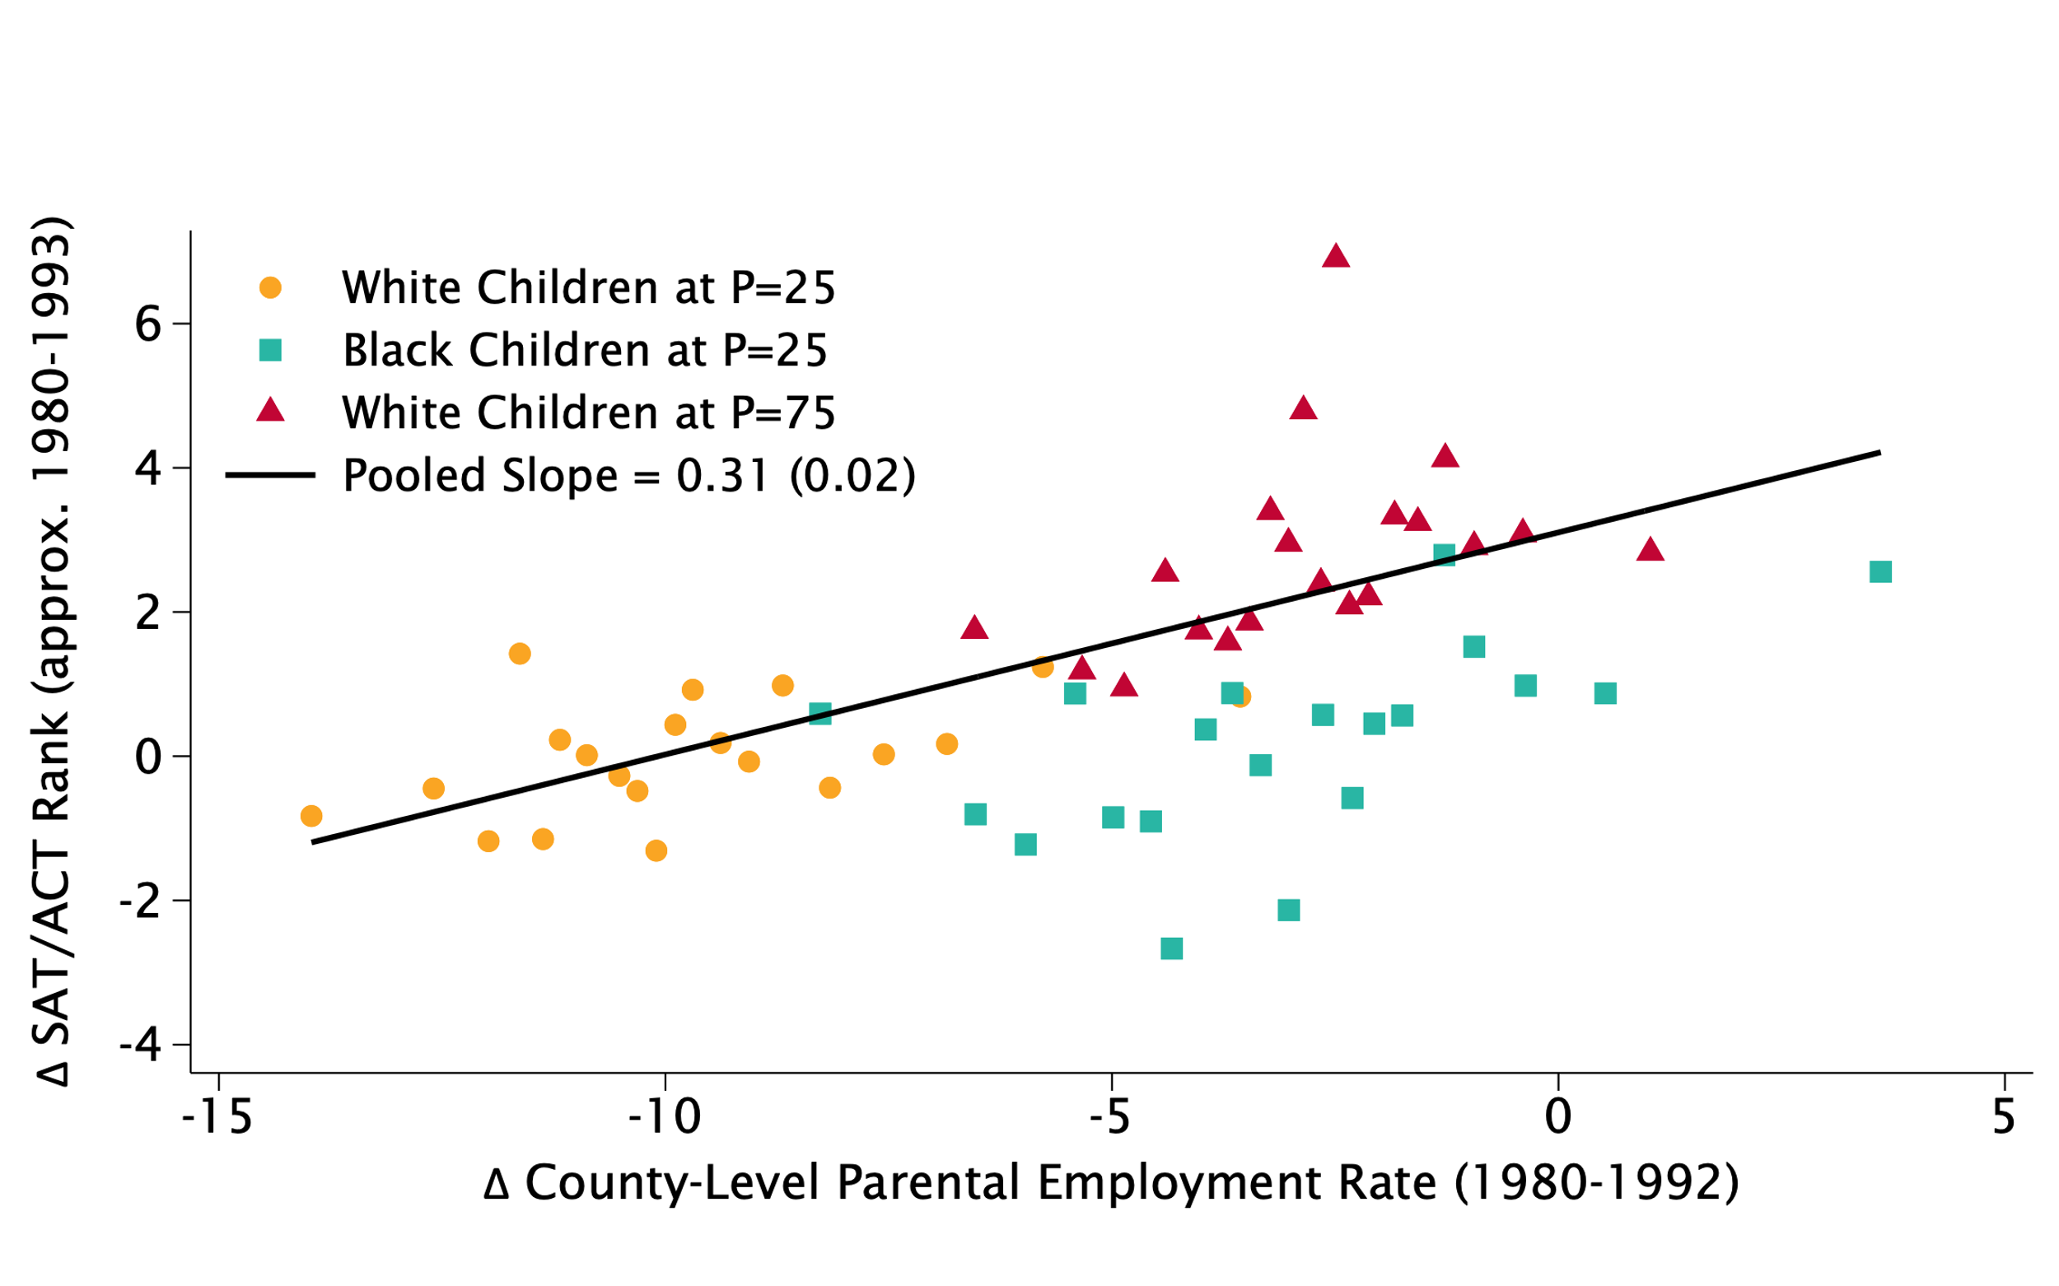
Changes in Children’s SAT/ACT Scores vs. Parent Employment Rates
By County, Race, and Class

Slide 51
Why Does Childhood Exposure to Higher Parent Employment Improve Outcomes?

Slide 52
Why Does Growing Up in a Community With Higher Parent Employment Rates Improve Children’s Outcomes?
[Social Interaction]
Higher parental employment improves children’s outcomes via social interactions (job referrals, aspirations)
[Economic Resources]
Higher parental employment expands financial resources at community level (schools, local programs)
Test between these explanations by exploiting differences in friendship patterns across groups

Slide 53
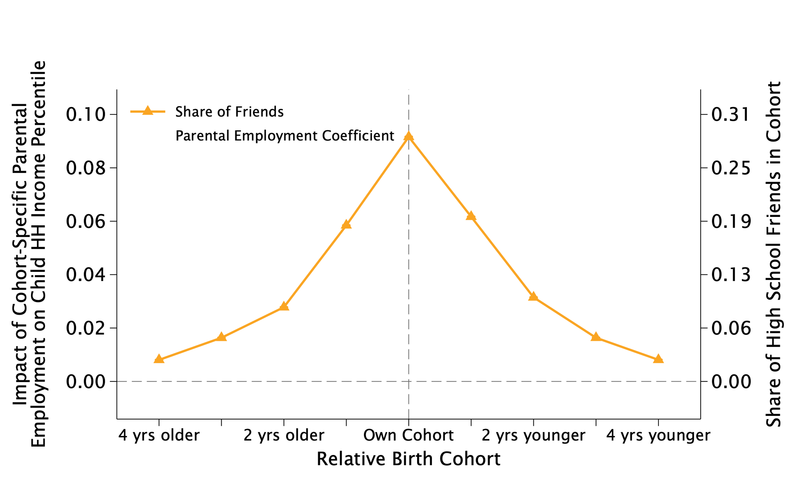
Effect of Changes in Parental Employment Rates Across Cohorts
Friendship Rates and Parent Employment Effects in Own Cohort vs. Adjacent Cohorts

Slide 54
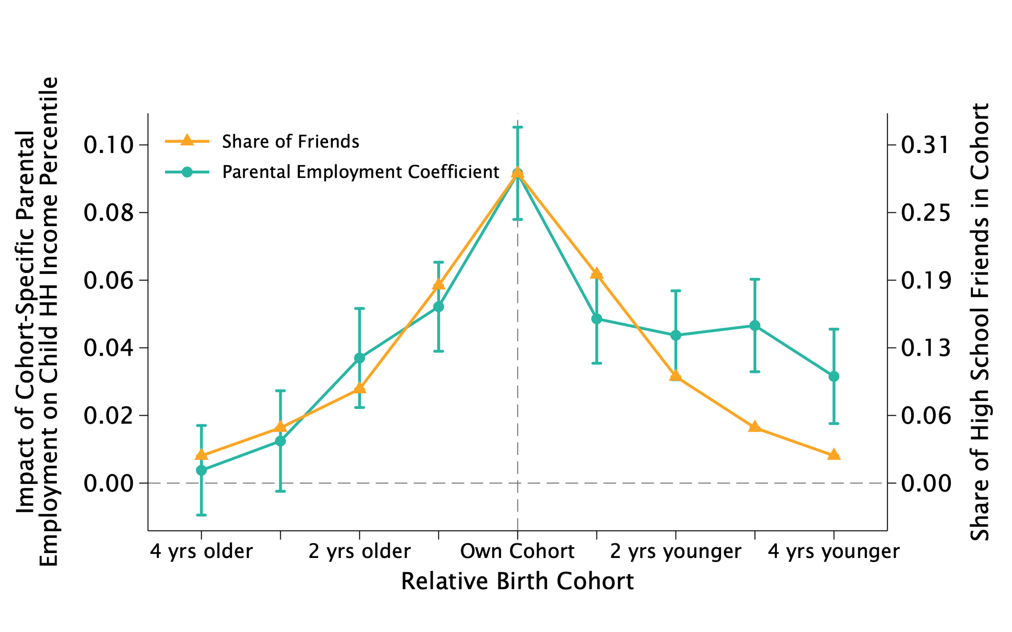
Effect of Changes in Parental Employment Rates Across Cohorts
Friendship Rates and Parent Employment Effects in Own Cohort vs. Adjacent Cohorts

Slide 55
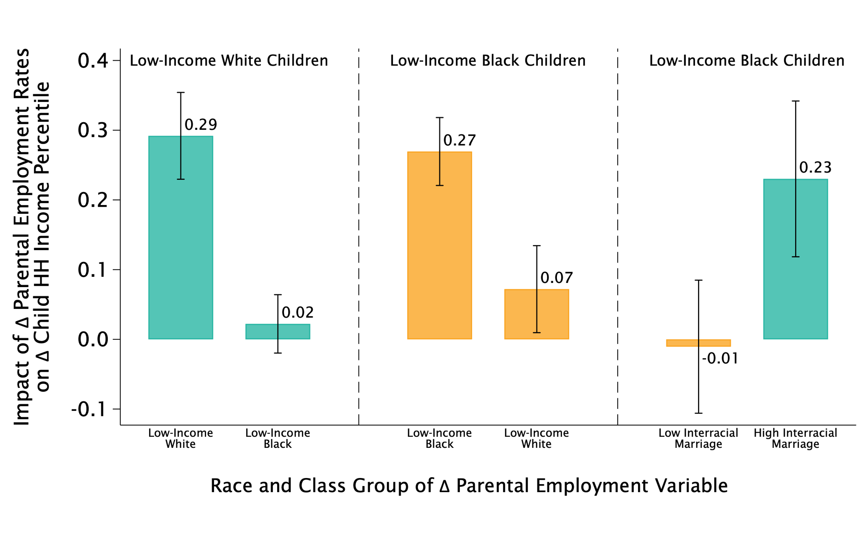
Effect of Group-Specific Changes in Parent Employment Rates

Slide 56
Effect of Group-Specific Changes in Parent Employment Rates

Slide 57
Effect of Group-Specific Changes in Parent Employment Rates

Slide 58
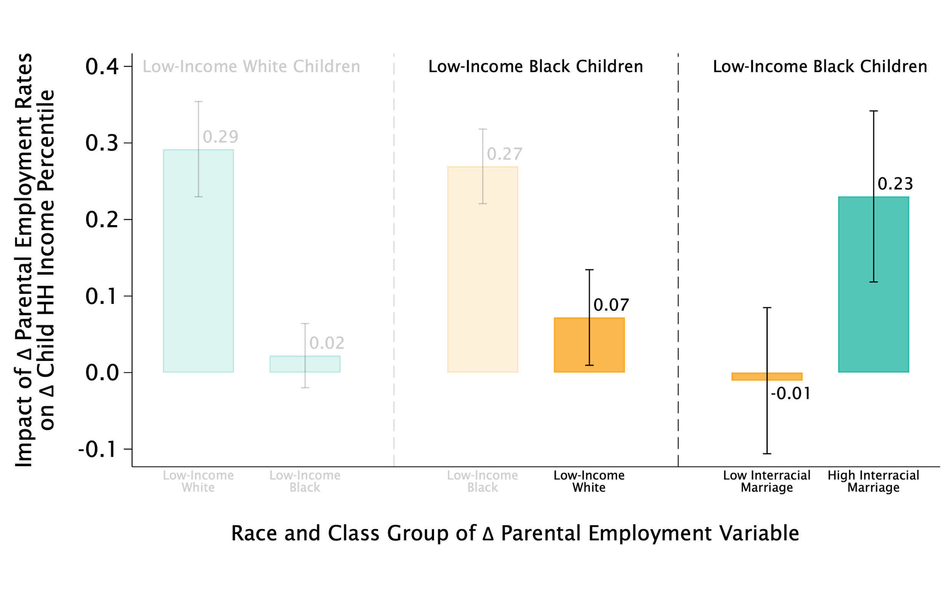
Effect of Group-Specific Changes in Parent Employment Rates

Slide 59
Effect of Group-Specific Changes in Parent Employment Rates

Slide 60
Implications for Increasing Mobility

Slide 61
Policy Implications
Most important takeaway: opportunity can change in short timeframes
What do these findings imply for efforts to increase mobility going forward?
Support next generation in communities where parents’ employment rates are currently falling (not just current generation)
Focus on social communities within neighborhoods – not just neighborhoods as a whole – as unit of change
Provide social capital in addition to financial and human capital

Slide 62
New Data on Changes in Opportunity
Key open question: what interventions can create changes in social communities that increase mobility?
To support the field in making progress on answering this question, we have released new data on changes in economic mobility
Visit the Opportunity Atlas (www.opportunityatlas.org) to see data for your own county and download data by race, parental income, gender, cohort, and county

Slide 63
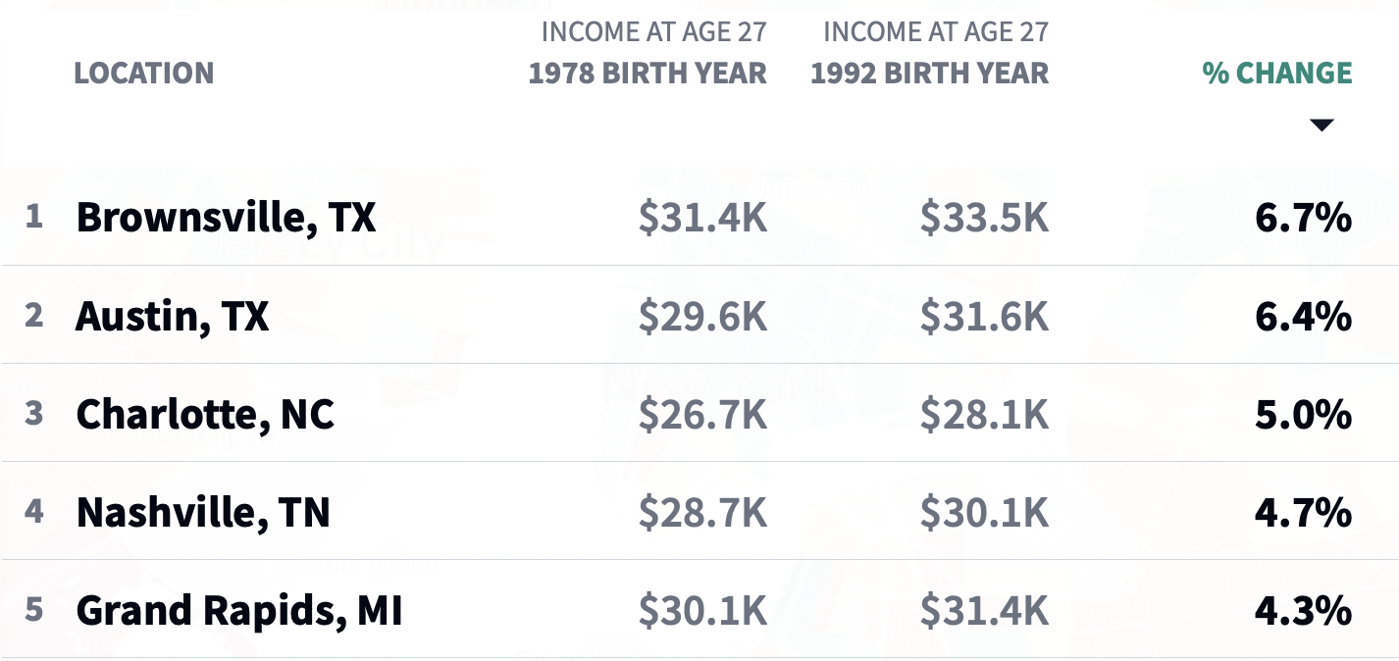
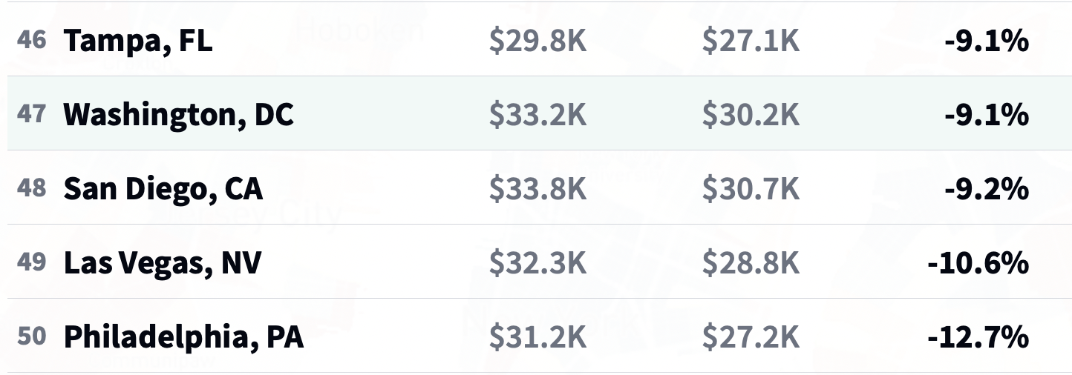
Changes in Economic Mobility Across Areas
50 Largest Metro Areas (Commuting Zones)
Top 5 Most Improved
Bottom 5: Least Improved

