Slide 1
Changing Opportunity
How Changes in Children’s Social Environments Have Increased Class Gaps and Reduced Racial Gaps in Economic Mobility
Chetty, Dobbie, Goldman, Porter, Yang
NONTECHNICAL SUMMARY FIGURES

Slide 2
Growing Class Gaps, Shrinking Race Gaps - Changes Between Children Born in 1978 and 1992
Change in Average Income at Age 27
Change in White Class Gap
Change in Black – White Race Gap
$13,202
Black Children
White Children
13K
13K
$12,994
Class Gap Grew By 28%
Low-income Parents
+ $1.4K
– $2.0K
12K
12K
Starting income: $21.5K
Starting income: $34.5K
Income gap ($)
11K
11K
High-income Parents
+ $1.2K
+ $770
$10,383
Race Gap Fell By 27%
Starting income: $30.6K
Starting income: $44.9K
10K
10K
$9,521
9K
9K
1978
1985
1992
1978
1985
1992
Year of Birth
Year of Birth
Figure Description
This figure shows 1) the change in average adult income for Black and white children born to high- and low-income parents in 1978 and 1992 along with the starting average incomes for children born in 1978 (left table), 2) the change in the income gap between white individuals who grew up in low- versus high-income families, or the class gap (center chart), and 3) the change in the income gap between Black and white individuals who grew up in low-income families, or the race gap (right chart).
Source: Chetty, Dobbie, Goldman, Porter, Yang.
Changing Opportunity: Sociological Mechanisms Underlying Growing Class Gaps and Shrinking Race Gaps in Economic Mobility (July 2024) | Nontechnical Summary

Slide 3
The Persistence of Poverty Has Declined for Black Children and Increased for White Children; Chance of Reaching Upper Income Remain Unchanged
Persistence of Poverty
Figure Description
This figure shows how rates of persistence of poverty – defined as the fraction of children born to parents in the bottom fifth of the income distribution who remain in
the bottom fifth as adults – and rates of reaching upper income – defined as the fraction of children born to parents in the bottom fifth of the income distribution who reach the top fifth as adults – have changed for white and Black children. Black children’s chances of reaching upper income remained the same between 1978 and 1992.
20%
25%
30%
35%
40%
Reaching Upper Income
0%
5%
10%
15%
20%
White Children
1978
1992
Black Children
1978
1992
Source: Chetty, Dobbie, Goldman, Porter, Yang.
Changing Opportunity: Sociological Mechanisms Underlying Growing Class Gaps and Shrinking Race Gaps in Economic Mobility (July 2024) | Nontechnical Summary

Slide 4
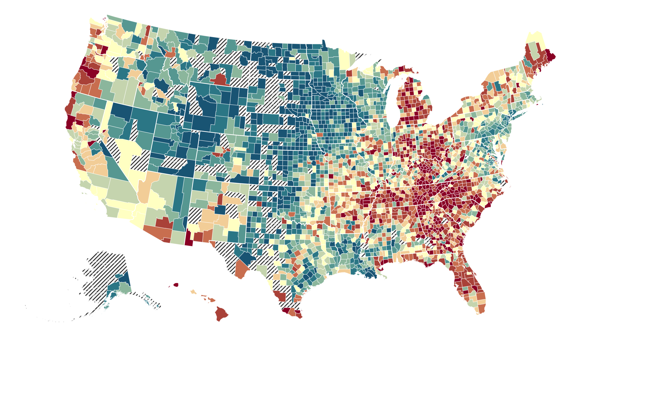
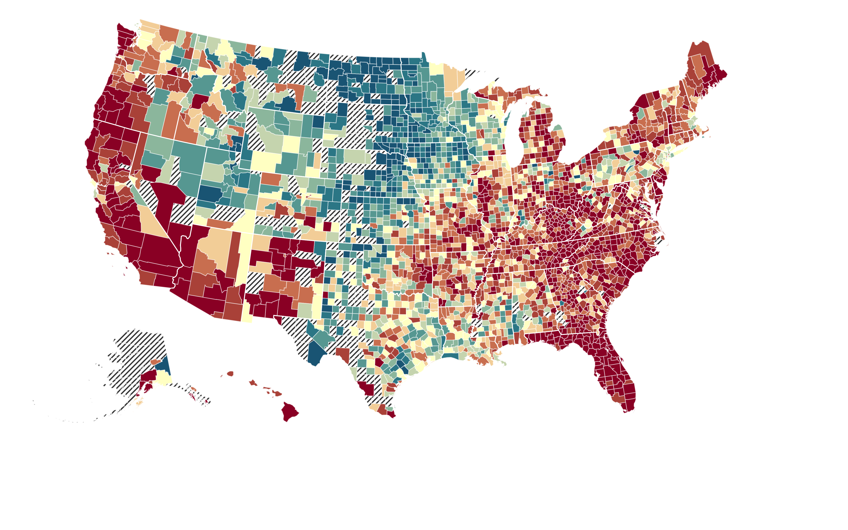
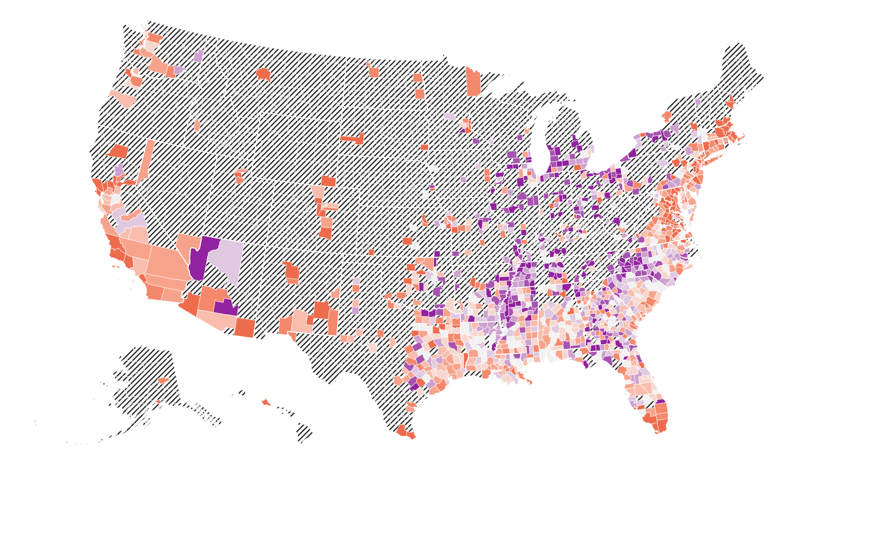
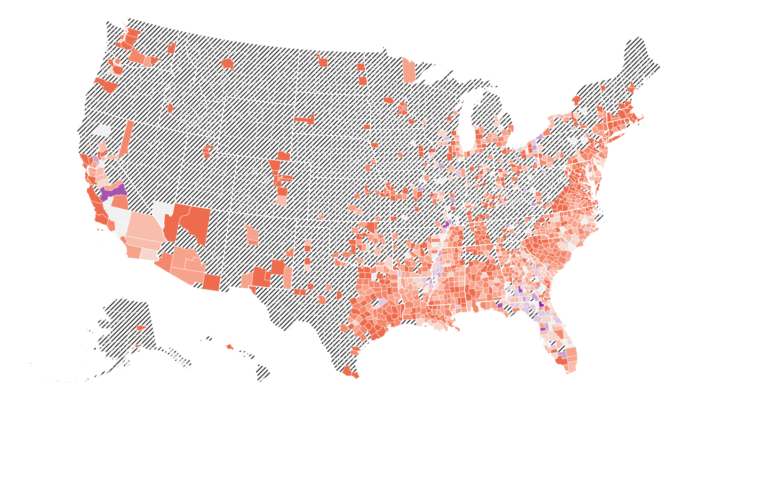
The Changing Geography of Economic Opportunity in America
Incomes in Adulthood for White Children Born to Low-Income Parents (25th Percentile) in 1978 and 1992
1978
1992
Figure Description
These maps show how opportunity has changed across places in America for Black and white individuals born in 1978 and 1992. The color scales for the Black vs. white maps are distinct to help visualize changes for each demographic group. The fact that two color scales are necessary underscores how wide remaining racial gaps are. Dollar values are measured in 2005 and 2019 for the 1978 and 1992 birth years, respectively, and are inflation adjusted to 2023 dollars.
Household Income in Adulthood
$18.8K
$21.2K
$25.6K
$30.8K
$33.7K
$40.9K
Incomes in Adulthood for Black Children Born to Low-Income Parents (25th Percentile) in 1978 and 1992
1978
1992
Source: Chetty, Dobbie, Goldman, Porter, Yang.
Changing Opportunity: Sociological Mechanisms Underlying Growing Class Gaps and Shrinking Race Gaps in Economic Mobility (July 2024) | Nontechnical Summary
Notes:
Figure description
Source

Slide 5
Changes in Income for Black and White Children with Low-Income Parents Are Positively Correlated
Travis, TX
6
4
Cook County, IL
Franklin, OH
Figure Description
This figure shows the relationship between income changes in adulthood for Black children and their white peers from low-
income families for the 50 most populous U.S. counties based on their population size in 2022.
2
Philadelphia, PA
Wayne, MI
Change in Household Income Percentiles
for Black Children from Low-Income Families
Middlesex, MA
0
Pima, AZ
-
2
Fairfax, VA
Los Angeles, CA
-
4
-
6
-
4
-
2
0
Change in Household Income Percentiles
for White Children from Low-Income Families
Source: Chetty, Dobbie, Goldman, Porter, Yang.
Changing Opportunity: Sociological Mechanisms Underlying Growing Class Gaps and Shrinking Race Gaps in Economic Mobility (July 2024) | Nontechnical Summary

Slide 7
Social Interaction Matters — Children’s Outcomes Are Influenced by Changes in Employment Rates of Parents of Other Children in Their Own Grade Rather than Surrounding Grades
30
Effect of parental employment
10
on child outcomes
Share of Friends
Figure Description
The teal line shows the impacts of changes in the employment rates of parents of children in their own birth cohort vs. surrounding birth cohorts. The orange line shows the share of high school friends that
children have in their own grade vs. other surrounding grades.
24
(Facebook data)
8
18
6
Percent of High School Friends in Cohort
(% change in Child HH Income Percentile)
Effect of par. emp. on child outcomes
12
4
6
2
0
0
4 yrs older
2 yrs older
Own Cohort
2 yrs younger
4
yrs
younger
Relative Birth Year
Source: Chetty, Dobbie, Goldman, Porter, Yang.
Changing Opportunity: Sociological Mechanisms Underlying Growing Class Gaps and Shrinking Race Gaps in Economic Mobility (July 2024) | Nontechnical Summary

