Slide 1

Diversifying Society’s Leaders?
The Determinants and Causal Effects of Admission
to Highly Selective Private Colleges
Raj Chetty, Harvard University
David J. Deming, Harvard University
John N. Friedman, Brown University
October 2023
The opinions expressed in this paper are those of the authors alone and do not necessarily reflect
the views of the Internal Revenue Service, the U.S. Treasury Department, the College Board, or ACT.

Slide 2
Share of Individuals in Leadership Positions who Attended Ivy-Plus Colleges
Ivy-League, Chicago, Duke, Stanford, MIT
Benchmark: College Attendees
0.8%
Income
Top 25% Earnings
1.4%
Top 10% Earnings
2.5%
Top 1% Earnings
7.8%
Top 0.1% Earnings
13.4%
Fortune 500 CEOs
11.6%
Arts and Sciences
Attend Graduate School
2.6%
Attend Elite Graduate School
20.3%
MacArthur Grant Recipients
28.6%
Public Service
Current US Senators
25.0%
Journalists at NYT or WSJ
26.1%
US Presidents (1961 - Current)
41.7%
Rhodes Scholars
48.4%
Supreme Court Justices (1967 - Current)
//
71.4%
0
10
20
30
40
50
Percent Who Attended Ivy-Plus Colleges

Slide 3
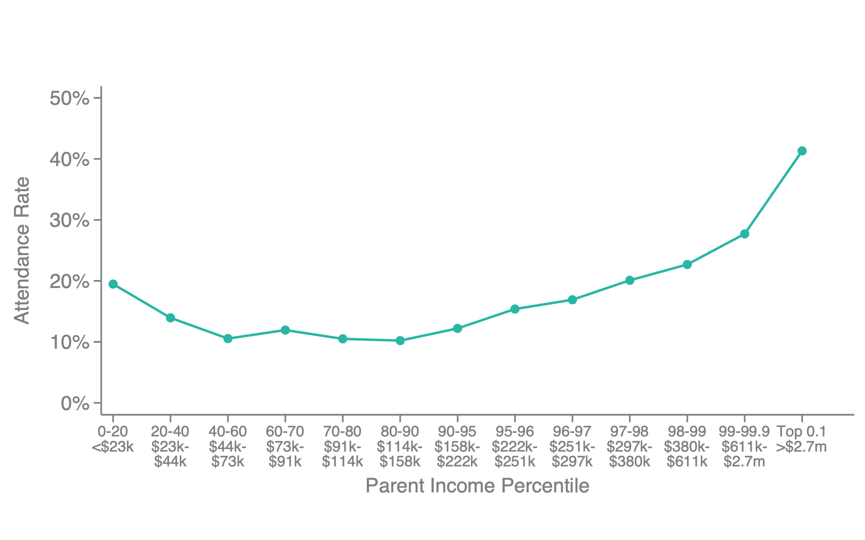
Ivy-Plus College Attendance Rates Controlling for SAT/ACT Scores, by Parental Income
Students Students with SAT Score of 1510 (out of 1600) or ACT Score of 34 (out of 36)

Slide 4
Question
Do highly selective private colleges amplify the persistence of privilege across generations?
  Could they diversify society’s leaders by changing their admissions policies?

Slide 5
Overview
Answer depends on two sub-questions:
[Inputs] Why are students from high-income families more likely to attend highly selective private colleges?
  Admissions policies or students’ choices about where to apply or matriculate?
  [Bowen & Bok 1998, Hoxby & Avery 2013, Gurantz et al. 2021, Dynarski et al. 2021, Autor et al. 2022]
[Outputs] What is the causal effect of these colleges on marginal students’ post-college outcomes?
  Perhaps students at highly selective schools would have done equally well no matter where they attended [Dale & Krueger 2002, 2014, Mountjoy & Hickman 2022 vs. Zimmerman 2019, Michelman Price & Zimmerman 2022, Bleemer 2022]

Slide 6
Data
Federal income tax records, 1996-2021
Federal college attendance records, 1999-2015
Standardized test score data, 2001-2015
Applications and Admissions Records from Colleges
  Several Ivy-Plus colleges, various years
  Highly Selective Public institutions: UC-Berkeley, UCLA, UT-Austin, plus other most selective public flagships
  Several college systems: UC system, Cal State, Texas system (THECB)
  Detailed student characteristics, admissions outcomes, internal ratings

Slide 7
Question 1
Why Are Students from High-Income Families
More Likely to Attend Highly Selective Colleges?

Slide 8
Disparities Before College
Begin by adjusting for disparities by socioeconomic status before college application using SAT/ACT scores
  Standardized test scores are an imperfect measure of latent potential, and may exhibit biases potentially correlated with parental income [e.g., Goodman et al. 2020]
  Use scores as a benchmark to start from and revisit latent potential by parental income at the end of the talk by examining post-college outcomes
Reweight test-score distribution within each parent income group to match distribution of scores for attendees of Ivy-plus colleges

Slide 9
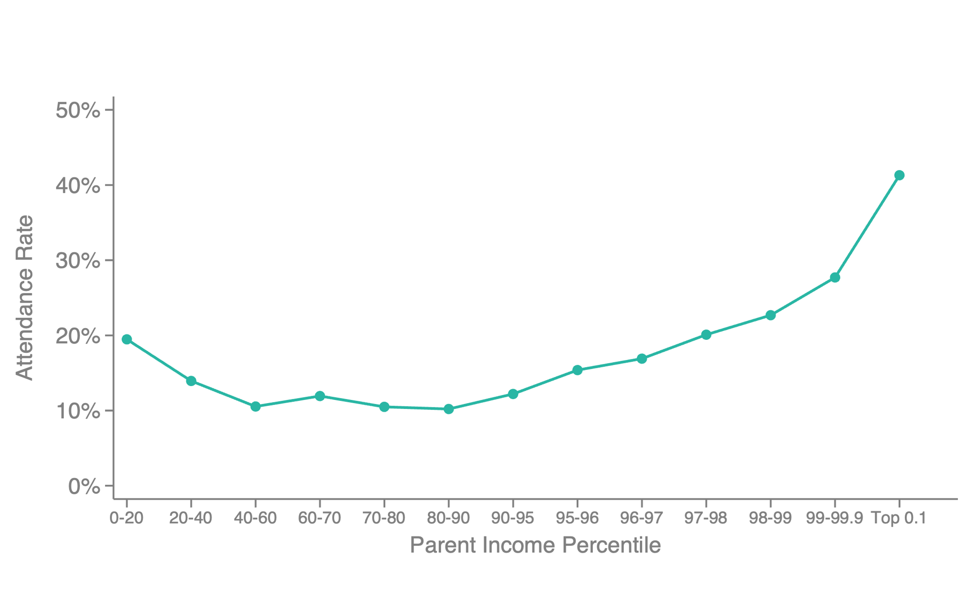
Ivy-Plus College Attendance Rates at the 99th Percentile of Test Score, by Parental Income
Students Students with SAT Score of 1510 (out of 1600) or ACT Score of 34 (out of 36)
Notes:
Ratio top 1/p70-80: 2.3

Slide 10
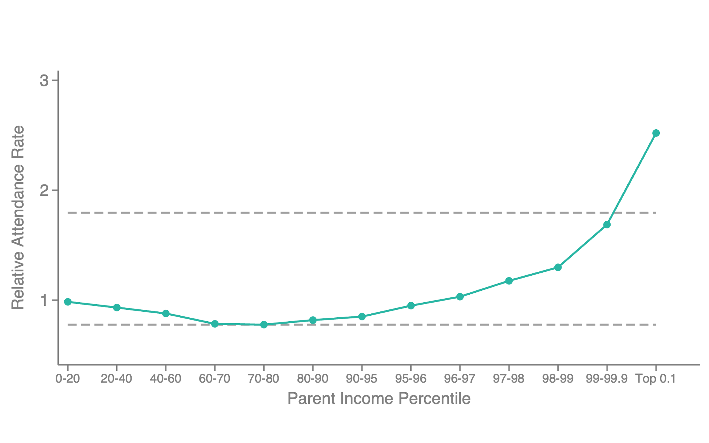
Ivy-Plus Attendance Rates by Parental Income
Reweighted on SAT/ACT Scores to Match Current Attendees
+168
extra students from top 1%
(per class of 1650 students)

Slide 11
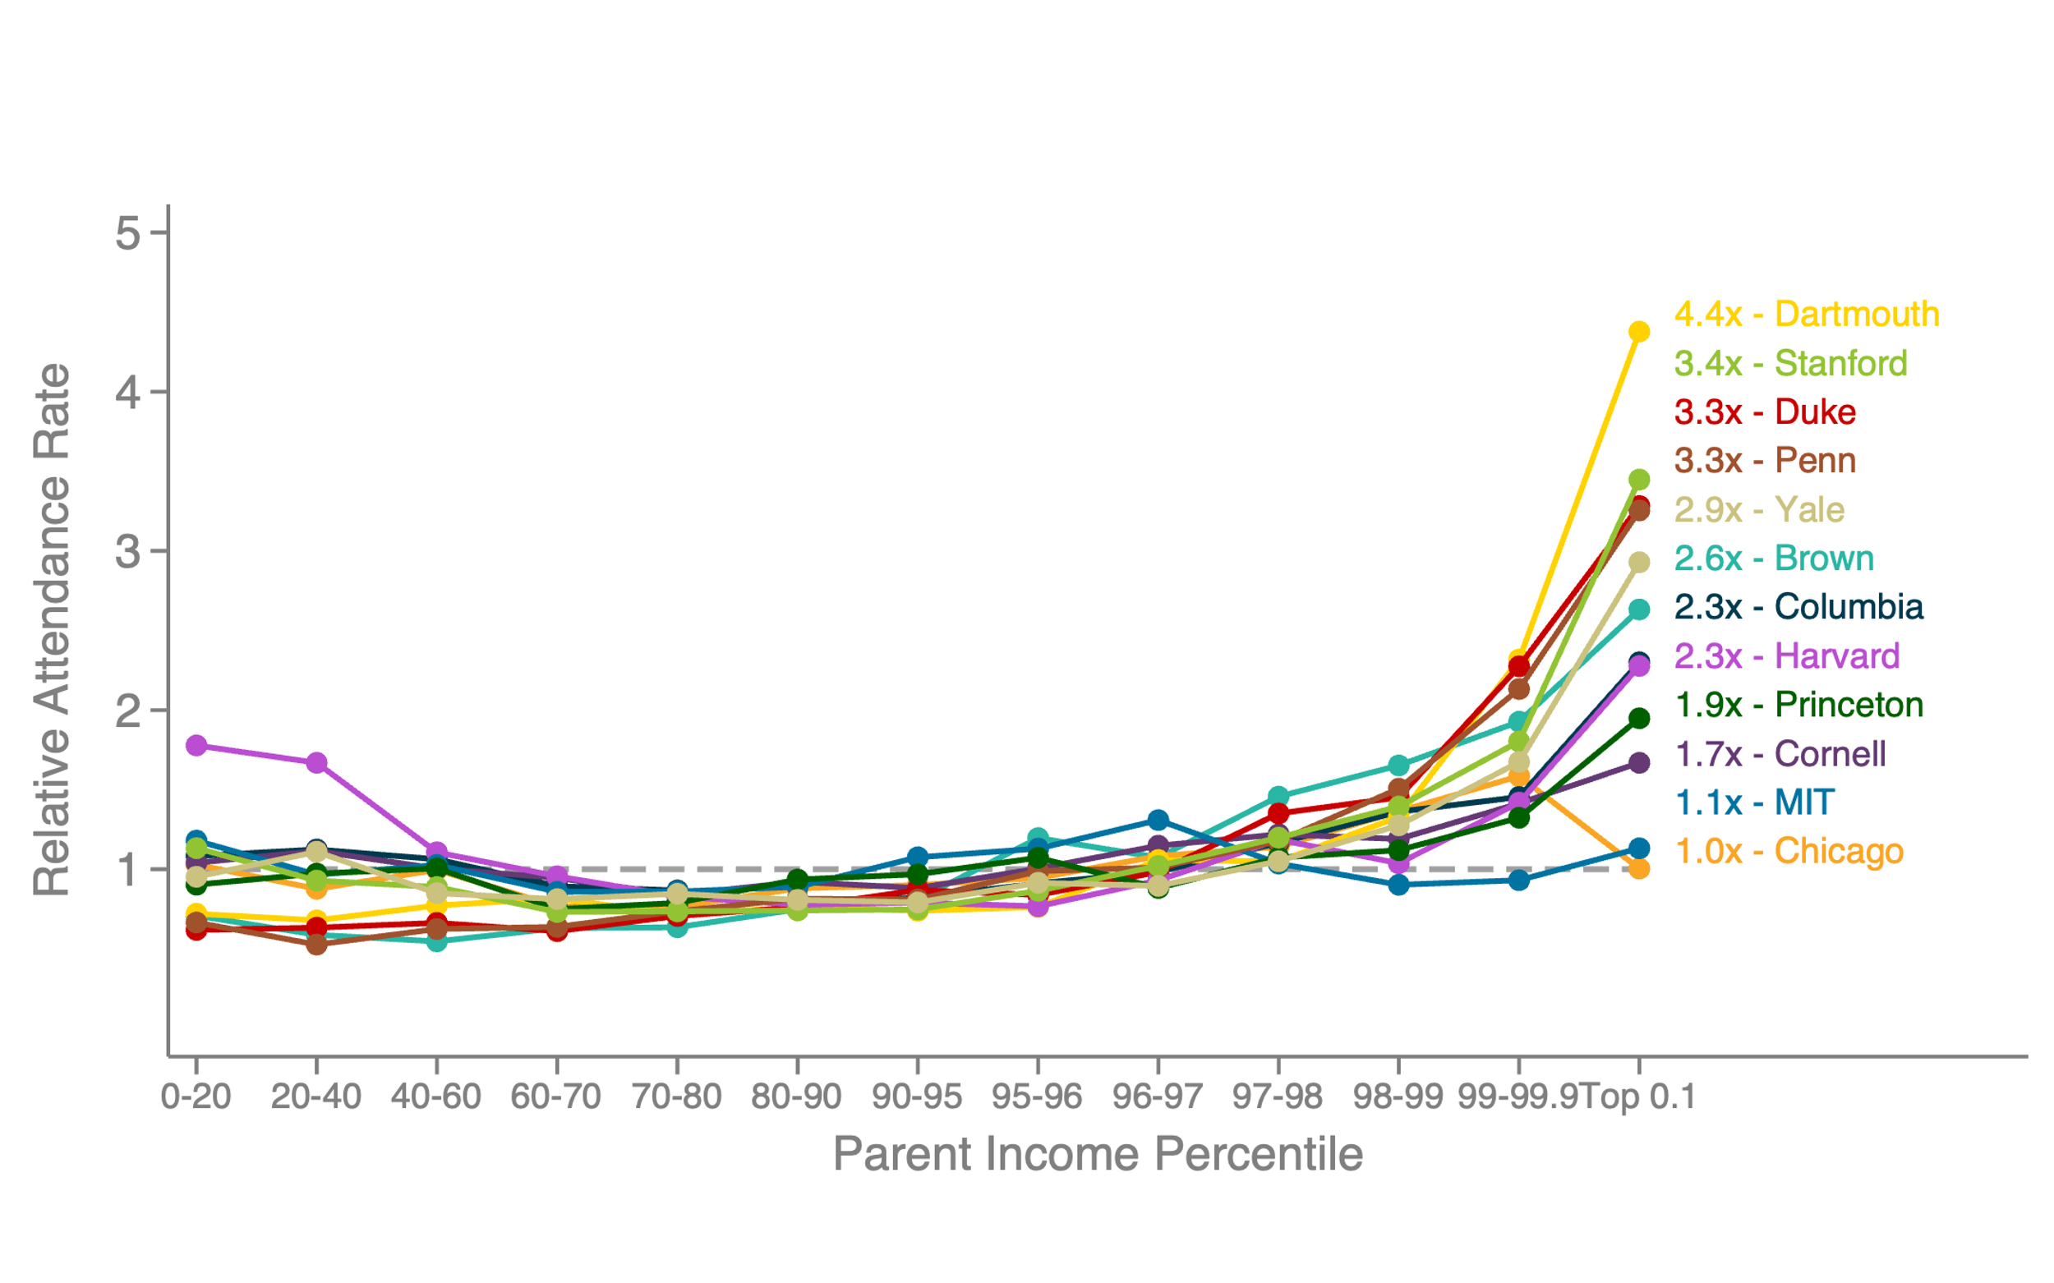
Attendance Rates at Selective Colleges by Parental Income
Reweighting on Test Score

Slide 12
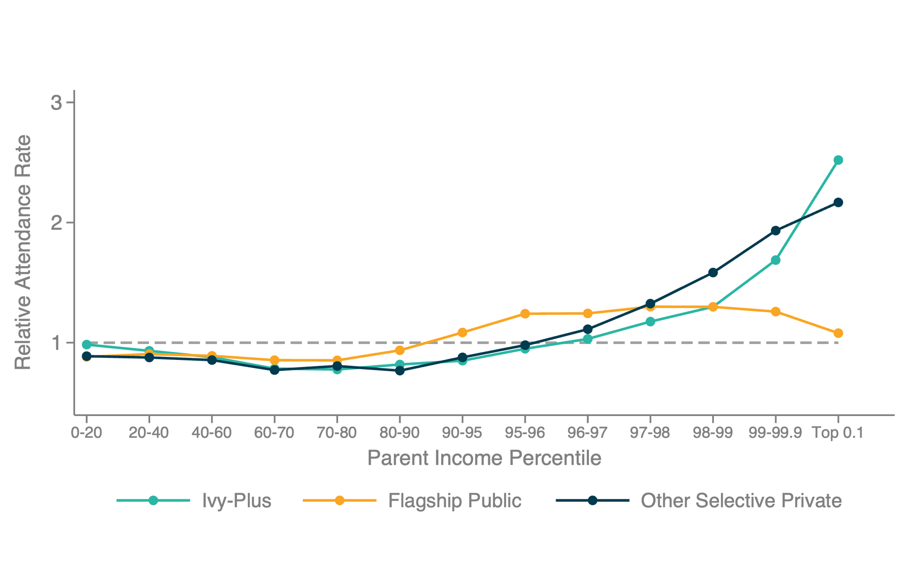
Attendance Rates at Selective Colleges by Parental Income, Controlling for Test Score
Other Private: Caltech, Carnegie Mellon, Emory, Georgetown, Hopkins, NYU, Northwestern, Rice, Notre Dame, USC, Vanderbilt, WashU
Flagship Public: Florida, Georgia, Michigan, Ohio State, UC-Berkeley, UCLA, UNC-Chapel Hill, UT-Austin, Virginia

Slide 13
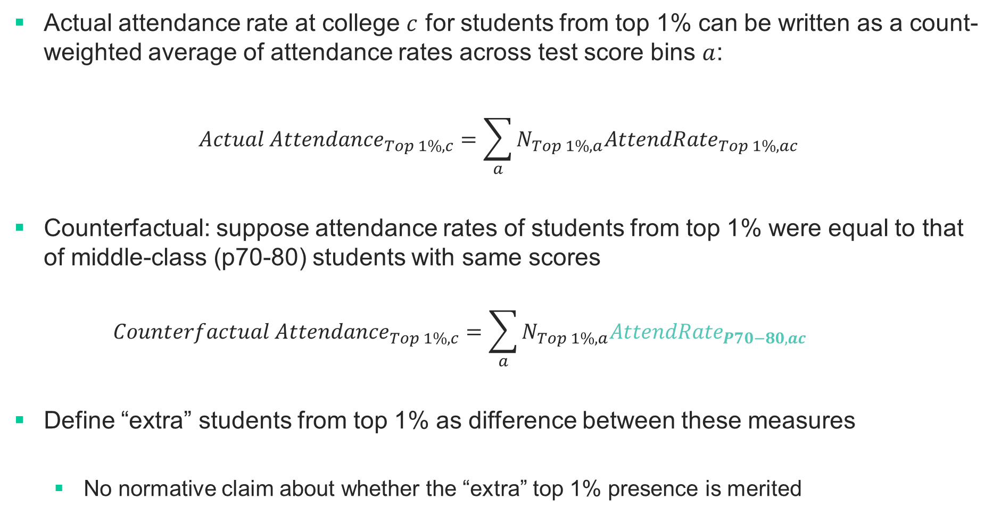
How Many “Extra” Students from Top 1% at Ivy-Plus Colleges?
Actual attendance rate at college $c$ for students from top 1% can be written as a count-weighted average of attendance rates across test score bins $a$:
$${Actual Attendance}_{Top 1\%,c}=\sum_{a}{N_{Top 1\%,a}{AttendRate}_{Top 1\%,ac}}$$
Counterfactual: suppose attendance rates of students from top 1% were equal to that of middle-class (p70-80) students with same scores
$${Counterfactual Attendance}_{Top 1\%,c}=\sum_{a}{{N_{Top 1\%,a}AttendRate}_{P70−80,ac}}$$
Define “extra” students from top 1% as difference between these measures
  No normative claim about whether the “extra” top 1% presence is merited

Slide 14
Ivy-Plus Attendance Rates by Parental Income
Reweighted on SAT/ACT Scores to Match Current Attendees
+168
extra students from top 1%
(per class of 1650 students)

Slide 15
Pipeline Analysis
What accounts for the “extra” 168 students from the top 1%?
  Applications, admissions, or matriculation?
Athletes admitted through separate recruitment process without clear distinction between different stages of process [see e.g., Bowen and Levin 2003, Arcidiacono 2019]
  Exclude recruited athletes from what follows and return to them below

Slide 16
Relative Application Rates at Highly Selective Colleges, by Parental Income
Reweighted on SAT/ACT Scores to Match Current Attendees
2
1.5
Relative Application Rate
1
.5
0
0-20
20-40
40-60
60-70
70-80
80-90
90-95
95-96
96-97
97-98
98-99
99-99.9
Top 0.1
Parent Income Percentile
Ivy-Plus
Flagship Public

Slide 17
Admissions Rates for Non-Athletes at Ivy-Plus Colleges, by Parental Income
Reweighted on SAT/ACT Scores to Match Current Attendees
2.5
Relative Admissions Rate for Top 0.1% (Income > $2.7 million) = 2.18
2
1.5
Relative Admission Rate
Relative Admissions Rate for P99-P99.9 = 1.26
1
Relative Admissions Rate for P70-P80 = 0.88
.5
0
0-20
20-40
40-60
60-70
70-80
80-90
90-95
95-96
96-97
97-98
98-99
99-99.9
Top 0.1
Parent Income Percentile

Slide 18
Admissions Rates for Non-Athletes at Highly Selective Colleges, by Parental Income
Reweighted on SAT/ACT Scores to Match Current Attendees
2.5
2
1.5
Relative Admission Rate
1
.5
0
0-20
20-40
40-60
60-70
70-80
80-90
90-95
95-96
96-97
97-98
98-99
99-99.9
Top 0.1
Parent Income Percentile
Selected Ivy-Plus
Selected Flagship Public

Slide 19
Matriculation Rates at Highly Selective Colleges, by Parental Income
Reweighted on SAT/ACT Scores to Match Current Attendees
2.5
2
1.5
Relative Matriculation Rate
1
.5
0
0-20
20-40
40-60
60-70
70-80
80-90
90-95
95-96
96-97
97-98
98-99
99-99.9
Top 0.1
Parent Income Percentile
Selected Ivy-Plus
Selected Flagship Public

Slide 20
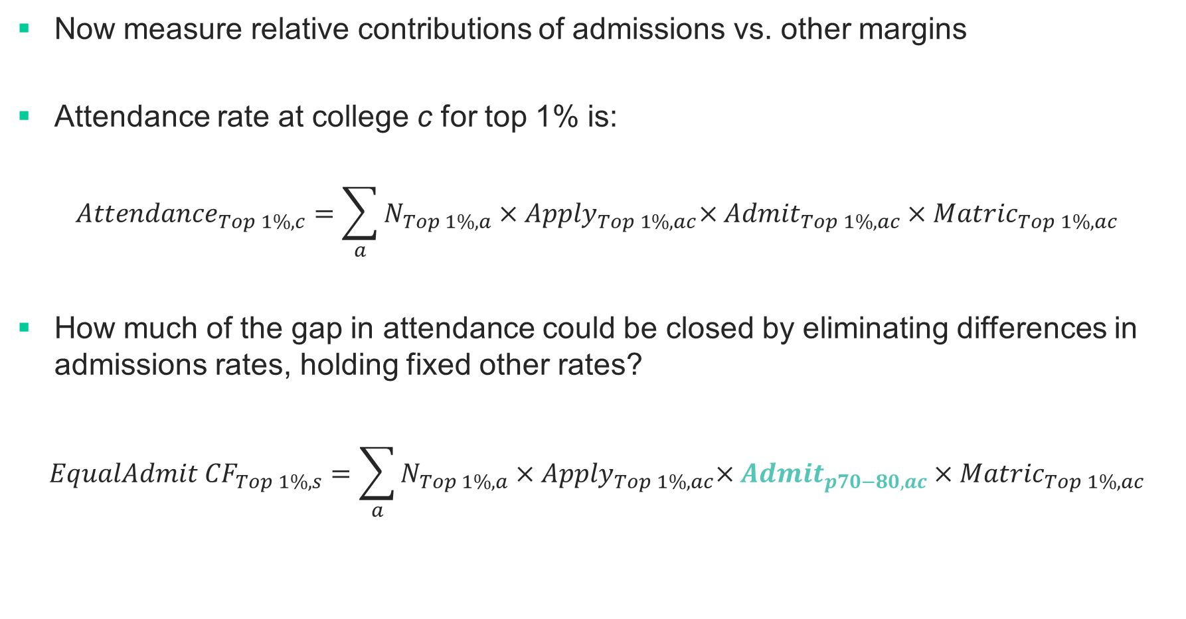
Counterfactuals: Quantification of Components of Pipeline
Now measure relative contributions of admissions vs. other margins
Attendance rate at college c for top 1% is:
$${Attendance}_{Top 1\%,c}=\sum_{a}{N_{Top 1\%,a}{×Apply}_{Top 1\%,ac}×{Admit}_{Top 1\%,ac}×{Matric}_{Top 1\%,ac}}$$
How much of the gap in attendance could be closed by eliminating differences in admissions rates, holding fixed other rates?
$${EqualAdmit CF}_{Top 1\%,s}=\sum_{a}{N_{Top 1\%,a}{×Apply}_{Top 1\%,ac}×{Admit}_{p70−80,ac}×{Matric}_{Top 1\%,ac}}$$

Slide 21
Why Are Students from High-Income Families More Likely to Attend Ivy-Plus Colleges?
Pipeline Decomposition
Application
Non-Athletic Admissions
Matriculation
Attendance
34
87
20
168
20.1%
51.9%
11.9%
Extra students from top 1%
0
10
20
30
40
50
60
70
80
90
100
110
120
130
140
150

Slide 22
Share of Students Admitted to Selected Colleges who are Recruited Athletes
Reweighted on SAT/ACT Scores to Match Current Attendees
15%
10%
Athlete Share of Admitted Students
5%
0%
0-20
20-40
40-60
60-70
70-80
80-90
90-95
95-96
96-97
97-98
98-99
99-99.9
Top 0.1
Parent Income Percentile
Ivy-Plus
Selected Flagship Public

Slide 23
Why Are Students from High-Income Families More Likely to Attend Ivy-Plus Colleges?
Pipeline Decomposition
Application
Recruited Athletes
Non-Athletic Admissions
Matriculation
Attendance
34
27
87
20
168
20.1%
16.2%
51.9%
11.9%
Extra students from top 1%
0
10
20
30
40
50
60
70
80
90
100
110
120
130
140
150

Slide 24
Why Are Students from High-Income Families More Likely to Attend Ivy-Plus Colleges?
Pipeline Decomposition
114
68.1%
Attributable to Admissions
Application
Recruited Athletes
Non-Athletic Admissions
Matriculation
Attendance
34
27
87
20
168
20.1%
16.2%
51.9%
11.9%
Extra students from top 1%
0
10
20
30
40
50
60
70
80
90
100
110
120
130
140
150

Slide 25
Why Do Admissions Rates
Differ by Parental Income?

Slide 26
Determinants of Admissions Rates
Begin by examining contribution of other preferences in admissions documented in prior work for children of alumni (“legacies”) and faculty children, excluding athletes
[e.g., Bowen and Levin 2003, Arcidiacono et al. 2019]
Focus here on how much this contributes to gaps by parental income

Slide 27
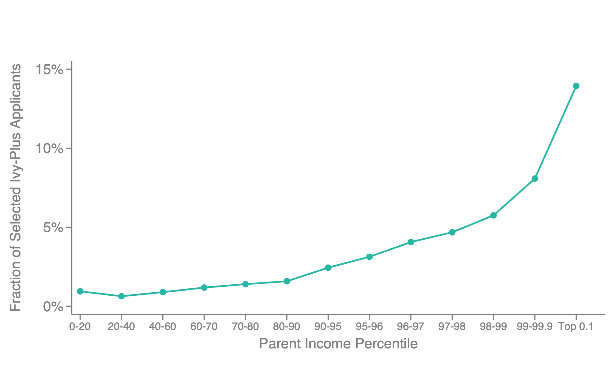
Share of Applicants at Selected Ivy-Plus Colleges who are Legacies

Slide 28
Relative Admissions Rates for Legacy Applicants at Ivy-Plus Colleges
Reweighted on SAT/ACT Scores to Match Current Attendees
10
Legacy Students
8
6
Relative Admission Rate
4
2
0
0-20
20-40
40-60
60-70
70-80
80-90
90-95
95-96
96-97
97-98
98-99
99-99.9
Top 0.1
Parent Income Percentile

Slide 29
Effects of Legacy Preferences
What would admissions rate be for legacy students absent legacy preference?
First estimate an admissions model for non-legacy students based on application characteristics [Card 2017, Arcidiacono et al. 2020]
  Observable student chars: test score, GPA, internal ratings, gender, race, first-gen, early / regular decision round, high school FE, parent income, application year
Then predict admissions rates for legacy students in this model, with their own chars

Slide 30
Relative Admissions Rates for Legacy Applicants at Ivy-Plus Colleges
Reweighted on SAT/ACT Scores to Match Current Attendees
10
Legacy Students
No Legacy Preference Counterfactual
8
6
Relative Admission Rate
4
2
0
0-20
20-40
40-60
60-70
70-80
80-90
90-95
95-96
96-97
97-98
98-99
99-99.9
Top 0.1
Parent Income Percentile

Slide 31
Effects of Legacy Preferences
Key assumption: observable characteristics capture all factors that differentiate legacy students from non-legacies in admissions
  Test by examining admissions decisions at other Ivy-plus colleges

Slide 32
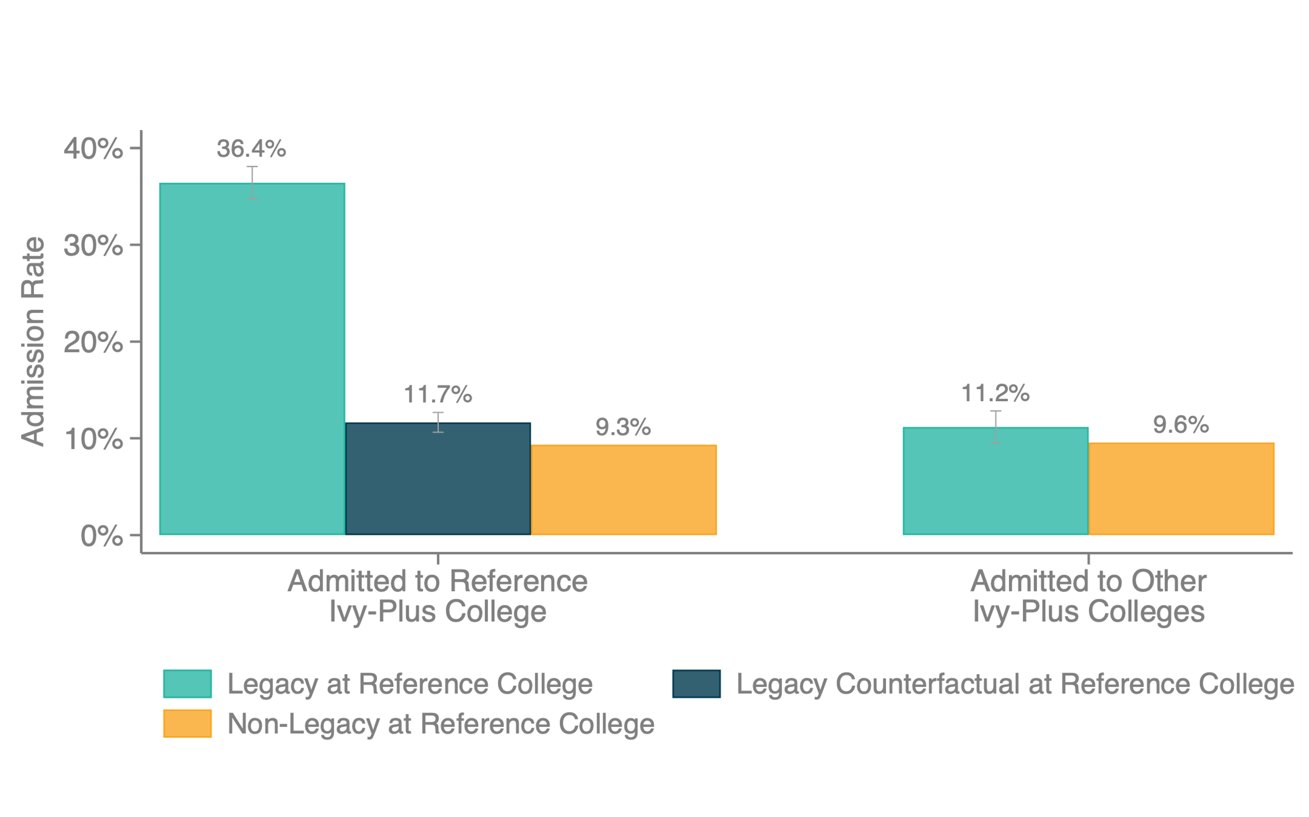
Admissions Rates for Legacy Students
Admission Rate by Legacy Status

Slide 33
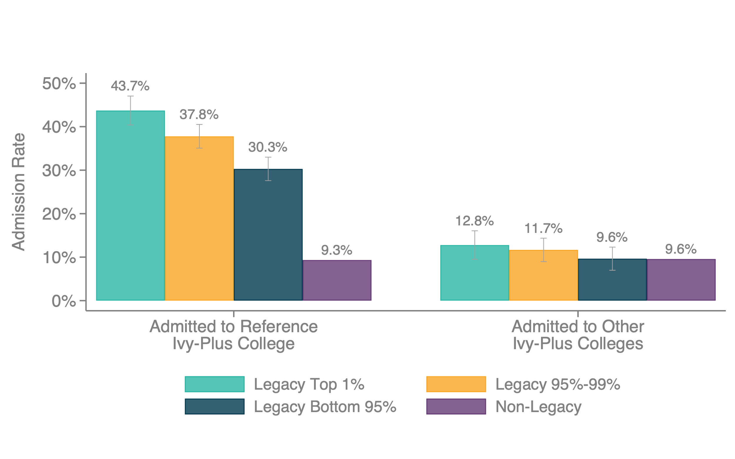
Admissions Rates for Legacy Students, by Parental Income
Admission Rate by Legacy Status

Slide 34
Effect of Legacy Preferences
114
68.1%
Attributable to Admissions
Application
Recruited Athletes
Legacy Preference
Matriculation
Attendance
34
27
52
20
168
20.1%
16.2%
31%
11.9%
Extra students from top 1%
0
10
20
30
40
50
60
70
80
90
100
110
120
130
140
150

Slide 35
Explaining Remaining Admissions Preference
To understand source of remaining difference in admissions rates, turn to detailed information on applicant ratings
  Focus first on non-legacy applicants (to avoid contamination from legacy effect)

Slide 36
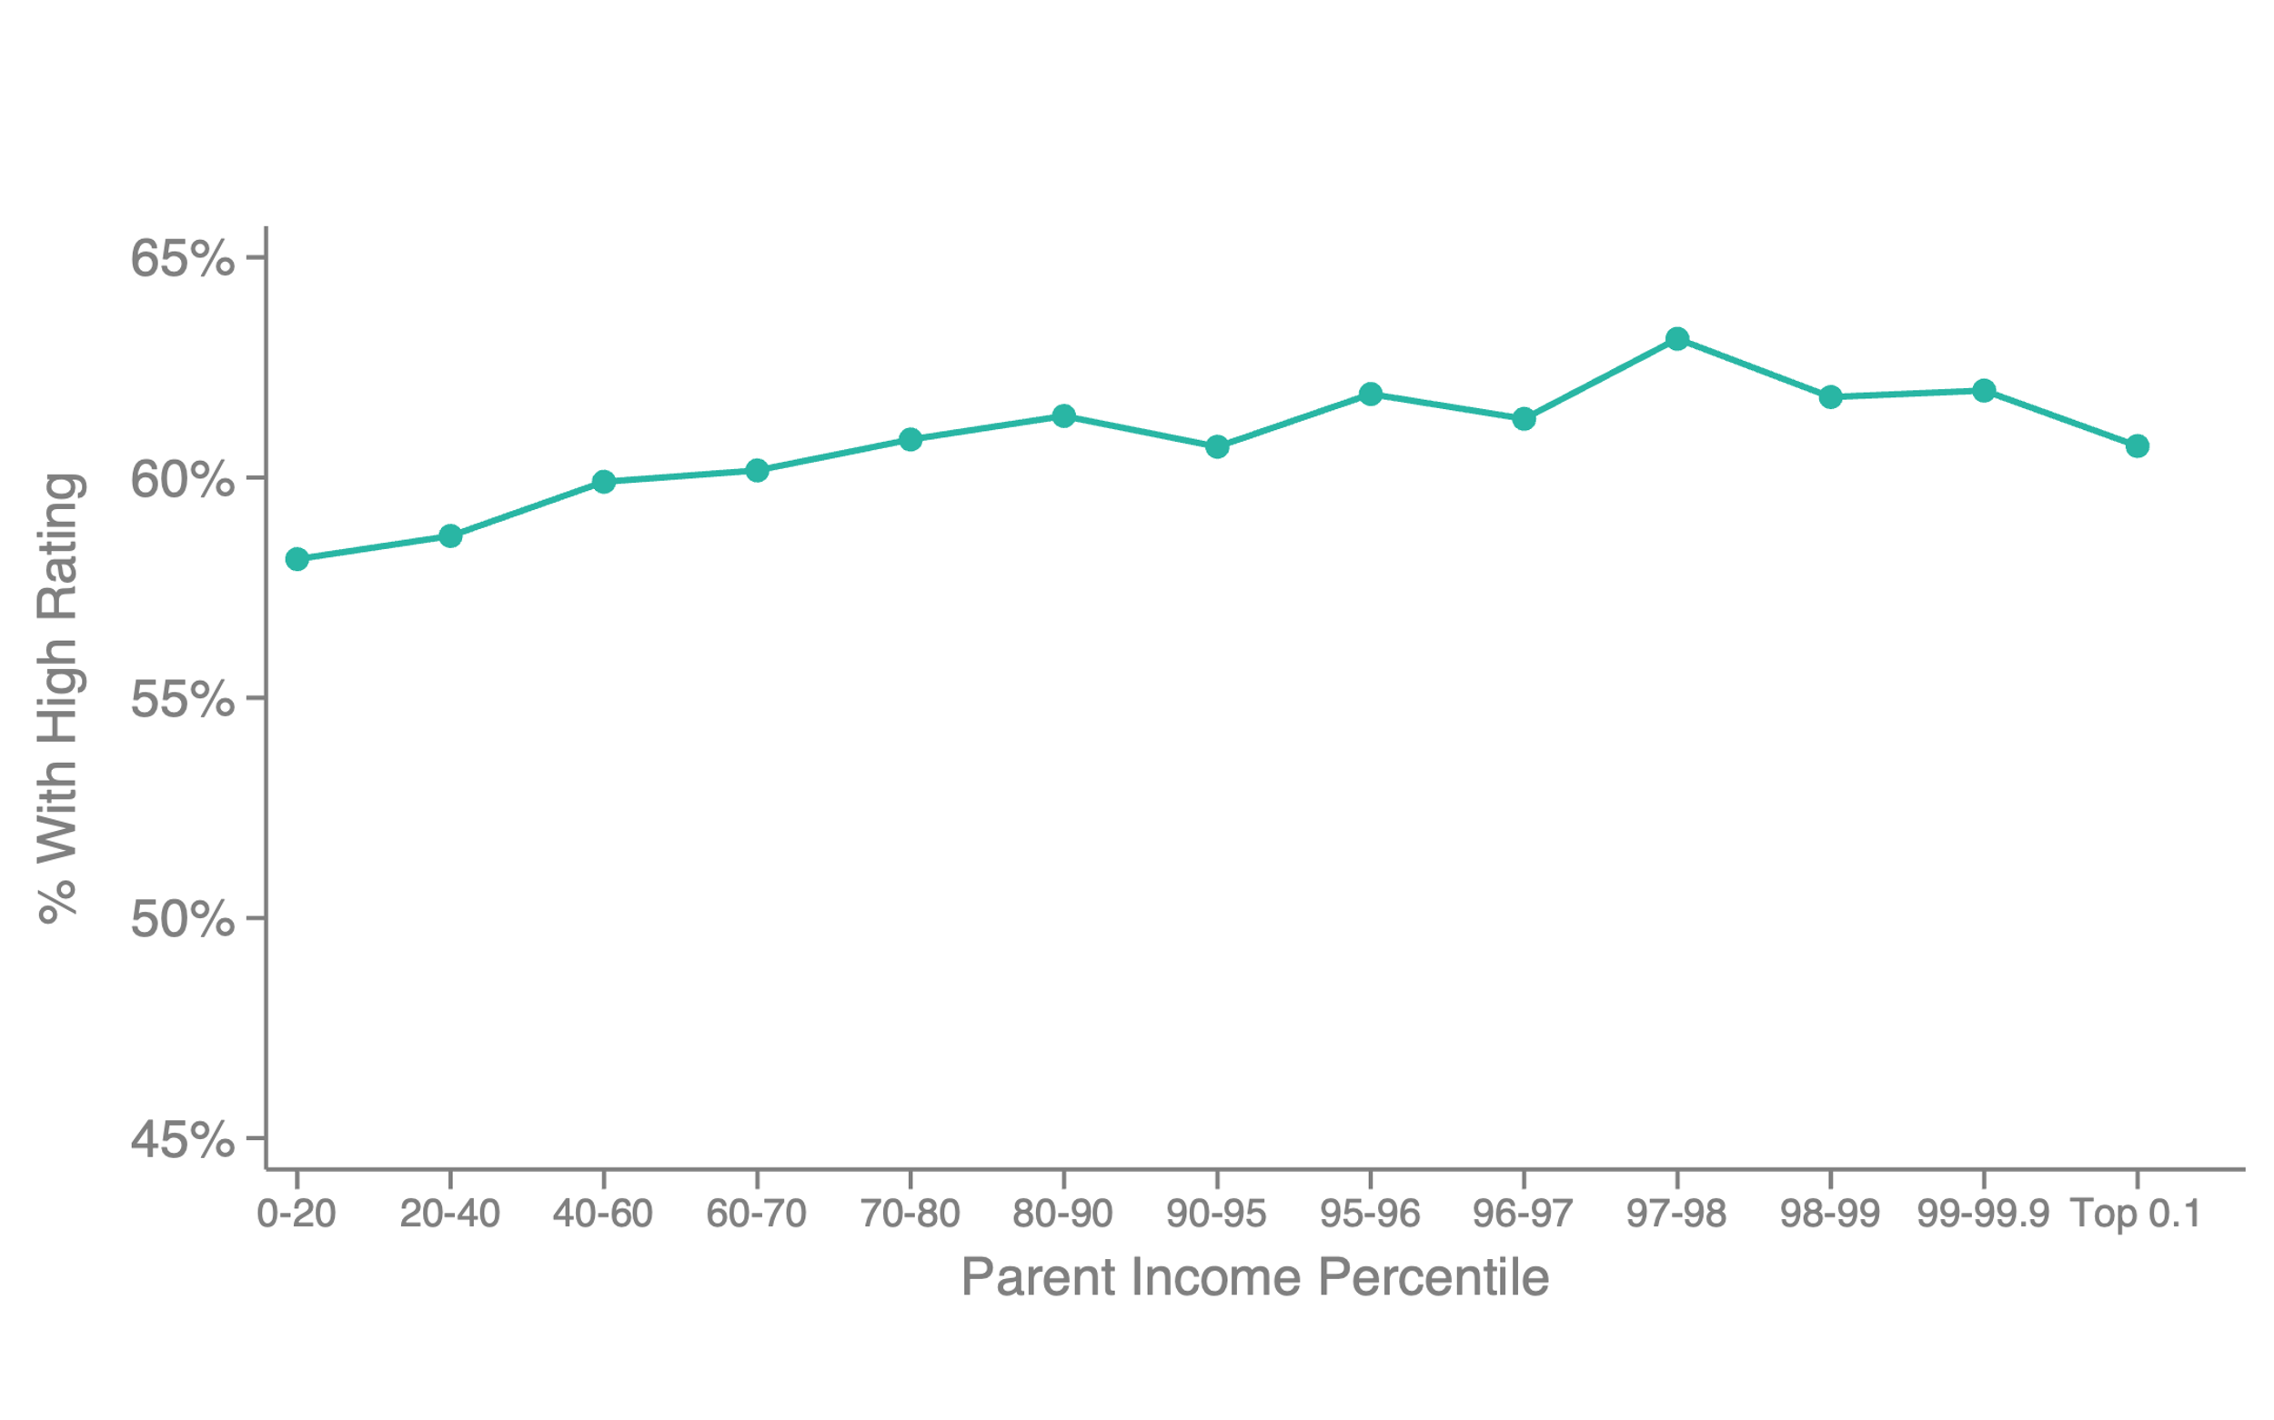
Admissions Office Ratings of Applicants by Parental Income: Academic Rating
Reweighting on Test Scores, Excluding Legacies, Athletes, and Faculty Children

Slide 37
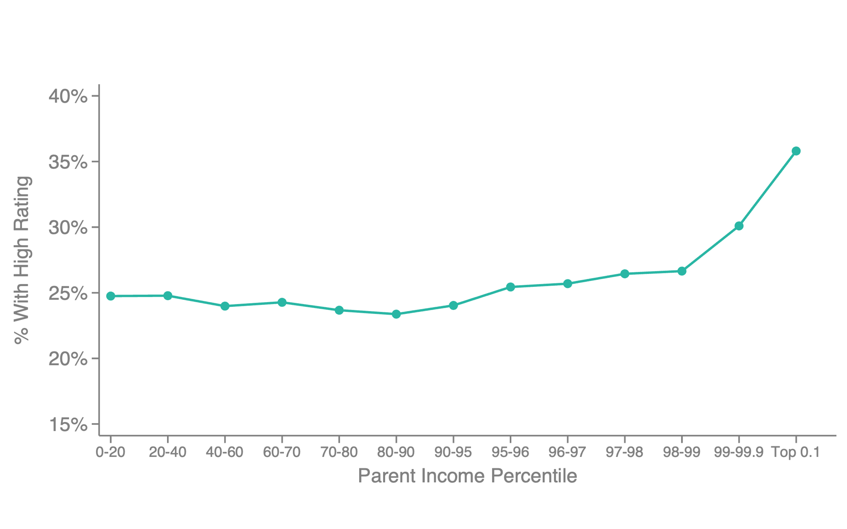
Admissions Office Ratings of Applicants by Parental Income: Non-Academic Rating
Reweighting on Test Scores, Excluding Legacies, Athletes, and Faculty Children

Slide 38
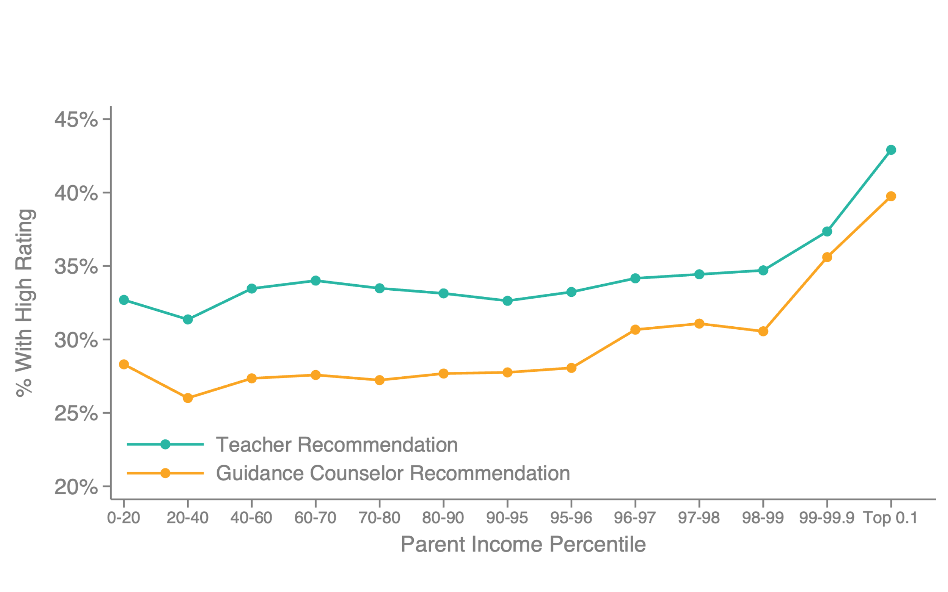
Non-Academic Ratings by Parental Income
Reweighting on Test Scores, Excluding Legacies, Athletes, and Faculty Children

Slide 39
High School Effects on Admissions and Ratings
Differences in ratings and admissions are mediated by high schools
Estimate HS fixed effects on admissions by regressing Ivy-plus admission indicator on HS dummies, SAT scores, & demographic controls (race, gender, parent income)

Slide 40
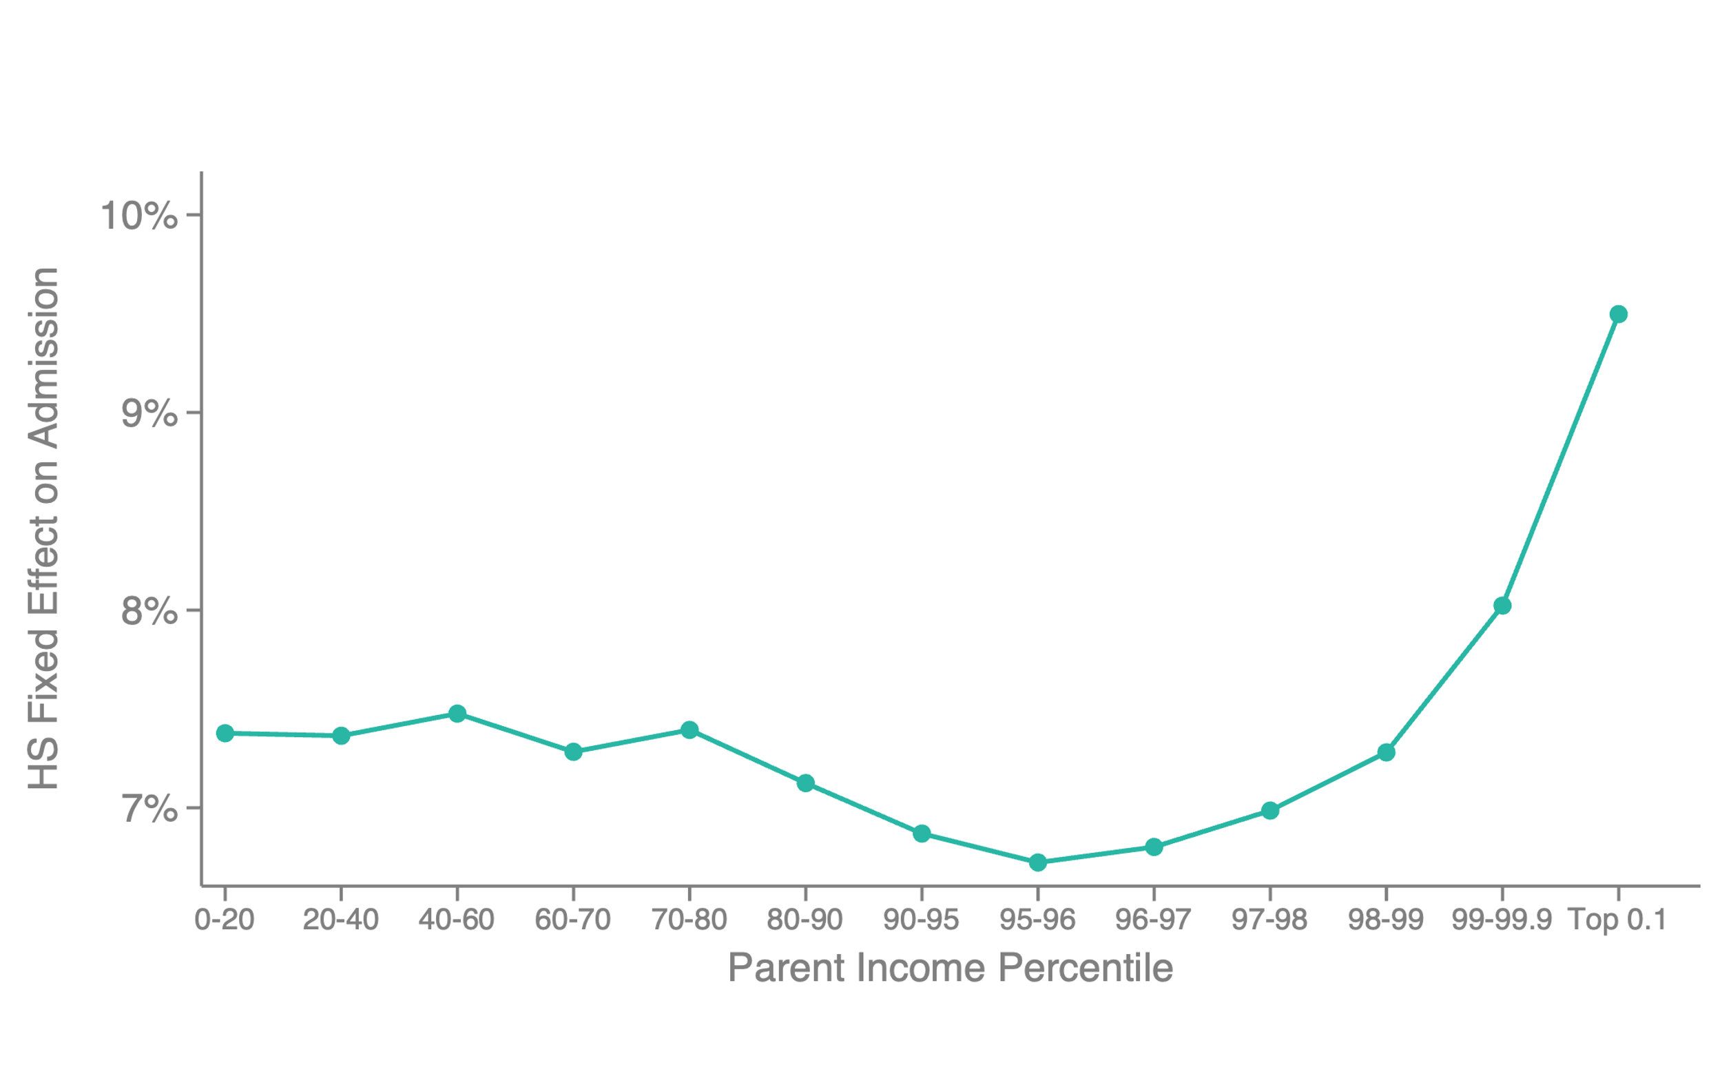
High-School Fixed Effects on Admissions vs. Parental Income

Slide 41
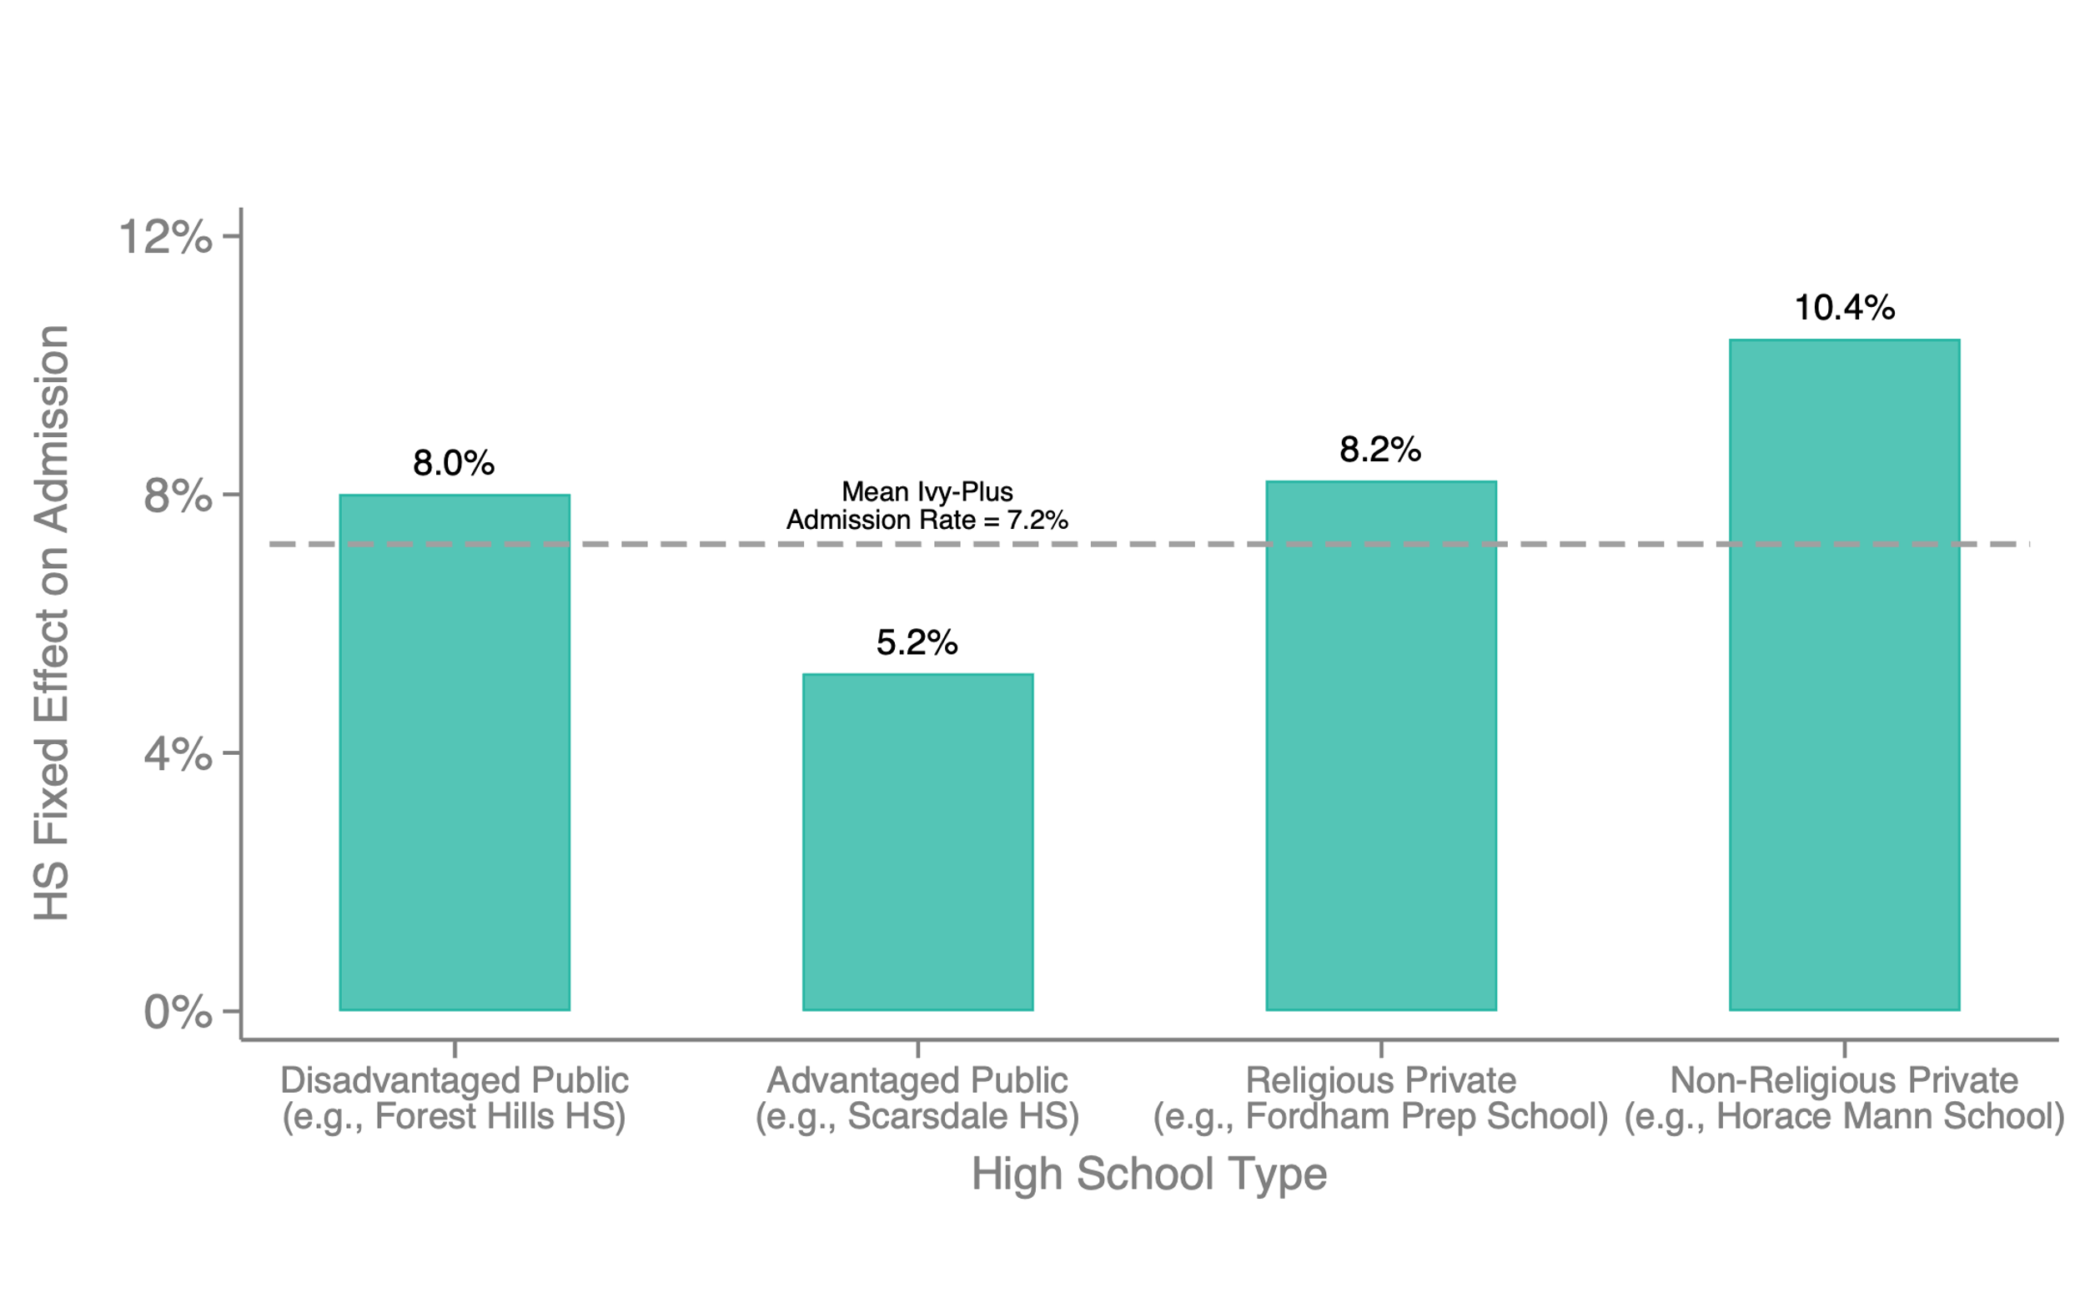
High School Effects on Ivy-Plus Admissions, by High School Type

Slide 42
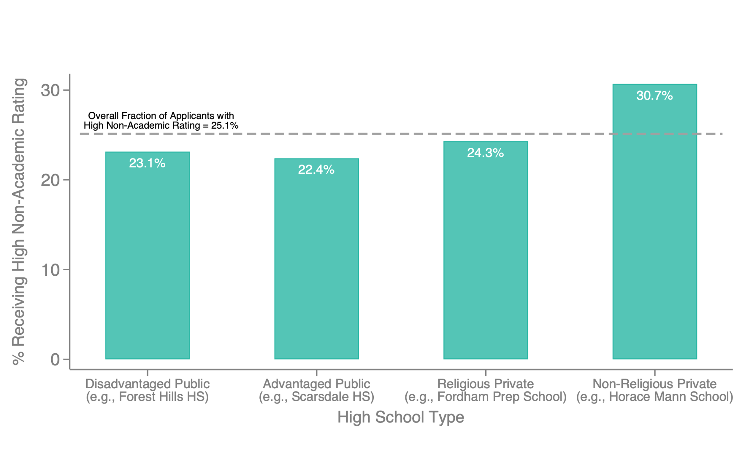
High School Effects on Non-Academic Rating, by High School Type

Slide 43
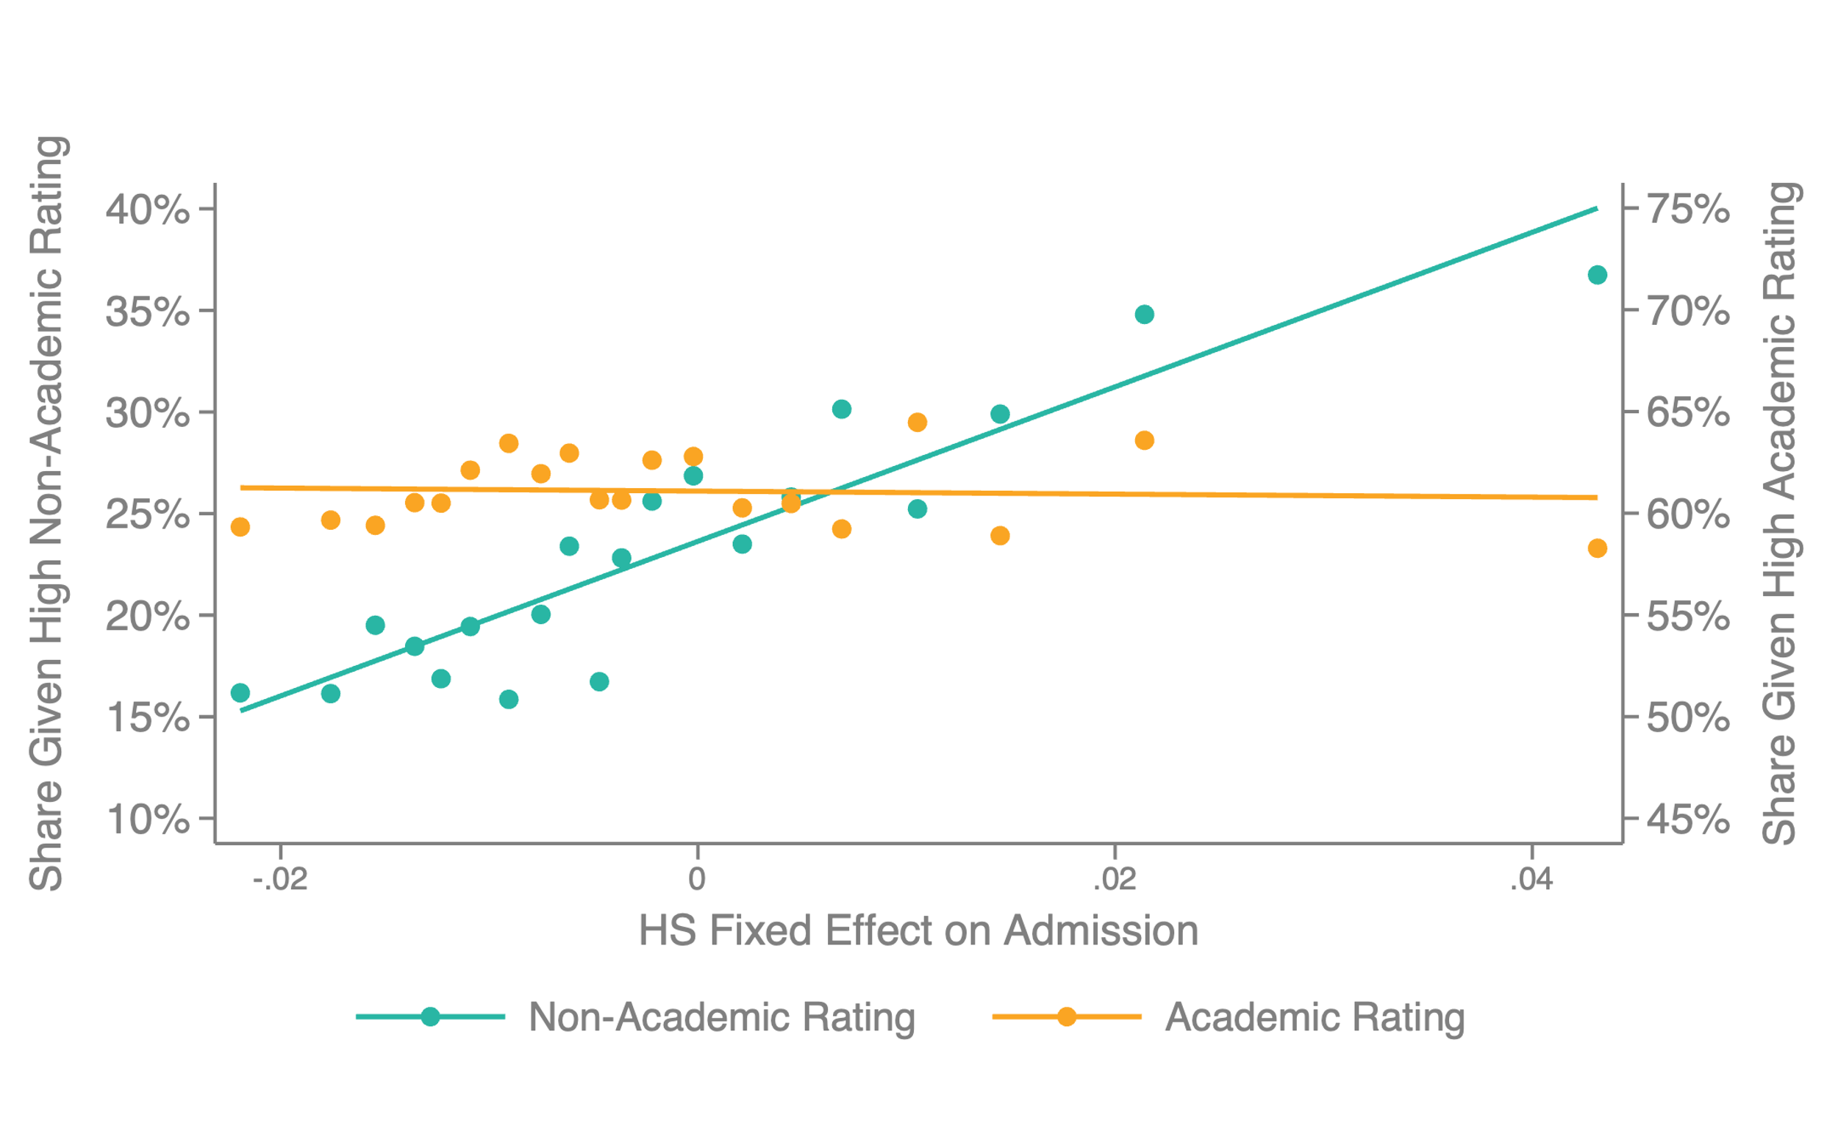
Ratings vs. High School Fixed Effects on Admissions, Controlling for SAT Score
Share of Ivy-Plus Applicants with High Ratings vs. (Shrunken) High School FE on Admissions

Slide 44
Effect of Non-Academic Ratings Preferences
114
68.1%
Attributable to Admissions
Application
Recruited Athletes
Legacy Preference
Non-Academic Cred.
Matriculation
Attendance
34
27
52
35
20
168
20.1%
16.2%
31%
20/9%
11.9%
Extra students from top 1%
0
10
20
30
40
50
60
70
80
90
100
110
120
130
140
150

Slide 45
Question 2
Does Admission to an Ivy-Plus College Have a Causal Effect on Students’ Post-College Outcomes?

Slide 46
Identifying the Causal Effects of Attending Highly Selective Colleges
Goal: identify causal effects of Ivy-plus attendance relative to average state flagship university (elastic outside option for highly qualified students)
Use two research designs to estimate this causal effect
  Isolating idiosyncratic variation in admissions among marginal students
  (new method introduced here)
  Isolating idiosyncratic variation in matriculation among admitted students
  (replicating Mountjoy and Hickman 2022, building on Dale and Krueger 2002)
Start with admissions design, motivated by preceding evidence on importance of admissions margin
Notes:
Would students who attend an Ivy-Plus university excel regardless of where they go to college?
Or does attending have a causal effect on student’s outcomes?

Slide 47
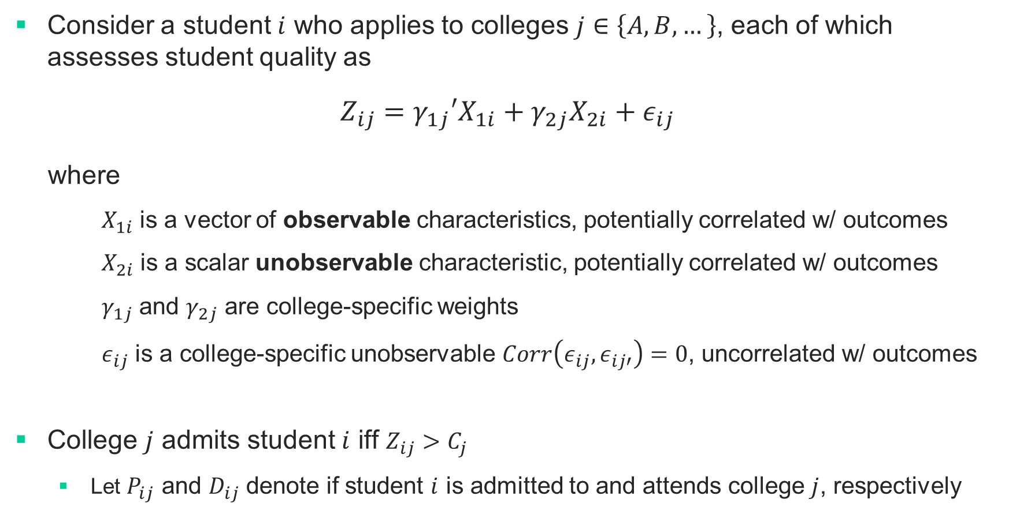
Empirical Model of College Admissions
Consider a student $i$ who applies to colleges $j∈\left\{A,B,…\right\}$, each of which assesses student quality as
$$Z_{ij}=γ_{1j}′X_{1i}+γ_{2j}X_{2i}+ε_{ij}$$
where
  $X_{1i}$ is a vector of observable characteristics, potentially correlated w/ outcomes
  $X_{2i}$ is a scalar unobservable characteristic, potentially correlated w/ outcomes
  $γ_{1j}$ and $γ_{2j}$ are college-specific weights
  $ε_{ij}$ is a college-specific unobservable $Corr\left(ε_{ij},ε_{ij′}\right)=0$, uncorrelated w/ outcomes
College $j$ admits student $i$ iff $Z_{ij}>C_{j}$
  Let $P_{ij}$ and $D_{ij}$ denote if student $i$ is admitted to and attends college $j$, respectively

Slide 48
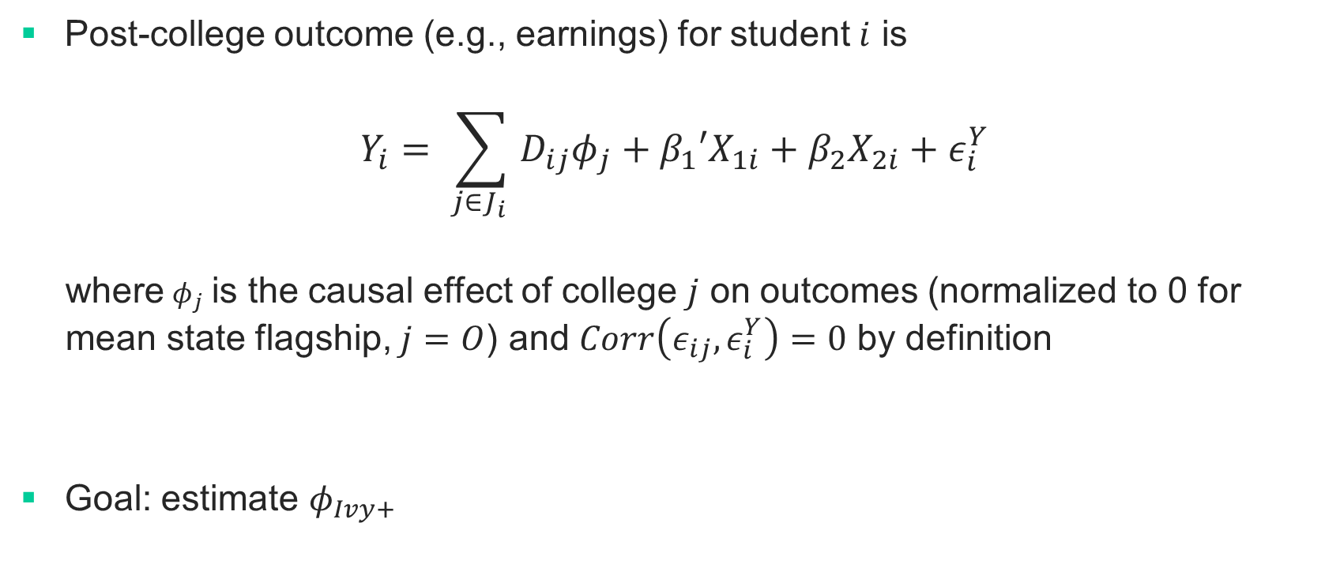
Empirical Model of Post-College Outcomes
Post-college outcome (e.g., earnings) for student $i$ is
$$Y_{i}= \sum_{j∈J_{i} }{D_{ij}φ_{j}+β_{1}′X_{1i}+β_{2}X_{2i}+ε_{i}^{Y}}$$
where $φ_{j}$ is the causal effect of college $j$ on outcomes (normalized to 0 for mean state flagship, $j=O$) and $Corr\left(ε_{ij},ε_{i}^{Y}\right)=0$ by definition
Goal: estimate $φ_{Ivy+}$

Slide 49
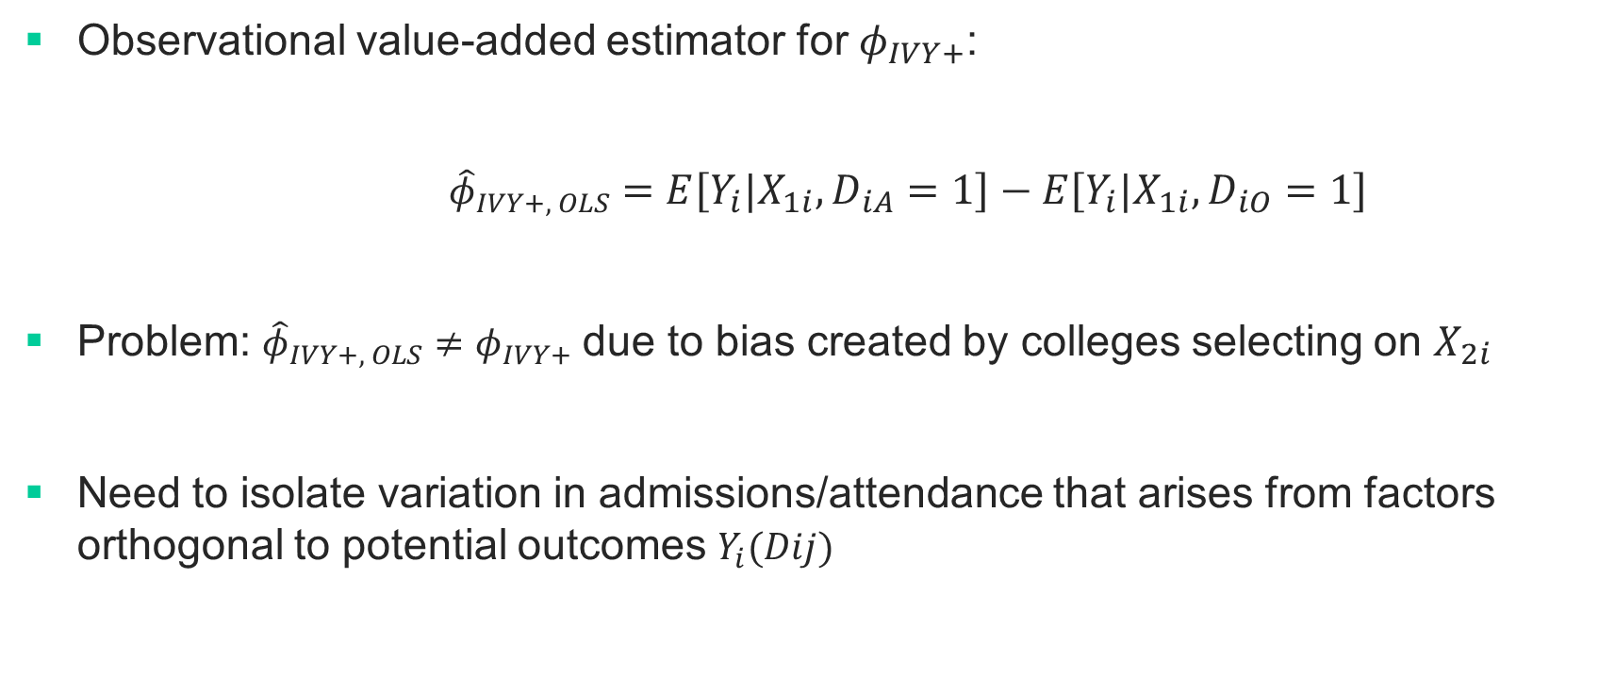
Selection Bias in Estimating College Fixed Effects
Observational value-added estimator for $φ_{IVY+}$:
  ${\hat{φ}}_{IVY+, OLS}=E\left[Y_{i}|X_{1i},D_{iA}=1\right]−E\left[Y_{i}|X_{1i},D_{iO}=1\right]$
Problem: ${\hat{φ}}_{IVY+, OLS}≠φ_{IVY+}$due to bias created by colleges selecting on $X_{2i}$
Need to isolate variation in admissions/attendance that arises from factors orthogonal to potential outcomes $Y_{i}(Dij)$

Slide 50
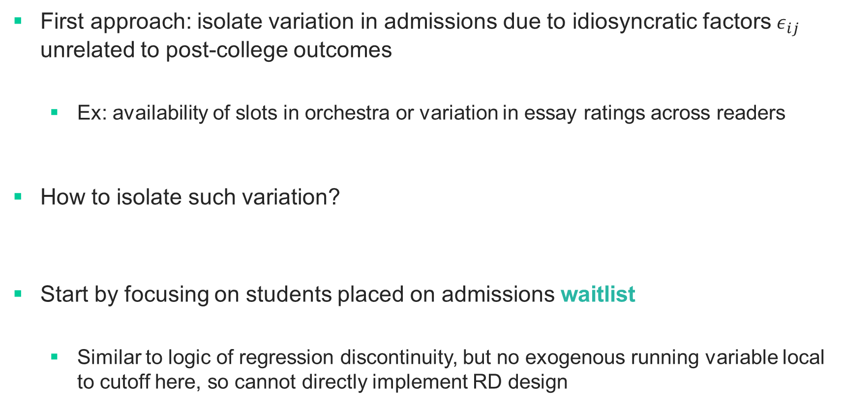
Research Design #1: Isolating idiosyncratic Variation in Admissions
First approach: isolate variation in admissions due to idiosyncratic factors $ε_{ij}$ unrelated to post-college outcomes
  Ex: availability of slots in orchestra or variation in essay ratings across readers
How to isolate such variation?
Start by focusing on students placed on admissions waitlist
  Similar to logic of regression discontinuity, but no exogenous running variable local to cutoff here, so cannot directly implement RD design

Slide 51
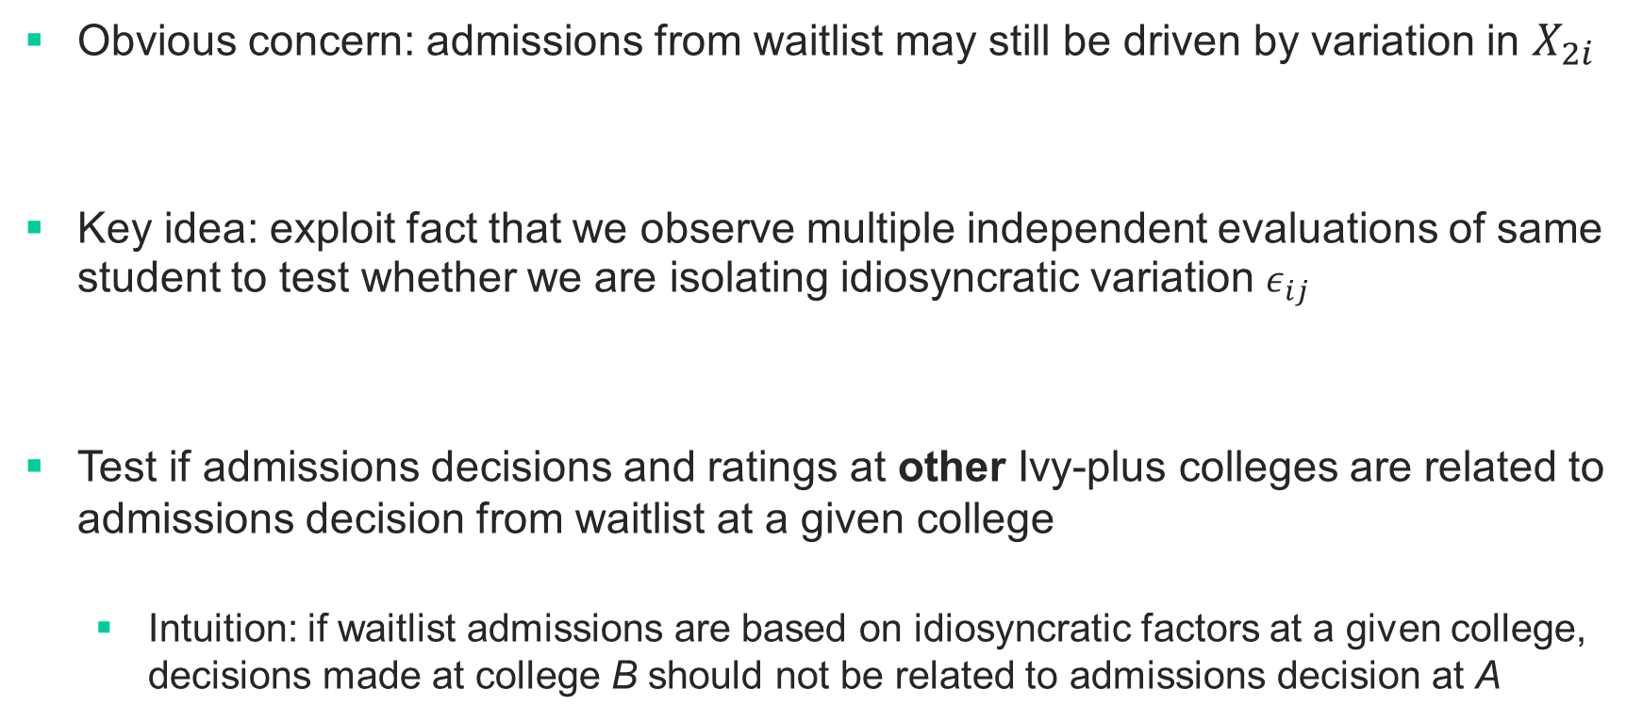
Research Design #1: Isolating idiosyncratic Variation in Admissions
Obvious concern: admissions from waitlist may still be driven by variation in $X_{2i}$
Key idea: exploit fact that we observe multiple independent evaluations of same student to test whether we are isolating idiosyncratic variation $ε_{ij}$
Test if admissions decisions and ratings at other Ivy-plus colleges are related to admissions decision from waitlist at a given college
  Intuition: if waitlist admissions are based on idiosyncratic factors at a given college, decisions made at college B should not be related to admissions decision at A

Slide 52

Two-Rater Test for Idiosyncratic Selection
Assumption 1: Correlated Admissions Criteria
$$γ_{2A}·γ_{2B}>0$$
  Requires that colleges place same-signed (but not identical) weights on applicant characteristics $X_{2i}$ that matter for potential outcomes

Slide 53
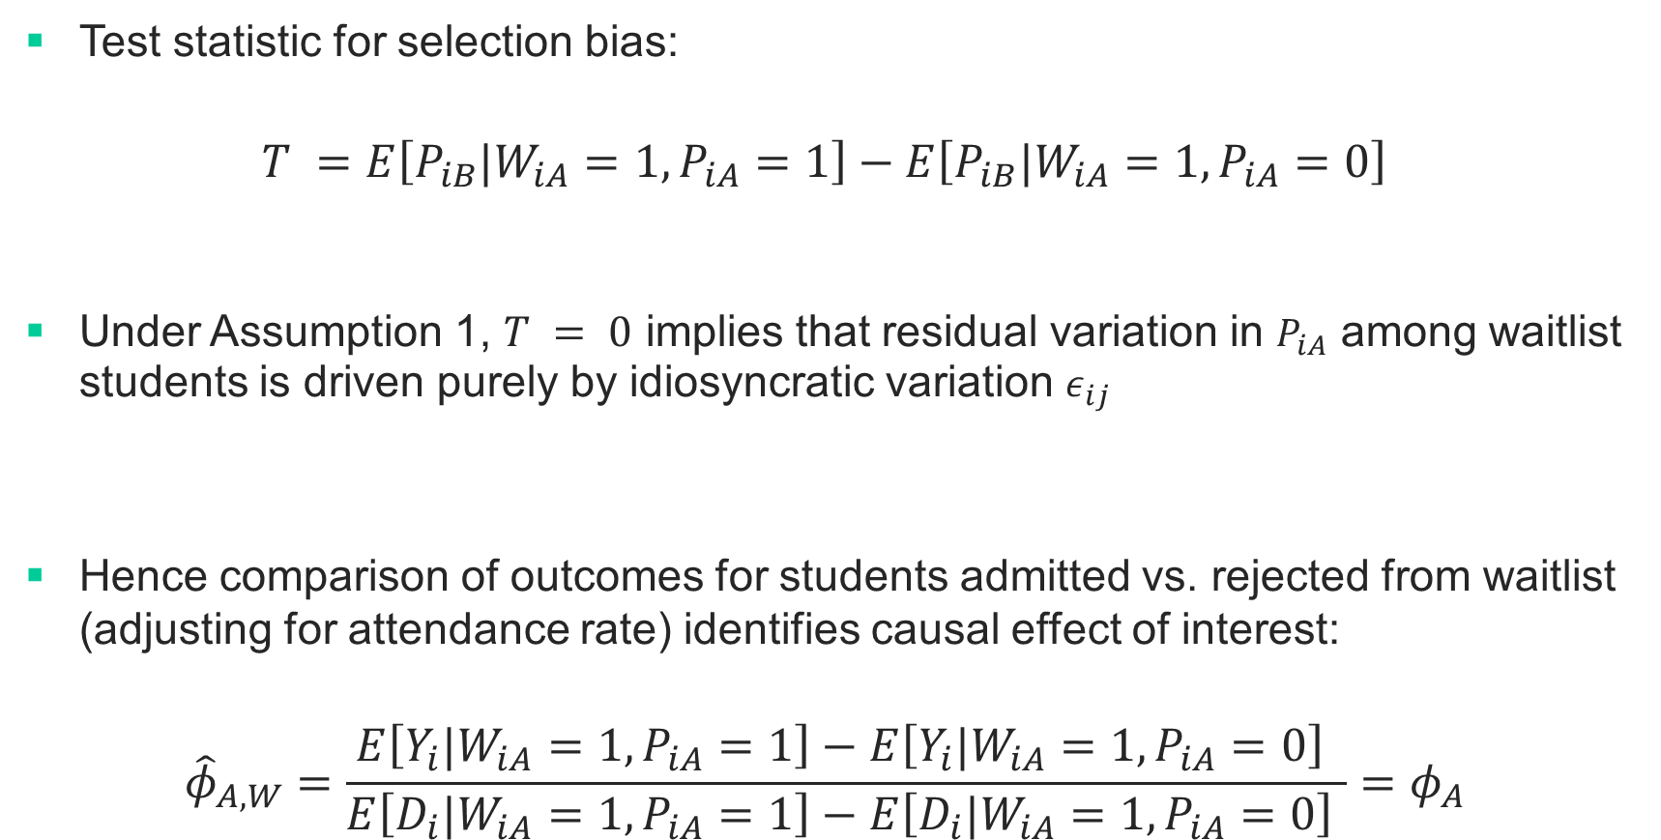
Two-Rater Test for Idiosyncratic Selection
Test statistic for selection bias:
$T =$ $E\left[P_{iB}|W_{iA}=1,P_{iA}=1\right]−E\left[P_{iB}|W_{iA}=1,P_{iA}=0\right]$
Under Assumption 1, $T = 0$ implies that residual variation in $P_{iA}$ among waitlist students is driven purely by idiosyncratic variation $ε_{ij}$
Hence comparison of outcomes for students admitted vs. rejected from waitlist (adjusting for attendance rate) identifies causal effect of interest:
$${\hat{φ}}_{A,W}=\frac{E\left[Y_{i}|W_{iA}=1,P_{iA}=1\right]−E\left[Y_{i}|W_{iA}=1,P_{iA}=0\right] }{E\left[D_{i}|W_{iA}=1,P_{iA}=1\right]−E\left[D_{i}|W_{iA}=1,P_{iA}=0\right] }=φ_{A}$$

Slide 54
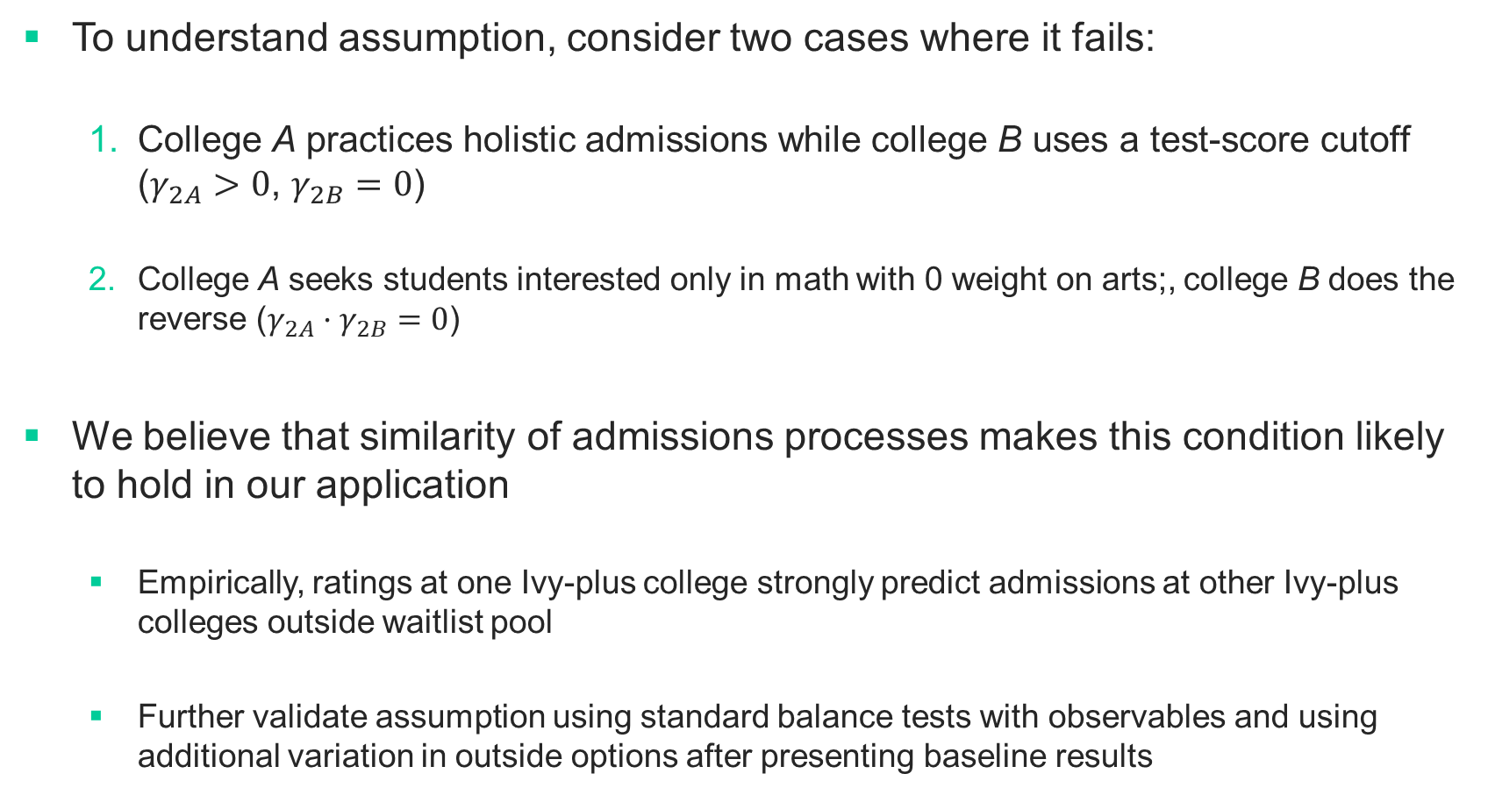
Correlated Admissions Assumption Underlying Two-Rater Test
To understand assumption, consider two cases where it fails:
  College A practices holistic admissions while college B uses a test-score cutoff ($γ_{2A}>0$, $γ_{2B}=0$)
  College A seeks students interested only in math with 0 weight on arts;, college B does the reverse ($γ_{2A}·γ_{2B}=0$)
We believe that similarity of admissions processes makes this condition likely to hold in our application
  Empirically, ratings at one Ivy-plus college strongly predict admissions at other Ivy-plus colleges outside waitlist pool
  Further validate assumption using standard balance tests with observables and using additional variation in outside options after presenting baseline results

Slide 55
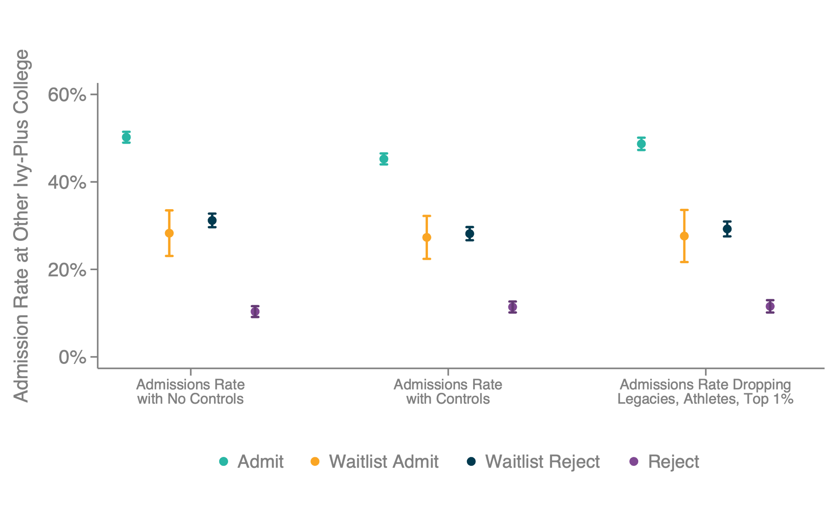
Two-Rater Test for Idiosyncratic Selection

Slide 56
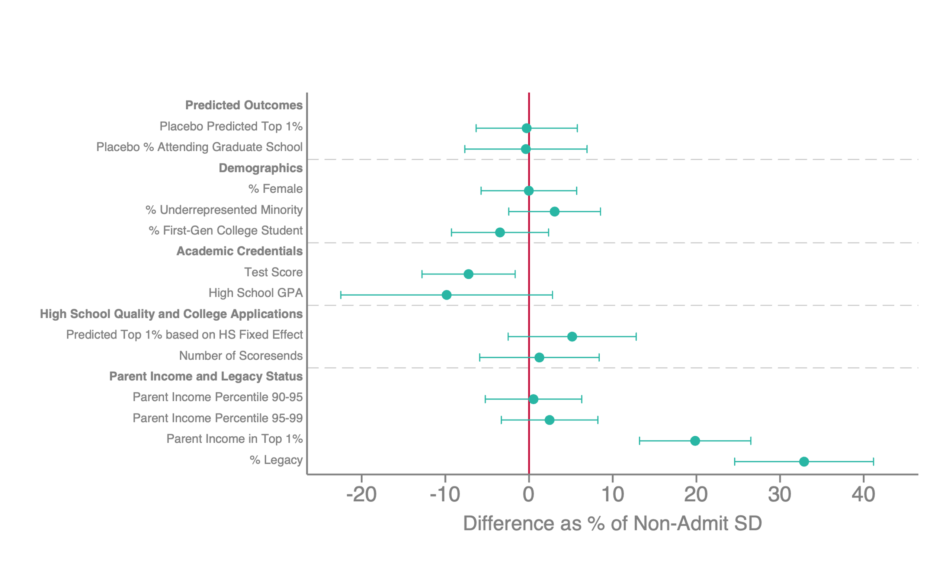
Treatment Effects of Ivy-Plus College Attendance
Comparing Waitlist Admits vs. Rejects

Slide 57
Balance Test
Multiple-rater test shows no significant difference in admissions at other colleges
  Quantitatively, upper bound of 95% CI is 2.0pp
  Admissions at other school predicts +2pp in top 1%
  Can rule out bias of +0.04pp from this estimate
Waitlist admits and rejects also balanced on placebo outcomes
  Some imbalance on covariates, particularly from legacy students and top 1% who may use connections to get off waitlist
  Drop these students below, results unchanged. This is because characteristics like legacy not positively correlated with outcomes (more on this below).

Slide 58
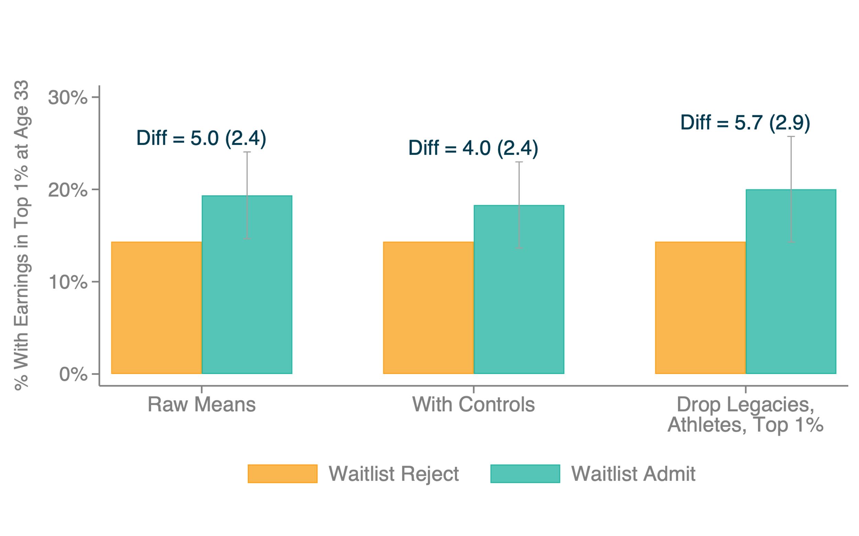
Treatment Effects of Ivy-Plus College Admission for Waitlisted Applicants
Earnings in Top 1% at Age 33

Slide 59
Increasing Precision Using Predictions Based on Initial Firm
Outcomes at age 33 observed for relatively few cohorts in our sample, limiting precision and capacity to examine heterogeneity
Can gain precision by studying earlier ages, but earnings change rapidly especially for Ivy-plus graduates in their late twenties…

Slide 60
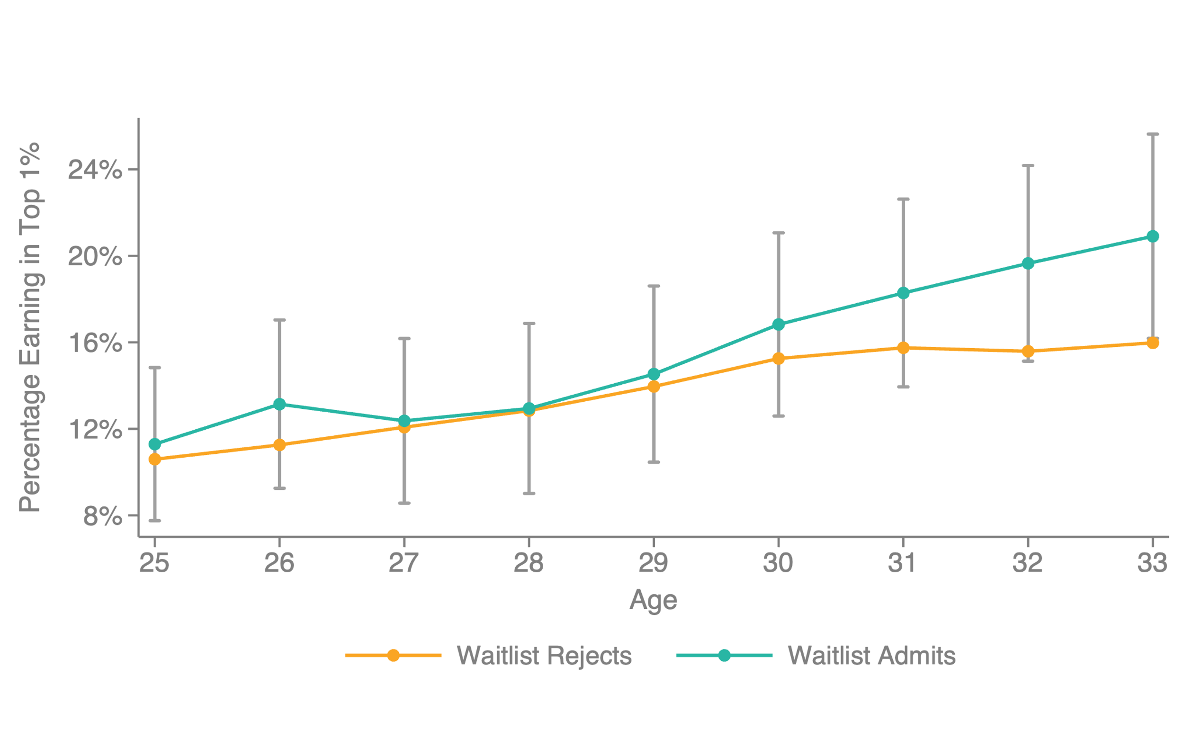
Treatment Effects of Ivy-Plus College Admission for Waitlisted Applicants, by Age
Earnings in Top 1% at Age 33

Slide 61
Increasing Precision Using Predictions Based on Initial Firm
To increase precision, predict age 33 earnings using employer at age 25
  Use historical data from universe of tax records to calculate fraction in top 1% at age 33 by age 25 firm (or graduate school, for those not employed)

Slide 62
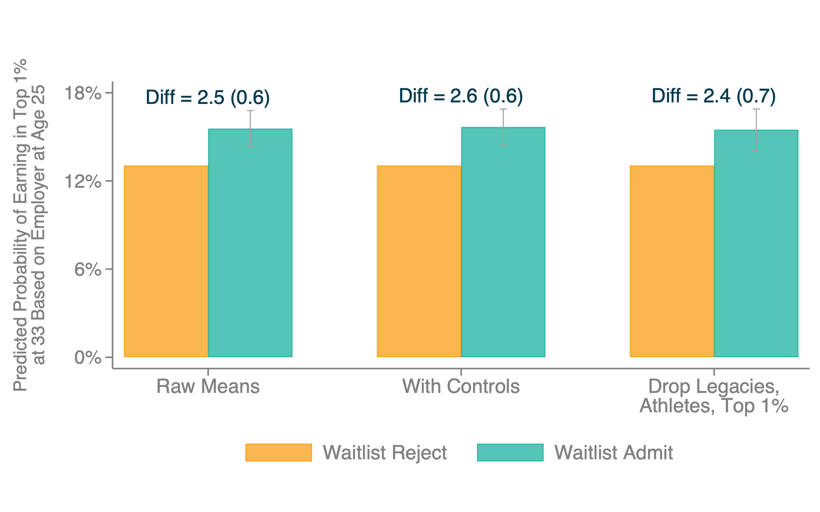
Treatment Effects of Ivy-Plus College Admission for Waitlisted Applicants
Predicted Earnings in Top 1%

Slide 63
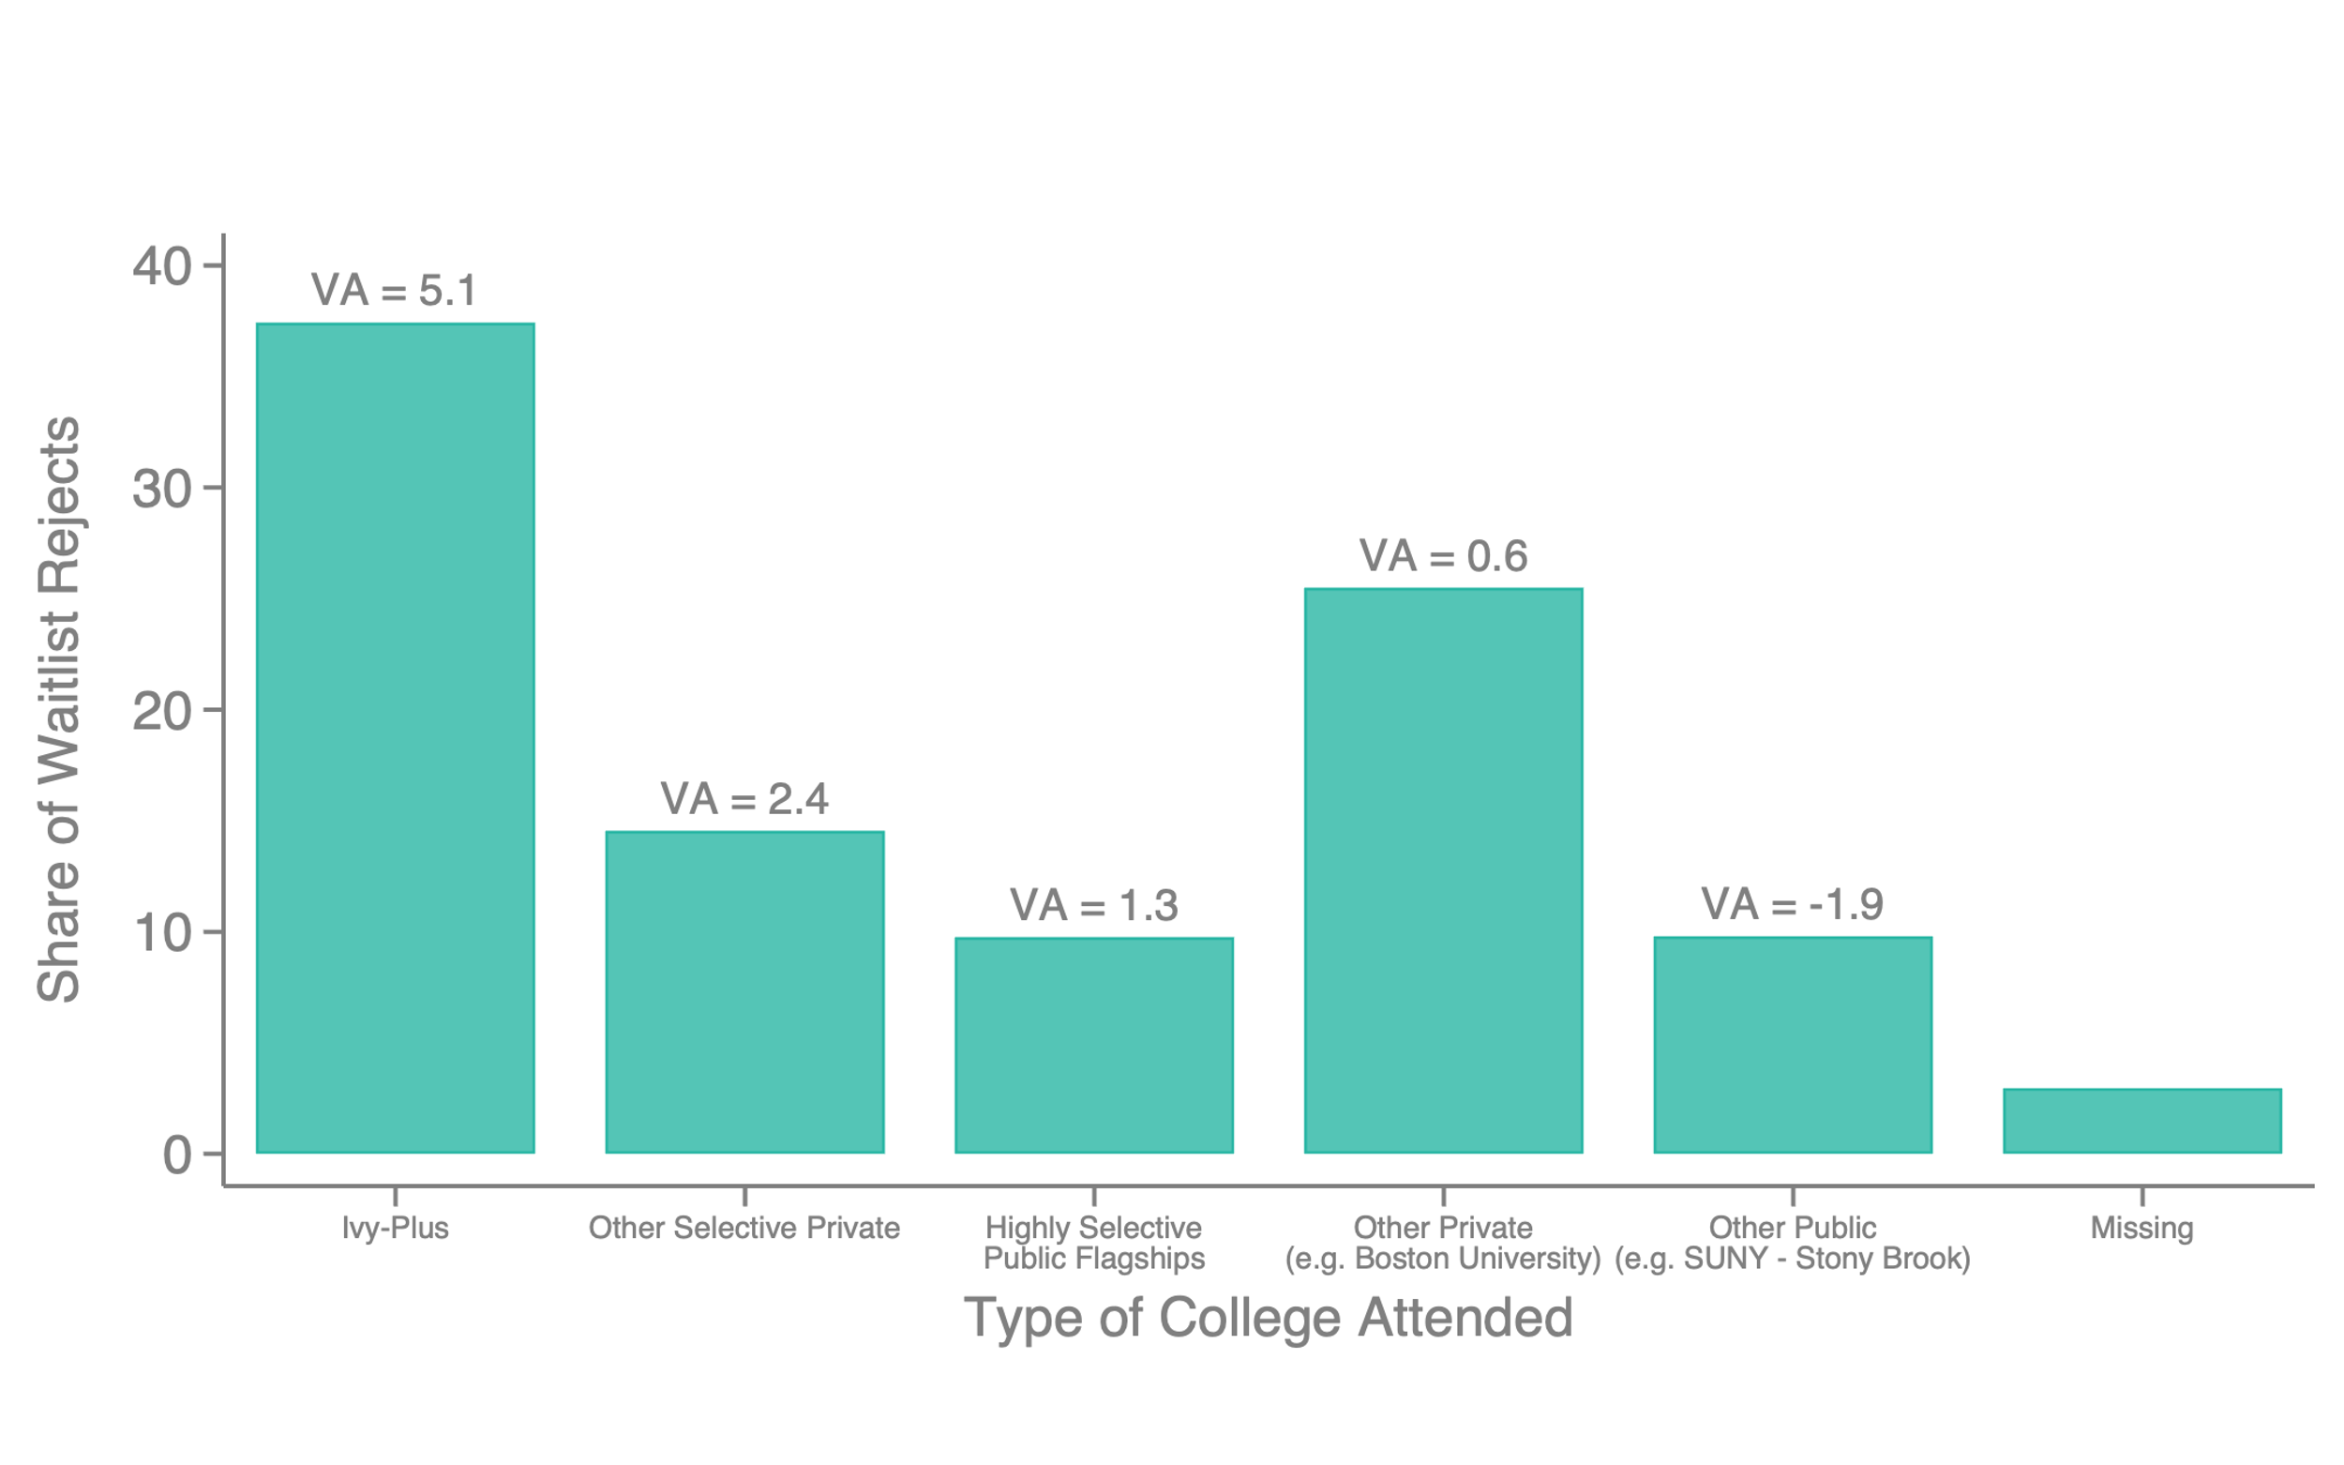
Distribution of Outside Options
Colleges Attended by Ivy-Plus Applicants Rejected from Waitlist

Slide 64
Exploiting Heterogeneity by Outside Options
Next, estimate heterogeneity in treatment effects by outside option
  Define student subgroups 𝑔 to identify differences in mean outside options by home state, parent income, race, and school applied (estimates from waitlist rejects)
  Estimate quality of outside options for each group as mean observational VA of college that non-waitlisted students rejected from Ivy-plus colleges attend
Key assumption: no essential heterogeneity in treatment effect of attending Ivy-plus college across groups
  Implies heterogeneity in effects across groups driven purely by differences in outside options (as in Bleemer 2022)

Slide 65
Heterogeneity in Waitlist Admission Effects by Strength of Outside Options
8
β = -0.87 (0.24)
Causal effect of attending Ivy-Plus vs. avg.
state flagship on Top 1% rate: 4.58 pp. (1.20)
6
4
Waitlist Design Treatment Effect
on Predicted Top 1%
2
0
-2
-1
0
1
2
3
4
5
Average
Average Ivy-Plus
Flagship
in College-
Public
Actual Outcome
Placebo Outcome
Specific Sample
Implied Mean Observational Value-Added of Outside Options

Slide 66
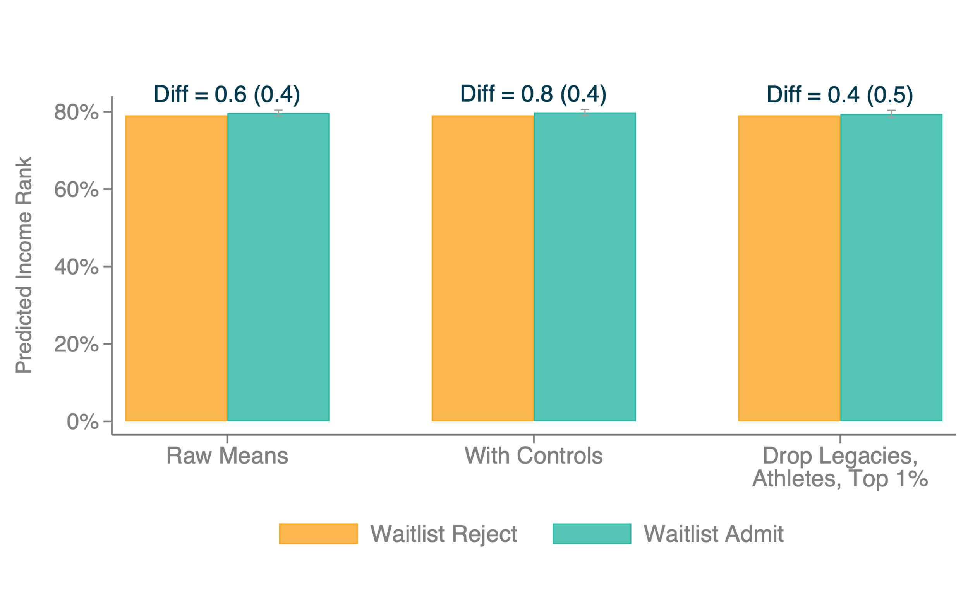
Treatment Effects of Ivy-Plus College Admission for Waitlisted Applicants
Predicted Mean Income Rank

Slide 67
Non-Monetary Outcomes
Does attending an Ivy-plus college have an impact on non-monetary outcomes as well?
Begin by examining impacts on attending an elite (top 10) graduate program

Slide 68
Treatment Effects of Ivy-Plus College Admission for Waitlisted Applicants
Non-Monetary Outcomes
40
30
% Students in the Elite Position
20
Diff = 3.2 (1.6)
10
0
In Elite Grad School

Slide 69
Expanding Non-Monetary Outcomes
To obtain more general measures of non-monetary success, define a revealed preference measure of working at a prestigious firm
  Calculate ratio of Ivy-plus to flagship public attendees at each firm using historical data (leaving out own observation)
  Define firms that rank highest on this ratio as “elite” firms, counting firms up to the number required to account for 25% of Ivy-plus employment
  Then regress this ratio on predicted top 1% share and rank firms on the residual to obtain a measure of “prestigious” firms
  Significant overlap between this list and publicly available lists of 10 most prestigious hospitals, research institutions, etc. (e.g., Mass General Hospital, Mayo Clinic, Johns Hopkins)

Slide 70
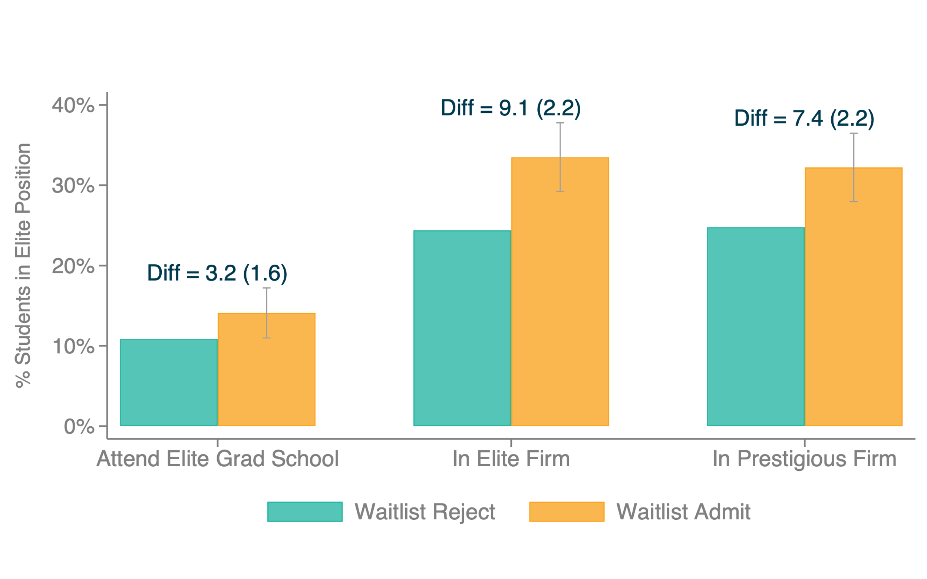
Treatment Effects of Ivy-Plus College Admission for Waitlisted Applicants
Non-Monetary Outcomes

Slide 71
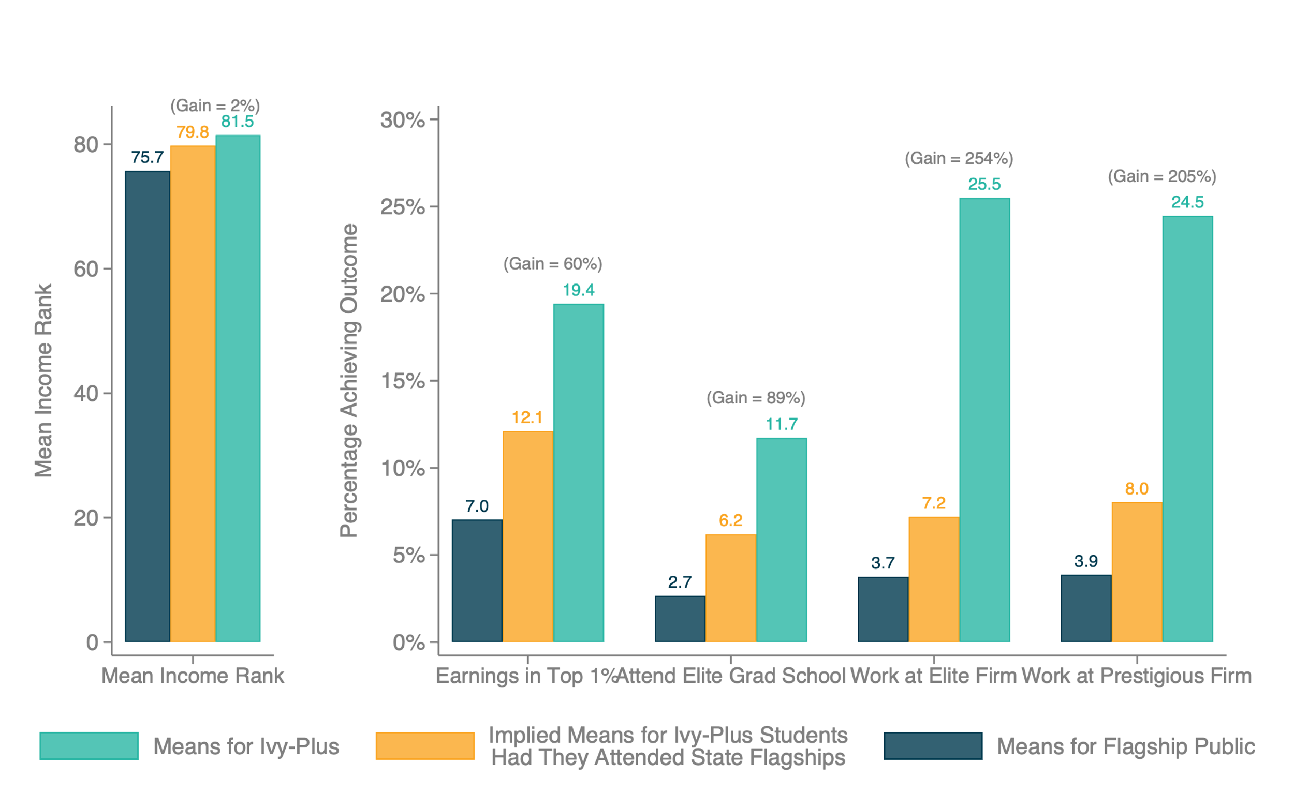
Summary of Magnitudes: Causal Effect of Attending Ivy-Plus vs. Average State Flagship
Causal
Effect
Selection

Slide 72
Research Design #2: Variation in Matriculation Conditional on Admission
Compare students who choose different colleges conditional on being admitted to the same set of colleges
  Relies on different identification assumption: idiosyncratic student preferences conditional on choice set [Mountjoy and Hickman 2022, Assumption 1]
Implement this design in our data for Ivy-plus and state flagship public colleges
Then reconcile our findings with previous papers that use this design [Dale and Krueger 2002, 2014, Mountjoy and Hickman 2022]

Slide 73
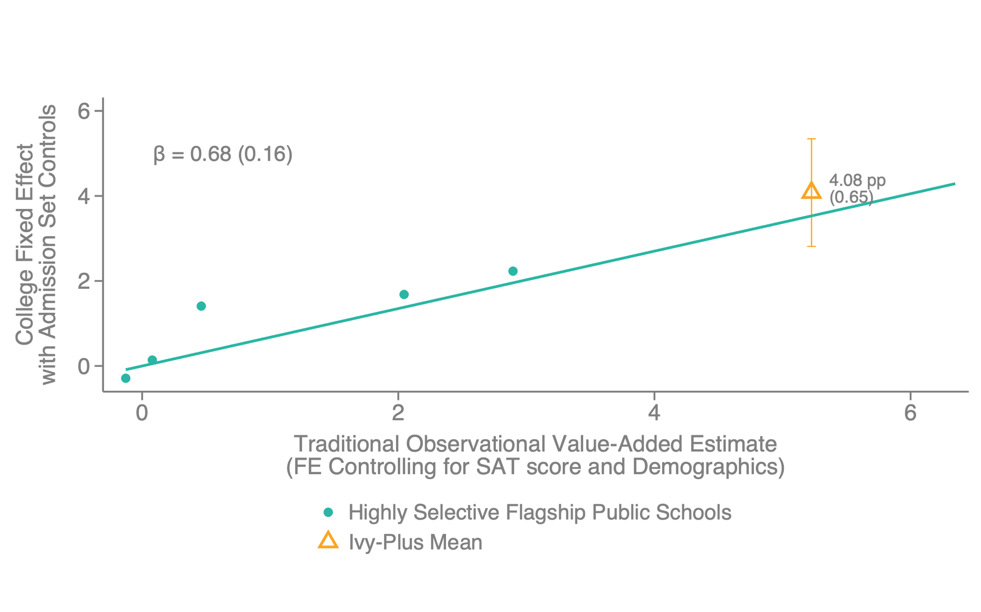
Causal Effects of Ivy-Plus Attendance: Matriculation Design
Flagship Public and Ivy-Plus Schools, Predicted Top 1%

Slide 74
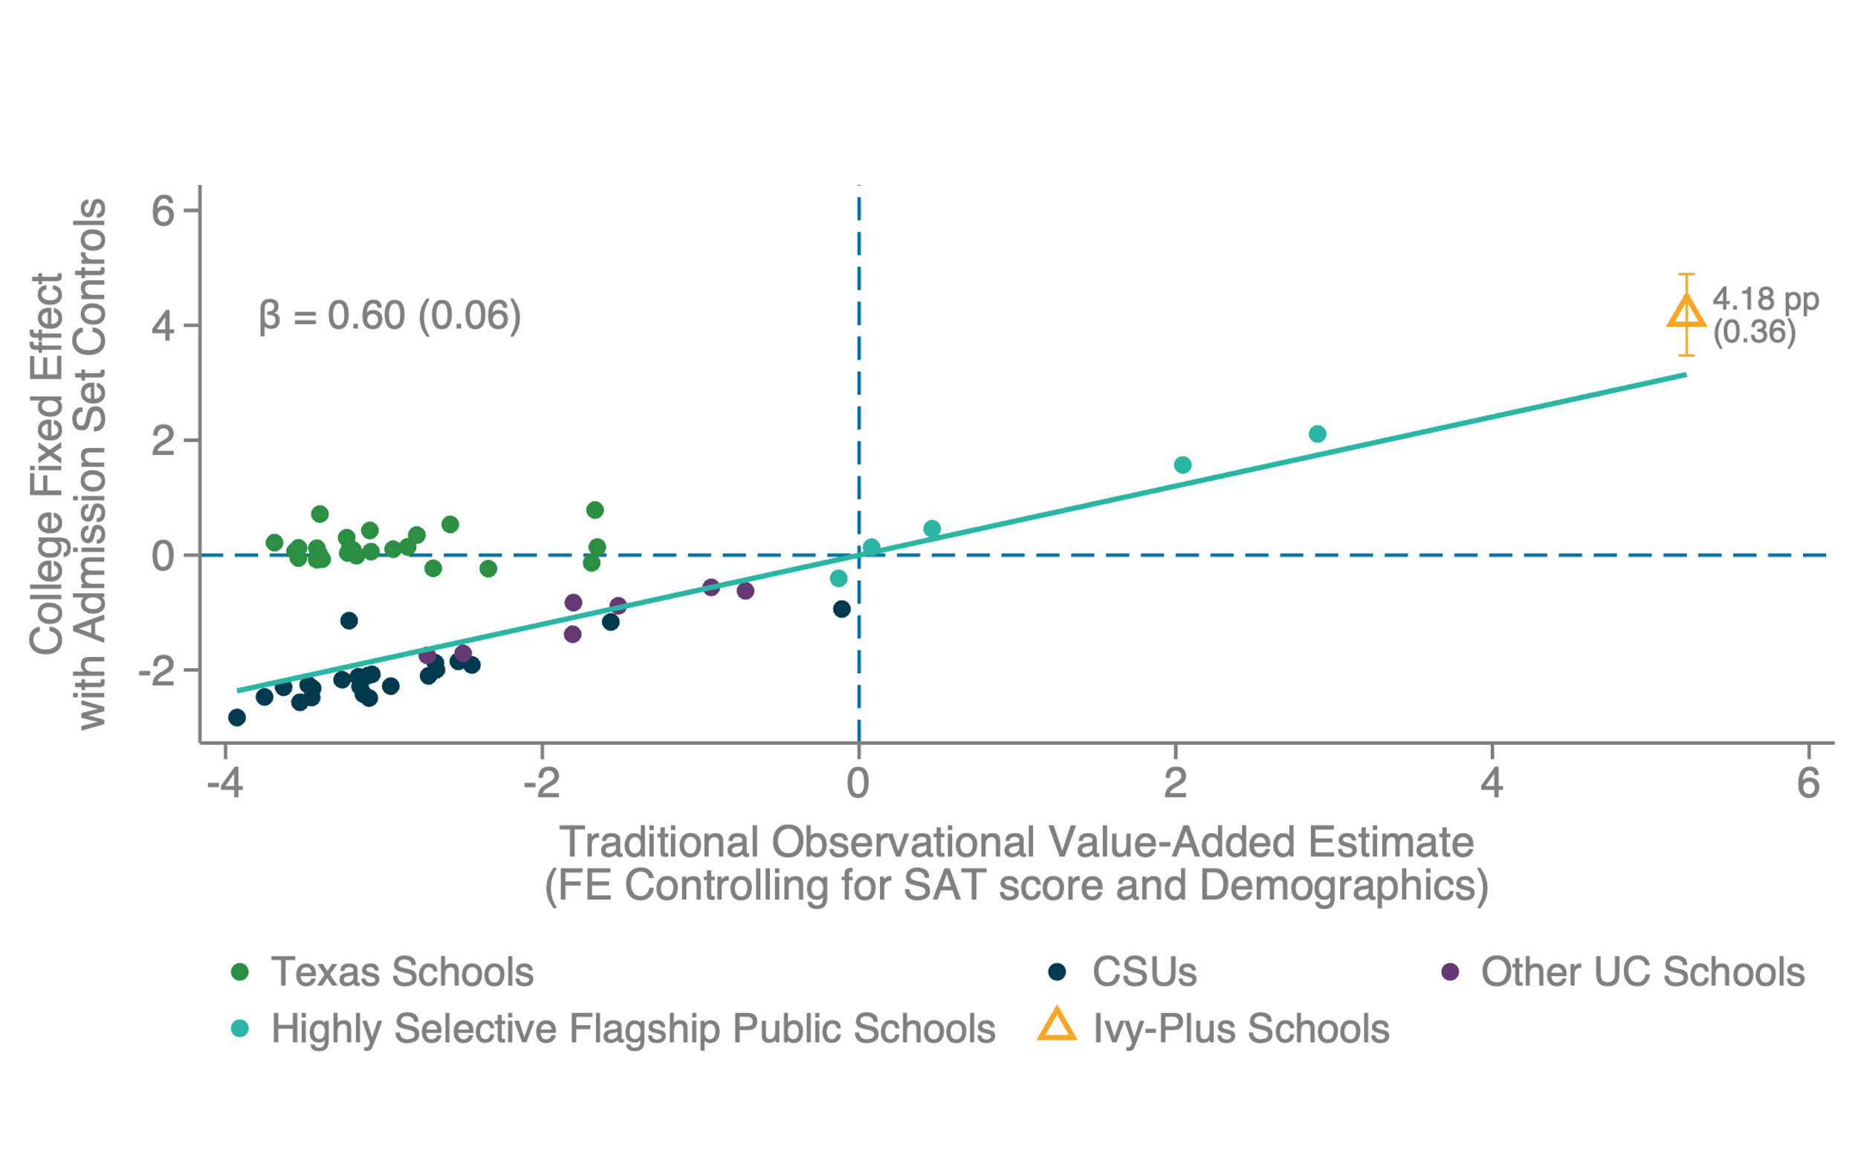
Causal Effects of Ivy-Plus Attendance: Matriculation Design
Texas, California, Elite Public, and Ivy-Plus Schools, Predicted Top 1%

Slide 75
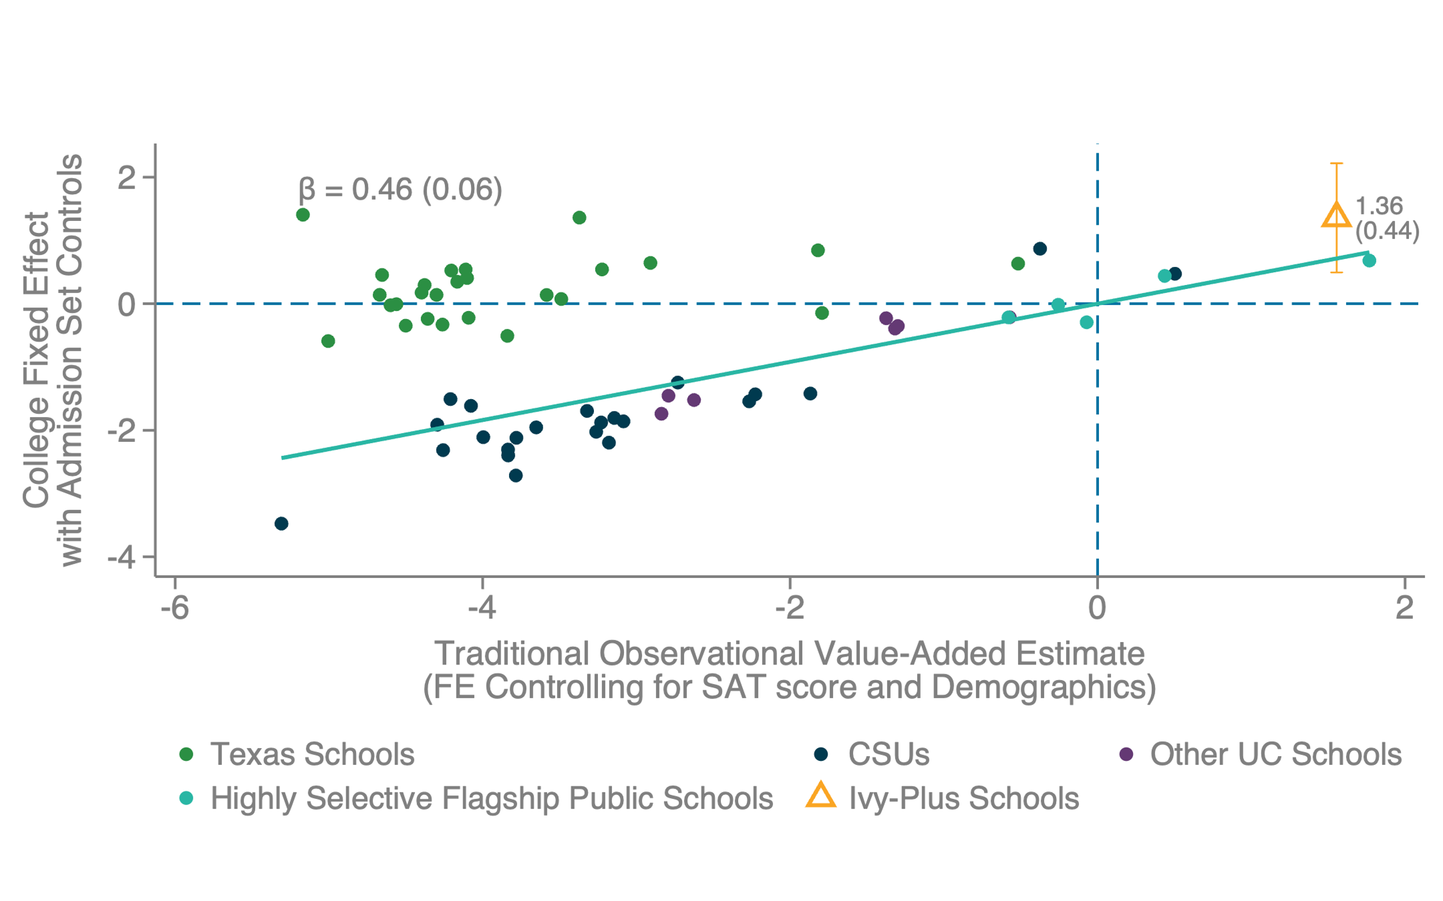
Causal Effects of Ivy-Plus Attendance: Matriculation Design
Texas, California, Elite Public, and Ivy-Plus Schools, Predicted Mean Income Rank

Slide 76
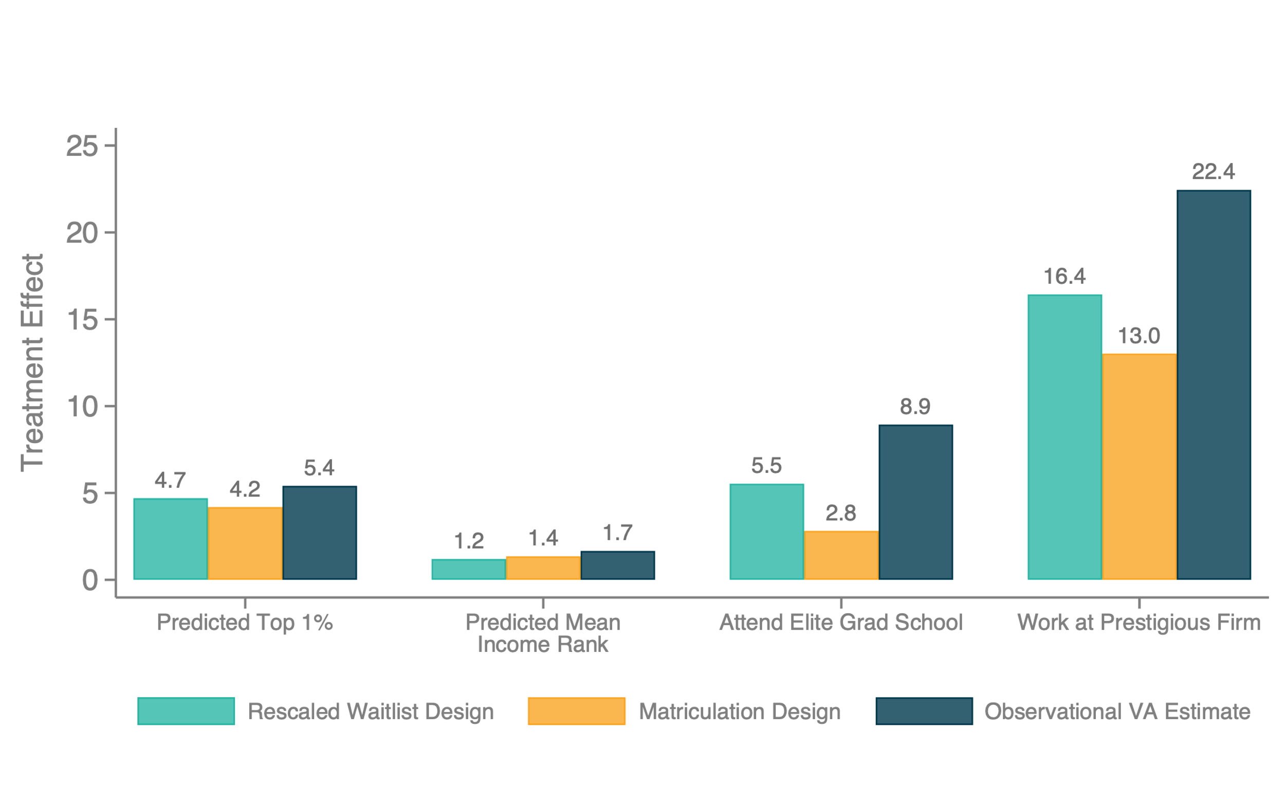
Treatment Effects of Ivy-Plus College Attendance
Comparing All Methods

Slide 77
Reconciliation with Dale and Krueger
Why do our conclusions differ from Dale and Krueger (2002, 2014) who find that attending a more selective college has small/zero impact on earnings?
  We find a large effect of Ivy-Plus attendance solely on top-tail outcomes; Dale and Krueger focus on mean impacts on log earnings
  Dale and Krueger proxy for college quality using average SAT scores; we directly estimate colleges’ effects on outcomes
    Earnings outcomes are not highly correlated with mean SAT scores within subset of highly selective colleges [Chetty et al. 2020]

Slide 78
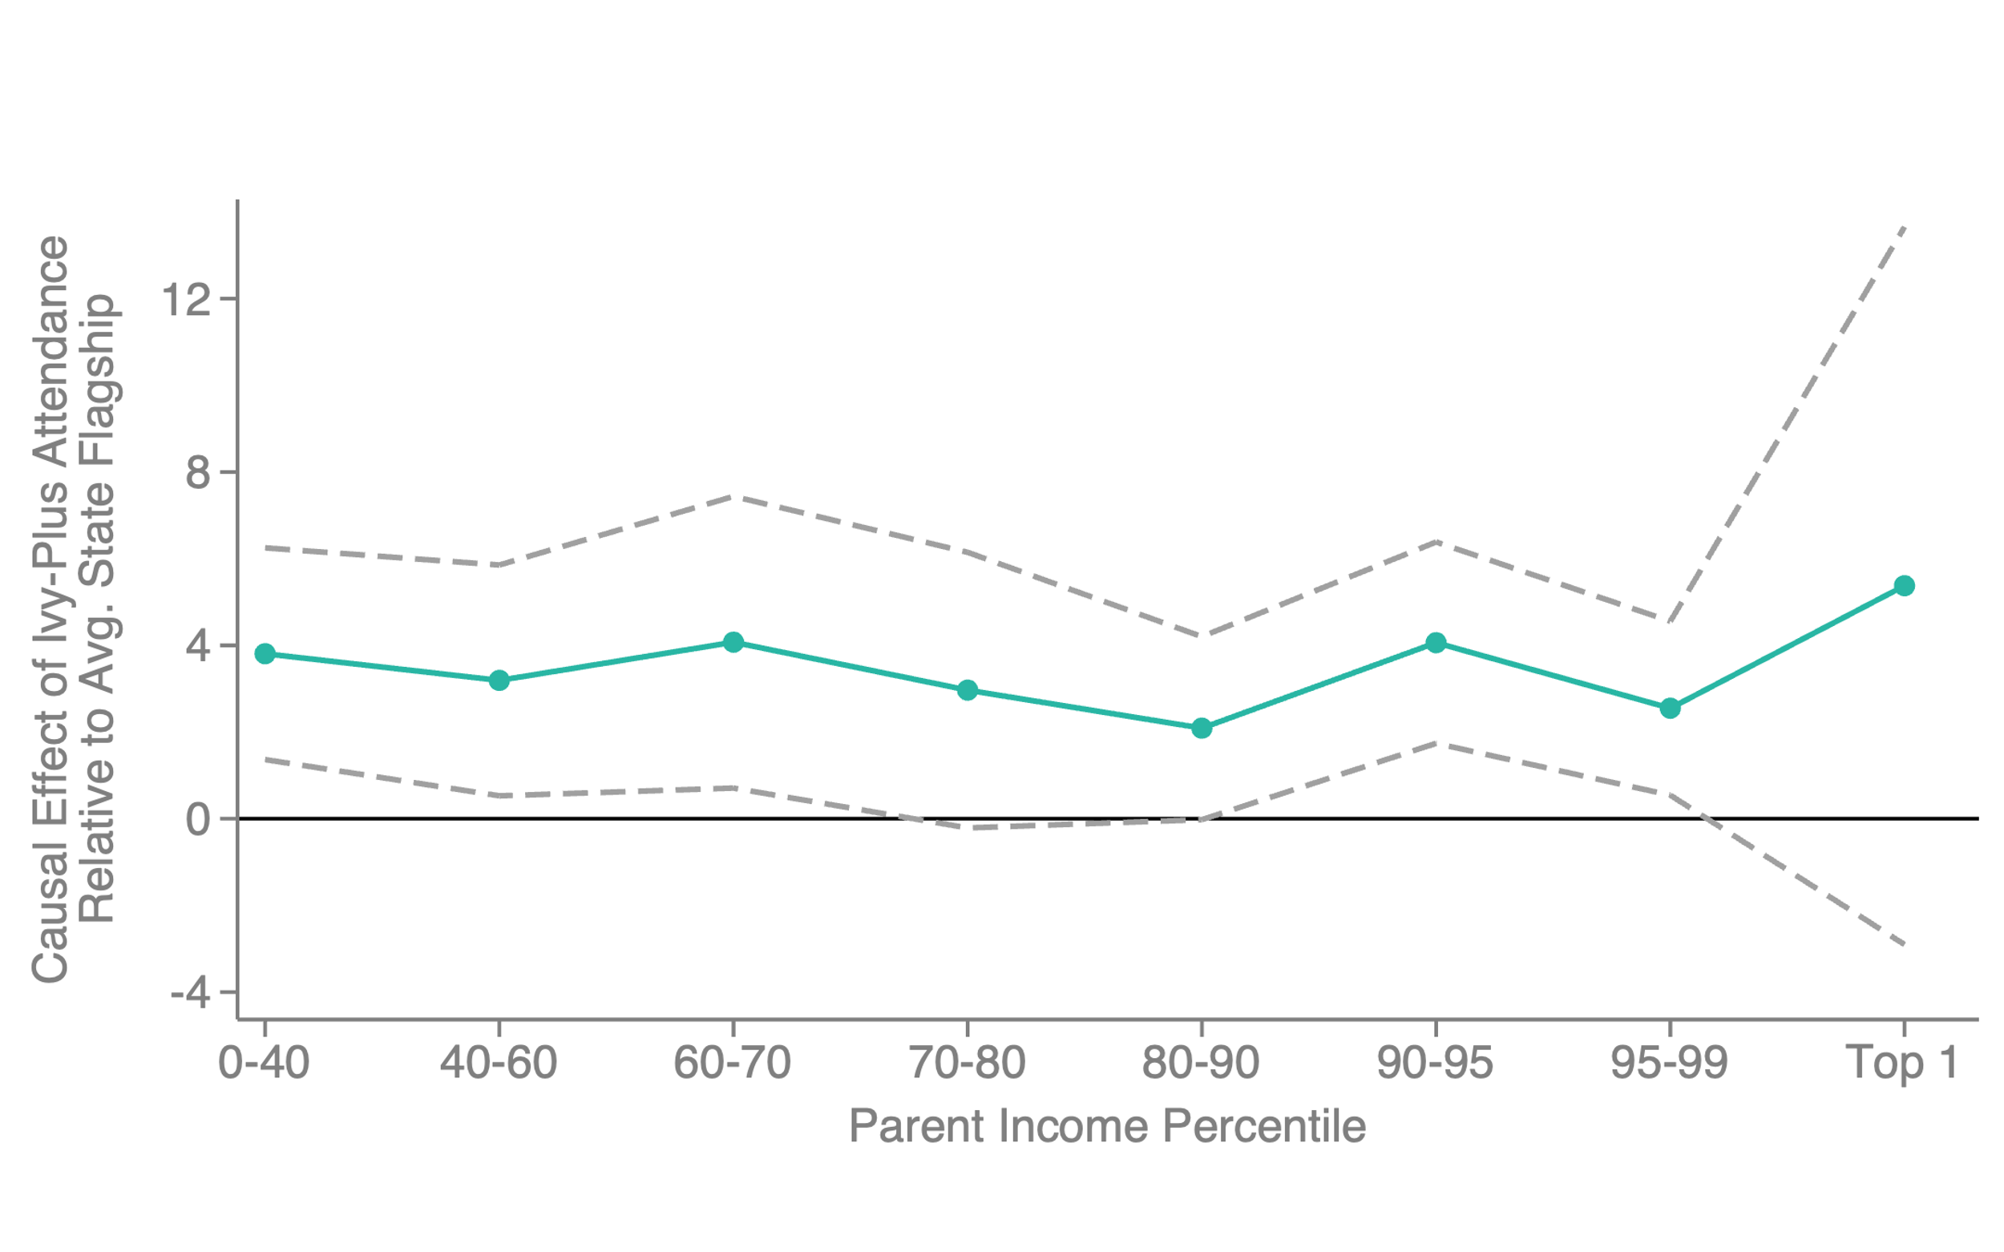
Causal Effects of Ivy-Plus Attendance: Matriculation Design
Heterogeneity by Parent Income

Slide 79
Outcome-Based Tests of
Admissions Preferences

Slide 80
Outcome-Based Tests of Admissions Preferences
Are the factors that lead to high-income admissions advantage (legacy, athlete status, high non-acad ratings) associated with better post-college outcomes?
  More broadly, is there a tradeoff between admitting more students from middle class families and class “quality”?
Helpful for evaluating whether admissions preferences that favor students from high-income families are “merited” from an outcome-based perspective
And critical for understanding whether diversifying student body would translate to greater diversity among society’s leaders
In this section, answer this question by examining how outcomes vary with admissions preferences

Slide 81
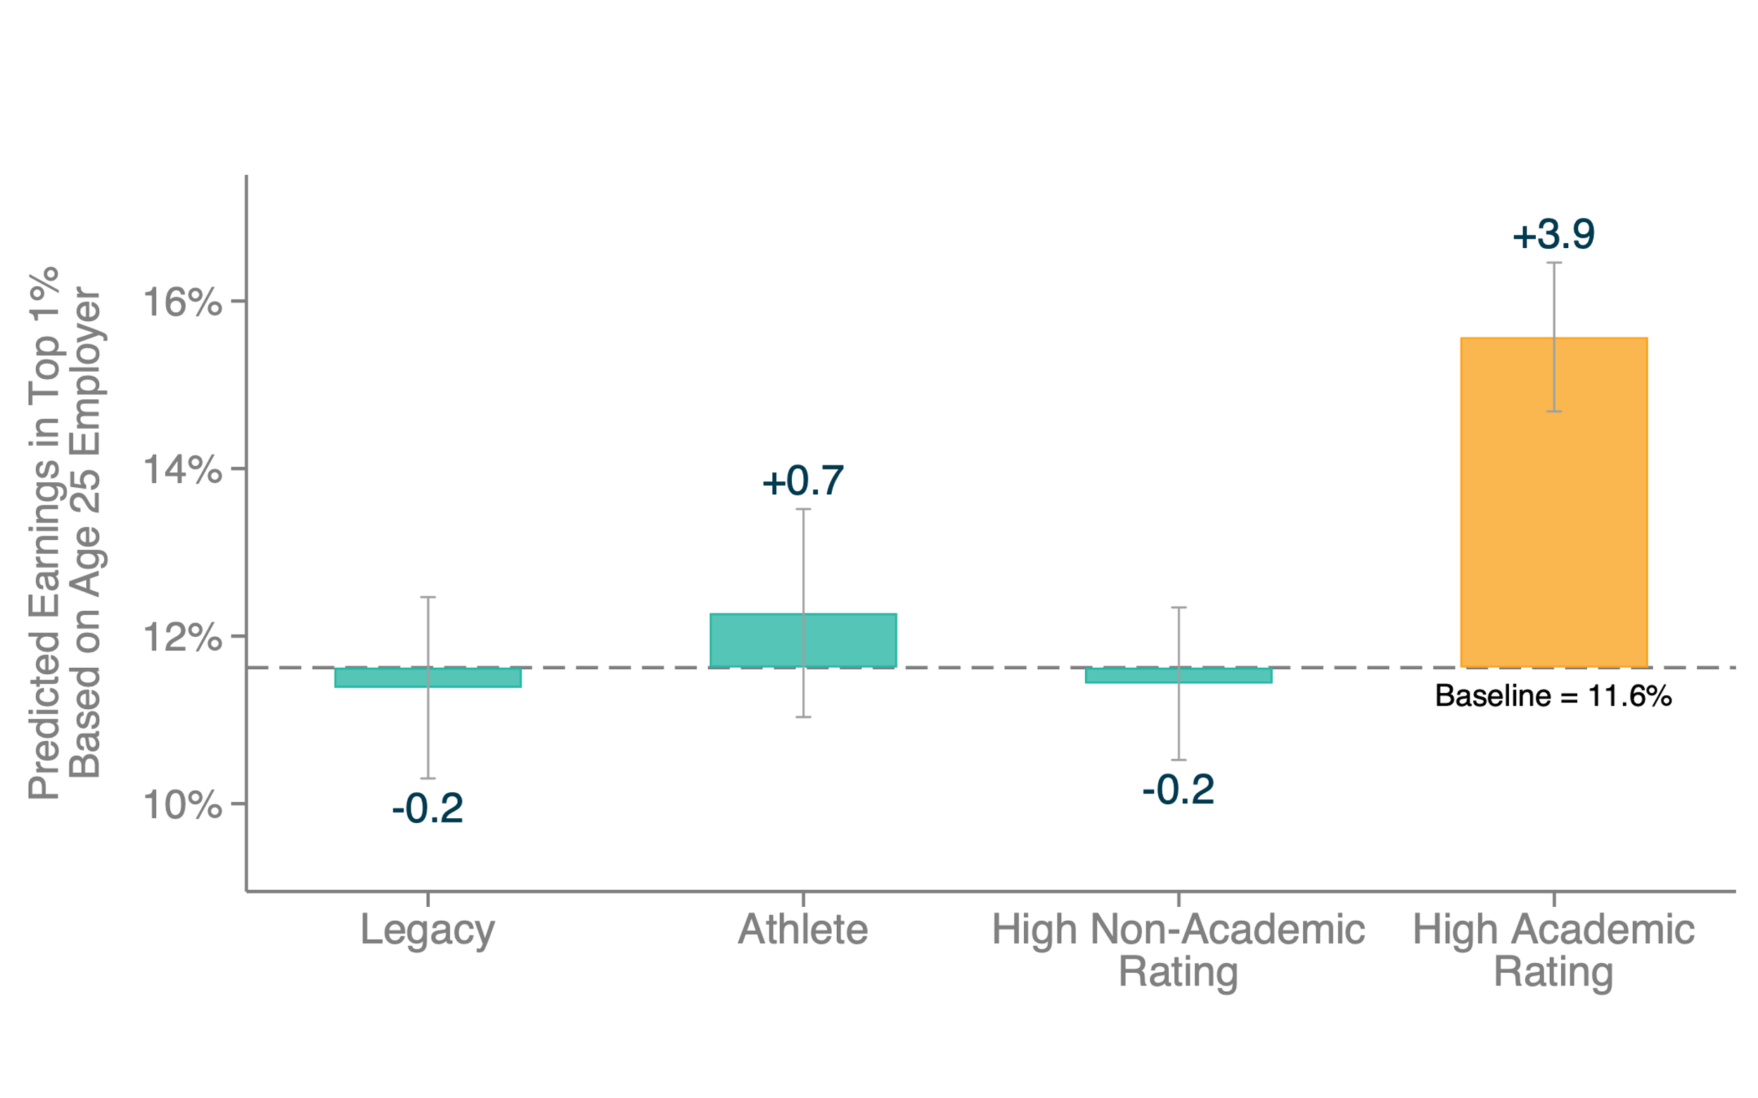
Post-College Outcomes by Application Credentials Among Ivy-Plus Matriculants
Predicted Top 1%

Slide 82
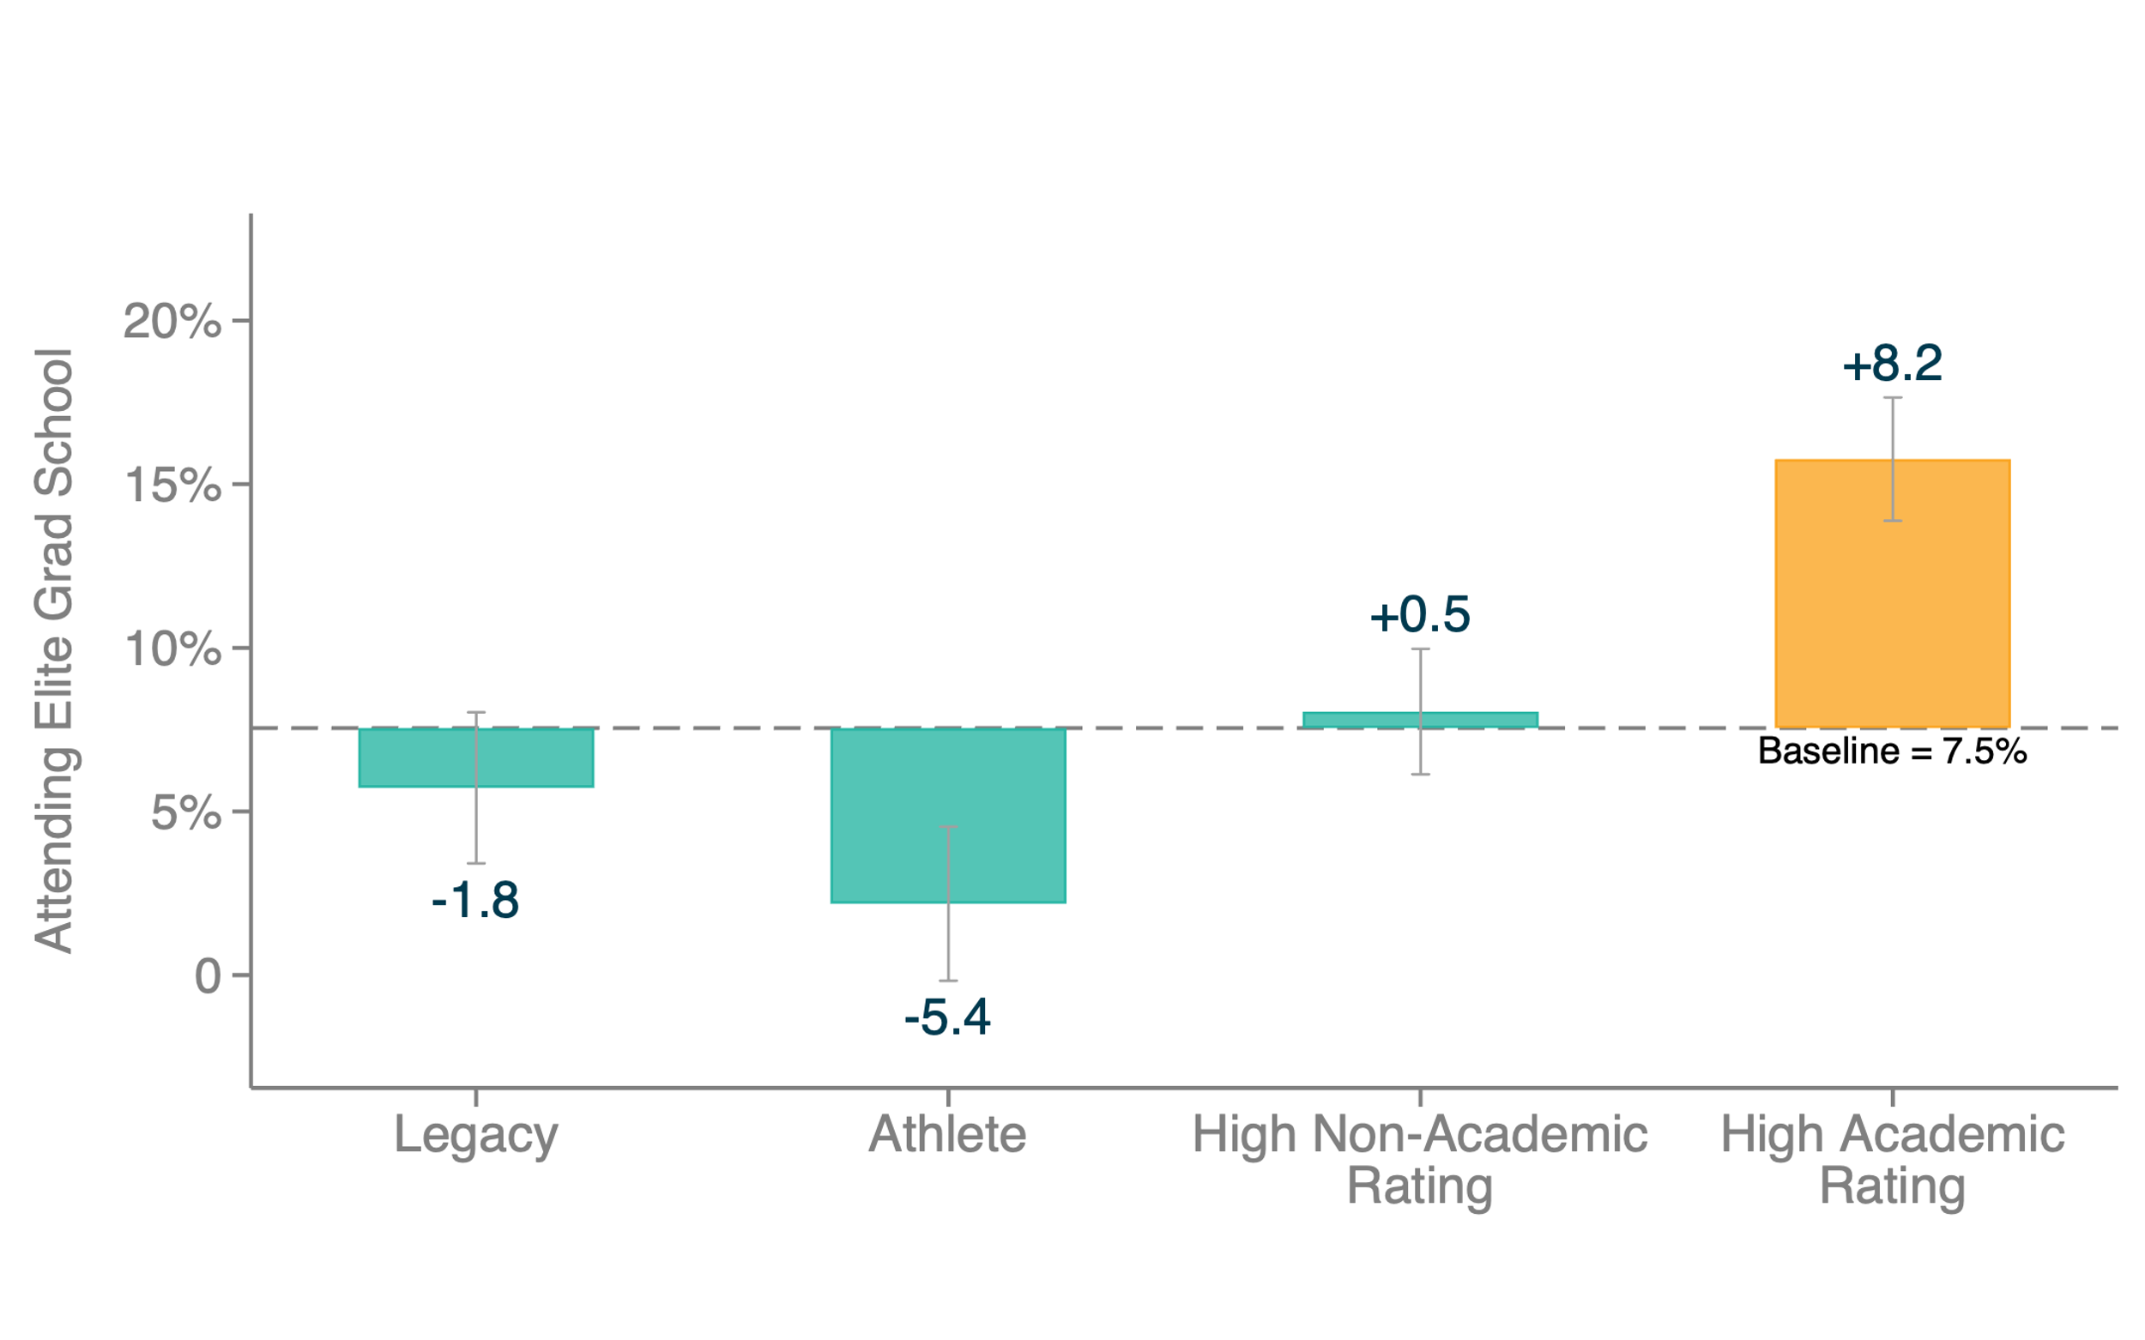
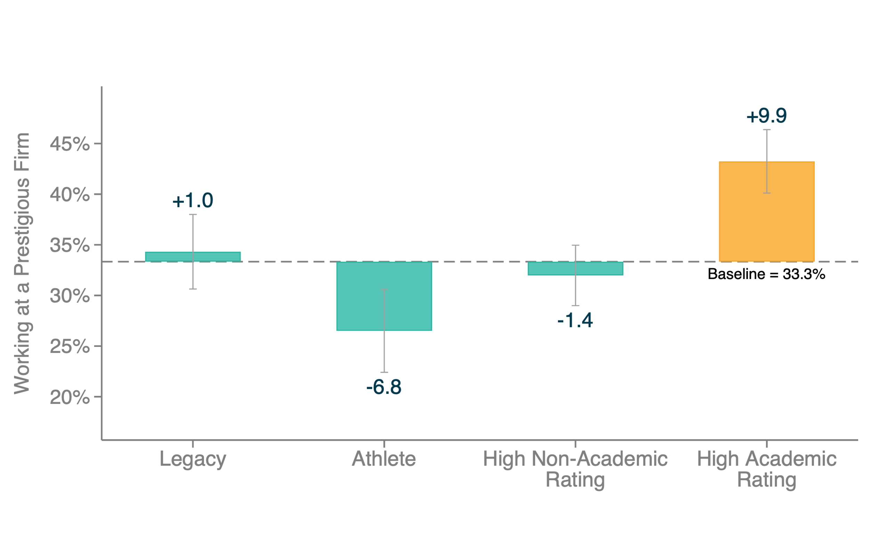
Post-College Outcomes by Application Credentials Among Ivy-Plus Matriculants
Non-Monetary Outcomes
Attending Elite Graduate School
Working at Prestigious Firm

Slide 83
Impact of Admissions Changes on Students’ Post-College Outcomes
Adjust for selection when conditioning on matriculants by returning to applicant sample and using our causal effect estimates
Identify potential outcomes of marginal rejected students (from waitlist) had they attended an Ivy-plus college by adding in our VA estimates

Slide 84
Post-College Outcomes Among Ivy-Plus Applicants
Predicted Top 1% by Non-Academic Rating
12
11.0
11
10.4
Predicted Probability of Earning in Top 1%
at 33 Based on Employer at Age 25
10
9
8
Admits and Waitlisted Students
Low Non-Academic Rating
High Non-Academic Rating

Slide 85
Post-College Outcomes Among Ivy-Plus Applicants
Predicted Top 1% by Non-Academic Rating
12
11.0
11.2
11
10.4
10.4
Predicted Probability of Earning in Top 1%
at 33 Based on Employer at Age 25
10
9
8
Admits and Waitlisted Students
Value-Added of College Attended
Low Non-Academic Rating
High Non-Academic Rating

Slide 86
Post-College Outcomes Among Ivy-Plus Applicants
Predicted Top 1% by Non-Academic Rating
12
11.0
11.2
11
10.2
10.4
10.4
10.4
Predicted Probability of Earning in Top 1%
at 33 Based on Employer at Age 25
10
9
8
Admits and Waitlisted Students
Value-Added of College Attended
Controlling for VA of College Attended
Low Non-Academic Rating
High Non-Academic Rating

Slide 87
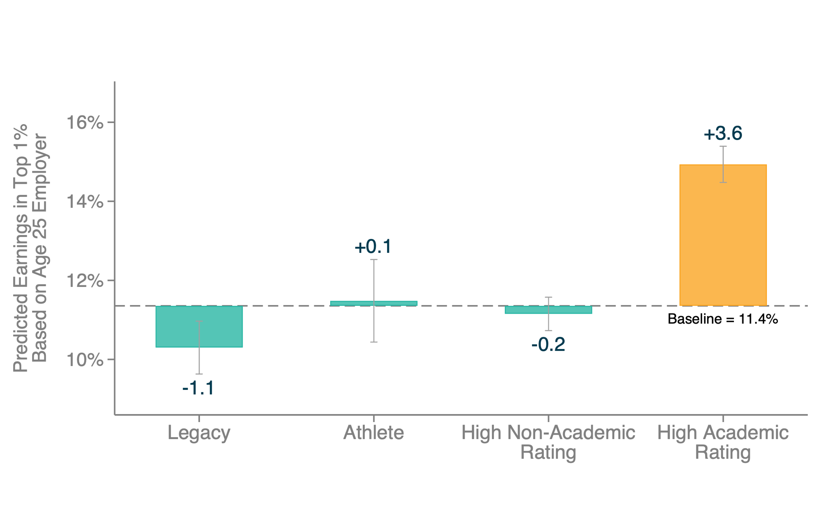
Post-College Outcomes by Application Credentials Among Ivy-Plus Applicants
Predicted Top 1%

Slide 88
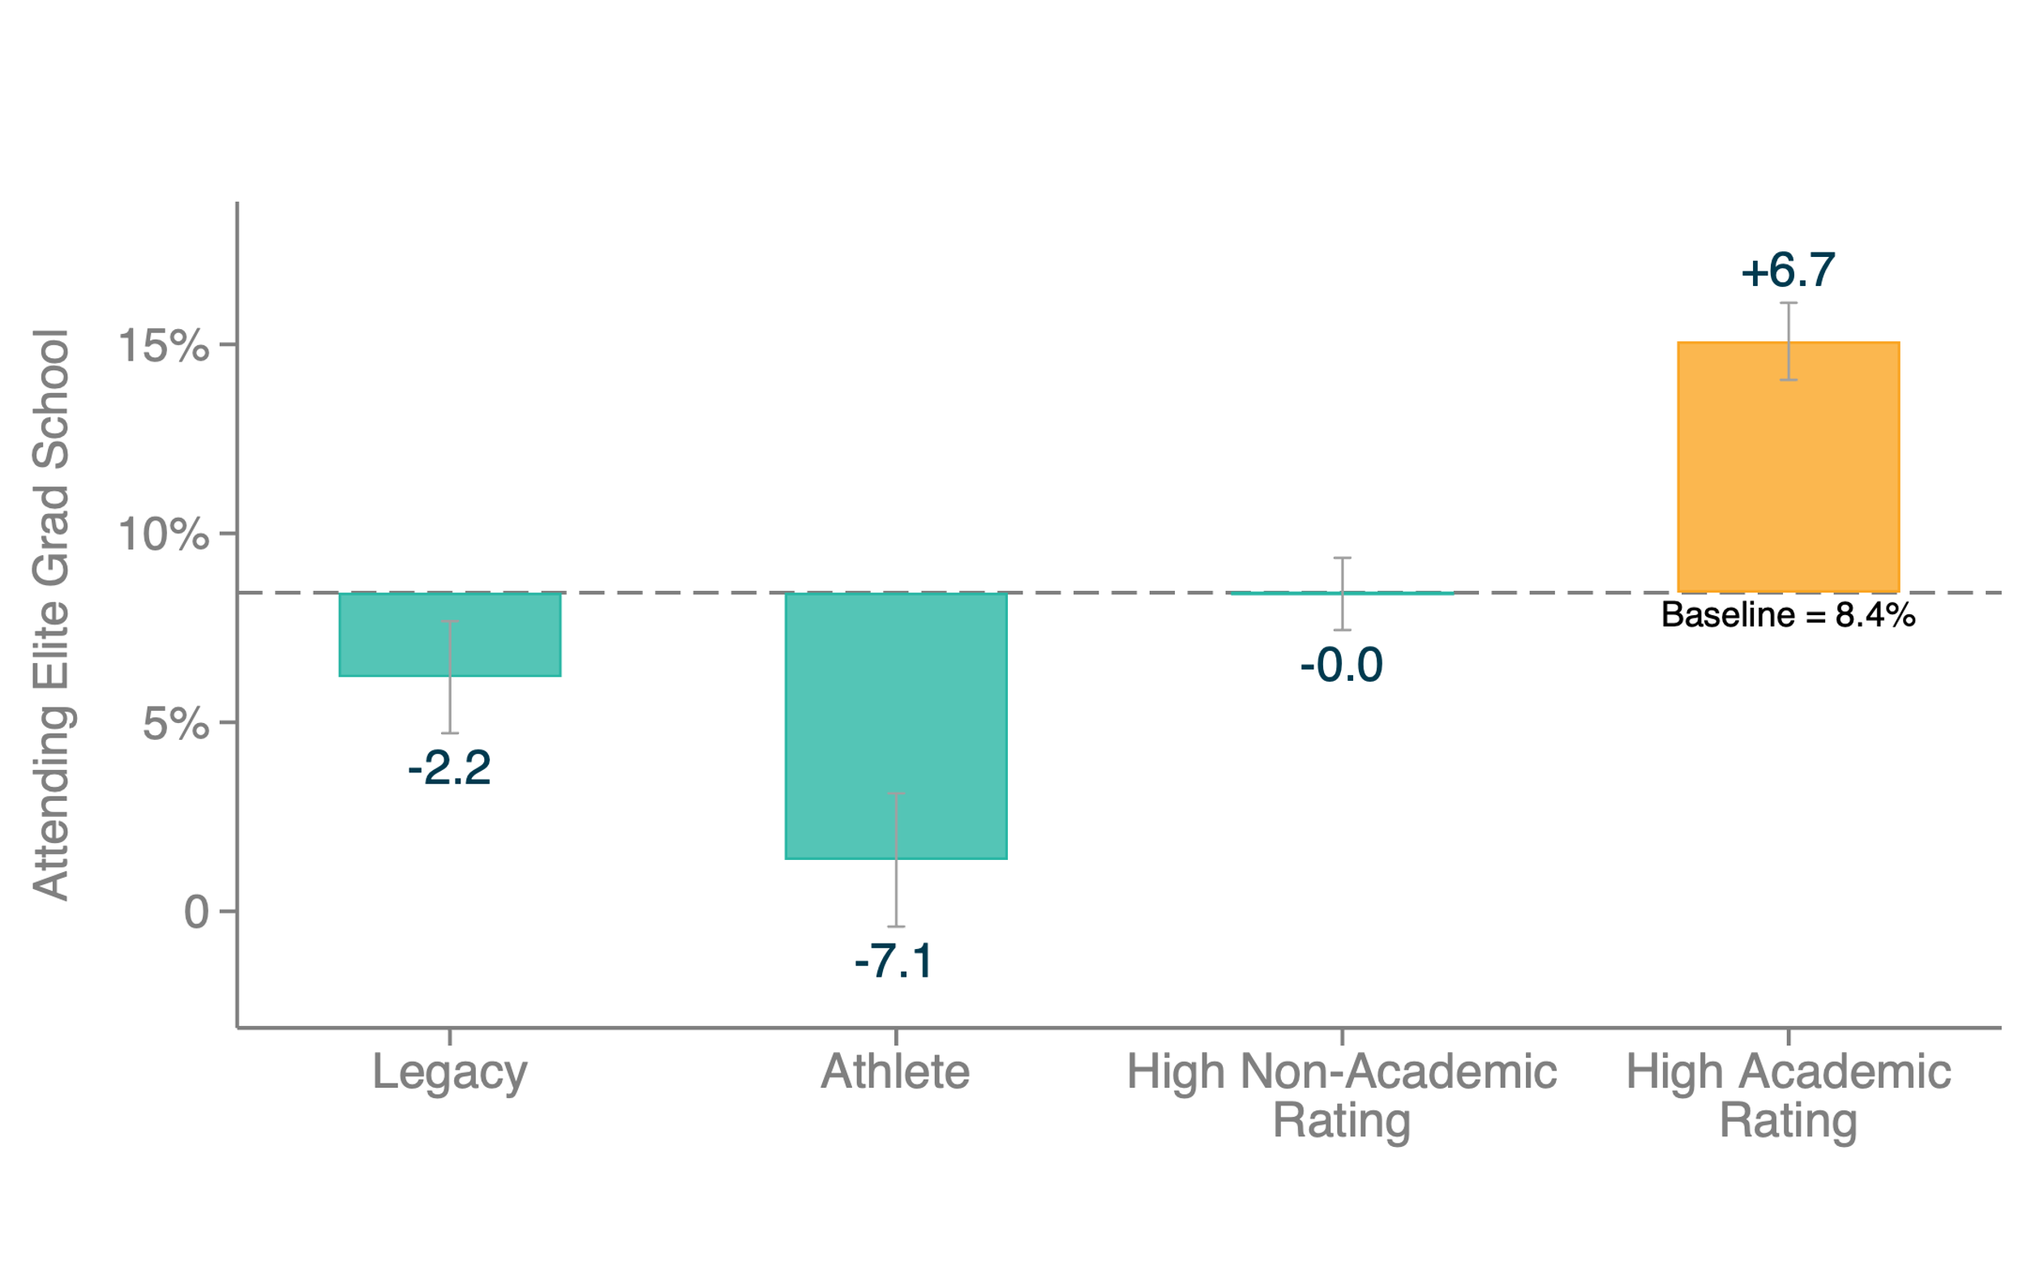
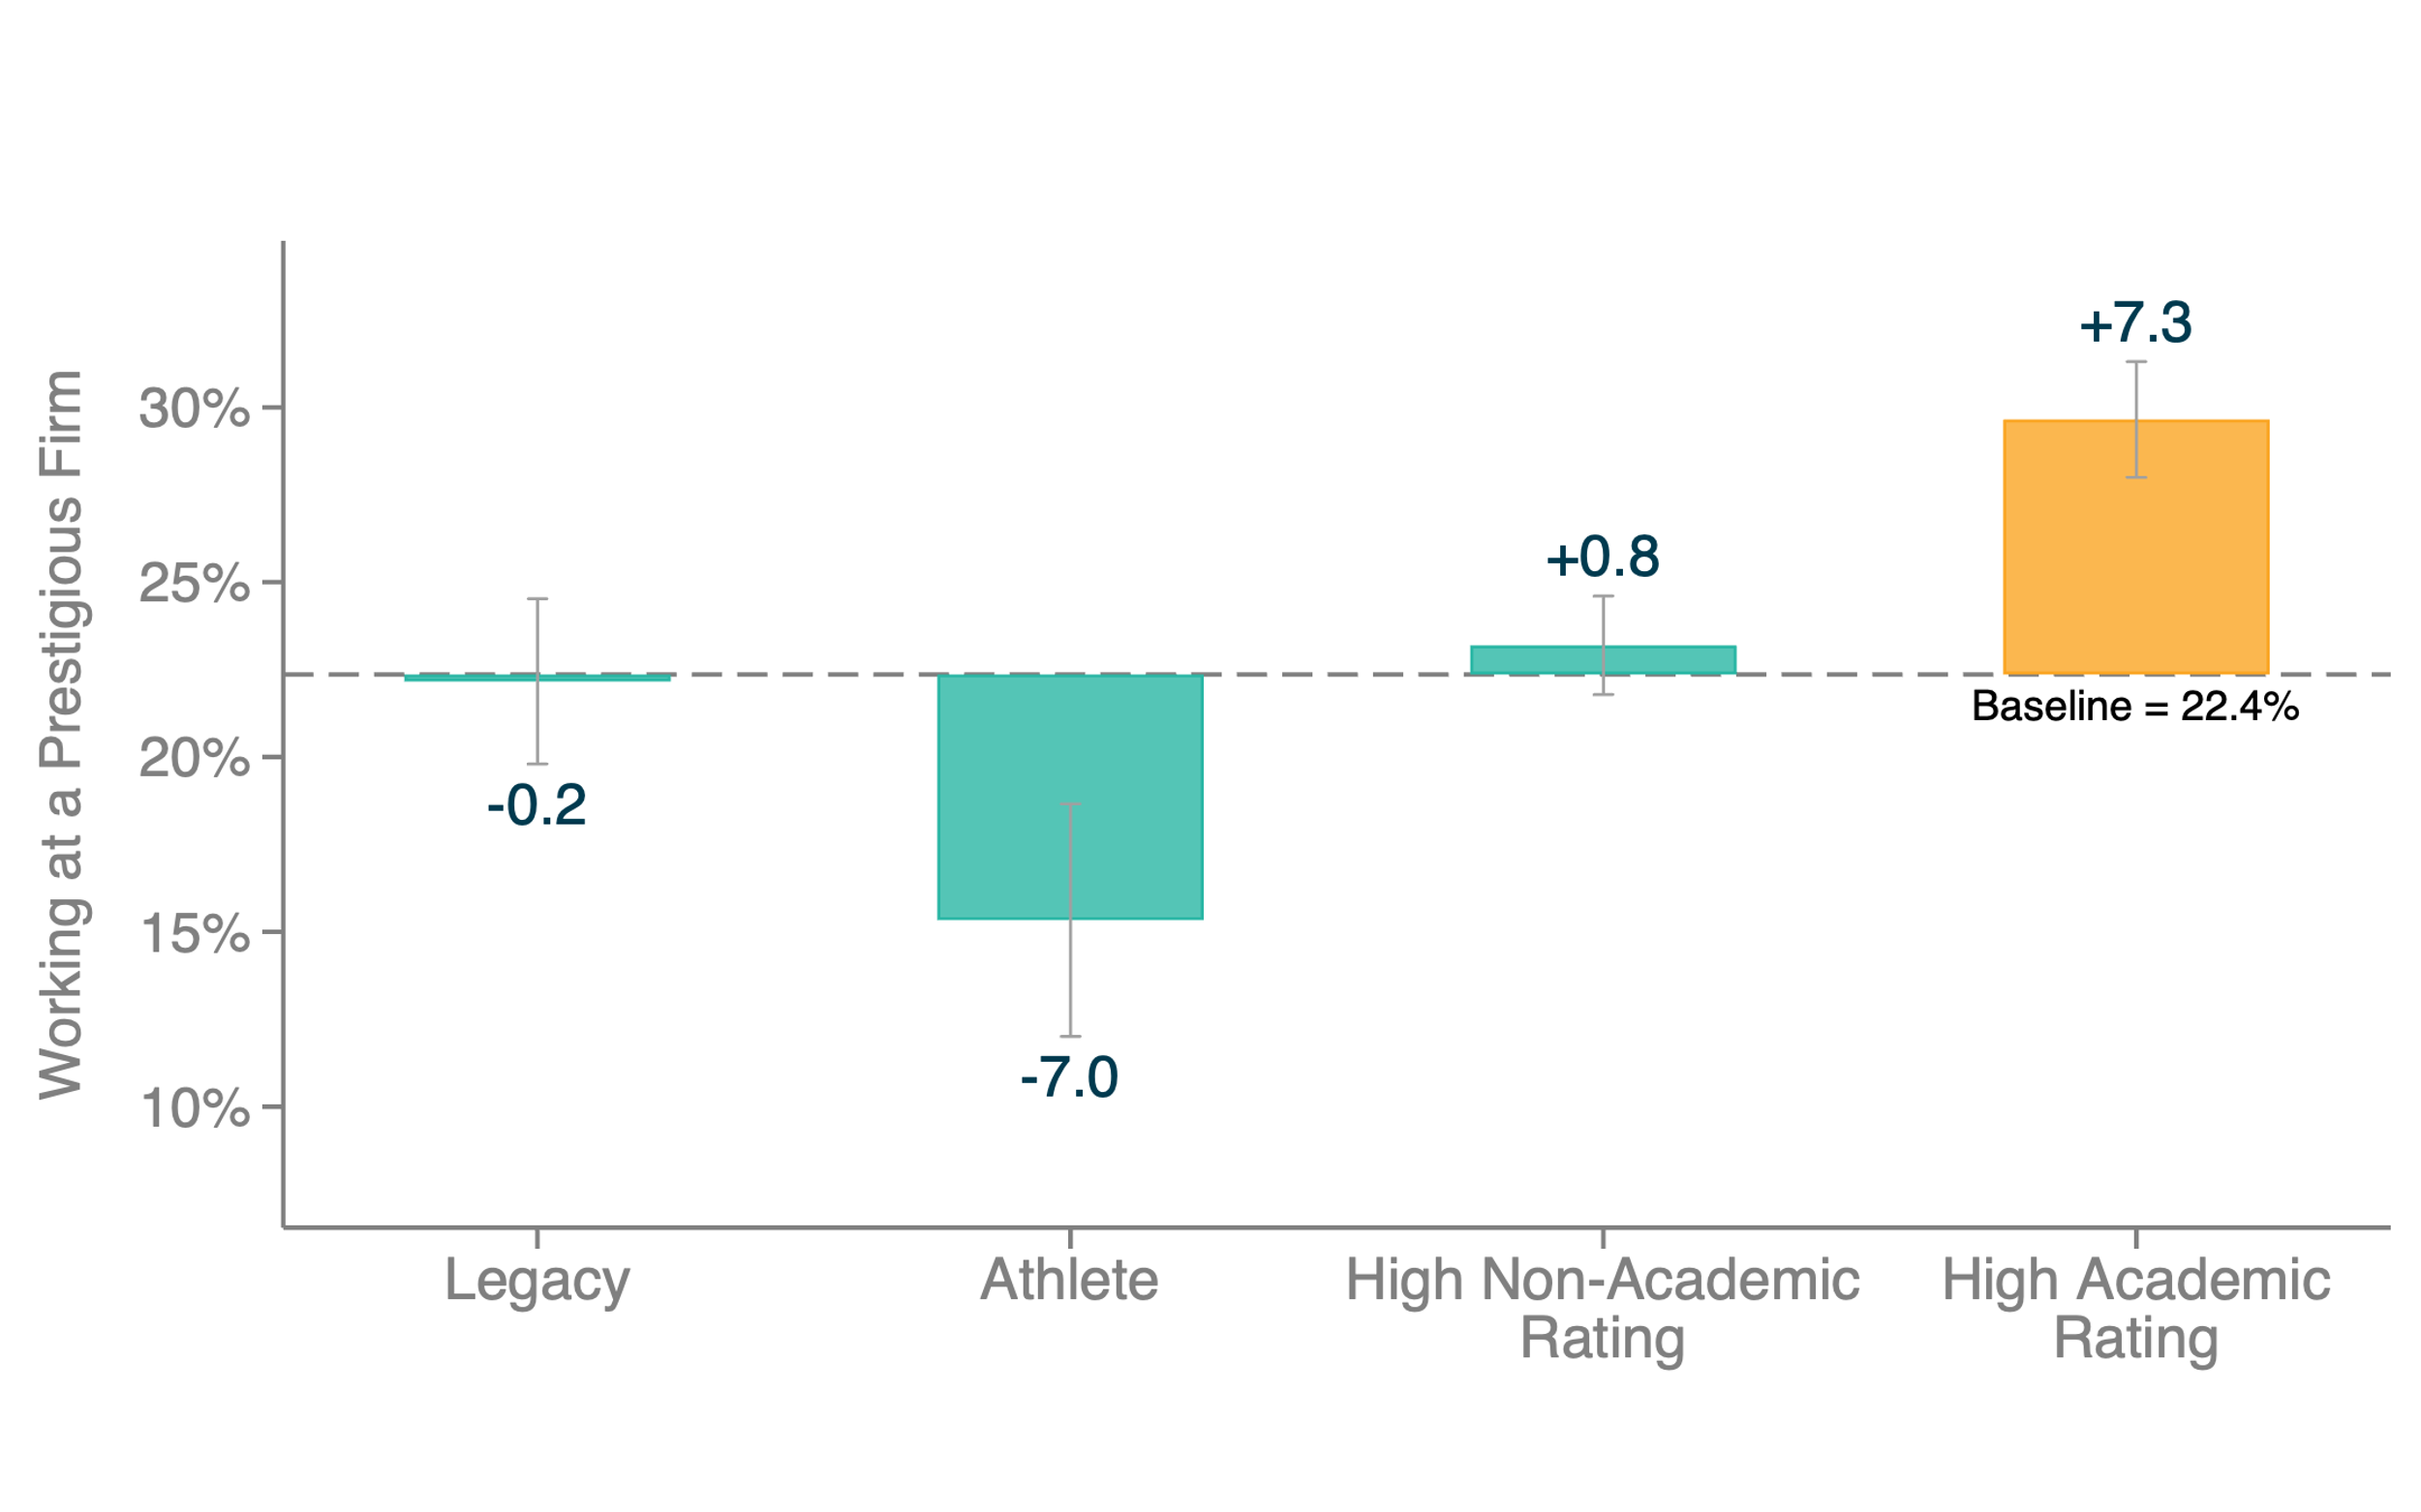
Post-College Outcomes by Application Credentials Among Ivy-Plus Applicants
Non-Monetary Outcomes
Attending Elite Graduate School
Working at Prestigious Firm

Slide 89
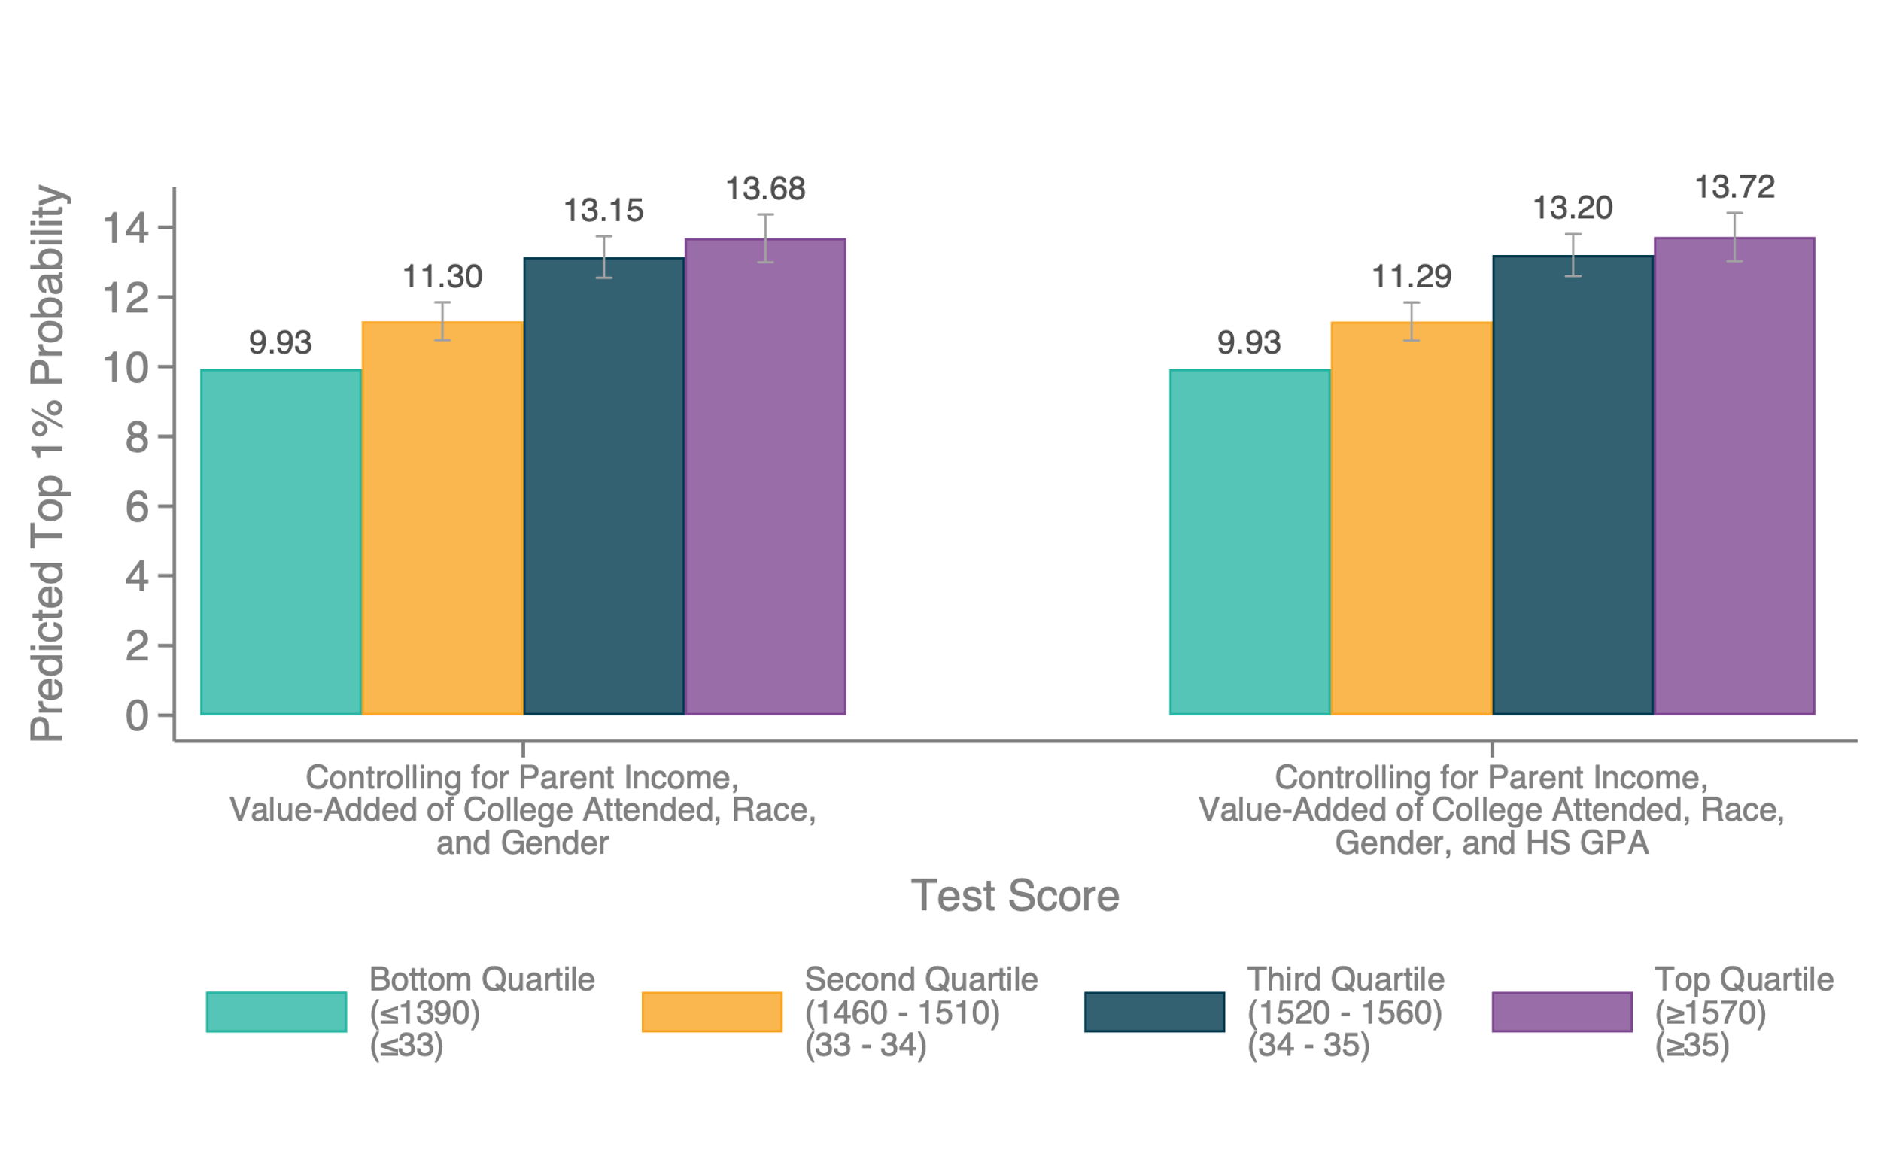
Fraction who Reach Top 1% by SAT Score, Controlling for Parent Income and College

Slide 90
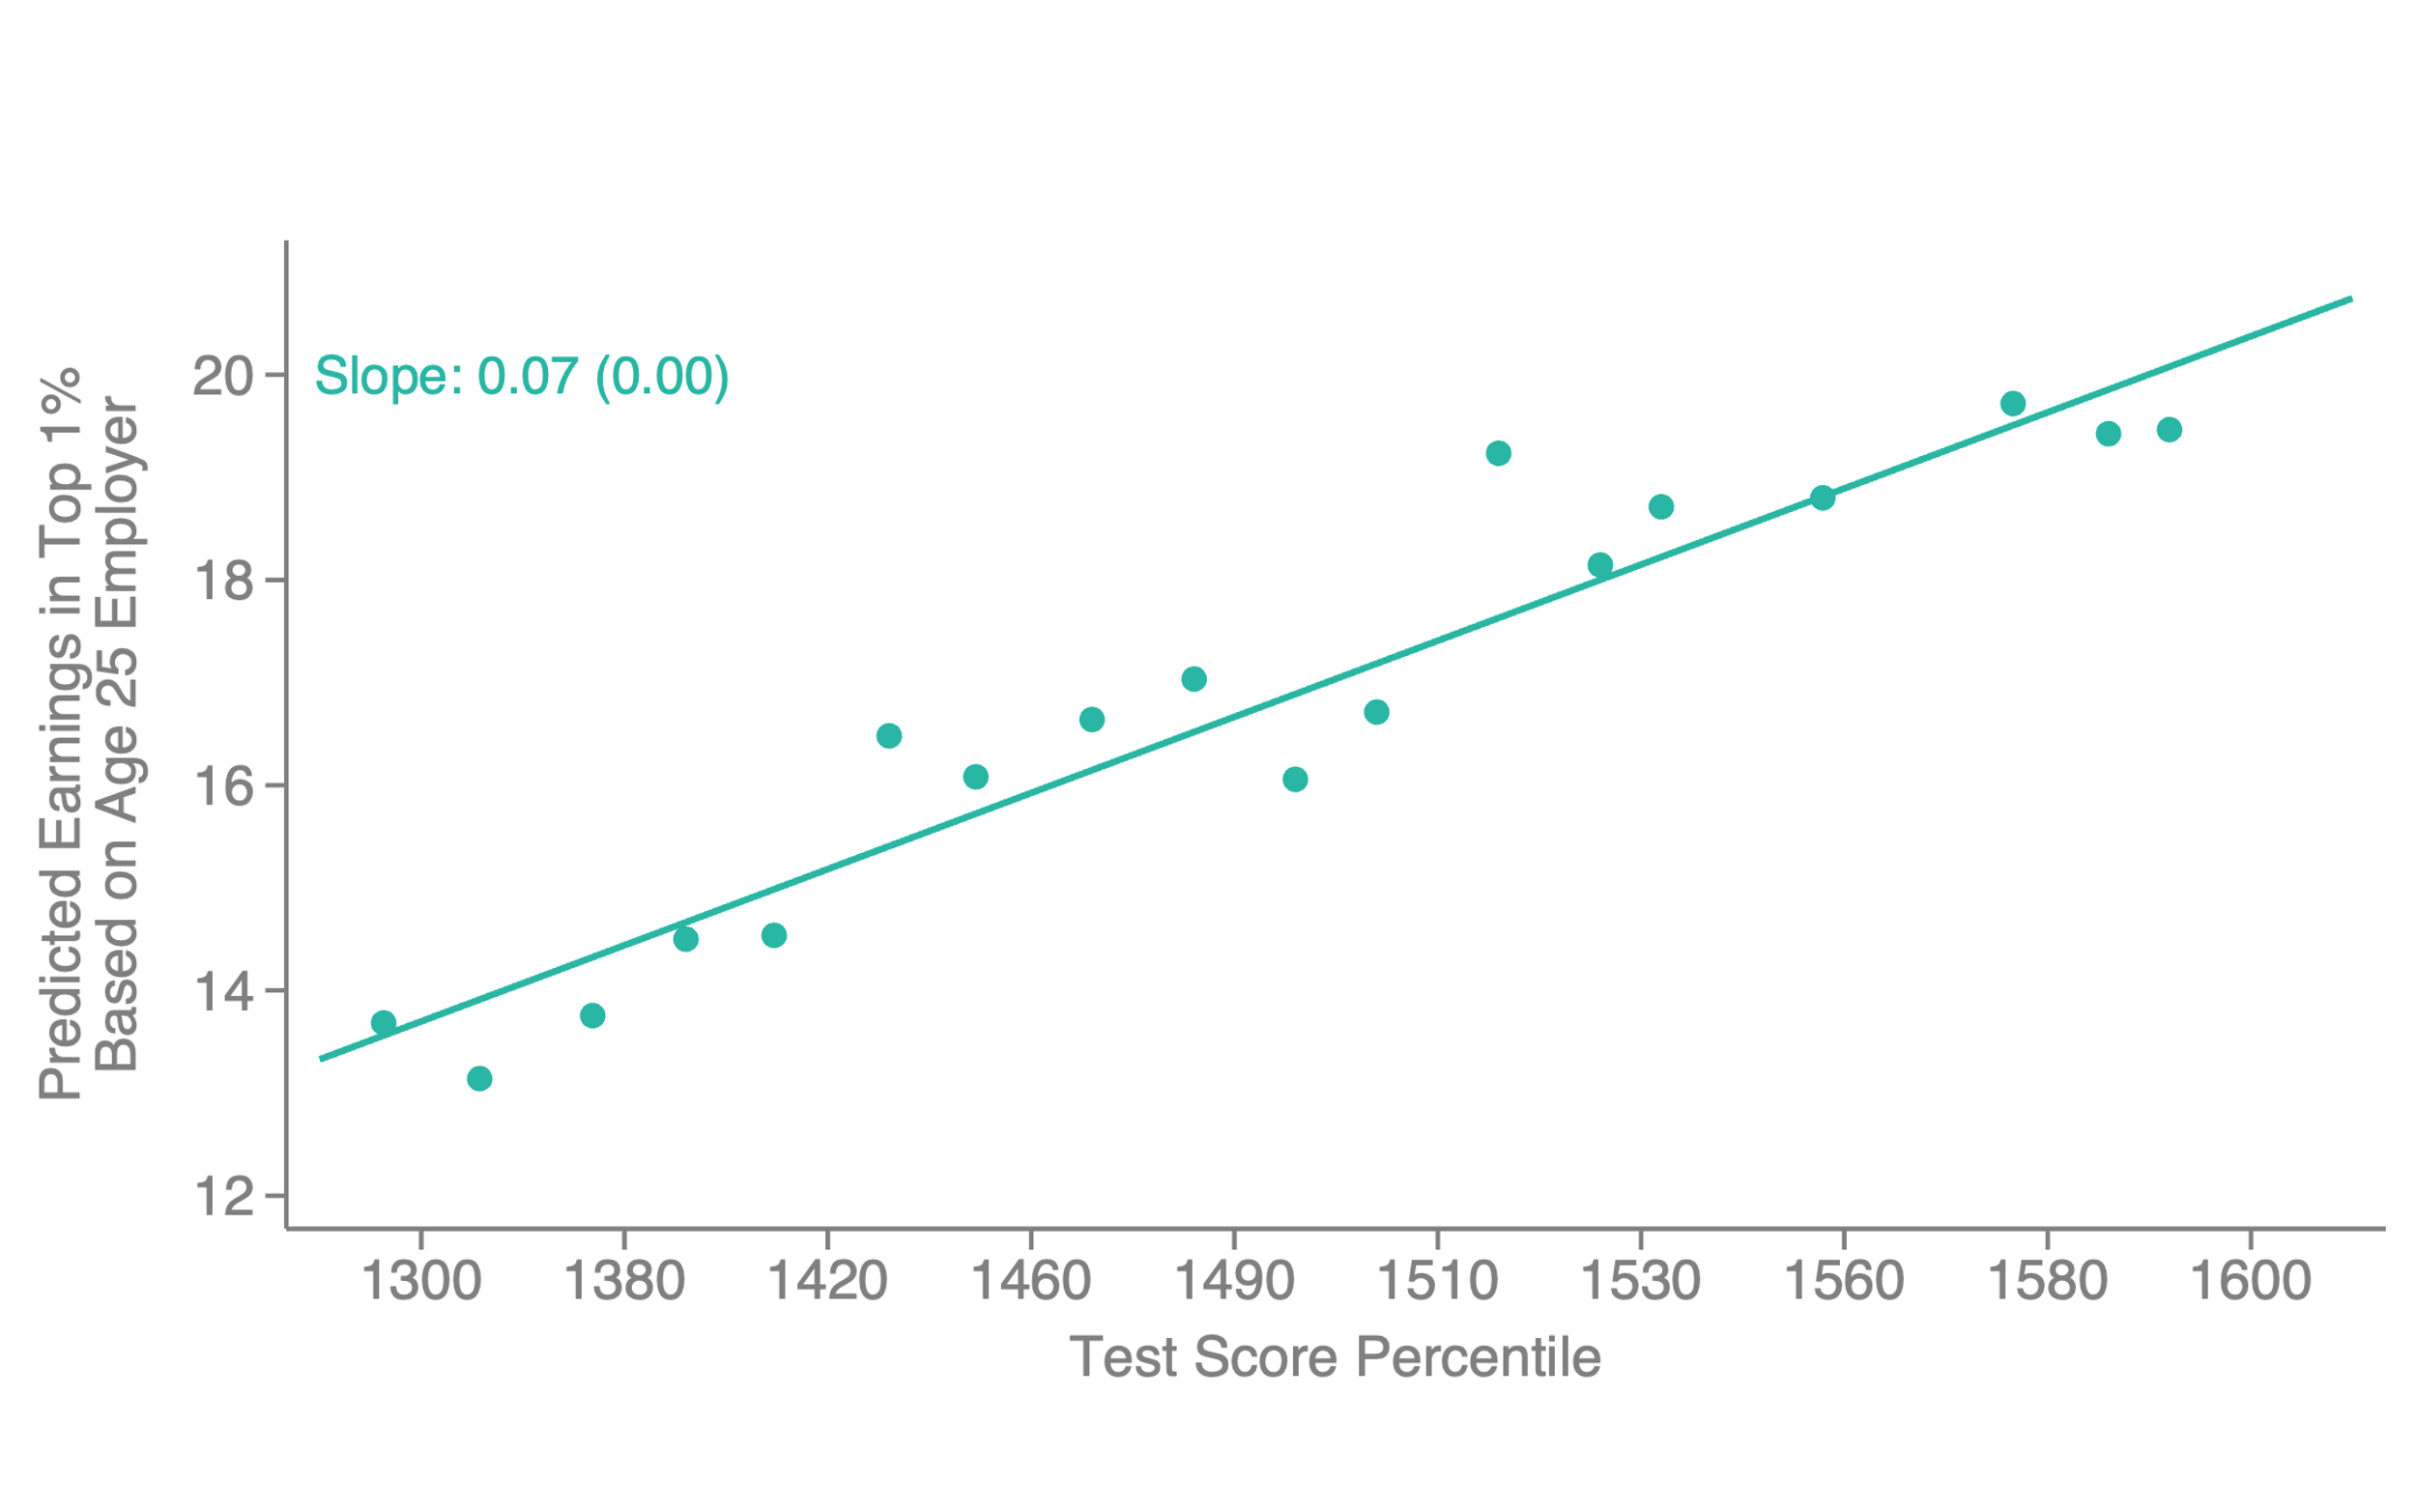
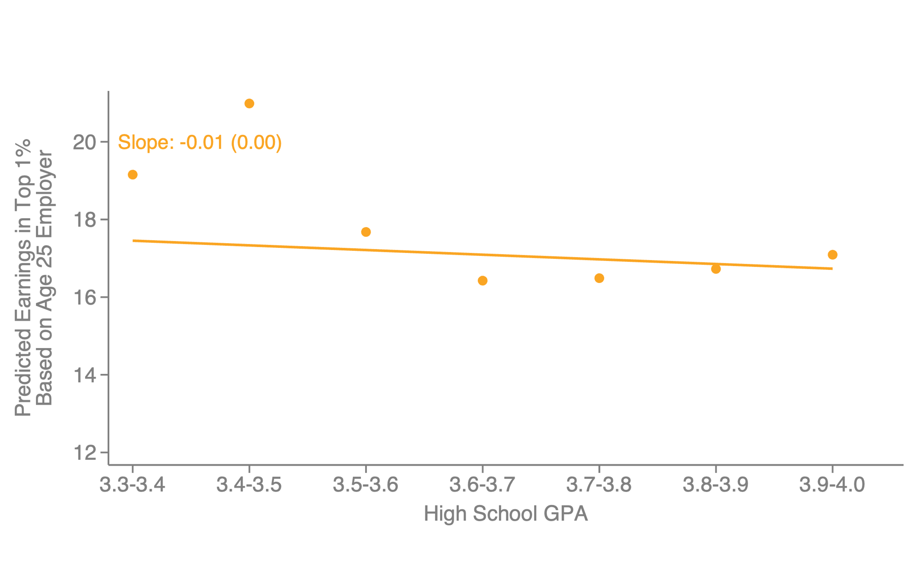
Fraction who Reach Top 1% by SAT/ACT Score vs. High School GPA
Ivy-Plus Students
Test Scores
High School GPA
Note: figures are binned scatter plots controlling for parent income, race, gender, legacy status, recruited athlete status, and HS GPA (left panel) or SAT score (right panel).

Slide 91
Differences in Outcomes by Parental Income
How do these findings fit with prior evidence that children from high-income families have significantly higher levels of earnings among Ivy-plus attendees?
[Chetty et al. 2020, Zimmerman 2022]

Slide 92
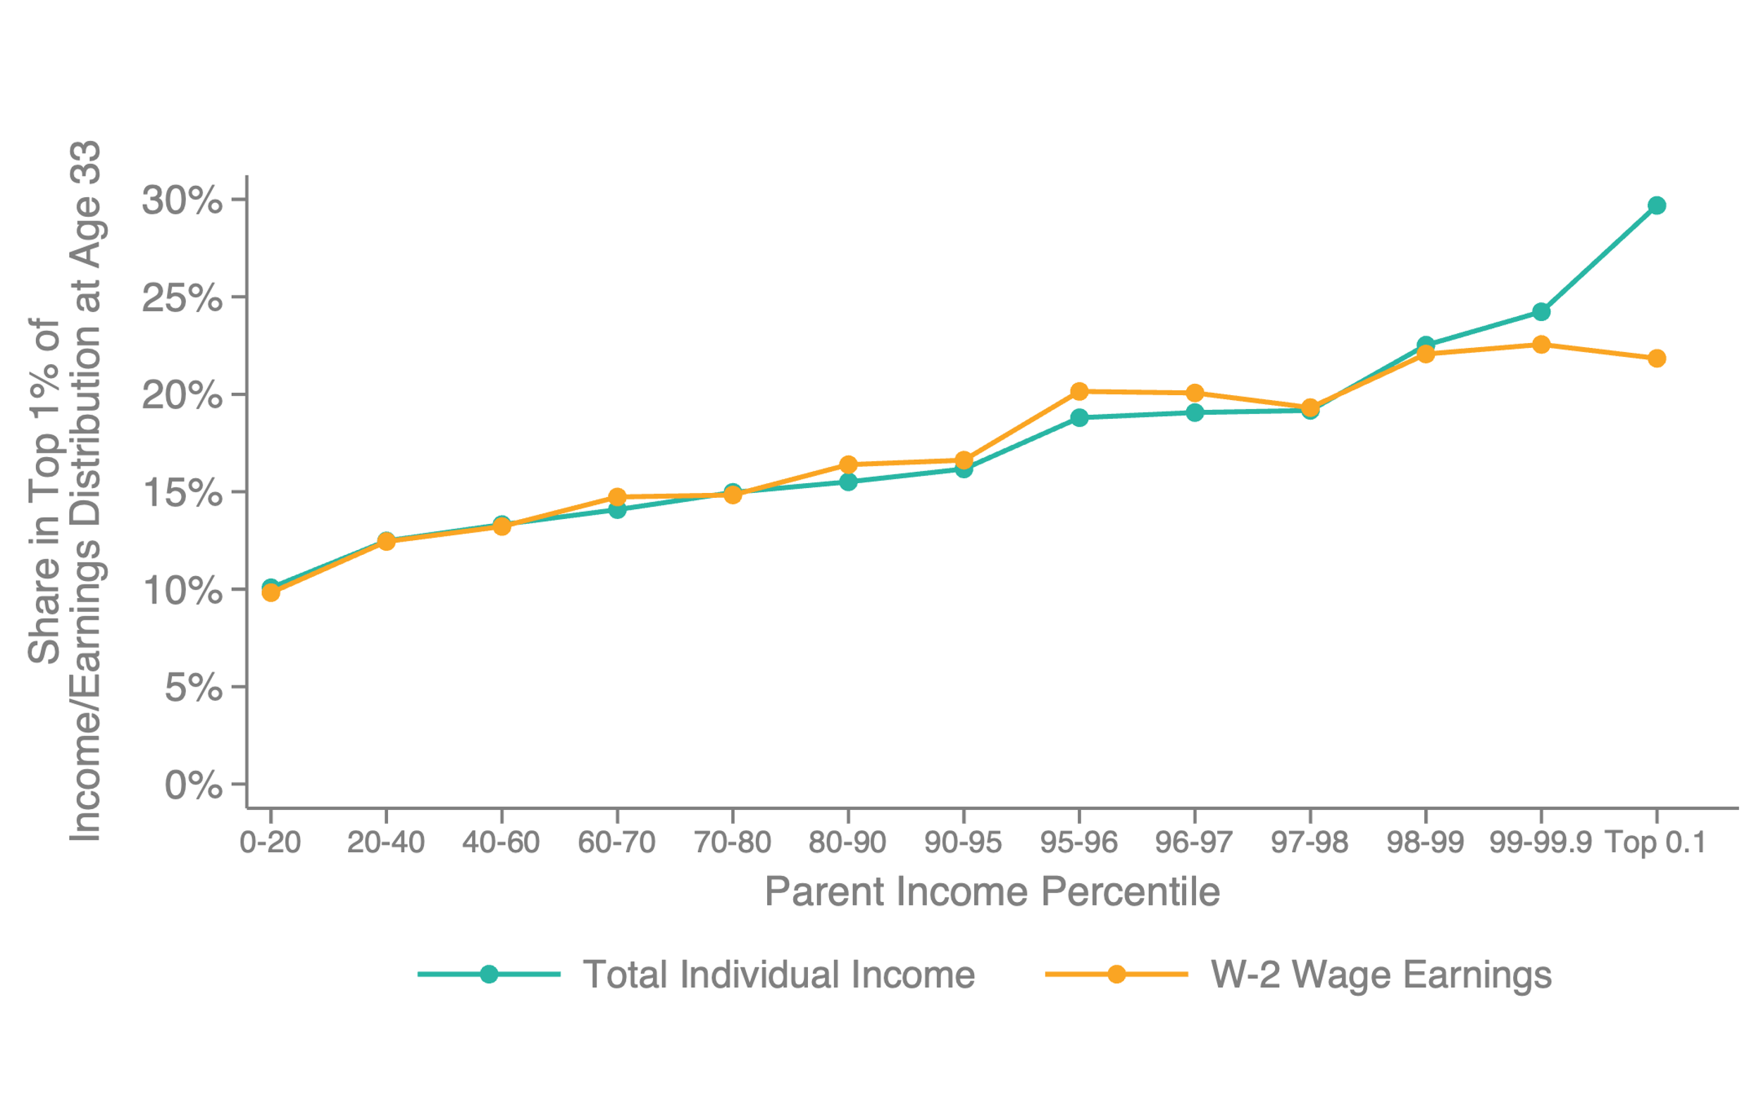
Share of Ivy-Plus Matriculants in Top 1% by Parental Income

Slide 93
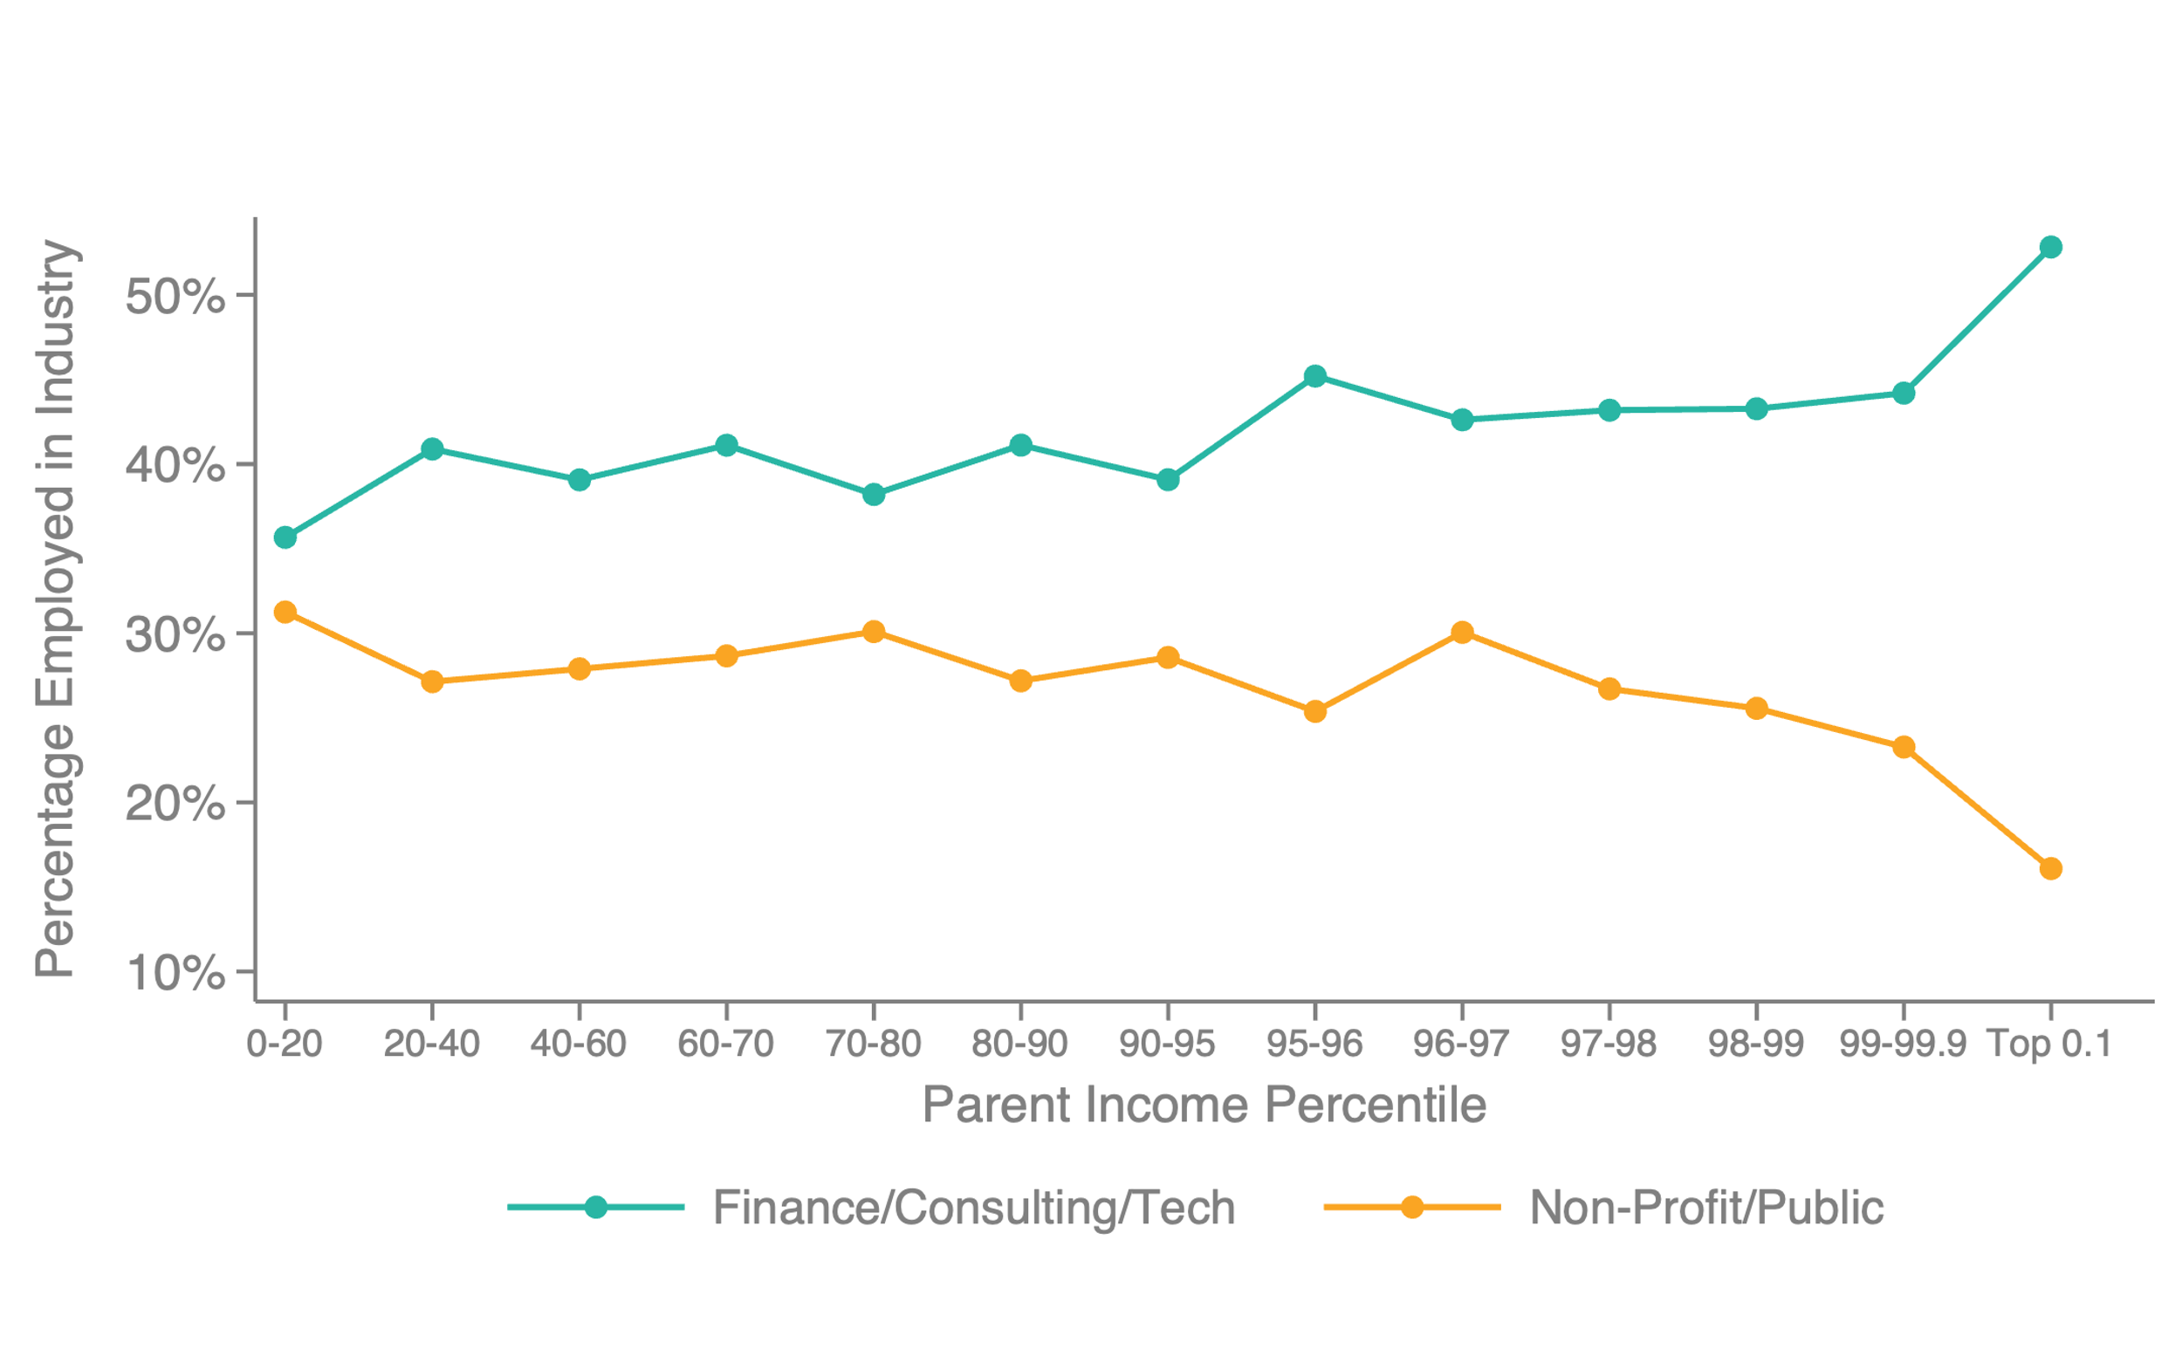
Share of Ivy-Plus Matriculants in Various Sectors by Parental Income
Business vs. Social Impact

Slide 94

Share of Ivy-Plus Matriculants in Elite Positions by Parental Income

Slide 95
Counterfactuals: Impacts of Changes
in Admissions Practices

Slide 96
Diversifying Society’s Leaders?
Conclude by returning to our motivating question: can Ivy-plus colleges diversify society’s leaders by changing their admissions practices?
Predict impacts of feasible changes in admissions practices on socioeconomic diversity of class and post-college outcomes
  Colleges could fill newly opened slots in many ways; here, assume they keep the distribution of SAT, race, and gender unchanged
Notes:
Note that these predictions rely on stronger assumptions and extrapolations: constant treatment effects, no behavioral responses, etc.

Slide 97
Assumptions
Policy counterfactuals rely on two key additional assumptions:
  No behavioral responses in application or matriculation rates (unlikely to hold exactly, but plausible that behavioral responses are small relative to mechanical effects)
  Causal effects of colleges unaffected by changes in composition of student body
Precise numerical predictions should be interpreted with caution; analysis gives a sense of order of magnitude of potential impacts

Slide 98
Predicted Impacts of Changes in Admissions Practices
Socioeconomic Composition of Student Body
70
67%
67%
65
+145
extra students from bottom 95%
63%
61%
Students from Bottom 95%
60
58%
55
50
Actual
Remove
+ Equalize
+ Contextualize
Need-Affirmative
Class
Legacy Preference
Athlete Shares
Non-Acad Cred
Preferences
by Income
for Students with
High Academic Rating
Policy Counterfactual

Slide 99
Impact of Admissions Changes on Students’ Post-College Outcomes
Would these increases in diversity of student body translate to analogous increases in diversity of society’s leaders?
Predict post-college outcomes of newly admitted students to answer this question, based on potential outcomes adjusted for college VA as above

Slide 100
Predicted Impacts of Changes in Admissions Practices
Socioeconomic Composition of Student Body
70
40
67%
67%
65
+145
extra students from bottom 95%
36%
63%
61%
35%
35
Students from Bottom 95%
% Working at Prestigious Firm
60
58%
33%
33%
33%
55
30
50
Actual
Remove
+ Equalize
+ Contextualize
Need-Affirmative
Class
Legacy Preference
Athlete Shares
Non-Acad Cred
Preferences
by Income
for Students with
High Academic Rating
Policy Counterfactual

Slide 101
Conclusion: Diversifying Society’s Leaders
Changes in admissions practices at Ivy-plus colleges could increase socioeconomic diversity of the student body, holding fixed pre-college academic credentials
These changes would not reduce and may even increase Ivy-plus graduates’ probabilities of reaching the upper tail of society
→ A handful of colleges could diversify socioeconomic backgrounds of society’s
leaders significantly by changing their admissions practices

Slide 102

Trends in Socioeconomic Diversity at Ivy-Plus Colleges, Entering Classes of 1998-2018
Ratio of Attendance Rates for Students from Middle Class (P70-80) vs. Top 1%

Slide 103
Appendix

Slide 104

Attendance Rates at Selective Public Flagship Universities, Controlling for Race

Slide 105

Admission Rates at Selective Public Flagship Universities, Controlling for Race

Slide 106

Attendance Rates at Selective Public Flagship Universities
Reweighting on Test Score

Slide 107

Attendance Rates at Selective Public Flagships by Parental Income
Reweighting on Test Score

Slide 108

Attendance Rates by Parental Income and College, Controlling for Test Score
In-State Attendance at Selective Public Flagships

Slide 109

Attendance Rates by Parental Income and College, Controlling for Test Score
Out-of-State Attendance at Selective Public Flagships

Slide 110

Attendance Rates by Parental Income and College
Attendance Rates to Selective Private Colleges

Slide 111

Attendance Rates Conditional on Application by Parental Income and College
Conditional Attendance to Ivy-Plus Colleges

Slide 112

Attendance Rates Conditional on Application by Parental Income and College
Conditional Attendance to Selective Private Colleges

Slide 113

Attendance Rates Conditional on Application by Parental Income and College
Conditional Attendance to Selective Public Colleges

Slide 114

Attendance Rates Conditional on Application by Parental Income and College
In-State Conditional Attendance to Selective Public Colleges

Slide 115

Attendance Rates Conditional on Application by Parental Income and College
Out-of-State Conditional Attendance to Selective Public Colleges

Slide 116

Application Rates by Parental Income and College, Controlling for Test Score
Application to Ivy-Plus Colleges

Slide 117

Application Rates at Selective Colleges by Parental Income, Controlling for Test Score

Slide 118

Application Rates by Parental Income and College, Controlling for Test Score
Application to Selective Public Flagships

Slide 119

Application Rates at Selective Public Flagship Colleges

Slide 120

Application Rates by Parental Income and College, Controlling for Test Score
In-State Application to Selective Public Flagships

Slide 121

Application Rates by Parental Income and College, Controlling for Test Score
Out-of-State Application to Selective Public Flagships

Slide 122

Application Rates by Parental Income and College, Controlling for Test Score
Application to Selective Private Colleges

Slide 123

Admissions Office Ratings vs. Test Scores, by Parental Income

Slide 124


Teacher and Guidance Counselor Ratings by High School Fixed Effect on Ivy-Plus Admissions
Share with High Teacher Rating
Share with High Guidance Counselor Rating

Slide 125

Treatment Effects of Ivy-Plus College Admission for Waitlisted Applicants
Attending Elite Graduate School

Slide 126

Treatment Effects of Ivy-Plus College Admission for Waitlisted Applicants
Working at Elite Firm

Slide 127

Treatment Effects of Ivy-Plus College Admission for Waitlisted Applicants
Working at Prestigious Firm

Slide 128

Quantiles of Income Distribution at Age 33
Ivy-Plus vs. Highly Selective Public Flagship Students

Slide 129

Ratio of Density of Income Distribution at Age 33
Ivy-Plus vs. Highly Selective Public Flagship Students

Slide 130

Fraction Attending Elite Grad School by SAT Score, Controlling for Parent Income and College

Slide 131

Fraction Working at a Prestigious Firm by SAT Score, Controlling for Parent Income and College

Slide 132

Attending Elite Grad School: Matriculation Design

Slide 133

Working at an Elite Firm: Matriculation Design

Slide 134

Working at a Prestigious Firm: Matriculation Design

