Slide 1
Careers in Social Science
June 2021

Slide 2
General Overview
Of Opportunity Insights
Careers in Social Science
Steps to Take
Other Resources & Advice
General Overview

Slide 3
Our mission is to develop scalable policy solutions that will empower families throughout the United States to rise out of poverty and achieve better life outcomes

Slide 4
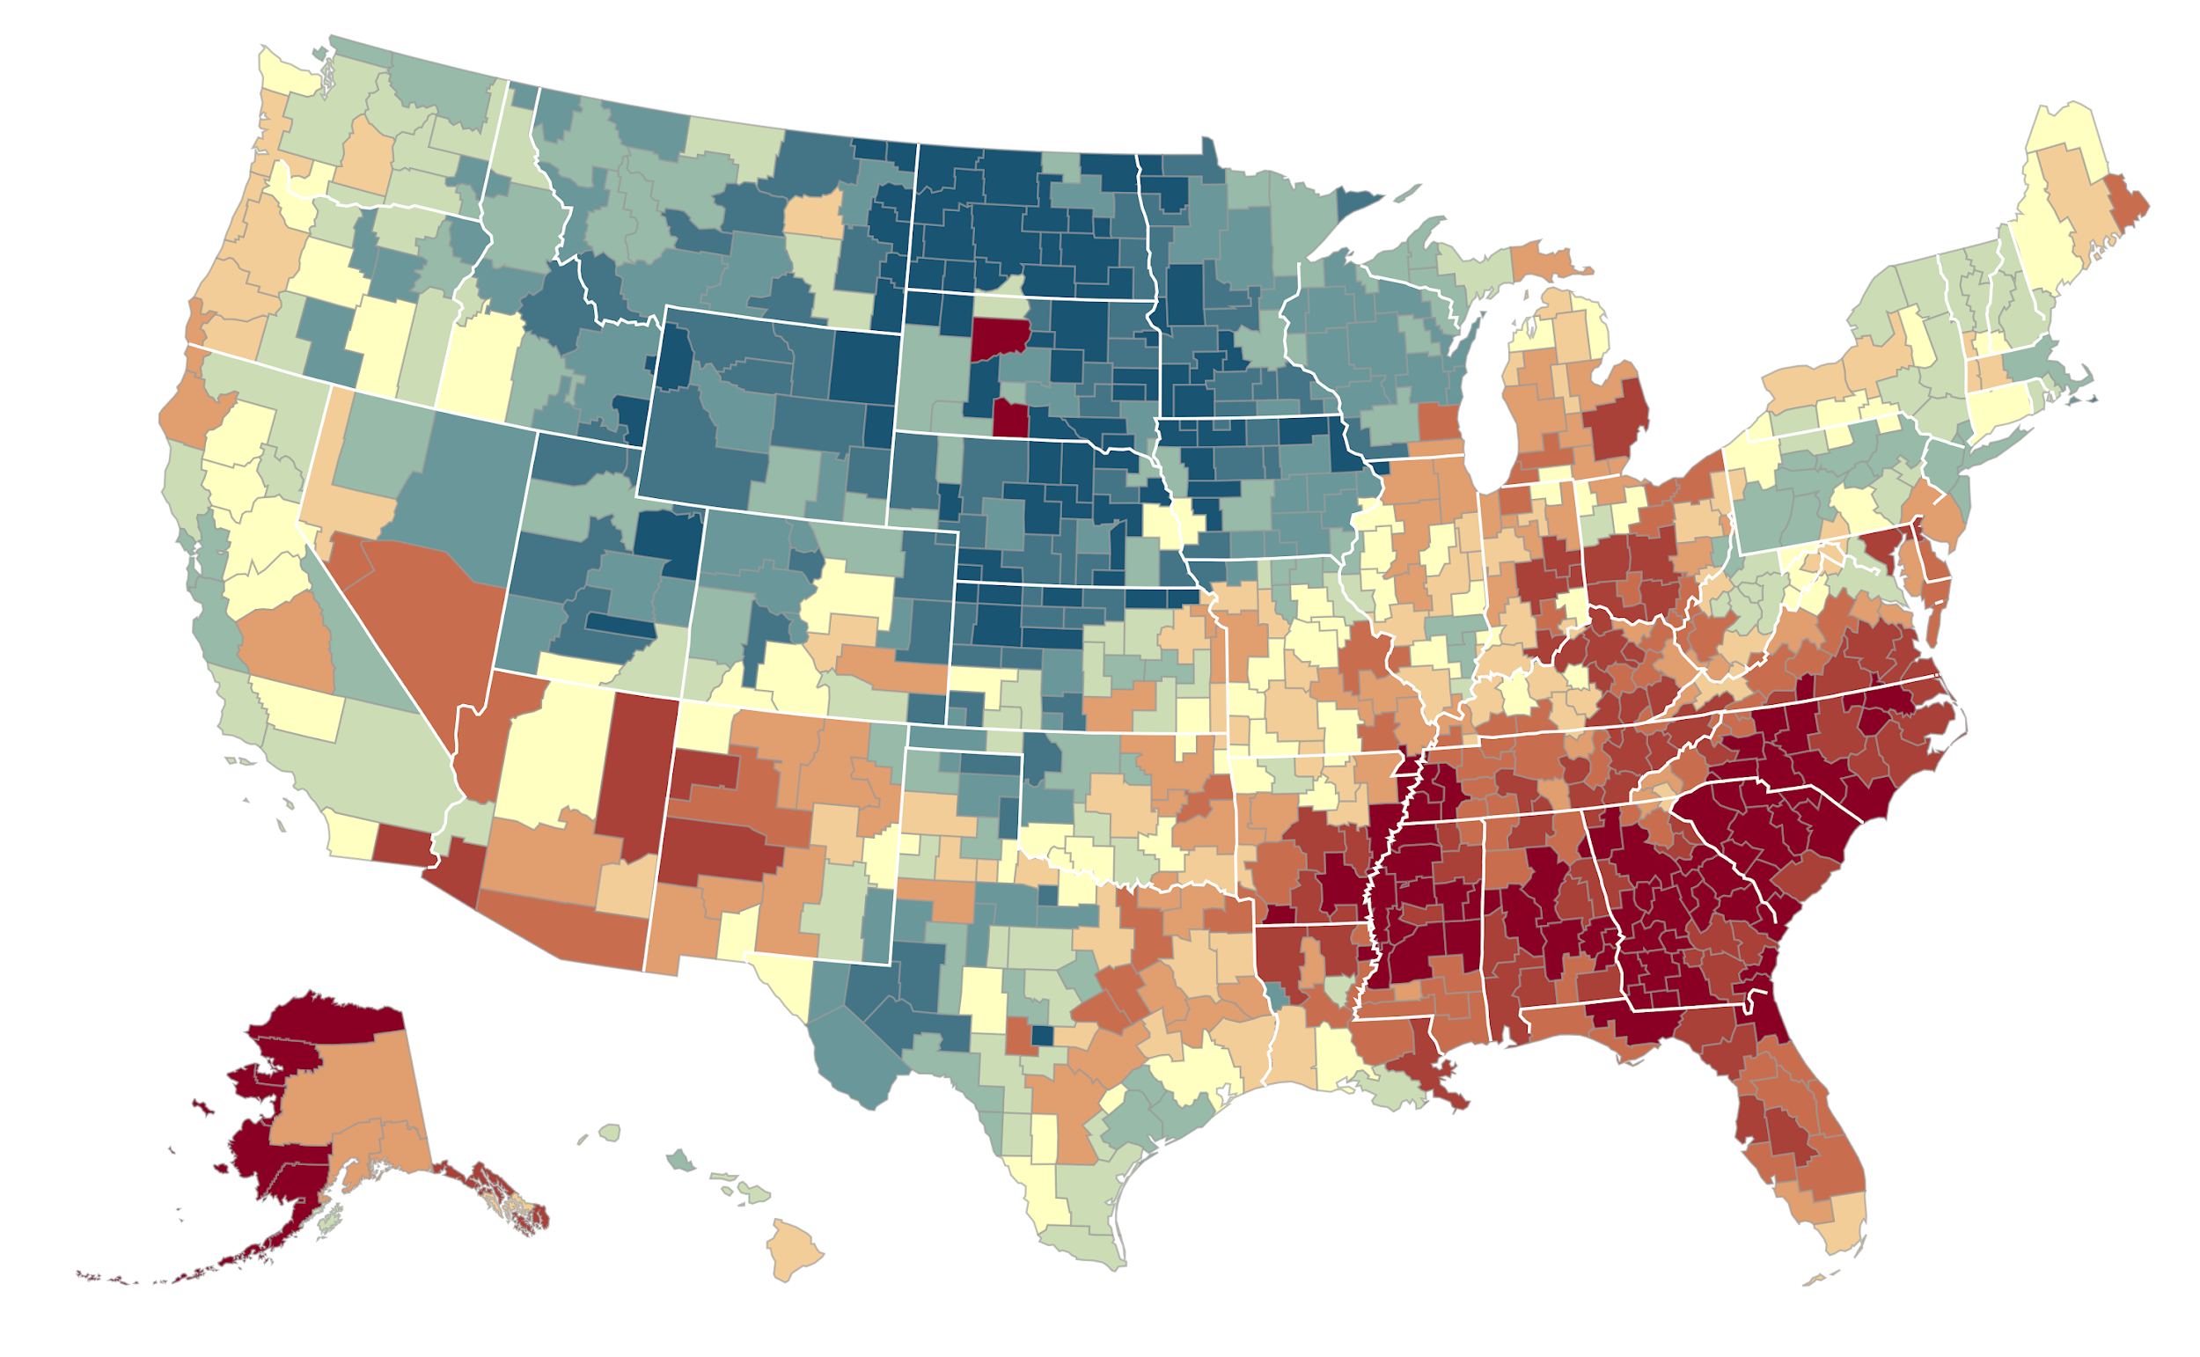
The Geography of Upward Mobility in the United States
Average Income at Age 35 for Children whose Parents Earned $25,000 (25th percentile)
Seattle $35.8k
Salt Lake
City $37.9k
Dubuque $46.1k
Cincinnati $27.8k
Cleveland $30.0k
Boston
$37.1k
New York City
$36.6k
San Francisco
Bay Area
$37.9k
Washington DC $34.5k
Los Angeles $34.8k
Charlotte $26.3k
<$27.3k
$33.8k
>$45.7k
Note: Blue = More Upward Mobility, Red = Less Upward Mobility
Chetty Hendren Kline Saez (QJE 2014)

Slide 5
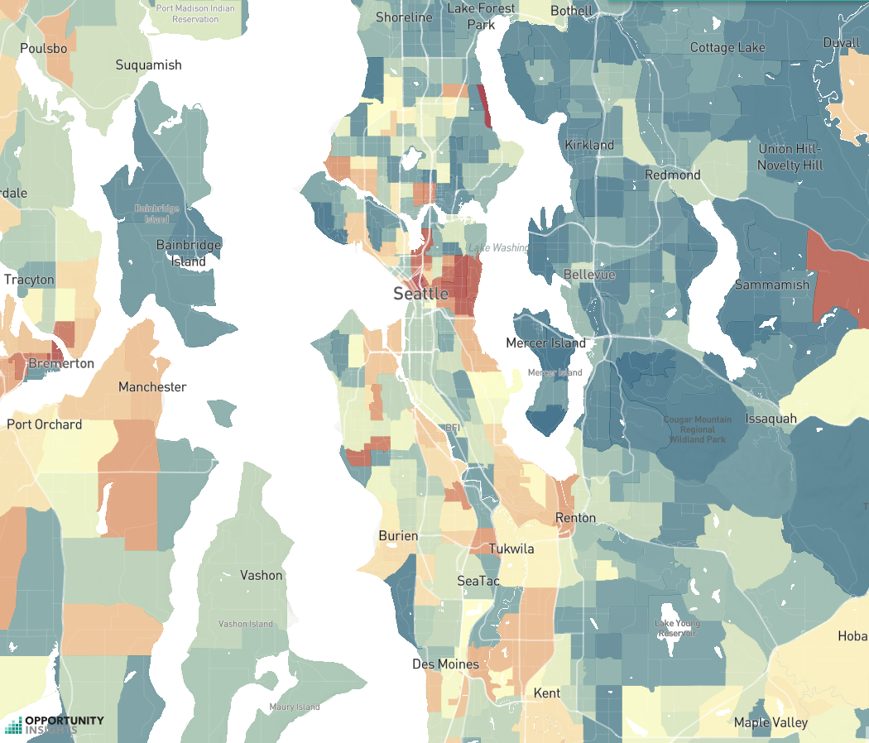
Is Affordable Housing in Seattle Maximizing Opportunities for Upward Mobility?
Most Common Current Locations of Families Receiving Housing Vouchers
> $65k
$33k
< $16k

Slide 6
Fraction of Families Who Leased Units in High Opportunity Areas
62.1%
60
40
Percent of Households Who Have Moved
to High Opportunity Areas
20
16.8%
0
Control
CMTO Treatment
Difference:
45.3 pp
SE: (4.9)
Bergman Chetty DeLuca Hendren Katz Palmer 2019

Slide 7
Parent Income Distribution by Percentile
Ivy Plus Colleges
15
10
Percent of Students
5
Note: “Ivy Plus” = Ivy League, Chicago, Stanford, MIT, Duke
0
0
20
40
60
80
100
Parent Rank

Slide 8
Parent Income Distribution by Percentile
Ivy Plus Colleges
15
14.5% of students from top 1%
10
Percent of Students
5
Note: “Ivy Plus” = Ivy League, Chicago, Stanford, MIT, Duke
0
0
20
40
60
80
100
Parent Rank

Slide 9
Parent Income Distribution by Percentile
Ivy Plus Colleges
15
14.5% of students from top 1%
10
Percent of Students
5
13.5% of students from bottom 50%
0
0
20
40
60
80
100
Parent Rank

Slide 10
Parent Income Distribution by Percentile
Ivy Plus Colleges
15
14.5% of students from top 1%
10
Percent of Students
More students from the top 1% than the bottom 50%
5
13.5% of students from bottom 50%
0
0
20
40
60
80
100
Parent Rank

Slide 11
Parent Income Distribution by Percentile
Ivy Plus Colleges
15
14.5% of students from top 1%
10
Percent of Students
5
3.8% of students from bottom 20%
0
0
20
40
60
80
100
Parent Rank

Slide 12
Parent Income Distribution by Percentile
Ivy Plus Colleges
15
14.5% of students from top 1%
10
Percent of Students
Probability of attending an elite private college is
77 times higher for children in the top 1% compared to the bottom 20%
5
3.8% of students from bottom 20%
0
0
20
40
60
80
100
Parent Rank

Slide 13
Parent Income Distributions by Quintile for 1980-82 Birth Cohorts
At Selected Colleges
80
Harvard University
60
Percent of Students
40
20
0
1
2
3
4
5
Parent Income Quintile

Slide 14
Parent Income Distributions by Quintile for 1980-82 Birth Cohorts
At Selected Colleges
80
Harvard University
UC Berkeley
60
Percent of Students
40
20
0
1
2
3
4
5
Parent Income Quintile

Slide 15
Parent Income Distributions by Quintile for 1980-82 Birth Cohorts
At Selected Colleges
80
Harvard University
UC Berkeley
SUNY-Stony Brook
60
Percent of Students
40
20
0
1
2
3
4
5
Parent Income Quintile

Slide 16
Parent Income Distributions by Quintile for 1980-82 Birth Cohorts
At Selected Colleges
80
Harvard University
UC Berkeley
SUNY-Stony Brook
60
Glendale Community College
Percent of Students
40
20
0
1
2
3
4
5
Parent Income Quintile

Slide 17
Parent Income Distributions by Quintile for 1980-82 Birth Cohorts
At Selected Colleges
80
Harvard University
UC Berkeley
SUNY-Stony Brook
60
Glendale Community College
Percent of Students
40
Top 1%
20
0
1
2
3
4
5
Parent Income Quintile

Slide 18
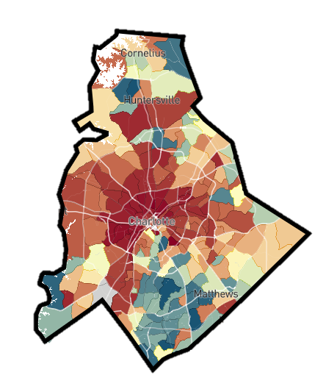
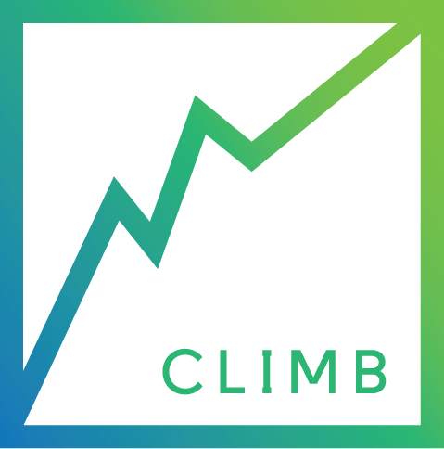
Opportunity Insights: Three Pillars
Reducing
Segregation
Place-Based
Investments
Improving Higher
Education
Help Low-Income
Families Move to
High-Opportunity Areas
Increase Upward Mobility in Low-Opportunity Areas
Amplify Impacts of
Colleges on Mobility

Slide 19
General Overview
Of Opportunity Insights
Careers in Social Science
Steps to Take
Other Resources & Advice
Careers in Social Science

Slide 20
You might find a career in social science fullfilling if…
You’re interested in the effects of social or economic policy
How did the ACA effect insurance coverage overall, in a certain place, or among a certain population?
How will the elimination of cash bail in Illinois affect pretrial detention rates?
You want to understand how and why people and organizations make decisions
How do firms decide to engage in a merger?
Why are men more likely than women to study economics?
How might exposure to innovation increase one’s propensity to become an inventor?
You’re curious about how the world works more generally
You find our work interesting!

Slide 21
Where can social science take you?
Academic Research
Professor: can offer more creative freedom to pursue your research interests
University-based labs that engage in social science research: OI, JPAL, Urban Labs, Berkeley Opportunity Lab
NGOs/Think Tanks
World Bank, IMF, Brookings, Economic Policy Institute, Urban Institute
Government
Council of Economic Advisors, Department of Labor, Census Bureau, Mayor’s Offices
… and more!
Notes:
Think of it as a spectrum from typically more creative freedom to less creative freedom but more policy relevance?

Slide 22
Economics and Diversity
Work being done to improve the field
American Economic Association Summer Program held at Howard University
“As many as 20% of PhDs awarded to minorities in economics over the past 20 years are graduates of the program.”
Research in Color
Predoc.org
Uncovering the hidden curriculum
Notes:
Sebastian: share personal anecdotes

Slide 23
General Overview
Of Opportunity Insights
Careers in Social Science
Steps to Take
Other Resources & Advice
Steps to Take

Slide 24
Steps to Take
Coursework
Math (up to Real Analysis)
Econometrics/Causal Inference
Statistics
Computer or Statistical Programming
Classes that interest you!
Research
Research assistance
Reach out to a professor whose class you enjoyed and succeeded in and ask if they are hiring RAs!
Independent research
A thesis can be a great way to experience a research project from ideation to completion!
Internships/Camps
Several notable institutions offer summer internships with (usually) 3rd year students such as the Federal Reserve Banks
AEA Summer Program, Expanding Diversity in Economics: A UChicago Summer Institute
Notes:
Thesis can also be a great opportunity to get feedback on your research from an advisor

Slide 25
Steps to Take
Mentorship
A supportive mentor is a great source of encouragement, new opportunities, and advice
Popular paths after undergrad:
PhD
Pre-doctoral fellowships
Masters (Public Policy, Economics, etc)
Working at research lab, NGO, or government

Slide 26
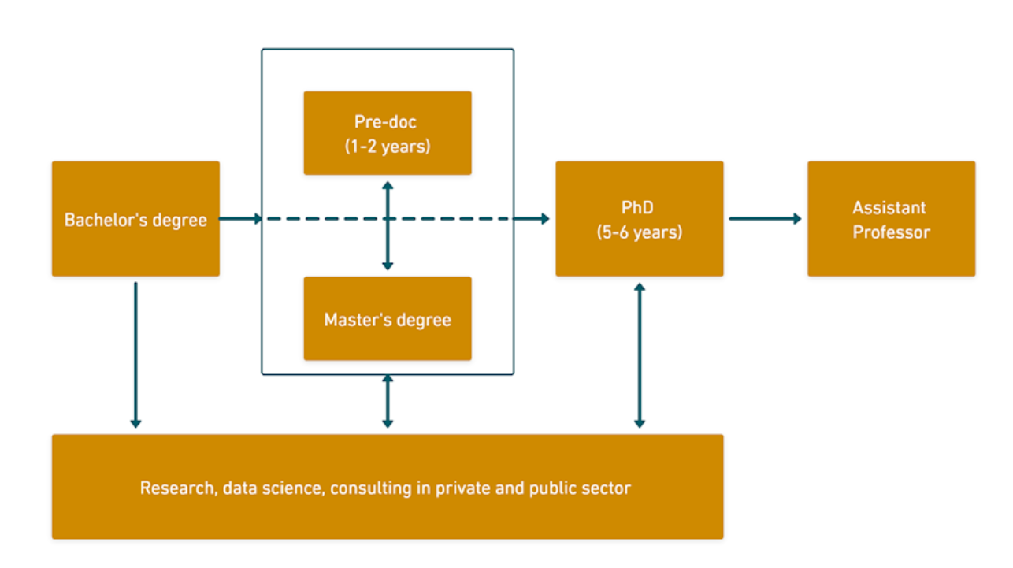
Steps to Take: Paths After Undergrad
Source: https://predoc.org/

Slide 27
Steps to Take
Applying to Grad School
PhDs
Which subject is the best fit? Economics, Public Policy, Sociology, etc
CV – 1 to 2 pages
Transcript
Statement of Purpose – 2 pages or 1000 words
Diversity and/or Personal Statement – 500 characters to 1000 words
Writing Sample – 10 to 20 pages
GRE/TOEFL
Letters of recommendation
Also consider NSFGRP, Ford Foundation Pre-Doctoral Fellowship
Masters
MPPs, Masters in Data Science, Masters in Economics (not as common)
Timing: Most applications due in late fall, or early winter

Slide 28
Steps to Take
Research Assistantships (RAs) /Predoctoral Fellowships (Predocs)
Why do an RA or Predoc?
Try out full-time research before applying to a PhD (and get paid for it)
Demonstrate a commitment to social science research, especially if not obvious from your resume
Take a break between undergrad and grad school -- gain new skills and perspectives in the meantime
What do you learn
How the sausage gets made
Data skills
Research translation
How to find them?
Predoc.org
Nber.org/nonnberjobs
@econ_ra on twitter
Applying
Application process
Timeline
Notes:
Potentially include predoc.org chart

Slide 29
General Overview
Of Opportunity Insights
Careers in Social Science
Steps to Take
Other Resources & Advice
Other Resources & Advice

Slide 30
Other Resources and Advice
Indulge your interests and curiosities:
Read!!! Doesn’t have to be academic papers, just read things with a curious mind
Seek out work and researchers that inspire you, and keep up with those publications
Don’t be afraid to ask questions
Let your professor(s) know you’re interested in a career in social science/grad school
They will be excited and can be a good source of individualized advice
Repositories of advice
Anthony Lee Zhang (Uchicago) Links
Jennifer Doleac (Texas A&M) Links
Masayuki Kudamatsu (Osaka) Links

Slide 31
Other Information Sessions with Opportunity Insights
General OI Info Session
September 8
Data Task Info Session
October 1

Slide 32
Other Resources and Advice
Indulge your interests and curiosities:
Read!!! Doesn’t have to be academic papers, just read things with a curious mind
Seek out work and researchers that inspire you, and keep up with those publications
Don’t be afraid to ask questions
Let your professor(s) know you’re interested in a career in social science/grad school
They will be excited and can be a good source of individualized advice
Repositories of advice
Anthony Lee Zhang (Uchicago) Links
Jennifer Doleac (Texas A&M) Links
Masayuki Kudamatsu (Osaka) Links

Slide 33
Thank You!
Q&A with the predocs
Meeting ID: 923 1168 3306
Password: OI_predocs
Send any further questions to hiring.opportunity.insights@gmail.com!
Please fill out our survey! (link in the chat)
Thank You! Q&A
Ask us anything!

