Slide 1


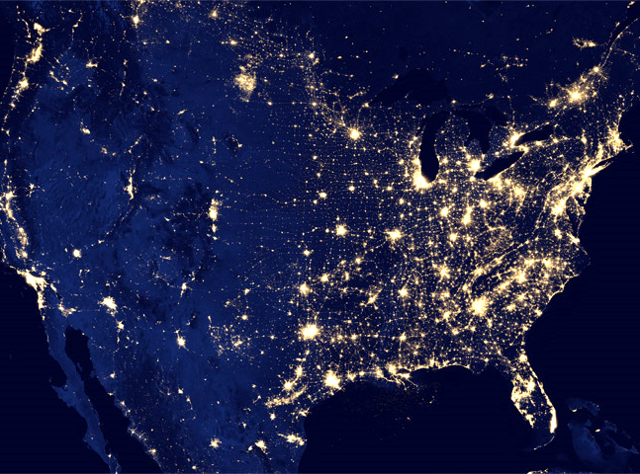



Using Big Data to Solve Economic and Social Problems
Professor Raj Chetty
Head Section Leader: Gregory Bruich, Ph.D.
Spring 2019
Notes:
Photo by Ev on Unsplash

Slide 2
The Causal Effects of Colleges

Slide 3
Causal Effects of Colleges
Third factor needed to assess effects of higher education system on mobility:
  Fraction of earnings variation across colleges due to causal effects
Why does this matter?
  Suppose differences in earnings outcomes between students at Harvard and another college were purely driven by selection of who gets in
  Then reducing segregation across colleges would have no impact on mobility
  But if differences reflect causal effects, changes in admissions policies could have a big impact on mobility

Slide 4
Estimating the Causal Effects of Colleges
Ideal experiment to estimate each college’s causal effect: compare earnings at age 30 after random assignment of students to colleges
Lacking such an experiment, need to find quasi-experimental variation that effectively allocates comparable students to different colleges
Challenging problem because one needs one experiment per college
Example: Zimmerman (2014) estimates causal effects by exploiting admissions cutoffs at Florida International University

Slide 5
Regression Discontinuity Methods
Zimmerman compares students just above and just below state-level GPA cutoff for admission to the Florida State University System

Slide 6
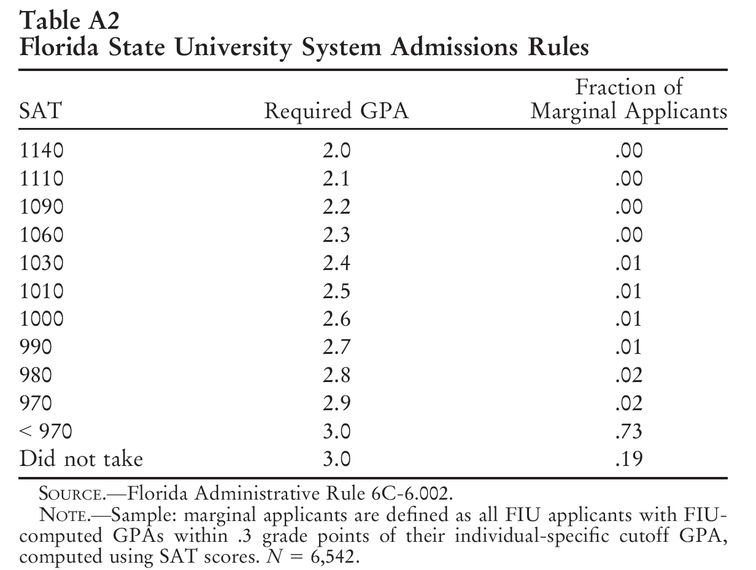
Source: Zimmerman (2014)

Slide 7
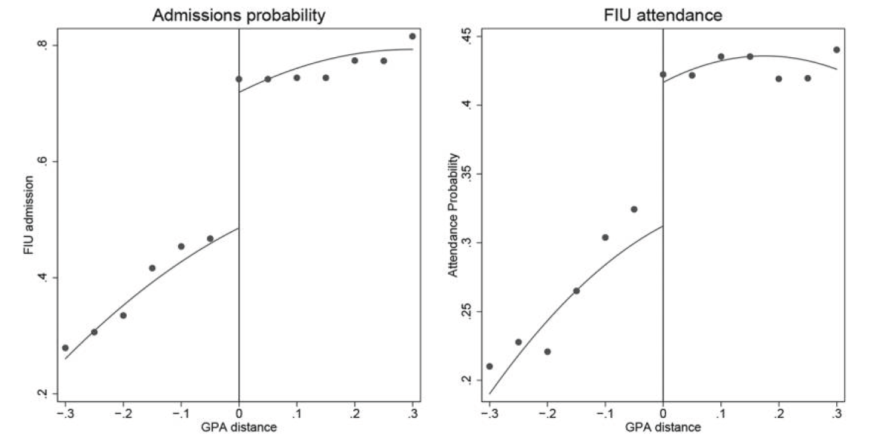
Florida International University Admissions and Attendance Rates
Around FIU GPA Admissions Cutoffs
23.4 pp
(2.1 pp)
10.4 pp
(2.5 pp)
Source: Zimmerman (2014)

Slide 8
Regression Discontinuity Methods
Zimmerman compares students just above and just below state-level GPA cutoff for admission to the Florida State University System
  Those with GPA just above cutoff are “treatment” group and those below are “control”
  Control group typically attends a two-year community college instead of FIU

Slide 9
Regression Discontinuity Methods
Key identification assumption to estimate causal effects: all other determinants of earnings are balanced on either side of the cutoff
  Any difference in earnings at the threshold must then be due to the discrete jump in chance of attending FIU instead of community college
Assumption is plausible because admission threshold was not publicized
  If cutoffs were well publicized, may worry that students just above cutoff are different from those below (“manipulation” of running variable)
Evaluate validity of assumption by making sure observable characteristics are similar on both sides of cutoff

Slide 10
Tests for Covariate Balance Around GPA Admissions Cutoffs
Racial Shares
Source: Zimmerman (2014)

Slide 11
Tests for Covariate Balance Around GPA Admissions Cutoffs
Gender
Source: Zimmerman (2014)

Slide 12
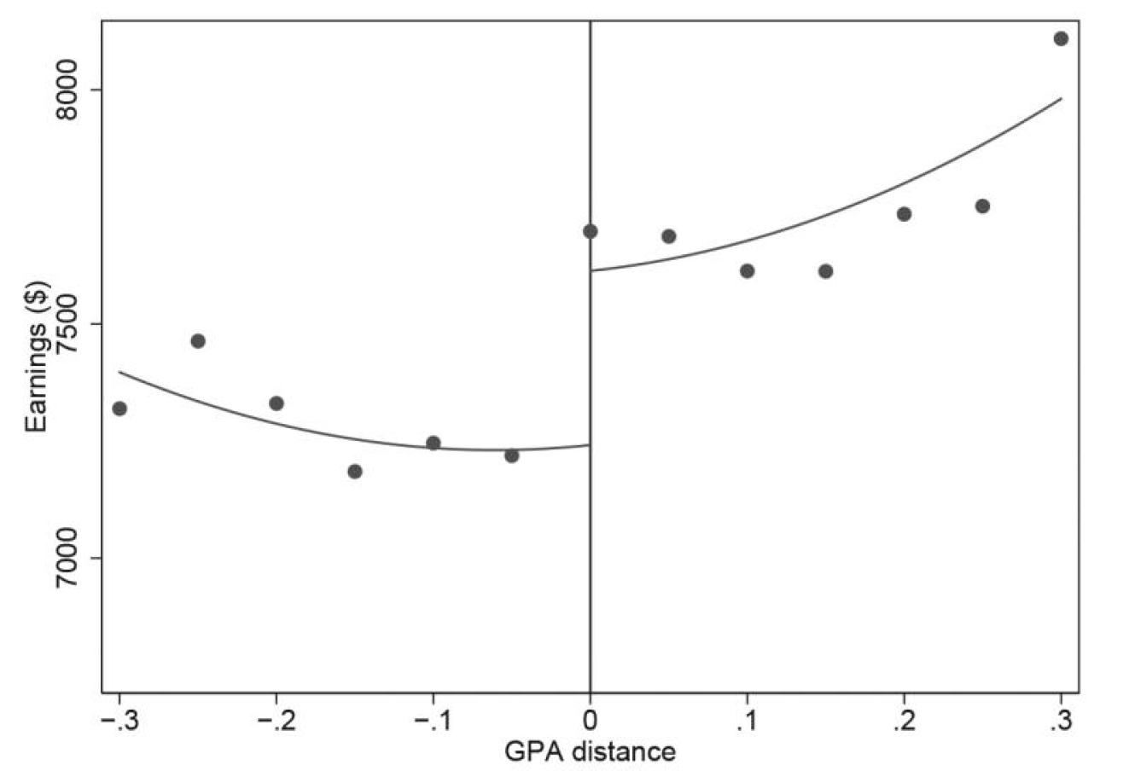
Mean Quarterly Earnings 8-14 Years after HS Graduation
Around FIU GPA Admissions Cutoffs
$372 or 5.1%
($141)
Source: Zimmerman (2014)

Slide 13
Causal Effects of Colleges
Ideally, we would estimate causal effect of every college relative to every other college using a method analogous to the one we just discussed
This is infeasible in practice → use earnings controlling for SAT scores and parent income as an estimate of each college’s causal effect
At least in case of Florida International University, this simple regression estimate matches quasi-experimental estimate
Therefore use these estimates to gauge portion of variation in earnings that is due to colleges’ causal effects when analyzing impacts on mobility

Slide 14
Effects of Higher Education System on Mobility: Counterfactual Simulations

Slide 15
Impact of Higher Education on Mobility
Combine three sets of estimates (parent income distributions, students’ earnings outcomes, causal effects) to analyze impacts of higher education system on mobility
Focus on how changes in where students go to college (application and admissions) would affect mobility, taking students’ earnings outcomes as given
  How would changes in application/admissions policies affect degree of income segregation across colleges ?
  How would such changes affect overall intergenerational mobility in the U.S.?

Slide 16
Preserving College Selectivity
Consider alternative admissions rules that preserve the selectivity of each college
  Unrealistic to consider counterfactual policies where e.g. Harvard becomes an unselective college
Use SAT scores to proxy for student’s qualifications at time of application
  Imperfect but scalable metric that is highly correlated with other elements of students’ records
Preserve selectivity by maintaining the same distribution of SAT scores at every college while simulating alternative admissions policies

Slide 17
Alternative Admissions Rules
Consider two alternative admissions rules:
  SAT-based admissions: colleges admit and enroll students purely based on their SAT scores, ignoring parent income and all other factors
    Hypothetical policy that eliminates all differences in application, admission, and enrollment decisions that are influenced by parent income
    Ex: eliminates any differences that arise from admissions rules that may favor students who can pay full tuition or differences in attendance rates due to costs

Slide 18
Parental Income Distributions Under Alternative Admissions Rules
Bottom Quintile Shares across College Tiers
15
10
Share with Parents in Bottom Quintile (%)
5
0
Ivy Plus
Selective Colleges
Other Colleges
Actual

Slide 19
Parental Income Distributions Under Alternative Admissions Rules
Bottom Quintile Shares across College Tiers
15
10
Share with Parents in Bottom Quintile (%)
5
0
Ivy Plus
Selective Colleges
Other Colleges
Actual
SAT-Based Admissions counterfactual

Slide 20
Parental Income Distribution for Children with SAT Scores Above 1300 (Top 7%)
60
56.9%
40
Top 1%
Percent of College Students with SAT above 1300
20
21.1%
12.1%
6.5%
5.7%
3.4%
0
1
2
3
4
5
Parent Income Quintile

Slide 21
Parental Income Distribution for Children with High SAT Scores
Vs. Students at Ivy-Plus Colleges
80
% with SAT above 1300 in U.S.
% of students at Ivy-Plus colleges
68.4%
60
56.9%
40
Top 1%
Percent
20
21.1%
13.4%
14.5%
12.1%
8.7%
6.5%
5.7%
5.7%
3.4%
3.8%
0
1
2
3
4
5
Parent Income Quintile

Slide 22
Parental Income Distribution for Children with High SAT Scores
and for Students at Highly Selective Colleges
80.0
% with SAT above 1100 in U.S.
% at highly selective colleges
60.0
54.2%
46.2%
40.0
Percent
24.4%
20.0
20.2%
15.6%
12.6%
9.0%
8.1%
4.9%
4.8%
0.0
1
2
3
4
5
Parent Income Quintile

Slide 23
Increasing Applications from High-Achieving, Low-Income Students
There is some scope to increase low and middle-income shares at highly selective colleges by admitting and enrolling more high-achieving, lower-income students
Under-representation of low-income students at these colleges is partly driven by lower application rates of well qualified low-income students
This “undermatching” phenomenon is not simply explained by differences in costs of attendance [Hoxby and Avery 2013]

Slide 24
Costs of Attending Colleges by Selectivity Tier for Low-Income Students
50
Costs for 20th pctile family
Sticker Price
40
30
Avg. Tuition Cost in 2009-10 ($1,000)
20
10
0
Competitive
Private 2-year
Public 2-year
Very competitive
For-profit 2-year
Most competitive
Highly competitive
Competitive plus
Less competitive
Highly competitive plus
Very competitive plus
Some or no selectivity, 4-year

Slide 25
University of Michigan HAIL Experiment
Alternative hypothesis: lack of information or application support for low-income students limits their applications even when tuition cost is low [Hoxby and Turner 2013]
Dynarski et al. (2018) test this hypothesis in a recent experiment at the University of Michigan that exploits big data for targeting
  Provide information about applying to U of M to high-achieving (GPA > 3.3, SAT > 1100) students from low-income families (incomes < $47K)
  Identify all such students in the state of Michigan using administrative data from schools on GPAs, SAT scores (mandatory in Michigan), and eligibility for free/reduced price lunch
  2,000 students meet these criteria each year; 50% randomly assigned to receive treatment of additional information and support

Slide 26
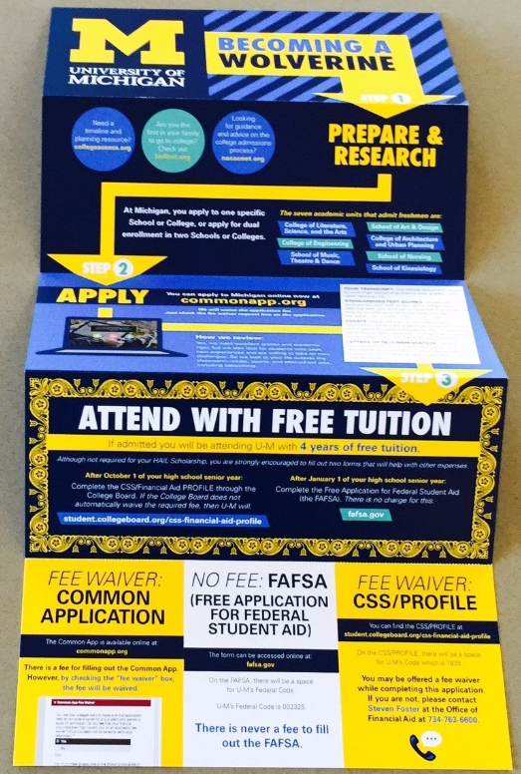
HAIL Scholarship Mailings Sent to Students in the Treatment Group
Source: Dynarski et al. (2018)

Slide 27
Excerpt of HAIL Scholarship Mailings Sent to Parents of Students in the Treatment Group
Dear Parent or Guardian of <<first name>> <<last name>>:
Since your child is an excellent student, we want to offer a potentially transformative college opportunity:
If <<first name>> applies and is admitted to the University of Michigan - Ann Arbor, your child will be awarded the HAIL Scholarship covering the entire cost of U-M tuition and fees for four years. This is an offer we are delighted to make, worth approximately $60,000. Furthermore, after a review of their financial aid applications, your student will likely be eligible for additional aid to cover other costs such as housing and textbooks.
Sincerely,
Kedra Ishop, PhD
Associate Vice President
Office of Enrollment Management

Slide 28
Effect of HAIL Scholarship on Application to University of Michigan
67%
26%
Source: Dynarski et al. (2018)

Slide 29
Effect of HAIL Scholarship on Admission to University of Michigan
32%
15%
Source: Dynarski et al. (2018)

Slide 30
Effect of HAIL Scholarship on Enrollment at University of Michigan
27%
12%
Source: Dynarski et al. (2018)

Slide 31
SAT-Based Admissions: Implications
Main lesson: removing cost and informational barriers for high-achieving, low-income students can increase their access to highly selective colleges appreciably
But such policies are insufficient to desegregate higher education system by themselves
  Even shifting to pure SAT-based enrollment would not change low-income shares appreciably at Ivy league institutions

Slide 32
Alternative Admissions Rules
Consider two alternative admissions rules:
  SAT-based admissions: colleges admit students purely based on their SAT scores, ignoring parent income and all other factors
  Class-based affirmative action: colleges give a SAT test score boost to children from low-income families
    Implicit boost given to legacy students (whose parents attended the same college) is approximately 170 points at elite private colleges [Espenshade et al. 2004]
    What is the effect of adding 170 points to SAT scores of low-income students?

Slide 33
Parental Income Distributions Under Alternative Admissions Rules
Bottom Quintile Shares across College Tiers
15
10
Share with Parents in Bottom Quintile (%)
5
0
Ivy Plus
Selective Colleges
Other Colleges
Actual
SAT Based Admissions counterfactual
Class Based Affirmative Action counterfactual (170-point SAT bonus)

Slide 34
Class-Based Affirmative Action: Implications
Class-based affirmative action of a magnitude comparable to the implicit boost given to legacy students would essentially desegregate the higher education system
But could come at a cost in terms of reducing selectivity and average student performance

Slide 35
Impact of Alternative Admissions Rules on Mobility
Now analyze impacts of same alternative admissions rules on mobility rates
Measure “mobility” as difference in chance of reaching top fifth of income distribution for children from families in bottom fifth vs. top fifth
Important assumption: causal effects of colleges are unaffected by changes in composition of student body

Slide 36
Mobility Rates Under Alternative Admissions Rules
Difference in Chance of Reaching Top Quintile for Students from Low vs. High Income Families
22
10.5% reduction
in gap
20
18
16
Difference in Prob of Reaching Top Quintile
Among Students with Parents in Q5 v1 Q1 (pp)
14
12
10
Actual
SAT Admissions
Class-Based
Counterfactual
Affirmative Action
Counterfactual
(170-point SAT Bonus)

Slide 37
Mobility Rates Under Alternative Admissions Rules
Difference in Chance of Reaching Top Quintile for Students from Low vs. High Income Families
22
10.5% reduction
in gap
20
25.4% reduction
in gap
18
16
Difference in Prob of Reaching Top Quintile
Among Students with Parents in Q5 v1 Q1 (pp)
14
12
10
Actual
SAT Admissions
Class-Based
Counterfactual
Affirmative Action
Counterfactual
(170-point SAT Bonus)

Slide 38
Effects of Higher Education on Mobility: Summary
Higher education system can play a significant role in increasing social mobility, but requires active effort to undo disparities that emerge before college
Admissions based purely on academic qualifications (as proxied for by SAT scores) would reduce segregation across colleges, but have little impact at elite colleges
  Pre-college differences in environment create large gaps in achievement → few students from low-income families have sufficiently strong qualifications to get in to elite colleges
But colleges can still actively counter these disparities and increase upward-mobility for children from low-income backgrounds if they wish to do so
  Class-based affirmative action would eliminate income segregation across colleges and increase mobility significantly

Slide 39
Meritocracy vs. Equality of Opportunity in Higher Education
Unlike other examples we have discussed (e.g., exposure to innovation), there may be a tradeoff between principles of meritocracy and equal opportunity here
Best (“optimal”) policy therefore may require a value judgement on what colleges’ goals should be
  Economists typically view such value judgements as outside our field’s domain and leave this to the public to decide

