Slide 1
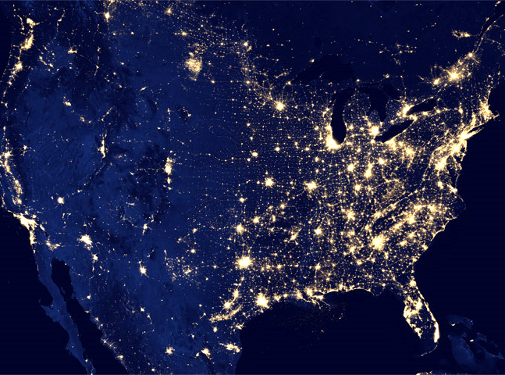
Using Big Data to Solve Economic and Social Problems
Professor Raj Chetty
Head Section Leader: Gregory Bruich, Ph.D.
Spring 2019
Notes:
Photo by Ev on Unsplash

Slide 2
Two Approaches to Increasing Upward Mobility
Moving to Opportunity: Provide Affordable Housing in High-Opportunity Areas
Place-Based Investments: Increase Upward Mobility in Low-Opportunity Areas

Slide 3
Moving to Opportunity Experiment
Implemented from 1994-1998 at 5 sites: Baltimore, Boston, Chicago, LA, New York
4,600 families were randomly assigned to one of three groups:
Experimental: offered housing vouchers restricted to low-poverty (<10%) Census tracts
Section 8: offered conventional housing vouchers, no restrictions
Control: not offered a voucher, stayed in public housing
Compliance rates: 48% of experimental group used voucher, 66% of Section 8 group used voucher

Slide 4
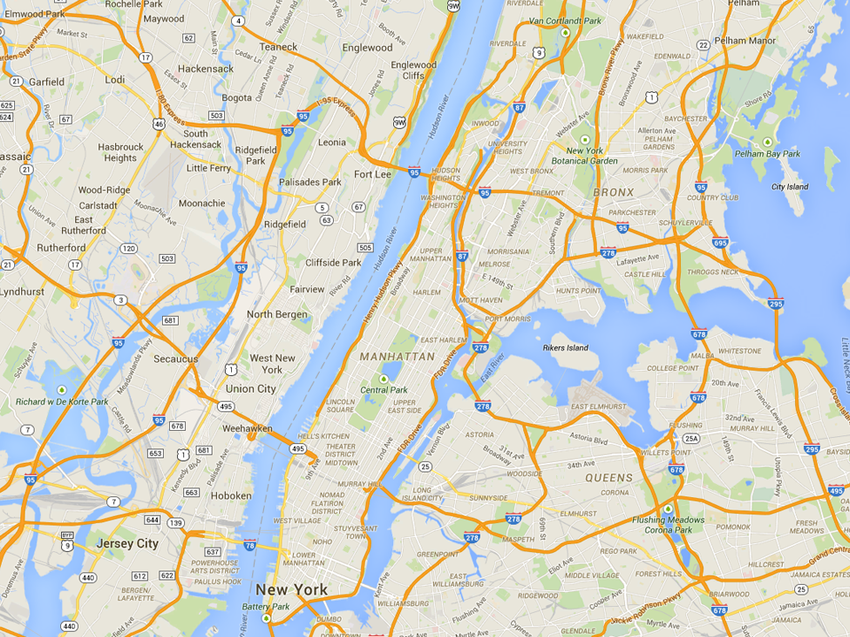
Common MTO Residential Locations in New York
Experimental
Wakefield Bronx
Control
MLK Towers
Harlem
Section 8
Soundview Bronx

Slide 5
Analysis of MTO Experimental Impacts
Early research on MTO found little impact of moving to a better area on economic outcomes such as earnings
But it focused primarily on adults and older youth at point of move [e.g., Kling, Liebman, and Katz 2007]
Motivated by our quasi-experimental study (Chetty and Hendren 2018), we test for exposure effects among children
Does MTO improve outcomes for children who moved when young?
Link MTO to tax data to study children’s outcomes in mid 20’s
Compare earnings across groups, adjusting for compliance rates

Slide 6
Impacts of MTO on Children Below Age 13 at Random Assignment
(a) Earnings
(b) College Attendance
17000
25
15000
20
13000
15
Individual Earnings at Age ≥ 24 ($)
College Attendance, Ages 18-20 (%)
11000
10
9000
$11,270
$12,994
$14,747
16.5%
18.0%
21.7%
5
7000
p = 0.101
p = 0.014
p = 0.435
p = 0.028
5000
0
Control
Section 8
Experimental
Voucher
Control
Section 8
Experimental
Voucher

Slide 7
Impacts of MTO on Children Below Age 13 at Random Assignment
(c) Neighborhood Quality
(d) Fraction Single Mothers
25
37.5
23
25
21
Zip Poverty Share (%)
Birth with no Father Present (%)
19
12.5
17
23.8%
21.7%
20.4%
33.0%
31.0%
23.0%
p = 0.046
p = 0.007
p = 0.610
p = 0.042
15
0
Control
Section 8
Experimental
Voucher
Control
Section 8
Experimental
Voucher

Slide 8
Impacts of MTO on Children Age 13-18 at Random Assignment
(a) Earnings
(b) Fraction Single Mothers
17000
62.5
15000
50
13000
37.5
Individual Earnings at Age ≥ 24 ($)
Birth with no Father Present (%)
11000
25
9000
$15,882
$13,830
$13,455
41.4%
40.2%
51.8%
7000
p = 0.219
p = 0.259
12.5
p = 0.857
p = 0.238
5000
0
Control
Section 8
Experimental
Voucher
Control
Section 8
Experimental
Voucher

Slide 9
Impacts of Moving to Opportunity on Adults’ Earnings
17000
15000
13000
Individual Earnings at Age ≥ 24 ($)
11000
9000
$14,381
$14,778
$13,647
7000
p = 0.711
p = 0.569
5000
Control
Section 8
Experimental
Voucher

Slide 10
Limitations of Randomized Experiments
Why not use randomized experiments to answer all policy questions?
Beyond feasibility, there are three common limitations:
Attrition: lose track of participants over time → long-term impact evaluation unreliable
Especially a problem when attrition rate differs across treatment groups because we lose comparability
This problem is largely fixed by the big data revolution: in MTO, we are able to track 99% of participants by linking to tax records

Slide 11
Limitations of Randomized Experiments
Why not use randomized experiments to answer all policy questions?
Beyond feasibility, there are three common limitations:
Attrition: lose track of participants over time → long-term impact evaluation unreliable
Sample size: small samples make estimates imprecise, especially for long-term impacts
This problem is not fixed by big data: cost of data has fallen, but cost of experimentation (in social science) has not

Slide 12
Impacts of Experimental Voucher by Age of Random Assignment
Household Income, Age ≥ 24 ($)
4000
2000
0
Experimental Vs. Control ITT on Income ($)
-2000
-4000
-6000
10
12
14
16
Age of Child at Random Assignment

Slide 13
Income Gain from Moving to a Better Neighborhood
By Child’s Age at Move
$41K
Savin Hill
$35K
Average Income at Age 35
$29K
$23K
Roxbury
2
10
20
28
Age of Child when Parents Move

Slide 14
Limitations of Randomized Experiments
Why not use randomized experiments to answer all policy questions?
Beyond feasibility, there are three common limitations:
Attrition: lose track of participants over time → long-term impact evaluation unreliable
Sample size: small samples make estimates imprecise, especially for long-term impacts
Generalizability: results of an experiment may not generalize to other subgroups or areas
Difficult to run experiments in all subgroups and areas → “scaling up” can be challenging

Slide 15
Quasi-Experimental Methods
Quasi-experimental methods using big data can address these issues
Consider study of 3 million families that moved across areas discussed earlier
How did we achieve comparability across groups in this study?
People who move to different areas are not comparable to each other
But people who move when children are younger vs. older are more likely to be comparable
→ Approximate experimental conditions by comparing children who move to a new area at different ages

Slide 16
Quasi-Experimental Methods
Quasi-experimental approach addresses limitations of MTO experiment:
Sample size: much larger samples yield precise estimates of childhood exposure effects (4% convergence per year)
Generalizability: results generalize to all areas of the U.S.
Limitation of quasi-experimental approach: reliance on stronger assumptions
Bottom line: reassuring to have evidence from both approaches that is consistent → clear consensus that moving to opportunity works

Slide 17
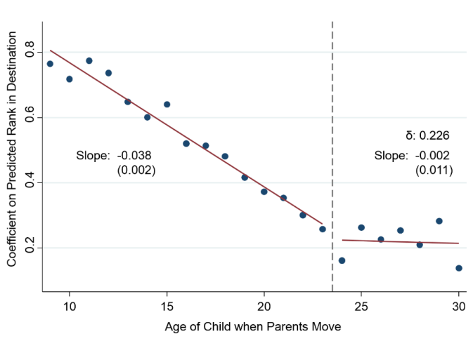
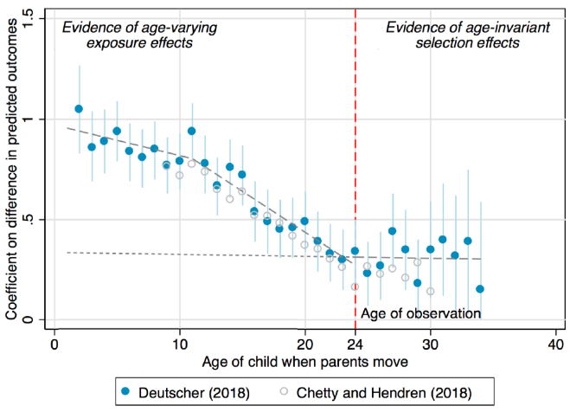
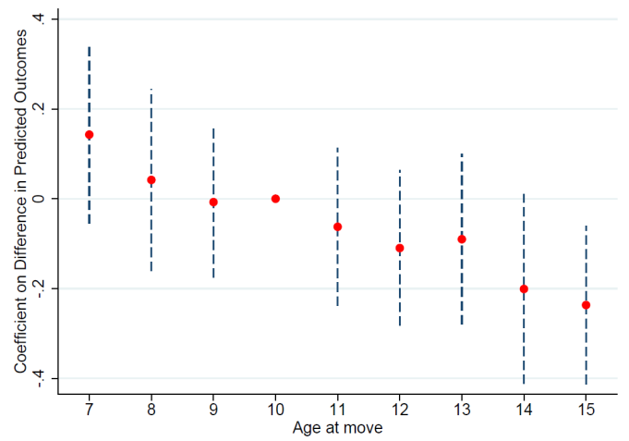
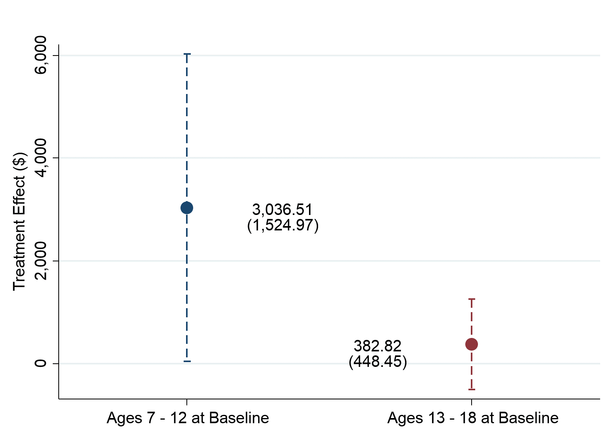
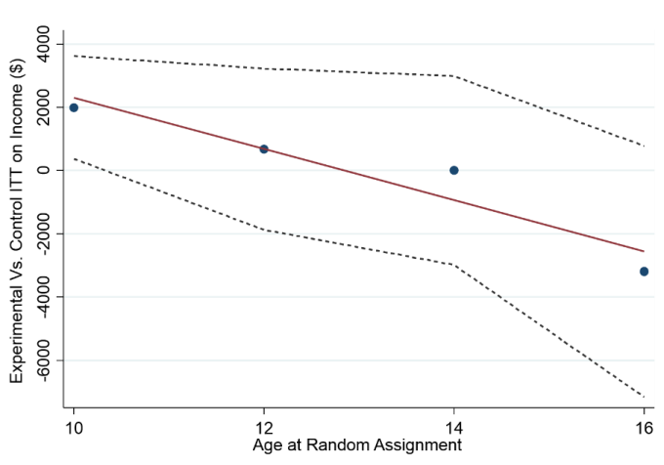
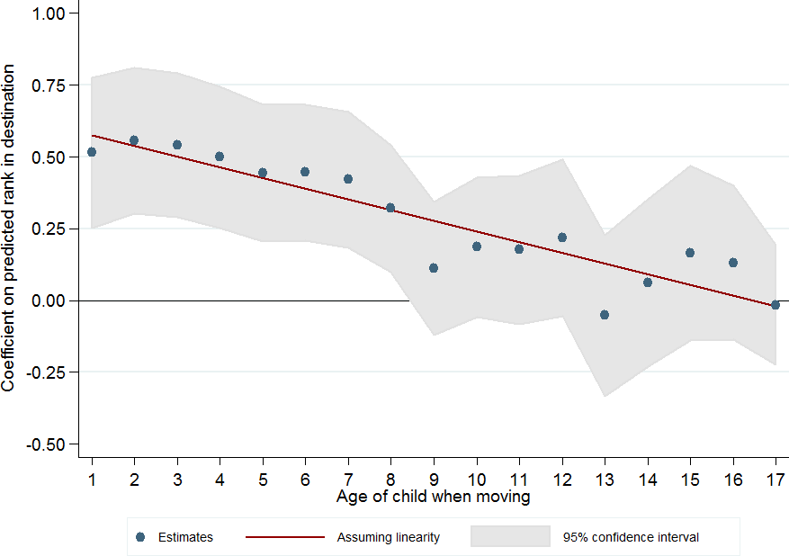
Childhood Exposure Effects Around the World
United States
Australia
Montreal, Canada
Source: Chetty and Hendren (QJE 2018)
Source: Deutscher (2018)
Source: Laliberté (2018)
MTO: Baltimore, Boston, Chicago, LA, NYC
Chicago Public Housing Demolitions
Denmark
Source: Faurschou (2018)
Source: Chetty, Hendren, Katz (AER 2016)
Source: Chyn (AER 2018)

Slide 18
Implications for Housing Voucher Policy
Housing vouchers can be very effective but must be targeted carefully
Vouchers should be targeted at families with young children
Current U.S. policy of putting families on waitlists is especially inefficient

Slide 19
Implications for Housing Voucher Policy
Housing vouchers can be very effective but must be targeted carefully
Vouchers should be targeted at families with young children
Vouchers should be explicitly designed to help families move to affordable, high-opportunity areas
In MTO experiment, unrestricted “Section 8” vouchers produced smaller gains even though families could have made same moves
More generally, low-income families rarely use cash transfers to move to better neighborhoods [Jacob et al. 2015]
80% of the 2.1 million Section 8 vouchers are currently used in high-poverty, low-opportunity neighborhoods

Slide 20
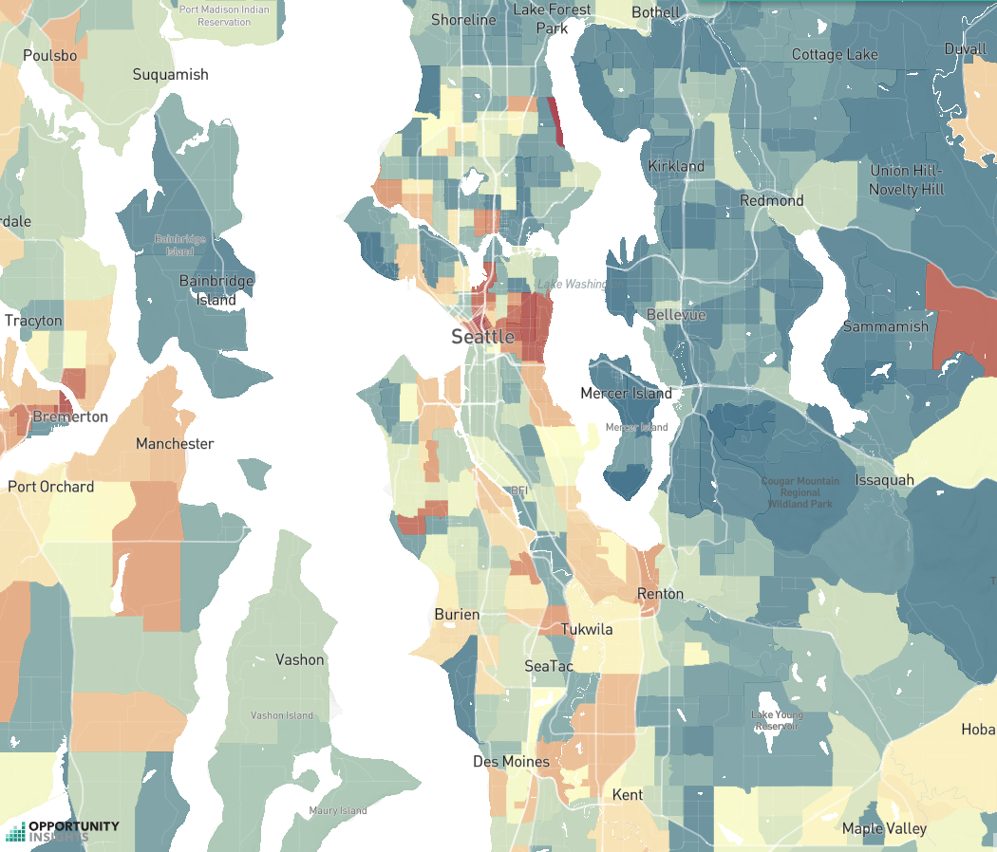
Is Affordable Housing in Seattle Maximizing Opportunities for Upward Mobility?
Most Common Current Locations of Families Receiving Housing Vouchers
> $65k
$33k
< $16k

Slide 21
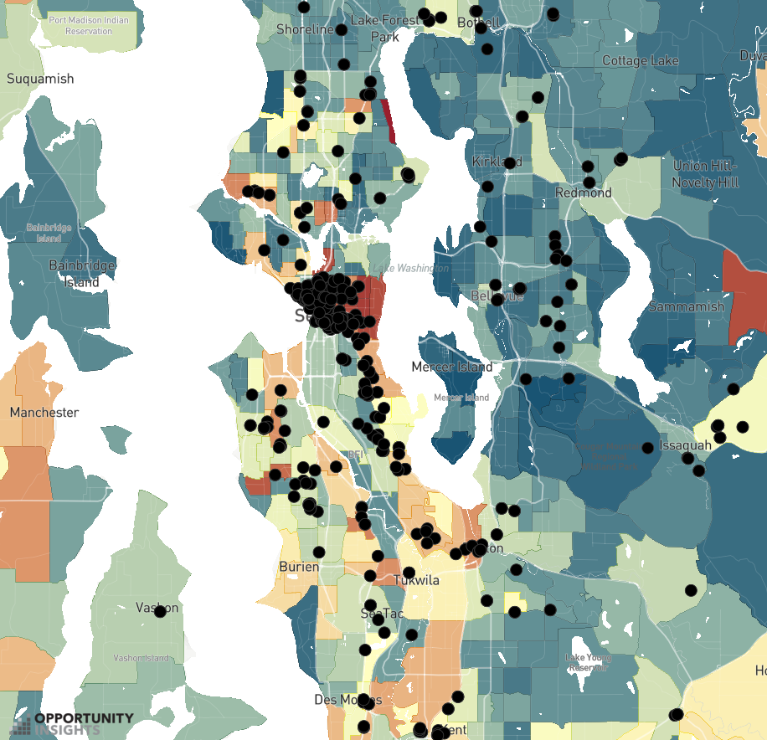
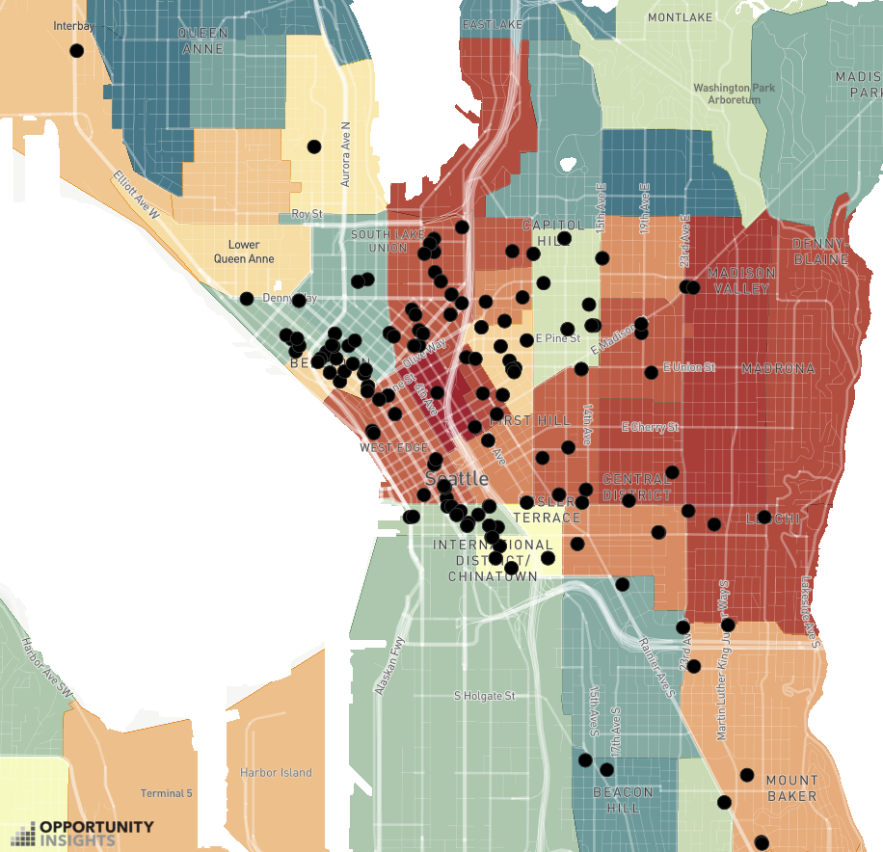
Is the Low Income Housing Tax Credit Reducing Mobility out of Poverty?
Location of LIHTC projects in Seattle
< $16k
$34k
> $56k

Slide 22
Why Don’t More Low-Income Families Move to Opportunity?
One simple explanation: areas that offer better opportunity may be unaffordable
To test whether this is the case, examine relationship between measures of upward mobility and rents

Slide 23
The Price of Opportunity in Seattle
Upward Mobility versus Median Rent by Neighborhood
50
45
40
with Low-Income Parents ($1000)
Average Incomes of Children
35
30
25
1000
1500
2000
2500
Median 2 Bedroom Rent in 2015

Slide 24
The Price of Opportunity in Seattle
Upward Mobility versus Median Rent by Neighborhood
50
45
40
with Low-Income Parents ($1000)
Average Incomes of Children
Creating Moves to Opportunity in Seattle
35
30
Central District
25
1000
1500
2000
2500
Median 2 Bedroom Rent in 2015

Slide 25
The Price of Opportunity in Seattle
Upward Mobility versus Median Rent by Neighborhood
50
Opportunity Bargains
45
Normandy Park
40
with Low-Income Parents ($1000)
Average Incomes of Children
Creating Moves to Opportunity in Seattle
35
30
Central District
25
1000
1500
2000
2500
Median 2 Bedroom Rent in 2015

Slide 26
Stability of Historical Measures of Opportunity
Tract-level data on children’s outcomes provide new information that could be helpful in helping families move to opportunity
Practical concern: data on upward mobility necessarily are historical, since one must wait until children grow up to observe their earnings
Opportunity Atlas estimates are based on children born in the early 1980s, who grew up in the 1990s and 2000s
Are historical estimates useful predictors of opportunity for children who are growing up in these neighborhoods now?

Slide 27
Stability of Tract-Level Estimates of Upward Mobility
Regression Estimates Using Estimates by Birth Cohort
100
80
60
Regression Coefficient (% of Coef. for One-Year Lag)
40
20
0
1
2
3
4
5
6
7
8
9
10
11
Lag (Years)

Slide 28
Creating Moves to Opportunity
Pilot study to help families with housing vouchers move to high-opportunity areas in Seattle using three approaches:
Providing information to tenants
Recruiting landlords
Offering housing search assistance
Bergman, Chetty, DeLuca, Hendren, Katz, Palmer 2019

Slide 30
Moving to Opportunity: Potential Concerns
Costs: is the voucher program too expensive to scale up?
Vouchers can save taxpayers money relative to public housing projects in long run

Slide 31
Impacts of MTO Experiment on Annual Income Tax Revenue in Adulthood
for Children Below Age 13 at Random Assignment
1200
1000
800
Annual Income Tax Revenue, Age ≥ 24 ($)
600
400
$447.5
$616.6
$841.1
200
p = 0.061
p = 0.004
0
Control
Section 8
Experimental
Voucher

Slide 32
Moving to Opportunity: Potential Concerns
Costs: is the voucher program too expensive to scale up?
Negative spillovers: does integration hurt the rich?
Evaluate this by examining how outcomes of the rich vary across areas in relation to outcomes of the poor
Empirically, more integrated areas do not have worse outcomes for the rich on average…

Slide 33
Children’s Outcomes vs. Parents Incomes in Salt Lake City vs. Charlotte
70
60
50
Child Percentile in National Income Distribution
40
30
20
0
20
40
60
80
100
Parent Percentile in National Income Distribution
Salt Lake City
Charlotte

Slide 34
Moving to Opportunity: Potential Concerns
Costs: is the voucher program too expensive to scale up?
Negative spillovers: does integration hurt the rich?
Limits to scalability
Moving everyone from one neighborhood to another is unlikely to have significant effects
Ultimately need to turn to policies that improve low-mobility neighborhoods rather than moving low-income families

Slide 35
Two Approaches to Increasing Upward Mobility
Moving to Opportunity: Provide Affordable Housing in High-Opportunity Areas
Place-Based Investments: Increase Upward Mobility in Low-Opportunity Areas

Slide 36
Place-Based Investments: Characteristics of High-Mobility Neighborhoods
Lower poverty rates
More stable family structure
Greater social capital
Better school quality
$
$
$

Slide 37
Spatial Decay of Correlation between Upward Mobility and Tract-Level Poverty Rates
Estimates from Multivariable Regression
0.0
-0.1
Regression Coefficient
-0.2
-0.3
Coefficient at 0: -0.314 (0.007)
Sum of Coefficients 1-10: -0.129 (0.009)
0
1
2
3
4
5
6
7
8
9
10
(1.9)
(3.0)
(4.0)
(4.8)
(5.6)
Neighbor Number
(Median Distance in Miles)

Slide 38
Spatial Decay of Correlation between Upward Mobility and Tract-Level Poverty Rates
Estimates from Multivariable Regression
0.0
-0.1
Poverty rates in neighboring tracts have little predictive power
conditional on poverty rate in own tract
Regression Coefficient
-0.2
-0.3
Coefficient at 0: -0.314 (0.007)
Sum of Coefficients 1-10: -0.129 (0.009)
0
1
2
3
4
5
6
7
8
9
10
(1.9)
(3.0)
(4.0)
(4.8)
(5.6)
Neighbor Number
(Median Distance in Miles)

Slide 39
Spatial Decay of Correlation between Upward Mobility and Block-Level Poverty Rates
Estimates from Multivariable Regression
0.01
0.00
-0.01
-0.02
Regression Coefficient
-0.03
-0.04
-0.05
Coefficient at 0: -0.057 (0.001)
-0.06
Sum of Coefficients 1-40: -0.224 (0.014)
0
20
40
60
80
100
120
140
160
180
200
(0.6)
(0.9)
(1.1)
(1.3)
Neighbor Number
(Median Distance in Miles)

Slide 40
What Place-Based Policies are Most Effective in Increasing Upward Mobility?
Current research frontier: understanding what types of interventions can improve children’s outcomes in lower-mobility places
Many efforts by local governments and non-profits to revitalize neighborhoods, but little evidence to date on what works
Key challenge: traditionally, very difficult to track the outcomes of prior residents rather than current neighborhood conditions

Slide 41
What Place-Based Policies are Most Effective in Increasing Upward Mobility?
Ongoing work at Opportunity Insights: tackle this problem using new data and interventions that build on what we know so far
Organizing framework: building a “pipeline” of opportunity from childhood to adulthood

Slide 42
Building a Pipeline for Economic Opportunity
Family Stability
Early Childhood Education
Social Capital: Mentorship
College and Career Readiness
Affordable Housing

Slide 43
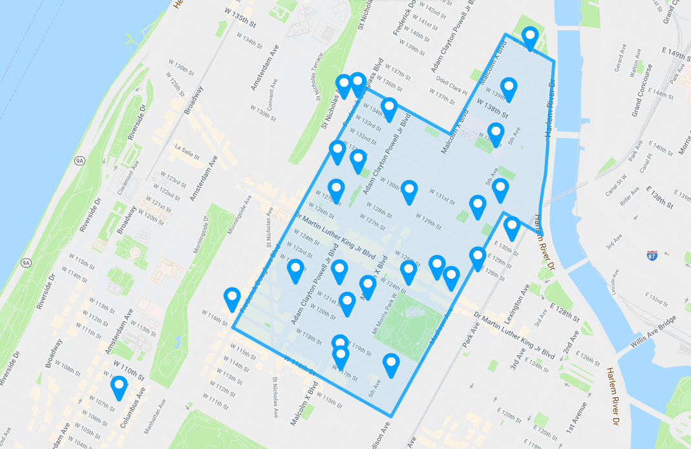
The Harlem Children’s Zone

Slide 45
Building Social Capital: Promising Interventions
BAM and Credible Messengers: mentoring programs focused on reducing violence and incarceration
Peer forward: older students provide younger students with college application guidance and support
Harmony Project: mentoring young children through music

Slide 46
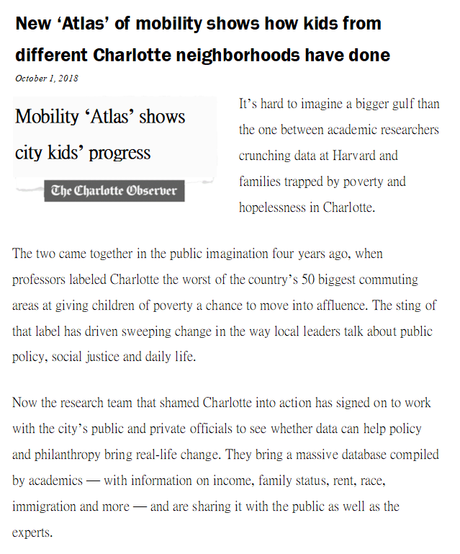
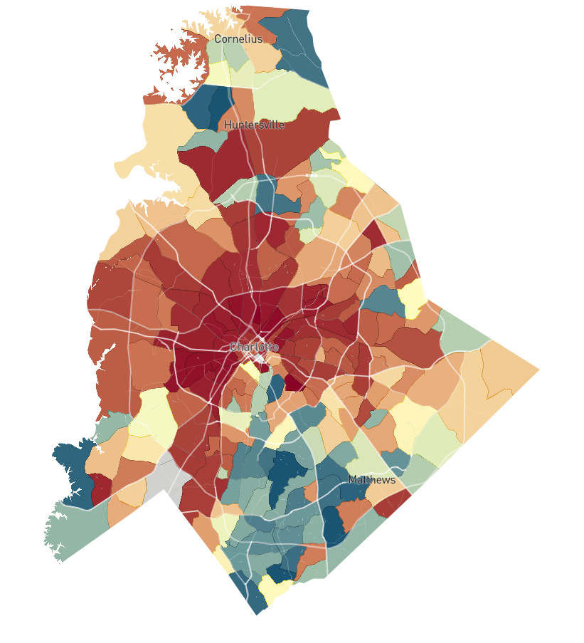
The Geography of Opportunity in Charlotte
< $16k
$34k
> $56k

Slide 47
Using Historical Data to Evaluate Place-Based Policies
In parallel to testing new interventions, we are using historical data and quasi-experimental methods to analyze previous place-based policies
First step: digitize data from tapes at the Census Bureau to build a longitudinal dataset that will allow us to follow Americans starting with those born in 1954
Use these data to study the impacts of place-based interventions (Harlem Children’s Zone, Hope VI demolitions, Enterprise Zones, …) on prior residents
What types of interventions improve prior residents’ outcomes rather than simply displacing them?

