Slide 1
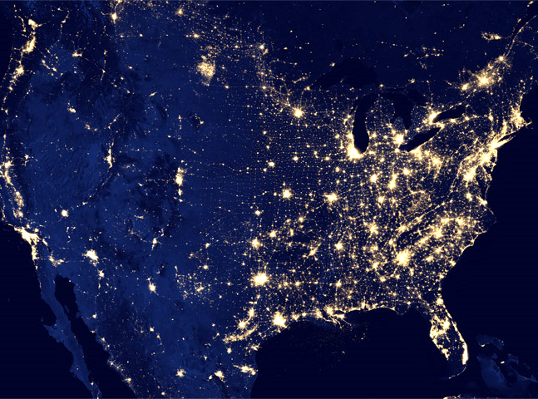
Using Big Data to Solve Economic and Social Problems
Professor Raj Chetty
Head Section Leader: Gregory Bruich, Ph.D.
Spring 2019
Notes:
Photo by Ev on Unsplash

Slide 2
Part 1 Local Area Variation in Upward Mobility
Causal Effects of Neighborhoods

Slide 3
Causal Effects of Neighborhoods vs. Sorting
Two very different explanations for variation in children’s outcomes across areas:
Sorting: different people live in different places
Causal effects: places have a causal effect on upward mobility for a given person

Slide 4
Identifying Causal Effects of Neighborhoods
Ideal experiment: randomly assign children to neighborhoods and compare outcomes in adulthood
We approximate this experiment using a quasi-experimental design
Study 3 million families who move across Census tracts in observational data
Key idea: exploit variation in age of child when family moves to identify causal effects of environment
Source: Chetty and Hendren QJE 2018; Chetty, Friedman, Hendren, Jones, Porter 2018

Slide 5
Income Gain from Moving to a Better Neighborhood
By Child’s Age at Move
$41K
Savin Hill
$35K
Average Income at Age 35
$29K
$23K
Roxbury
2
10
20
28
Age of Child when Parents Move

Slide 6
Income Gain from Moving to a Better Neighborhood
By Child’s Age at Move
$41K
Savin Hill
Move at age 2 from Roxbury to Savin Hill
→ average earnings of $38,000
$35K
Average Income at Age 35
$29K
$23K
Roxbury
2
10
20
28
Age of Child when Parents Move

Slide 7
Income Gain from Moving to a Better Neighborhood
By Child’s Age at Move
$41K
Savin Hill
$35K
Average Income at Age 35
$29K
$23K
Roxbury
2
10
20
28
Age of Child when Parents Move

Slide 8
Income Gain from Moving to a Better Neighborhood
By Child’s Age at Move
$41K
Savin Hill
$35K
Average Income at Age 35
$29K
$23K
Roxbury
2
10
20
28
Age of Child when Parents Move

Slide 9
Identifying Causal Effects of Neighborhoods
Key assumption: timing of moves to a better/worse area unrelated to other determinants of child’s outcomes
This assumption might not hold for two reasons:
Parents who move to good areas when their children are young might be different from those who move later
Moving may be related to other factors (e.g., change in parents’ job) that affect children directly

Slide 10
Identifying Causal Effects of Neighborhoods
Two approaches to evaluating validity of this assumption:
Compare siblings’ outcomes to control for family effects

Slide 11
Identifying Causal Effects of Neighborhoods
Two approaches to evaluating validity of this assumption:
Compare siblings’ outcomes to control for family effects
Use differences in neighborhood effects across subgroups to implement “placebo” tests
Ex: some places (e.g., low-crime areas) have better outcomes for boys than girls
Move to a place where boys have high earnings → son improves in proportion to exposure but daughter does not
Conclude that about two-thirds of the variation in upward mobility across areas is due to causal effects

Slide 12
Part 1 Local Area Variation in Upward Mobility
Characteristics of High-Mobility Areas

Slide 13
Why Does Upward Mobility Differ Across Areas?
Why do some places produce much better outcomes for disadvantaged children than others?
Begin by characterizing the properties of areas with high rates of upward mobility using correlational analysis
Do places with higher mobility tend to have better jobs, schools, different institutions, …?

Slide 14
Upward Mobility vs. Job Growth in the 30 Largest Metro Areas
San Jose
High mobility,
low growth
High mobility,
high growth
$38K
San Francisco
Boston
Minneapolis
Pittsburgh
New York
Seattle
Los Angeles
Sacramento
$34K
Washington
San Diego
Portland
Houston
Average Income at Age 35 of Children who Grew up in Low-Income Families
Denver
Riverside
Miami
San Antonio
Philadelphia
Kansas City
Dallas
Phoenix
$30K
Chicago
Cleveland
St. Louis
Cincinnati
Tampa
Detroit
Baltimore
Atlanta
$26K
Charlotte
Low mobility,
low growth
Low mobility,
high growth
0
20
40
60
Job Growth Rate (%) from 1990-2010

Slide 15
Five Strongest Correlates of Upward Mobility
Segregation
Greater racial and income segregation associated with lower levels of mobility

Slide 16
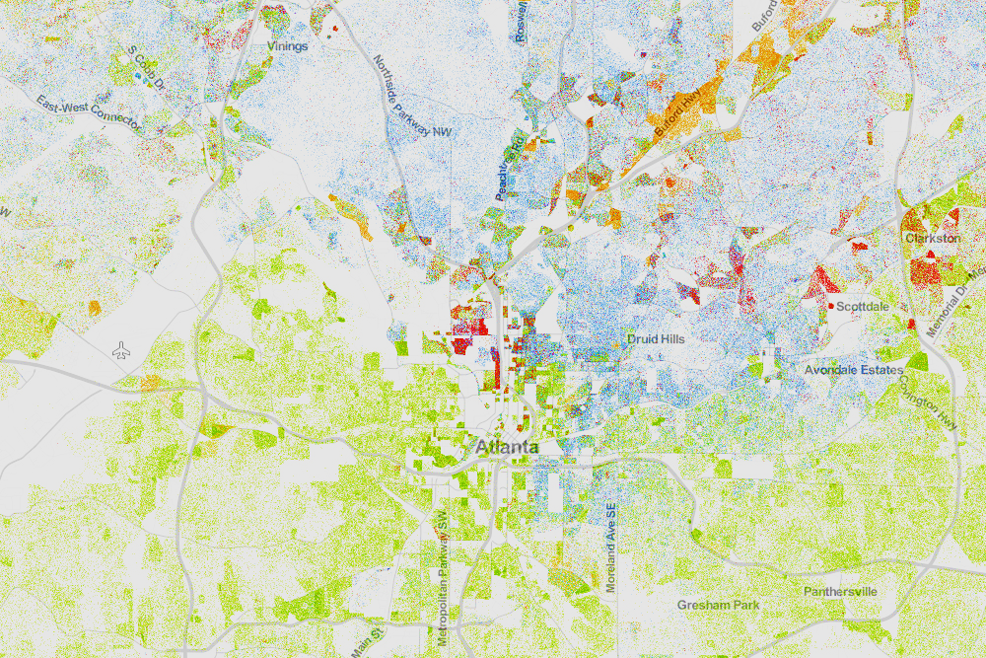
Racial Segregation in Atlanta
Whites (blue), Blacks (green), Asians (red), Hispanics (orange)
Source: Cable (2013) based on Census 2010 data

Slide 17
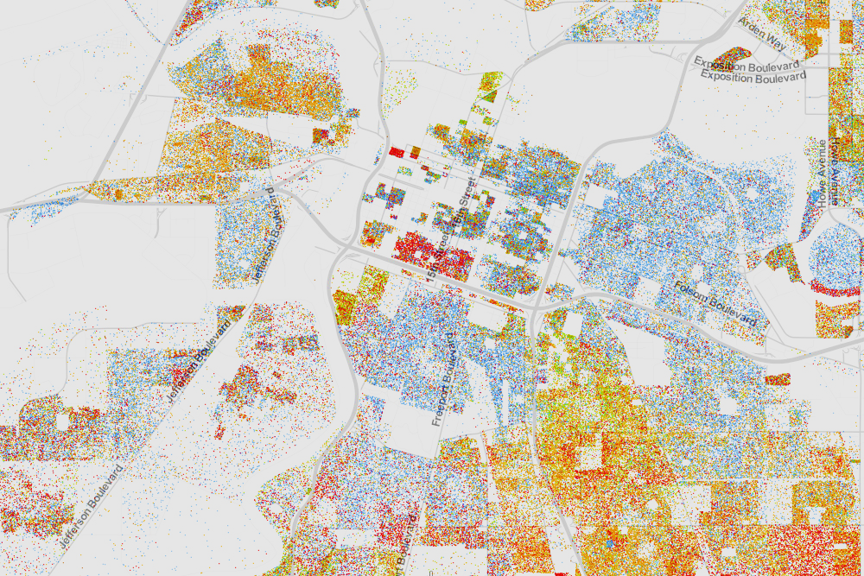
Racial Segregation in Sacramento
Whites (blue), Blacks (green), Asians (red), Hispanics (orange)
Source: Cable (2013) based on Census 2010 data

Slide 18
Five Strongest Correlates of Upward Mobility
Segregation
Income Inequality
Places with smaller middle class have much less mobility

Slide 19
Five Strongest Correlates of Upward Mobility
Segregation
Income Inequality
School Quality
Higher expenditure, smaller classes, higher test scores correlated with more mobility

Slide 20
Five Strongest Correlates of Upward Mobility
Segregation
Income Inequality
School Quality
Family Structure
Areas with more single parents have much lower mobility
Strong correlation even for kids whose own parents are married

Slide 21
Five Strongest Correlates of Upward Mobility
Segregation
Income Inequality
School Quality
Family Structure
Social Capital
“It takes a village to raise a child”
Putnam (1995): “Bowling Alone”

Slide 22
Part 1 Local Area Variation in Upward Mobility
Policies to Improve Upward Mobility

Slide 23
Policy Interest in Increasing Upward Mobility
Recent research has shifted national conversation on poverty to focus on income mobility and the role of childhood environment

Slide 24
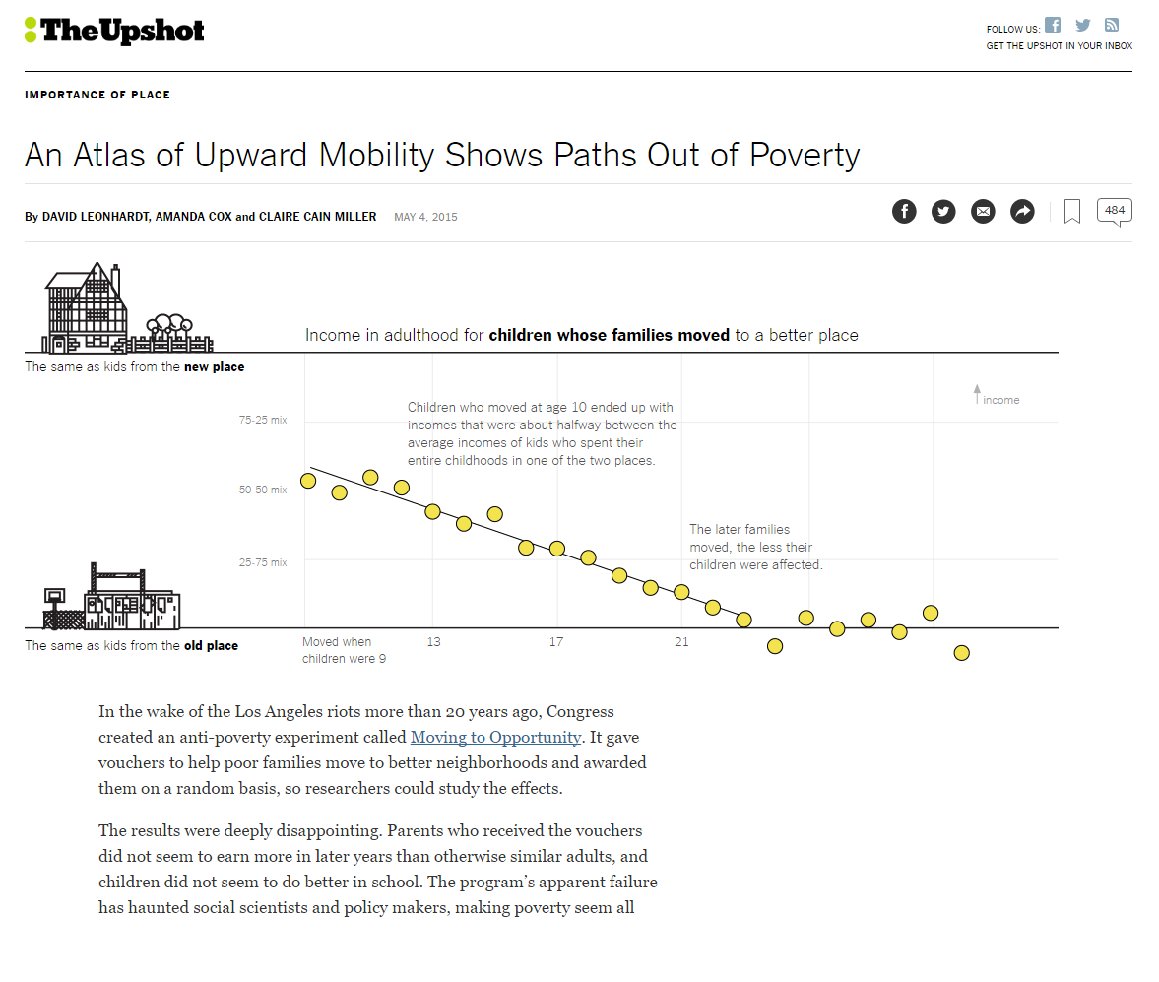

Slide 26
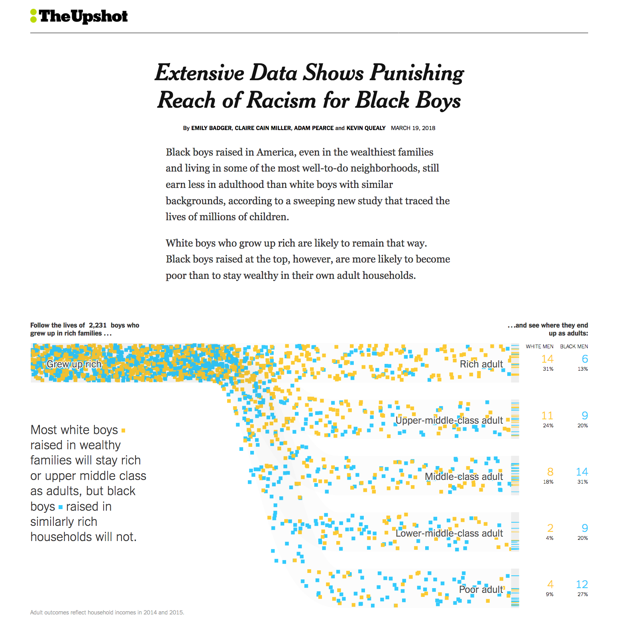
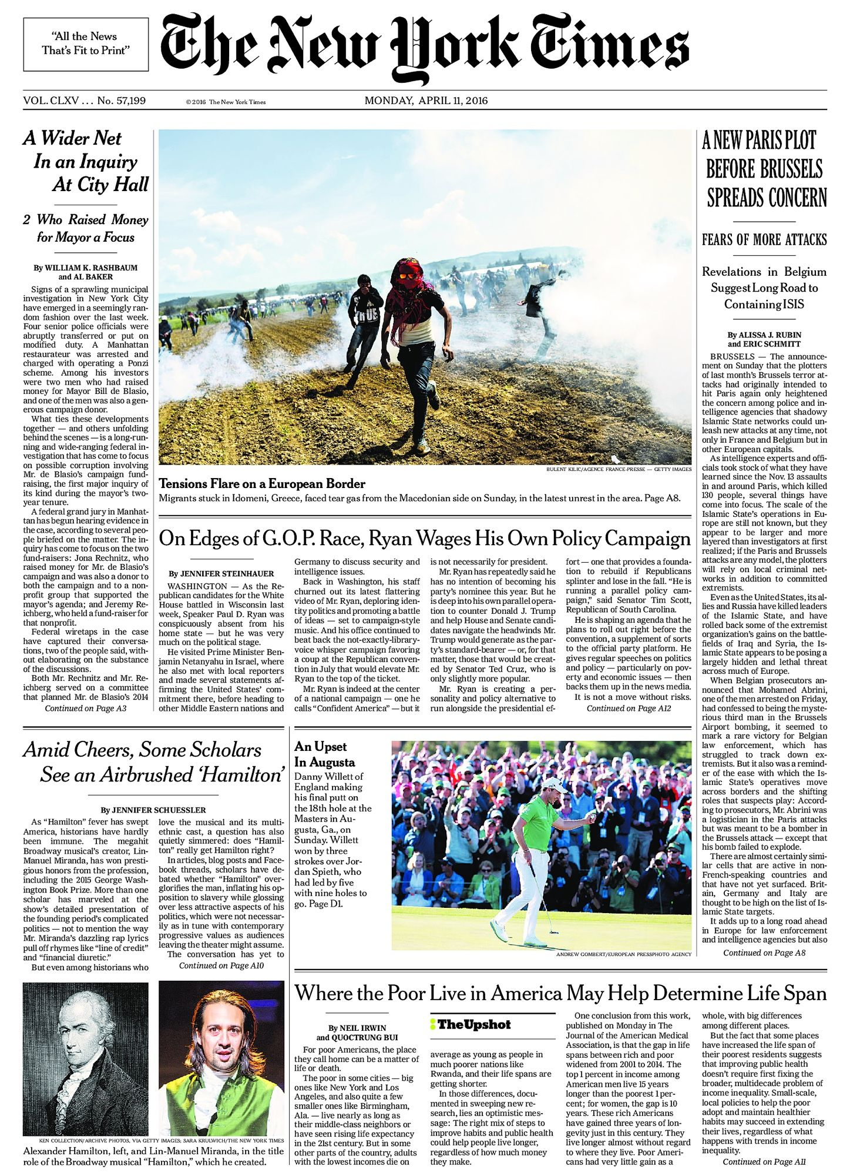
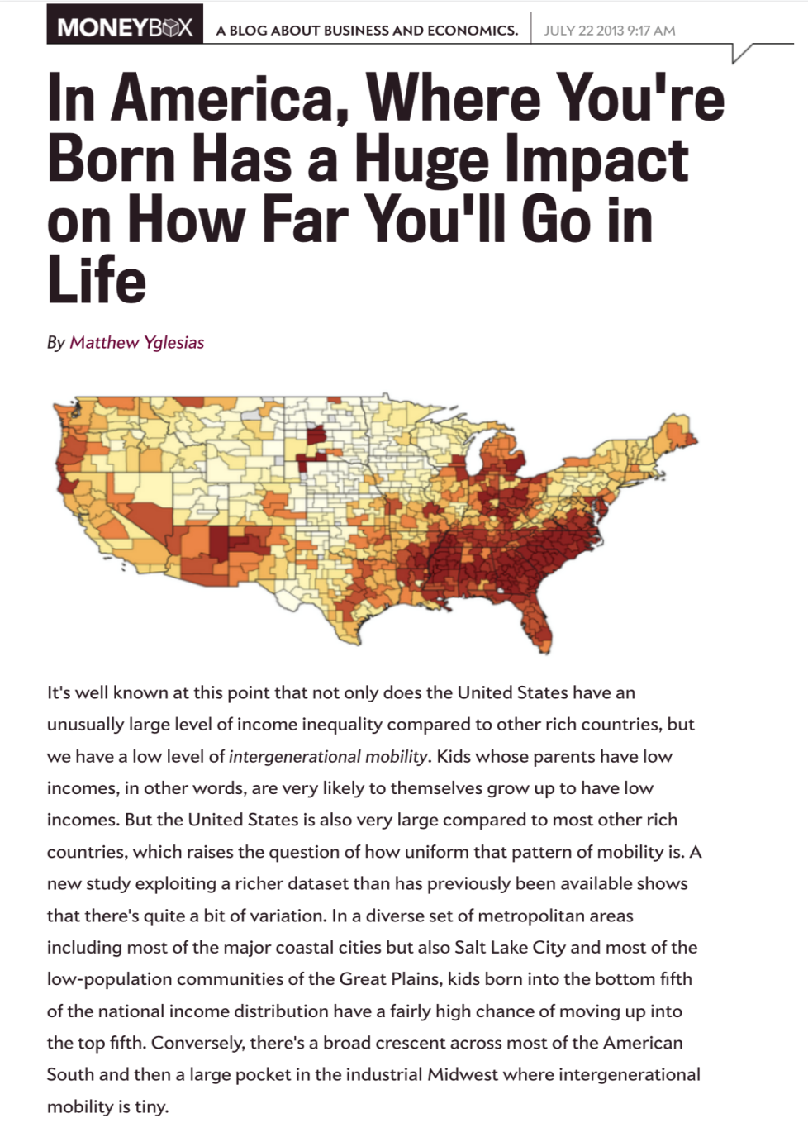
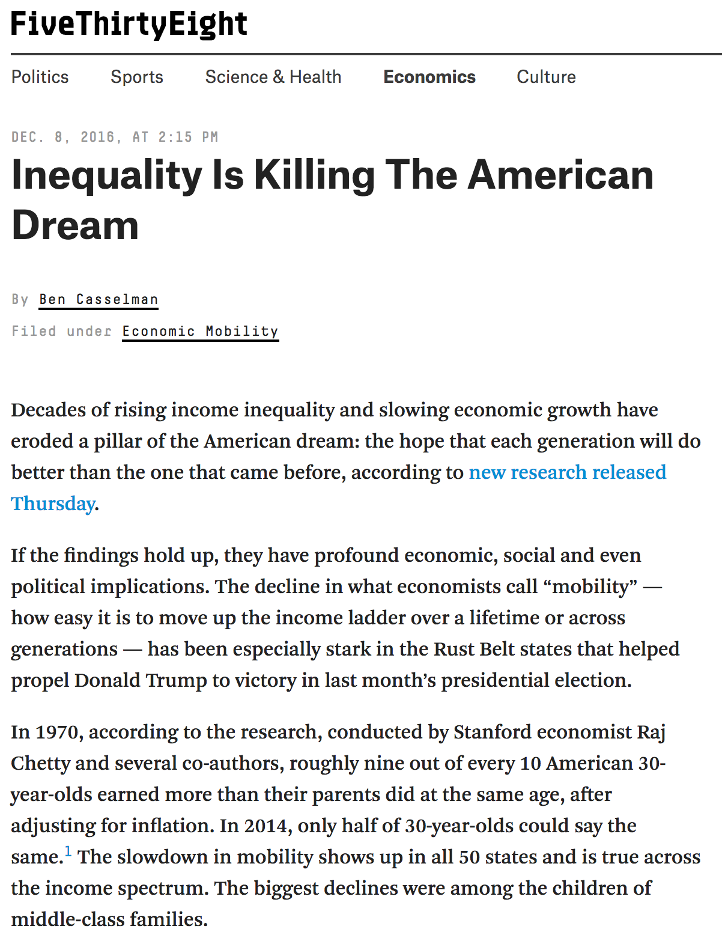
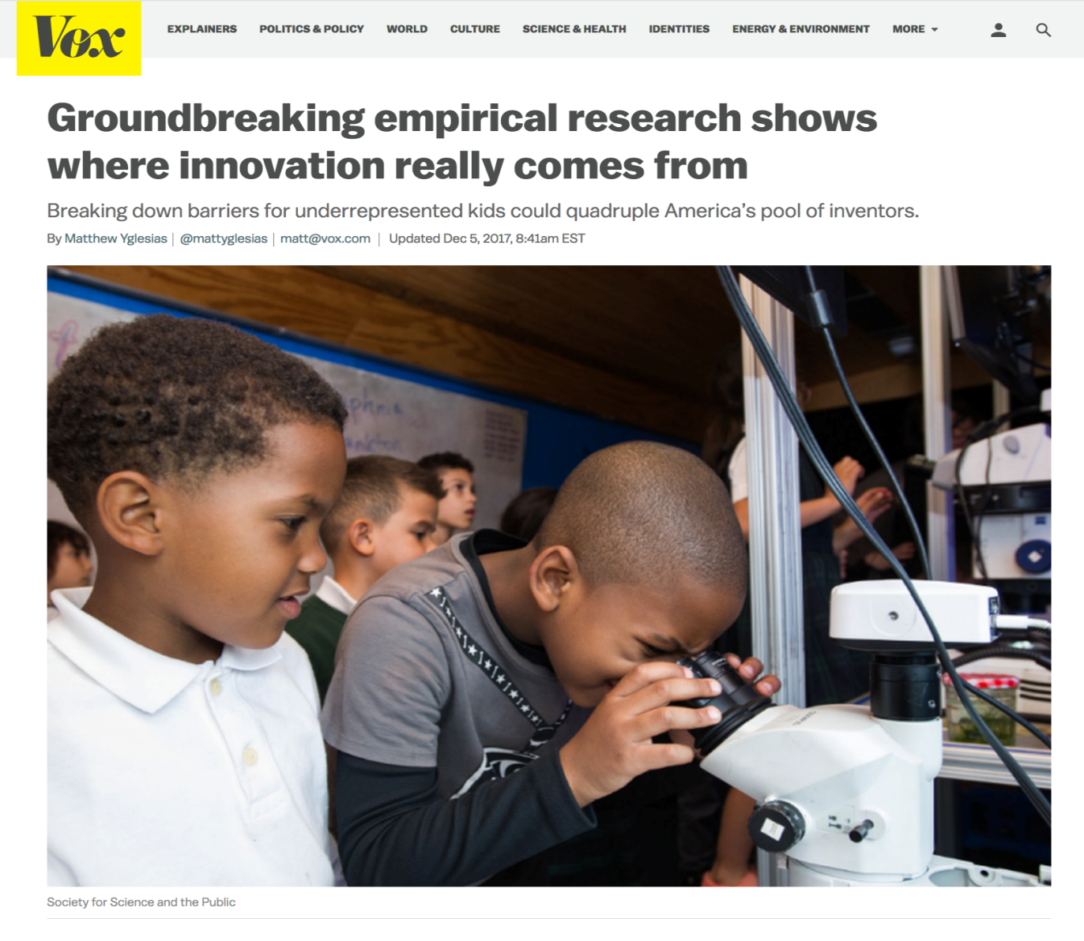
Why are we here?

Slide 27
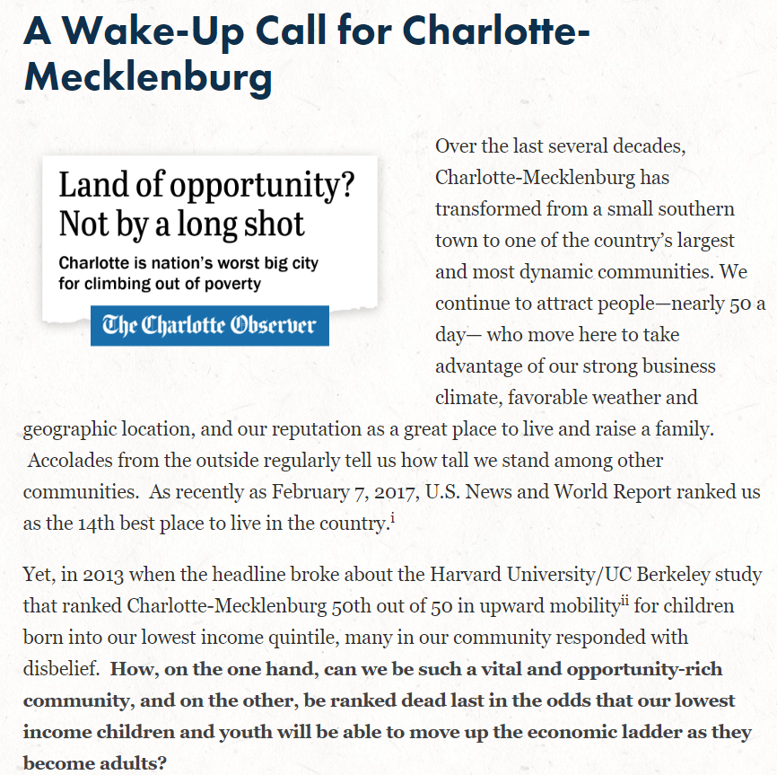
January 25, 2014

Slide 28
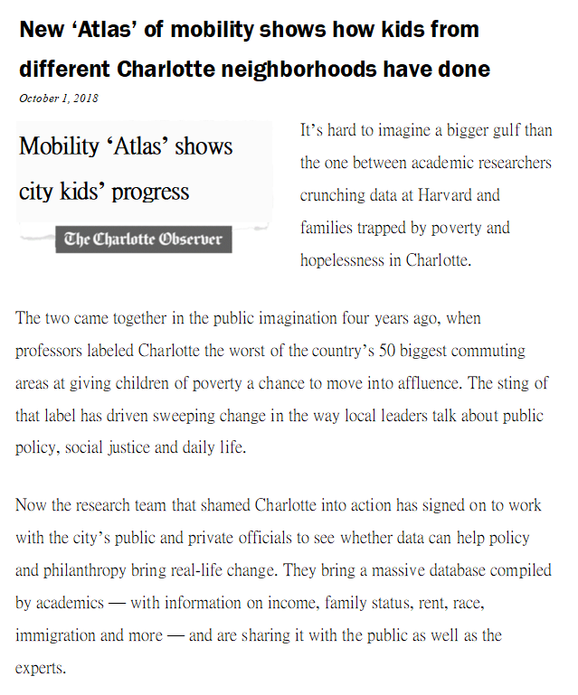
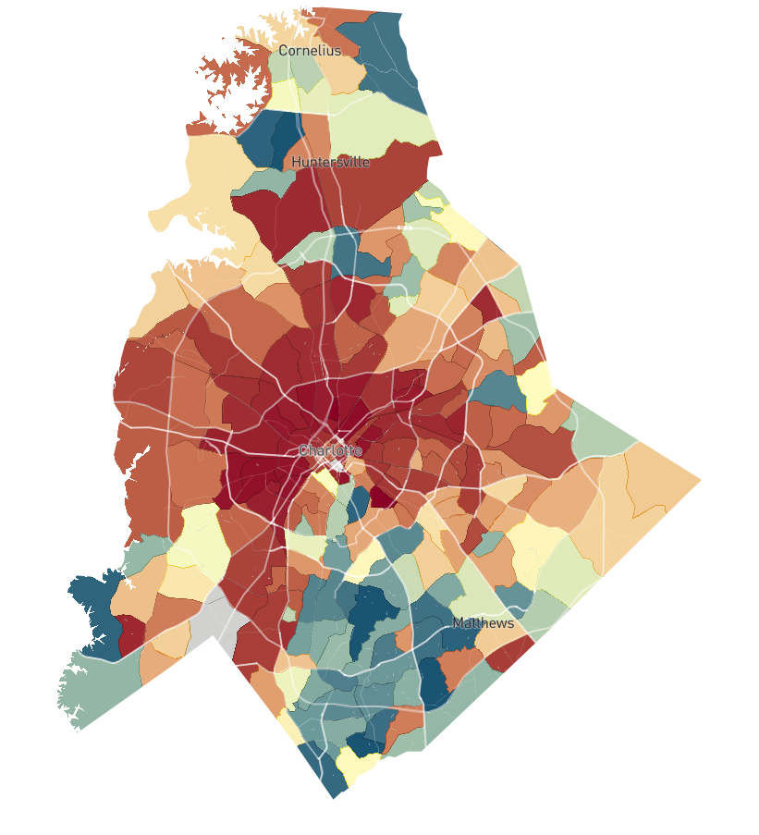
The Geography of Opportunity in Charlotte
< $16k
$34k
> $56k

Slide 29
Two Approaches to Increasing Upward Mobility
Moving to Opportunity: Provide Affordable Housing in High-Opportunity Areas
Place-Based Investments: Increase Upward Mobility in Low-Opportunity Areas

Slide 30
Part 1 Local Area Variation in Upward Mobility
Moving to Opportunity
Note: this Section is Based on: Chetty, Hendren, Katz. “The Long-Term Effects of Exposure to Better Neighborhoods: New Evidence from the Moving to Opportunity Experiment” AER 2016

Slide 31
Affordable Housing Policies in the United States
Many potential policies to help low-income families move to better neighborhoods:
Subsidized housing vouchers to rent better apartments
Mixed-income affordable housing developments (LIHTC)
Changes in zoning regulations and building restrictions
Are such housing policies effective in increasing social mobility?
Useful benchmark: cash grants of an equivalent dollar amount to families with children

Slide 32
Affordable Housing Policies
Economic theory predicts that cash grants of an equivalent dollar amount are better than expenditures on housing
Yet the U.S. spends $45 billion per year on housing vouchers, tax credits for developers, and public housing
Are these policies effective, and how can they be better designed to improve social mobility?
Study this question here by focusing specifically on the role of housing vouchers for low-income families

Slide 33
Studying the Effects of Housing Vouchers
Question: will a given child i’s earnings at age 30 (Y_{i}) be higher if his/her family receives a housing voucher?
Definitions:
Y_{i}(V=1) = child’s earnings if family gets voucher
Y_{i}(V=0) = child’s earnings if family does not get voucher
Goal: estimate treatment effect of voucher on child i:
G_{i} = Y_{i}(V=1) – Y_{i}(V=0)

Slide 34
Studying the Effects of Housing Vouchers
Fundamental problem in empirical science: we do not observe Y_{i}(V=1) and Y_{i}(V=0) for the same person
We only see one of the two potential outcomes for each child
Either the family received a voucher or didn’t…
How can we solve this problem?
This is the focus of research on causality in statistics

Slide 35
Randomized Experiments
Gold standard solution: run a randomized experiment (A/B testing in the lingo of tech firms)
Example: take 10,000 children and flip a coin to determine if they get a voucher or not
Difference in average earnings across the two groups is the average treatment effect of getting the voucher (average value of G_{i})
Intuition: two groups are identical except for getting voucher → difference in earnings capture causal effect of voucher

Slide 36
Importance of Randomization
Suppose we instead compared 10,000 people, half of whom applied for a voucher and half of whom didn’t
Could still compare average earnings in these two groups
But in this case, there is no guarantee that differences in earnings are only driven by the voucher
There could be many other differences across the groups:
Those who applied may be more educated
Or they may live in worse areas to begin with
Randomization eliminates all other such differences

Slide 37
Non-Compliance in Randomized Experiments
Common problem in randomized experiments: non-compliance
In medical trials: patients may not take prescribed drugs
In voucher experiment: families offered a voucher may not actually use it to rent a new apartment
We can’t force people to comply with treatments; we can only offer them a treatment
How can we learn from experiments in the presence of such non-compliance?

Slide 38
Adjusting for Non-Compliance
Solution: adjust estimated impact for rate of compliance
Example: suppose half the people offered a voucher actually used it to rent a new apartment
Suppose raw difference in earnings between those offered voucher and not offered voucher is $1,000
Then effect of using voucher to rent a new apartment must be $2,000 (since there is no effect on those who don’t move)
More generally, divide estimated effect by rate of compliance:
True Impact = Estimated Impact/Compliance Rate

