Slide 1


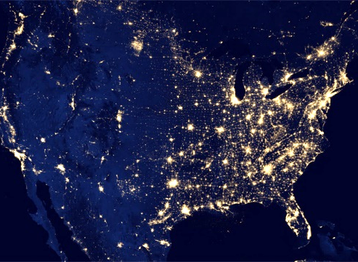



Using Big Data to Solve Economic and Social Problems
Professor Raj Chetty
Head Section Leader: Gregory Bruich, Ph.D.
Spring 2019
Notes:
Photo by Ev on Unsplash

Slide 2
Estimating the Social Cost of Carbon
Three general steps in estimating the social cost of carbon:
  Predict impact of 1 extra ton of CO₂ on climate using a climate forecasting model
  Measure impacts of changes in climate on economic productivity, health, property damage, etc.
  Calculate current social cost by converting future costs to current dollars (discounting)

Slide 3
Estimating the Social Cost of Carbon
Three general steps in estimating the social cost of carbon:
  Predict impact of 1 extra ton of CO₂ on climate using a climate forecasting model
  Measure impacts of changes in climate on economic productivity, health, property damage, etc.
  Calculate current social cost by converting future costs to current dollars (discounting)

Slide 4
Discounting Future Costs
Studies discussed thus far examine costs of environmental damage in a single year
  Ex: loss of GDP of 23% in 2100 due to climate change or $6.5 billion cost of greater air pollution for kids born each year
Final step in calculating social costs of environmental damage: add up this sequence of costs to generate a single current value
Critical question in this step: how much is money tomorrow worth today?
  If we don’t care about future generations, then costs are not large
  If we care equally about all generations, costs can be infinite

Slide 5
Estimating Long-Run Discount Rates
Challenge: how can we estimate how people value cash flows over a period of hundreds of years using real-world data?
Giglio, Maggiori, and Stroebel (2015) develop an innovative approach
Use data on all residential properly sales in the U.K. and Singapore in 2000s
Compare how much people pay for two different types of housing contracts
  Freeholds: perpetual ownership (like in the U.S.)
  Leasehold: ownership for a fixed period (e.g., 100 years or 1000 years)

Slide 6
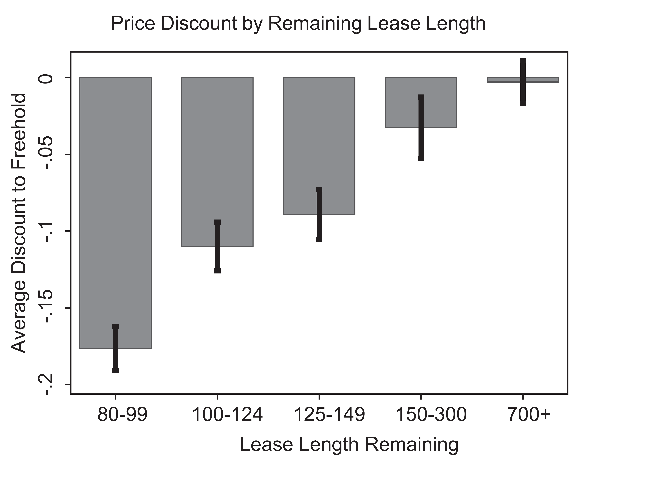
People pay 12% less for a house that they will own for 100 years relative to a house they will own forever

Slide 7
Estimating Long-Run Discount Rates
Price discount even for 100 yr+ leaseholds shows that they place substantial value on money then will have more than 100 years from now
Implied annual discount rate is 2.6%, i.e. $1,000 a year from now is worth $974 today

Slide 8
Summary: Social Cost of Carbon
Putting together all of these estimates, what is the social cost of carbon?
Obama Interagency Working Group on Social Cost of Carbon was tasked with answering this question
Compiled data on estimated impacts of carbon emissions
Applied a discount rate of 3% to future costs
→ Social cost of carbon set at $40 per ton of CO₂ emitted
  This number is now used in numerous policy decisions, ranging from fuel-economy rules for cars to regulations on power plants

Slide 9
Summary: Social Cost of Carbon
But this social cost estimate is not set in stone and is highly debated
Trump administration suggests using a 7% discount rate instead
  Yields a social cost of carbon of $5 per ton [Greenstone NYT 2016]
Would dramatically change the set of policies that the government will pursue

Slide 10
Policies to Mitigate Climate Change

Slide 11
How Can We Mitigate Climate Change and Reduce Pollution?
Given estimates of the costs of climate change, we can agree on targets in terms of reducing carbon emissions or air pollution
What policies can we use to change human behavior to achieve these social goals?
Most common policy tool: corrective (“Pigouvian”) taxes that increase private costs of consumption

Slide 12
Effects of Gasoline Taxes
Taxes on gasoline are one potential way to reduce gas consumption and CO₂ emissions
First question: are gas tax changes passed through to consumers or do just they affect the profits of oil companies?
Doyle and Sampatharank (2008) study this question using state-level gas tax reforms and a difference-in-differences design
  Gas prices spiked above $2.00 in 2000
  IN suspended its gas tax on July 1 and reinstated it on Oct 30
  IL suspended its gas tax on July 1 and reinstated it on Dec 31

Slide 13
Summer 2000 Difference in Log Gas Prices
IL/IN vs. Neighboring States: MI, OH, MO, IA, WI

Slide 14
Fall 2000 Difference in Log Gas Prices
IL/IN vs. Neighboring States: MI, OH, IL

Slide 15
Winter 2000/2001 Difference in Log Gas Prices
IL vs. Neighboring States: MI, IA, WI, IN

Slide 16
Effects of Gasoline Taxes on Gasoline Prices
Finding: 10 cent increase in gas tax → 7 cent increase in price paid by consumers
Implies that gas taxes could potentially reduce consumption of gas
Next question: how much less gas do people use when prices go up?

Slide 17
Effects of Gasoline Taxes on Gasoline Demand
Li et al. (2014) generalize this approach to estimate effects of state tax changes on demand for gas
Use data covering all 50 states and exploit changes in tax rates in all states from 1966-2008

Slide 18
Changes in State Gas Taxes from 1987-2008 (cents per gallon)

Slide 19
Effects of Gasoline Taxes on Gasoline Demand
To generalize diff-in-diff approach to 50 states and 44 years (more than 500 “experiments”), use a method called fixed effects regression
Relate differential changes in a state’s gas consumption (relative to avg. national change in a given year) to differential change in its tax rate
  Regress Δg_{sy} – Δg_{y} on Δtax_{sy} – Δtax_{y}
Resulting coefficient represents causal effect of tax change assuming that trends would be parallel across states absent tax changes

Slide 21
Effects of Gasoline Taxes on Gasoline Demand
$1 increase in gas tax → 17% reduction in gasoline consumption
Transportation sector accounts for about 1/3 of carbon emissions → $1 increase in gas tax reduces carbon emissions by about 5%
[Davis et al. 2011]
For comparison, scientists predict that we need to cut CO₂ emissions by about 50% to stop increase in global temperatures
Lesson: gas taxes make a difference, but need very large taxes to have a meaningful impact on climate change

Slide 22
Effect of Electricity Prices on Electricity Usage
Next, consider effects of prices on electricity consumption
Electricity is priced using tiered rates: price of an additional kilowatt is higher when you are already using a lot of electricity
Intended to discourage heavy usage without making electricity very expensive for the poor
Does tiered pricing work?

Slide 23
Analyzing Impacts of Tiered Price Schedules
Impacts of tiered price schedules can be analyzed by examining distribution of outcome variable
At points where prices change, we expect “bunching” in the distribution if people are responding [Saez 2010]
Simplest example: progressive income tax schedule
  Tax rate changes discontinuously at certain thresholds, analogous to a tiered pricing plan
Ex: low-income households receive Earned Income Tax Credit, which provides subsidies for earning more up to certain cutoffs

Slide 24
2008 Federal Earned Income Tax Credit Amount for Single Parents
$5K
$4K
$3K
Earned Income Tax Credit
$2K
$1K
$0K
$0
$10K
$20K
$30K
$40K
Total Earnings (Real 2010 $)
One Child
Two or More Children

Slide 25
Income Distributions for Individuals with Children in 2008 Based on U.S. Tax Data
5%
4%
3%
Percent of Tax Filers
2%
1%
One Child
Two Children
0%
$0
$10K
$20K
$30K
$40K
Total Earnings (Real 2010 $)
Source: Chetty, Friedman, Saez (2013)

Slide 26
Effects of Tiered Prices on Electricity Usage
Ito (2014) studies impact of prices on electricity usage using household-level billing data from utility companies in Orange County, CA
Begin by examining effect of tiered pricing on distribution of electricity consumption for customers of Southern California Edison (SCE)

Slide 27
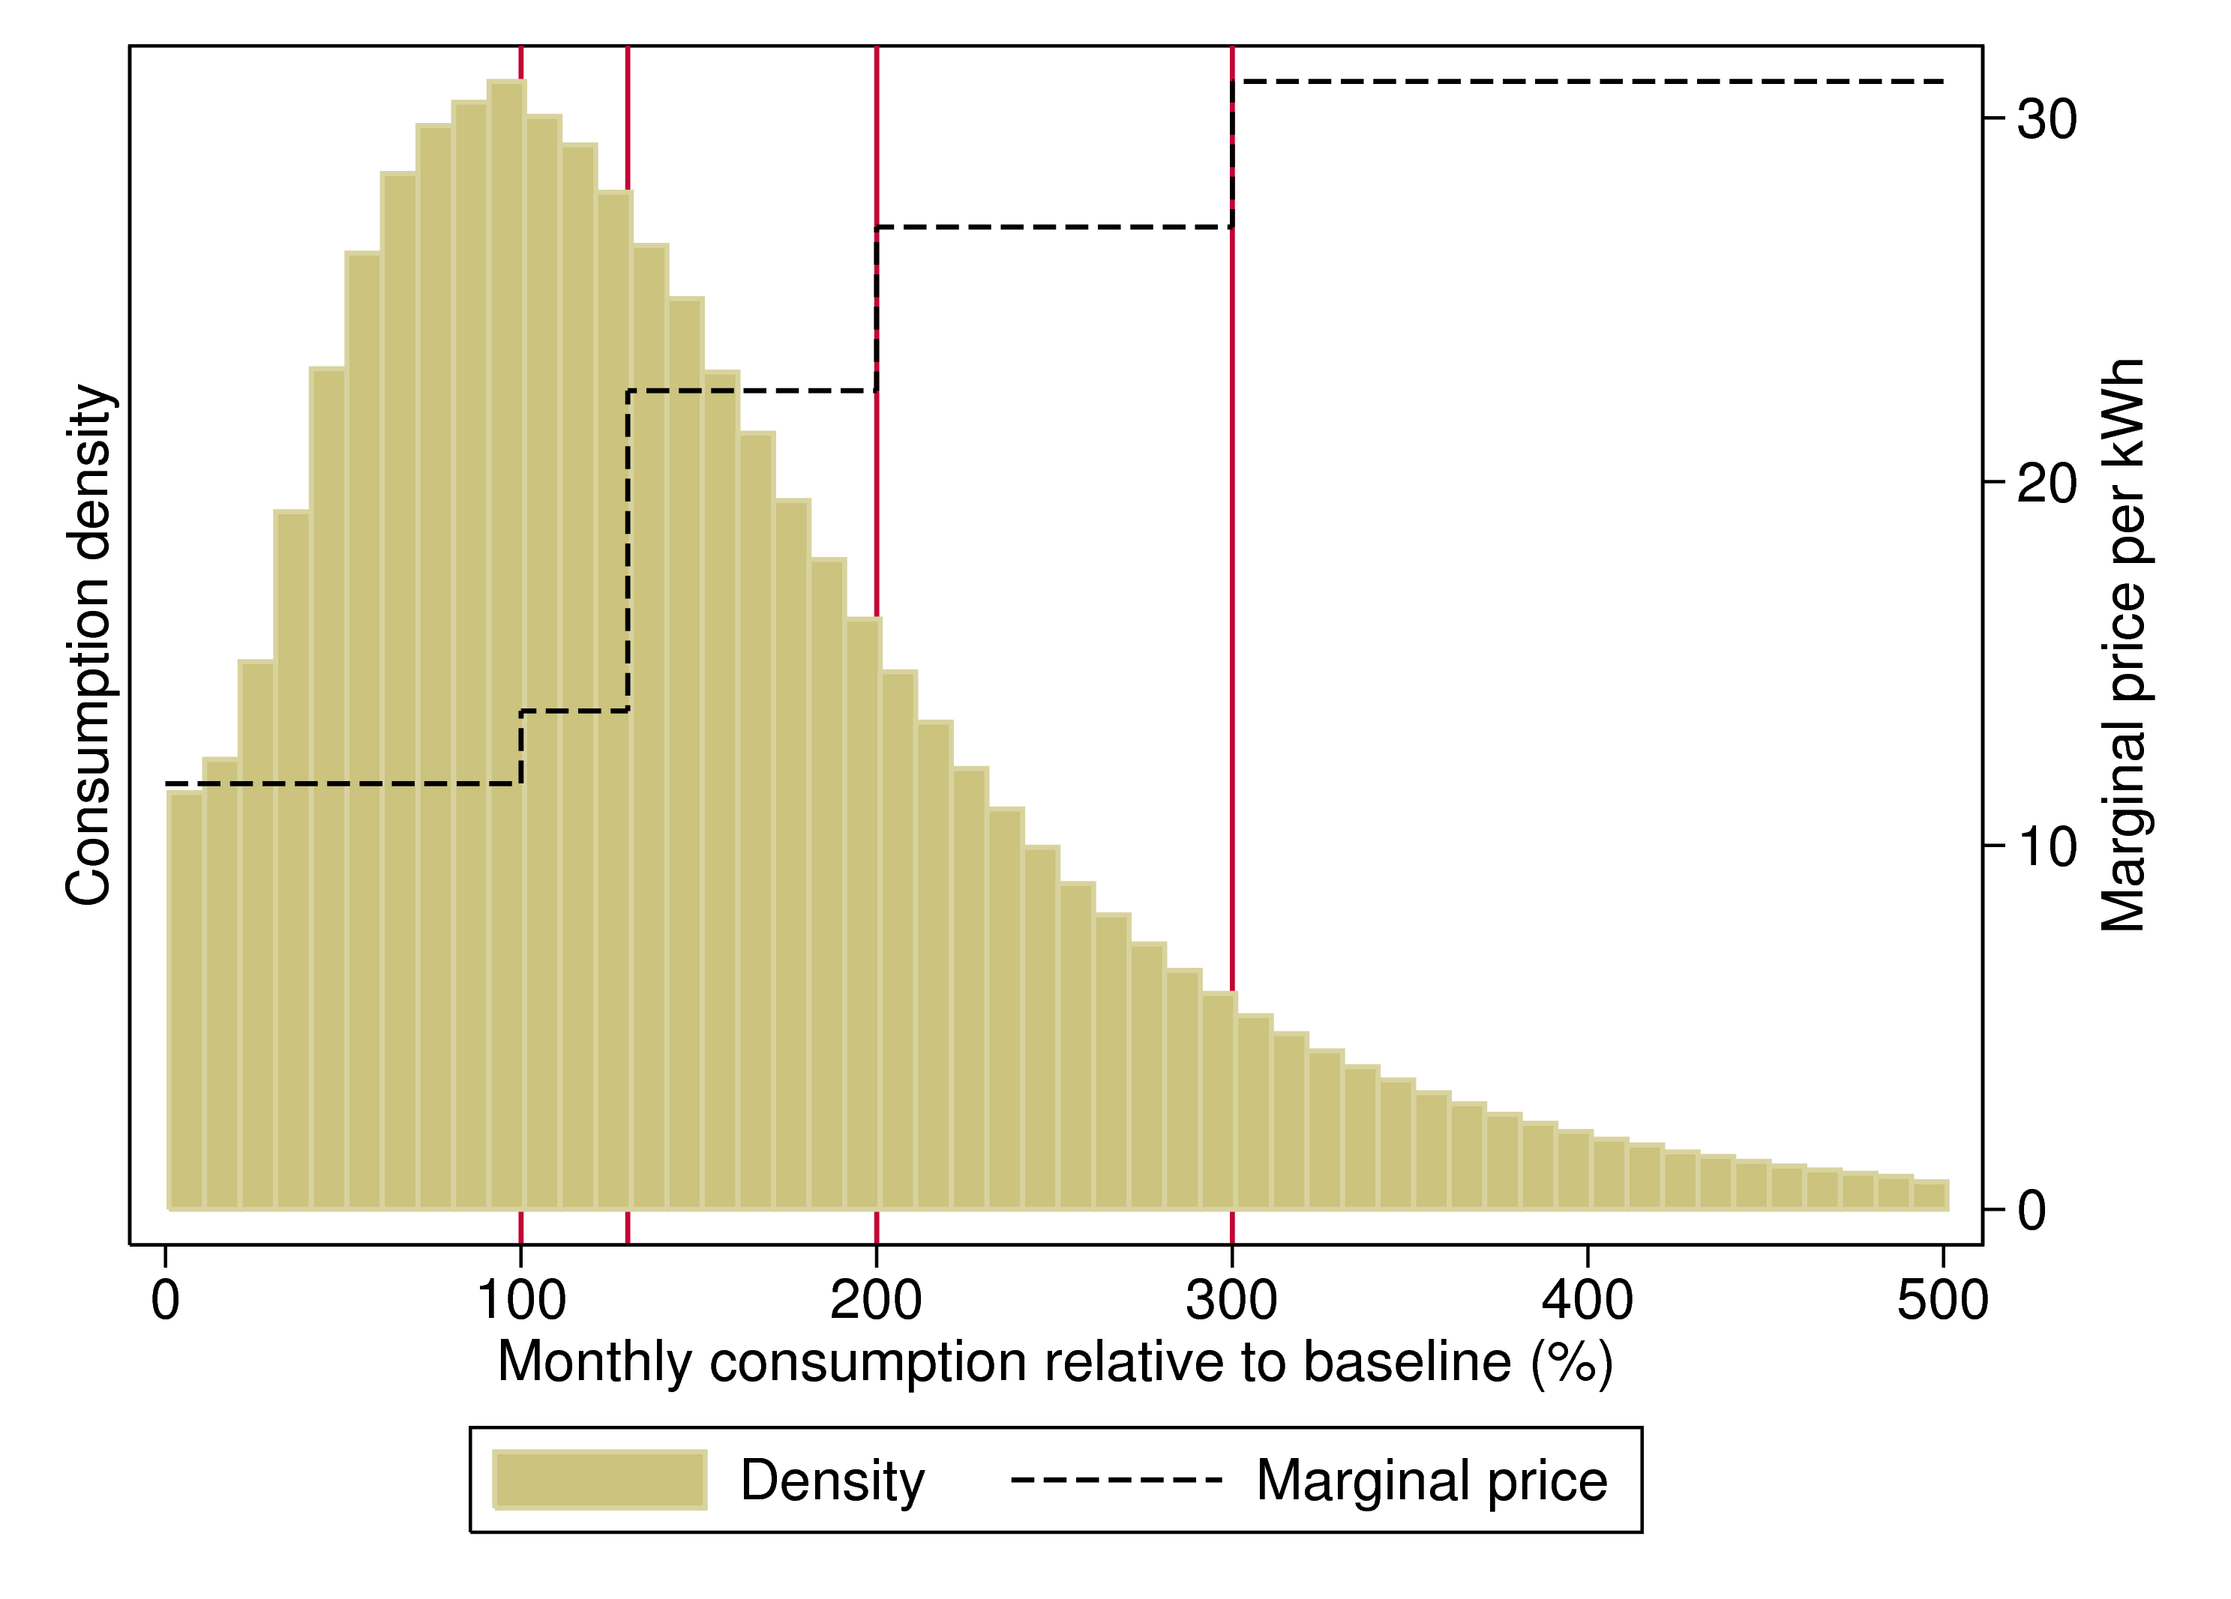
Prices and Distribution of Electricity Consumption for SCE Customers in 2007

Slide 28
Effects of Tiered Prices on Electricity Usage
No evidence of bunching at points where electricity prices jump → suggests that consumers are not responding to changes in tiered pricing
Two interpretations:
  Consumer demand for electricity is insensitive to price
  Lack of salience: consumers are unaware of electricity price schedule

Slide 29
Effects of Tiered Prices on Electricity Usage
To distinguish between these explanations, Ito uses a second strategy
Utility company that provides service depends upon where families live: Southern California Edison (SCE) vs. San Diego Gas and Electric (SDG&E)

Slide 30
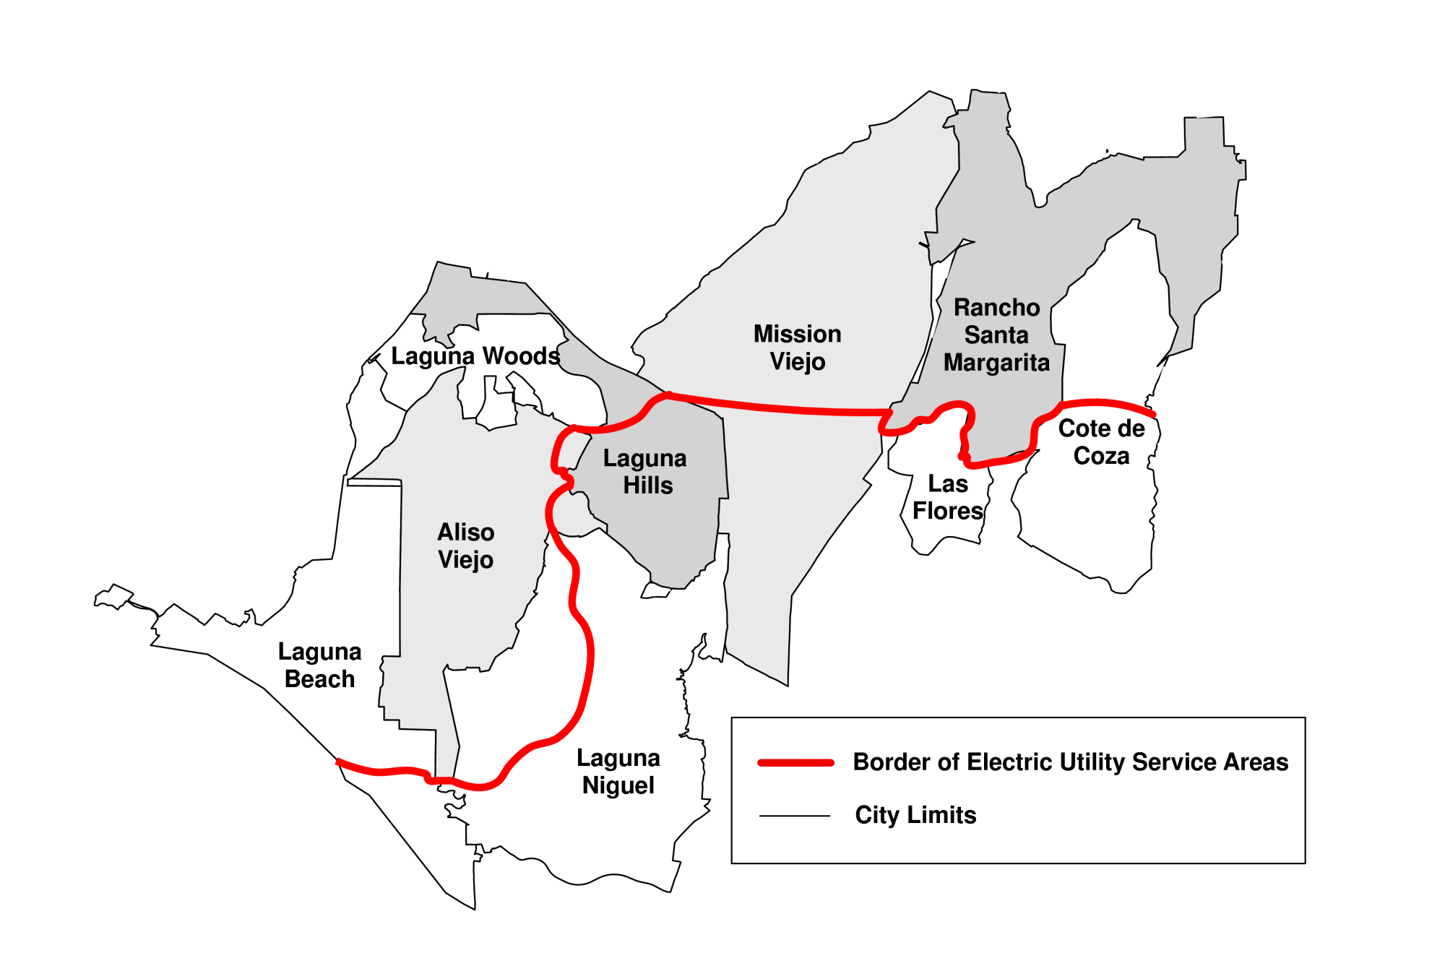
A Spatial Discontinuity in Electric Utility Service Areas in Orange County, California
SCE
SDG&E

Slide 31
Effects of Tiered Prices on Electricity Usage
To distinguish between these explanations, Ito uses a second strategy
Utility company that provides service depends upon where families live: Southern California Edison (SCE) vs. San Diego Gas and Electric (SDG&E)
In August 2000, SDG&E raised average electricity prices, while SCE did not
  Uses a spatial regression-discontinuity design to estimate effect of this change

Slide 32
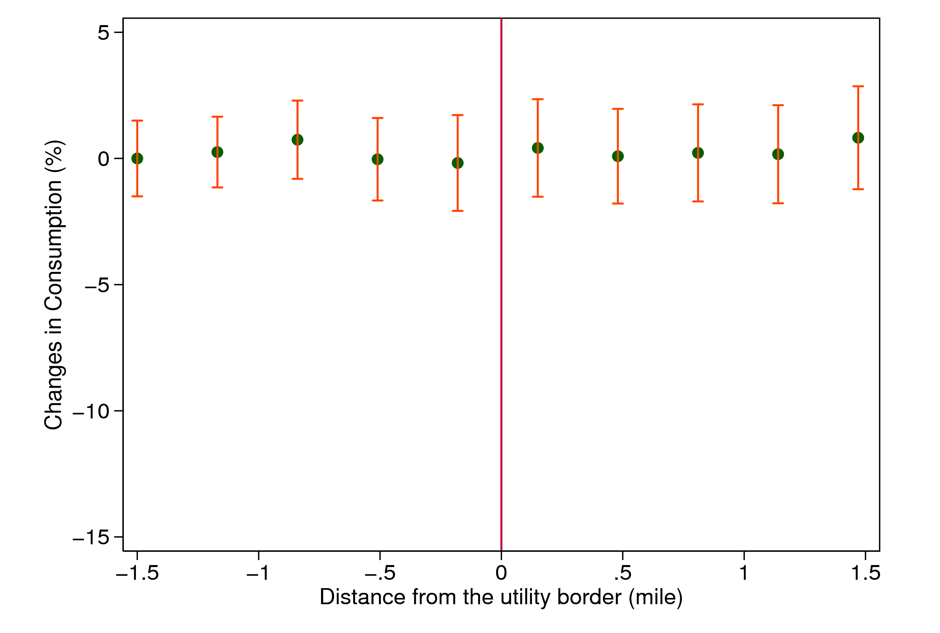
Changes in Consumption from July 1999 to July 2000,
by Distance from the Utility Border
SCE
SDG&E

Slide 33
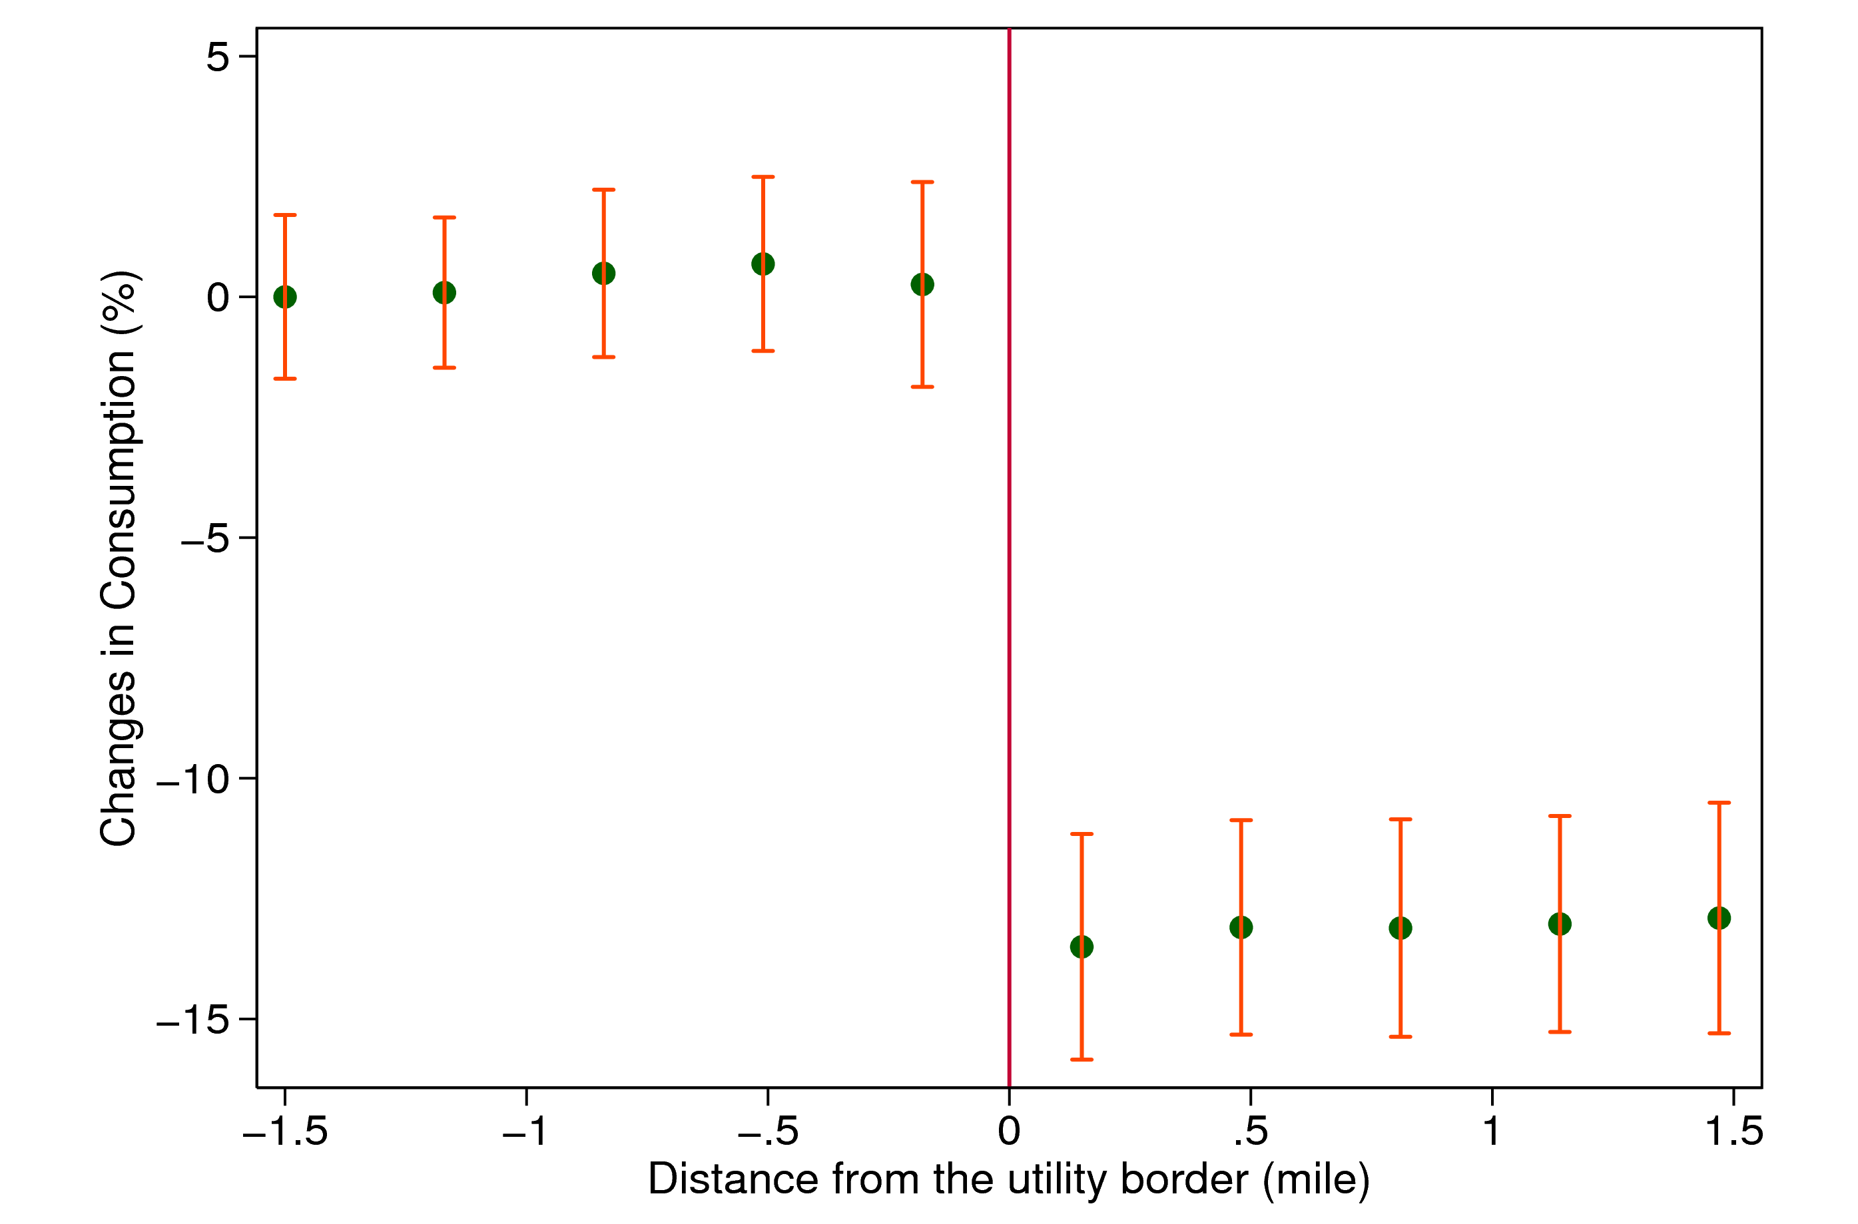
Changes in Consumption from August 1999 to August 2000,
by Distance from the Utility Border
SCE
SDG&E

Slide 34
Effects of Tiered Prices on Electricity Usage
Result: consumers are very sensitive to electricity prices when change is clearly visible, but do not respond to tiered pricing schedule
Implies that most consumers are not aware of the price they are paying for using additional electricity
Reinforces message that when designing corrective taxes, salience and structure of incentives matters as much as the dollars involved
  Traditional economics assumption that consumers are fully rational and perfectly informed about prices does not hold

Slide 35
How Can We Reduce Electricity Consumption More Effectively?
Two potential remedies to lack of effectiveness of tiered prices:
Make prices more salient to consumers using smart meters
  Pioneering technological work in this area done by O-Power
Use non-price tools motivated by results in social psychology
  Cialdini and collaborators (2007) demonstrate that social comparisons and injunctive social norms have significant effects on electricity use

Slide 37
Effects of Social Norm Treatments on Daily Electricity Consumption
Change in Electricity Usage (kWh/day)
Source: Schultz et al. (2007)

Slide 38
Magnitude of Social Norm Treatment
Social norms treatment reduces electricity usage by about 1 kilowatt-hour per day
  Equivalent to about a 2.5% reduction in electricity usage
  Analogous to turning off 10 hundred-watt lightbulbs for an hour a day
  Modest effect, but does not require charging consumers higher prices

Slide 39
Differential Effects of Social Norms Across Markets
OPower began mailing Home Energy Reports to millions of electricity customers in markets across the U.S.
In some markets, mailings were randomly assigned, permitting experimental estimates of causal effects
Allcott (2015) estimates impact of home energy reports for 111 markets separately to analyze whether impacts vary across areas

Slide 40
Effects of OPower Home Energy Reports Across Utilities, by Program Start Date
Reduction in Electricity Usage (%)

Slide 41
Site Selection Bias in Experimental Estimates
Illustrates an broader methodological lesson: experimental/quasi-experimental estimates in social science are not necessarily stable across settings
Important to continue to conduct studies across areas and time periods to understand policy impacts, rather than assuming effects will generalize

Slide 42
Perceptions of Climate Change
Why might public concern about climate change (and hence political support) be limited?
Moore et al. (2019) hypothesis: gradual change in climate → remarkability/salience of changes in climate lower
  “Boiling frog” phenomenon: gradual increases in temperature go unnoticed, even though total absolute change relative to past is large
Present evidence for such adjustment of perceptions using data from Twitter to measure how much people discuss weather

Slide 43
Measuring Perceptions of Climate Change: Methods
Data: 2.2 billion geocoded Tweets from 2014-16 and local area temperature measurements from 1981-2016
Goal: estimate a model that relates frequency of weather related tweets to temperature anomalies
“Bag of words” classification algorithm: define a tweet as weather-related if it contains any word in a list of pre-defined weather related terms

Slide 44
Words Related to Climate Change
arid, aridity, autumnal, balmy, barometric, blizzard, blizzards, blustering, blustery, blustery, breeze, breezes, breezy, celsius, chill, chilled, chillier, chilliest, chilly, cloud, cloudburst, cloudbursts, cloudier, cloudiest, clouds, cloudy, cold, colder, coldest, cooled, cooling, cools, cumulonimbus, cumulus, cyclone, cyclones, damp, damp, damper, damper, dampest, dampest, deluge, dew, dews, dewy, downdraft, downdrafts, downpour, downpours, drier, driest, drizzle, drizzled, drizzles, drizzly, drought, droughts, dry, dryline, fahrenheit, flood, flooded, flooding, floods, flurries, flurry, fog, fogbow, fogbows, fogged, fogging, foggy, fogs, forecast, forecasted, forecasting, forecasts, freeze, freezes, freezing, frigid, frost, frostier, frostiest, frosts, frosty, froze, frozen, gale, gales, galoshes, gust, gusting, gusts, gusty, haboob, haboobs, hail, hailed, hailing, hails, haze, hazes, hazy, heat, heated, heating, heats, hoarfrost, hot, hotter, hottest, humid, humidity, hurricane, hurricanes, icy, inclement, landspout, landspouts, lightning, lightnings, macroburst, macrobursts, meteorologic, meteorologist, meteorologists, meteorology, microburst, microbursts, microclimate, microclimates, millibar, millibars, mist, misted, mists, misty, moist, moisture, monsoon, monsoons, mugginess, muggy, nor'easter, nor'easters, noreaster, noreasters, overcast, parched, parching, precipitation, rain, rainboots, rainbow, rainbows, raincoat, raincoats, rained, rainfall, rainier, rainiest, raining, rains, rainy, sandstorm, sandstorms, scorcher, scorching, shower, showering, showers, sleet, slicker, slickers, slush, smog, smoggier, smoggiest, smoggy, snow, snowed, snowier, snowiest, snowing, snowmageddon, snowpocalypse, snows, snowy, sprinkle, sprinkling, squall, squalls, squally, storm, stormed, stormier, stormiest, storming, storms, stormy, stratocumulus, stratus, subtropical, summery, sun, sunnier, sunniest, sunny, temperate, temperature, tempest, thaw, thawed, thawing, thaws, thermometer, thunder, thundering, thunderstorm, thunderstorms, tornadic, tornado, tornadoes, tropical, troposphere, tsunami, turbulent, twister, twisters, typhoon, typhoons, umbrella, umbrellas, vane, warm, warmed, warms, weather, wet, wetter, wettest, wind, windchill, windchills, windier, windiest, windspeed, windy, wintery, wintry

Slide 45
Measuring Perceptions of Climate Change: Methods
Data: 2.2 billion geocoded Tweets from 2014-16 and local area temperature measurements from 1981-2016
Goal: estimate a model that relates frequency of weather related tweets to temperature anomalies
“Bag of words” classification algorithm: define a tweet as weather-related if it contains any word in a list of pre-defined weather related terms
Validation: sample 6,000 tweets and manually define them as weather-related or not to evaluate accuracy of classification of algorithm

Slide 46
Examples of Correctly Classified Tweets (“True Positives”)
it's too hot to be dressin cute
I swear when it comes to driving in the rain, people in Southern California are idiots on the road
Thinking of another day full of rain makes me cringe
It's pretty warm
Its so hot dawg
I want want to go swimming! Its too hot out here!!
I cold af
Hot as f**k
Something about a rainy day so cozy
I am so mad about this snow outside omg..
the weather is nuts!

Slide 47
Examples of Misclassified Tweets (“False Positives”)
I need an ice cold Bud Light. @budlight
In so tired of never being able to go out to dinner because everything is jam packed due to the Heat game. every year. Same bs.
"The cold never bothered me anyway." This movie never gets old
me- he looks familiar. ash- he is familiar he's hot
I live for all of the intense parts of songs by Arctic Monkeys.
1st degree burns from making hot coco. Hurts like hell
dad never failed to buy the ocean breeze
I wish I could freeze moments to be able to appreciate them more. Things are so fleeting

Slide 48
Measuring Perceptions of Climate Change: Methods
Data: 2.2 billion geocoded Tweets from 2014-16 and local area temperature measurements from 1981-2016
Goal: estimate a model that relates frequency of weather related tweets to temperature anomalies
“Bag of words” classification algorithm: define a tweet as weather-related if it contains any word in a list of pre-defined weather related terms
Validation: sample 6,000 tweets and manually define them as weather-related or not to evaluate accuracy of classification of algorithm
  46% of tweets classified as “weather-related” are false positives
  But frequency of errors is uncorrelated with temperature fluctuations → unbiased estimates of link between weather and climate perceptions despite errors

Slide 49
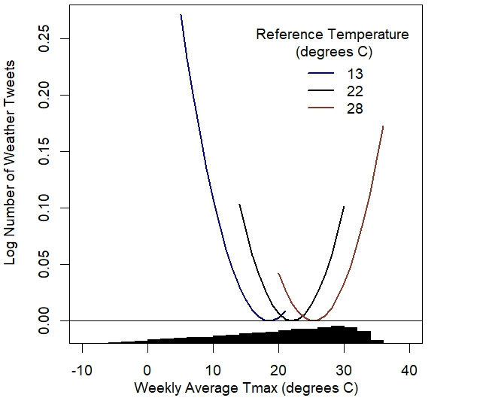
Weather-Related Tweets vs. Temperature, by Historical Avg. Temperature
Source: Moore et al. (2019)

Slide 50
Dynamic Adjustment Model
Next, relate tweets in a given week to rate of temperature anomalies both in that week and to frequency of similar anomalies in previous years
Dynamic adjustment model: captures how a sequence of anomalies (i.e., hotter temperatures over time) affect perceptions

Slide 51
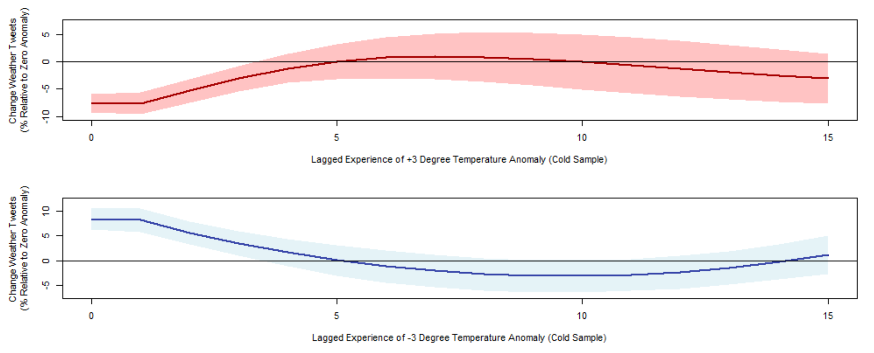
Short Run vs. Long Run Impacts of Temperature Anomalies
Source: Moore et al. (2019)

Slide 52
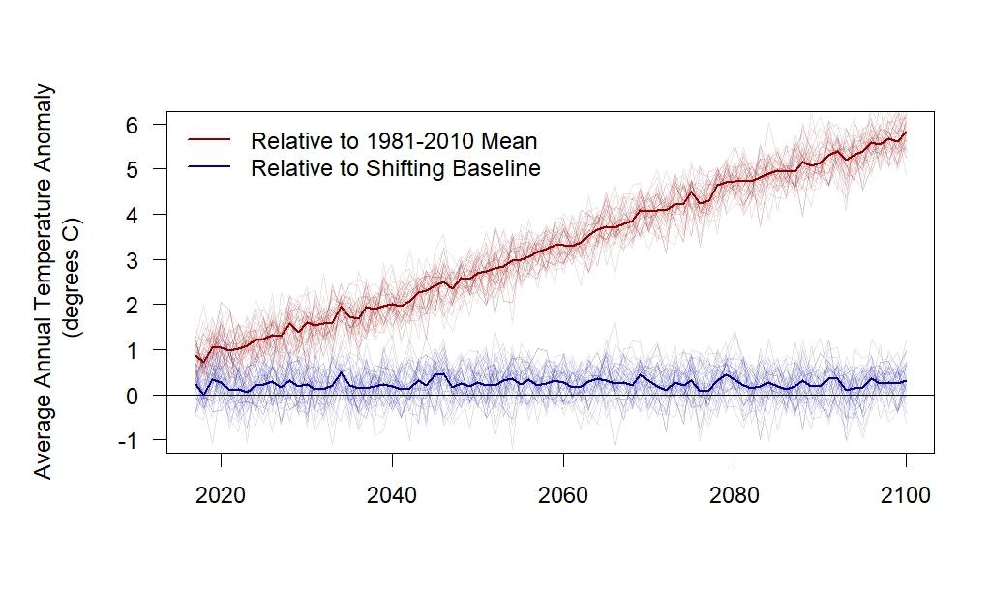
Perceived vs. Actual Changes in Temperature
Source: Moore et al. (2019)

