Slide 1
The Impacts of Neighborhoods on Intergenerational Mobility I:
Childhood Exposure Effects
Raj Chetty and Nathaniel Hendren
Harvard University and NBER
May 2017
The opinions expressed in this paper are those of the authors alone and do not necessarily reflect the views of the Internal Revenue Service or the U.S. Treasury Department. This work is a component of a larger project examining the effects of eliminating tax expenditures on the budget deficit and economic activity. Results reported here are contained in the SOI Working Paper “The Economic Impacts of Tax Expenditures: Evidence from Spatial Variation across the U.S.,” approved under IRS contract TIRNO-12-P-00374.

Slide 2

Introduction
How much do neighborhood environments affect children’s outcomes?
  Observational studies document substantial variation in outcomes across areas [Wilson 1987, Massey and Denton 1993, Cutler and Glaeser 1997, Wodtke et al. 1999, Altonji and Mansfield 2014]
  But experimental studies find no significant effects of moving to better areas on economic outcomes [e.g. Katz, Kling, and Liebman 2001, Oreopoulous 2003, Sanbonmatsu et al. 2011]
Notes:
2

Slide 3
This Talk
We use data from de-identified tax records on 7 million families who move across counties to present two sets of results:
  Quasi-experimental evidence that neighborhoods have significant causal effects in proportion to childhood exposure
  Estimates of causal effects of each county in the U.S. on children’s earnings
Results presented in two companion papers:
  First paper: “The Impacts of Neighborhoods on Intergenerational Mobility I: Childhood Exposure Effects”
  Second Paper: “The Impacts of Neighborhoods on Intergenerational Mobility II: County-Level Estimates”
Notes:
3

Slide 4
Data
Data source: de-identified data from 1996-2012 tax returns
Children linked to parents based on dependent claiming
Focus on children in 1980-1993 birth cohorts
  Approximately 50 million children
Notes:
4

Slide 5
Variable Definitions
Parent income: mean pre-tax household income between 1996-2000
      For non-filers, use W-2 wage earnings + SSDI + UI income
  Child income: pre-tax household income at various ages
Results robust to varying definitions of income and age at which child’s income is measured
Focus on percentile ranks in national income distribution
  Rank children relative to others in the same birth cohort
  Rank parents relative to other parents
Notes:
5

Slide 6
Defining “Neighborhoods”
We conceptualize neighborhood effects as the sum of effects at different geographies (hierarchical model)
Our primary estimates are at the commuting zone (CZ) and county level
  CZ’s are aggregations of counties analogous to MSAs
[Tolbert and Sizer 1996; Autor and Dorn 2013]
Variance of place effects at broad geographies is a lower bound for total variance of neighborhood effects
Notes:
6

Slide 7
Intergenerational Mobility by CZ
Begin with a descriptive characterization of children’s outcomes in each CZ
Focus on “permanent residents” of CZs
  Permanent residents = parents who stay in CZ c between 1996-2012
  Note that children who grow up in CZ c may move out as adults
Characterize relationship between child’s income rank and parent’s income rank p for each CZ c and birth cohort s
Notes:
7

Slide 8
Mean Child Income Rank at Age 30 vs. Parent Income Rank
for Children Born in 1980 and Raised in Chicago
70
60
50
Mean Child Rank in National Income Distribution
40
30
20
0
10
20
30
40
50
60
70
80
90
100
Parent Rank in National Income Distribution

Slide 9

Mean Child Income Rank at Age 30 vs. Parent Income Rank
for Children Born in 1980 and Raised in Chicago
70
60
50
Mean Child Rank in National Income Distribution
40
30
$\overline{y}$_{0,Chicago,1985}
= E[Child Rank | p = 0, c = Chicago, s = 1985]
20
0
10
20
30
40
50
60
70
80
90
100
Parent Rank in National Income Distribution

Slide 10

Mean Child Income Rank at Age 30 vs. Parent Income Rank
for Children Born in 1980 and Raised in Chicago
70
60
50
Mean Child Rank in National Income Distribution
40
$\overline{y}$_{p,Chicago,1985} = $\overline{y}$_{0,Chicago,1985}
+ (Rank-Rank Slope) $×$ $p$
30
Predict outcome for child in CZ c using slope + intercept of rank-rank relationship
20
0
10
20
30
40
50
60
70
80
90
100
Parent Rank in National Income Distribution

Slide 11
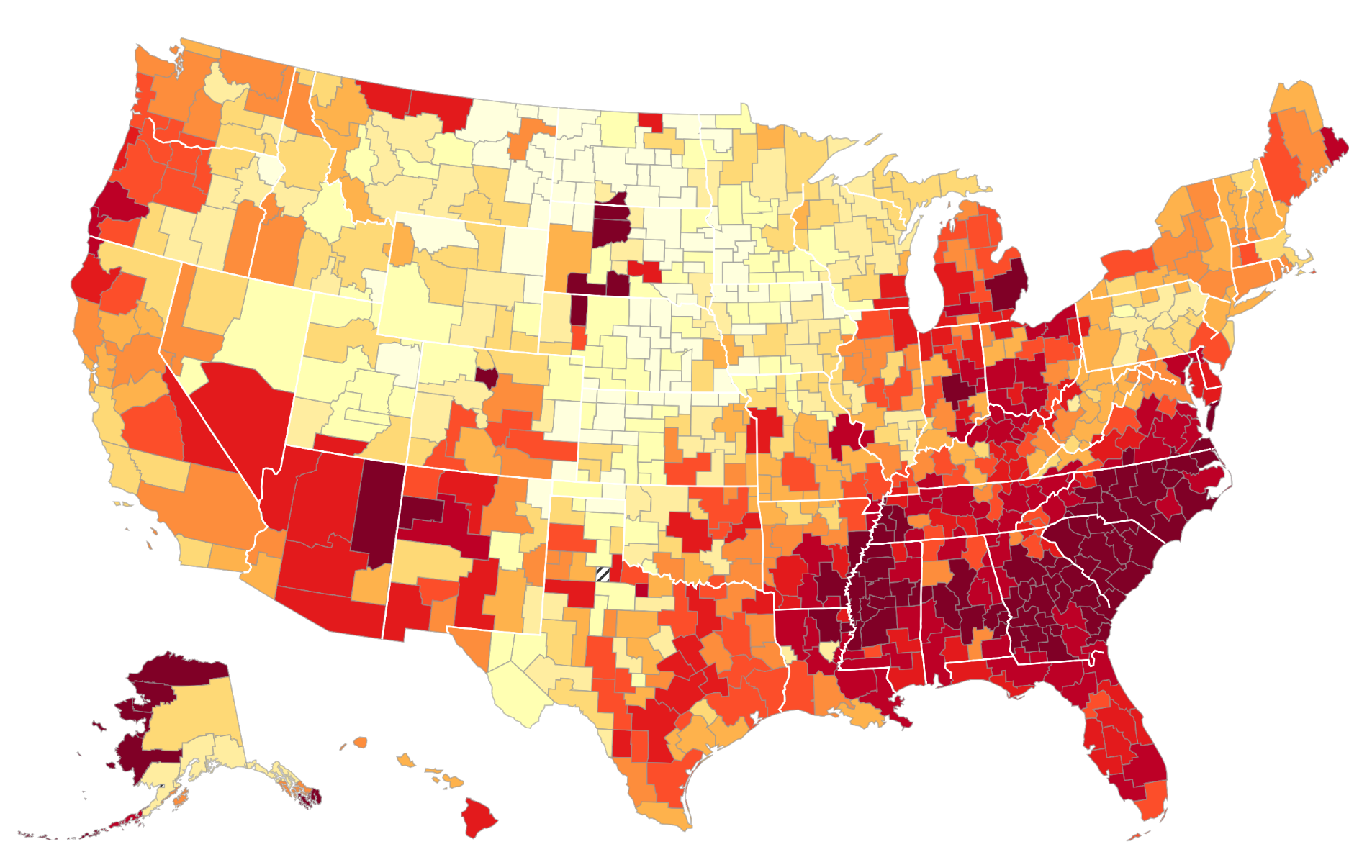

The Geography of Intergenerational Mobility in the United States
Predicted Income Rank at Age 30 for Children with Parents at 25th Percentile
Mean Percentile Rank
> 54.8
50.8 - 54.8
47.8 - 50.8
45.9 - 47.8
44.7 - 45.9
43.4 - 44.7
41.9 - 43.4
40.0 - 41.9
37.9 - 40.0
< 37.9
Insufficient Data

Slide 12
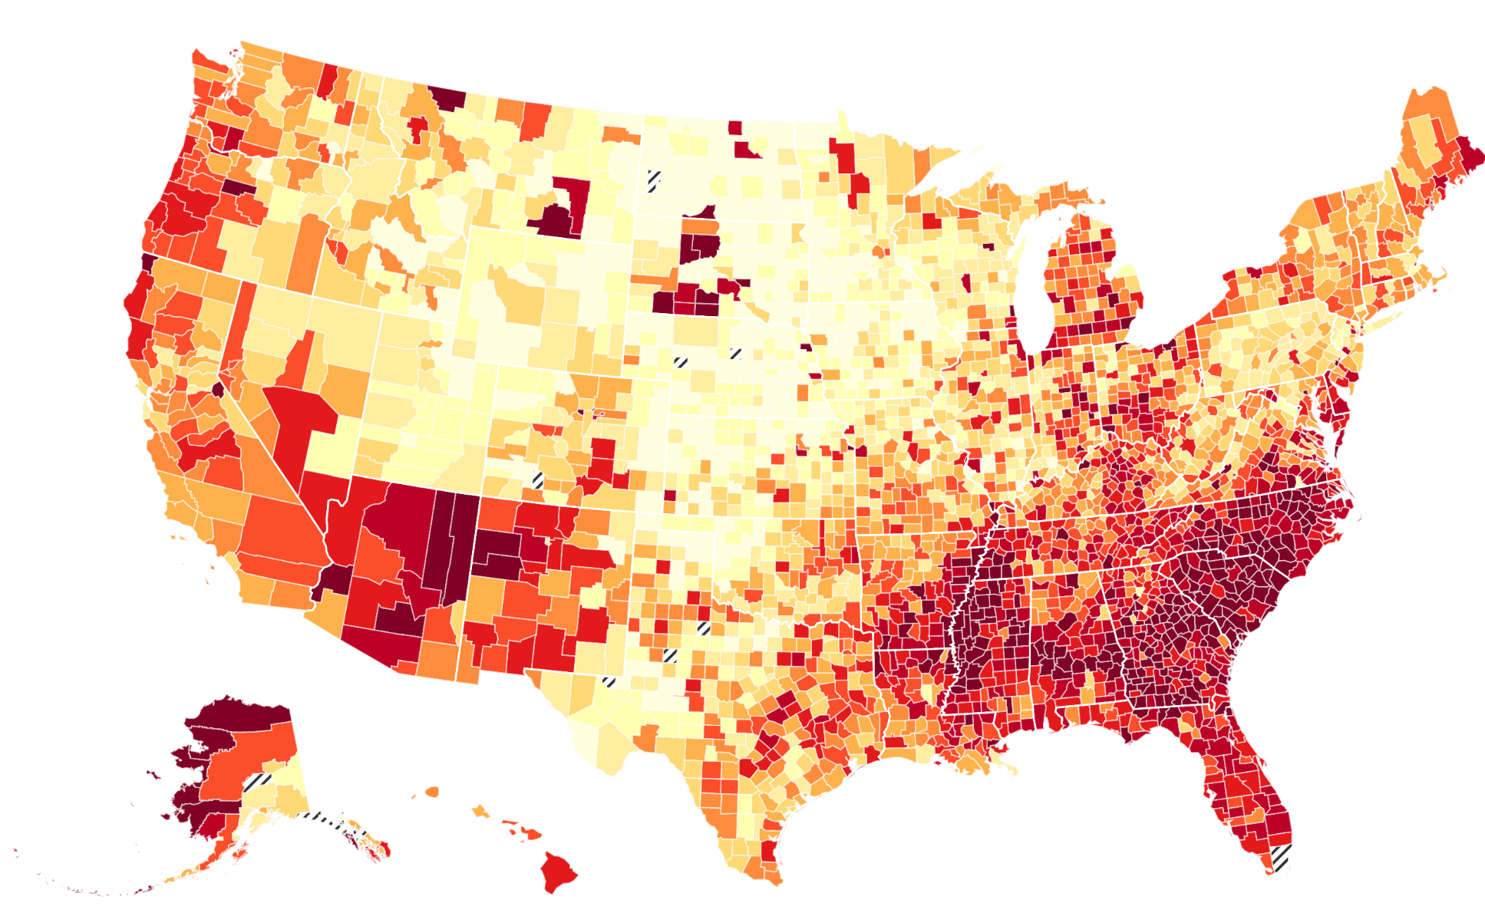
The Geography of Intergenerational Mobility in the United States
Predicted Income Rank at Age 30 for Children with Parents at 25th Percentile
Mean Percentile Rank
> 55.4
51.4 - 55.4
48.7- 51.4
46.8 - 48.7
45.3 - 46.8
43.6 - 45.3
42.0 - 43.6
40.3 - 42.0
37.7 - 40.3
< 37.7
Insufficient Data

Slide 13
The Geography of Intergenerational Mobility in the United States
Predicted Income Rank at Age 30 for Children with Parents at 25th Percentile
Mean Percentile Rank
> 55.4
51.4 - 55.4
48.7- 51.4
46.8 - 48.7
45.3 - 46.8
43.6 - 45.3
42.0 - 43.6
40.3 - 42.0
37.7 - 40.3
< 37.7
Insufficient Data
What is the Average Causal Impact of Growing Up in place with Better Outcomes?

Slide 14
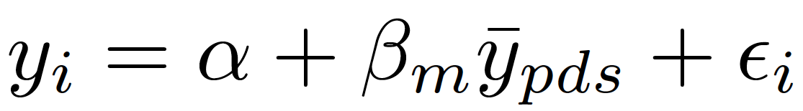
Neighborhood Exposure Effects
We identify causal effects of neighborhoods by analyzing childhood exposure effects
  Exposure effect at age m: impact of spending year m of childhood in an area where permanent residents’ outcomes are 1 percentile higher
Ideal experiment: randomly assign children to new neighborhoods d starting at age m for the rest of childhood
  Regress income in adulthood (y_{i}) on mean outcomes of prior residents:
  Exposure effect at age m is
(1)

Slide 15
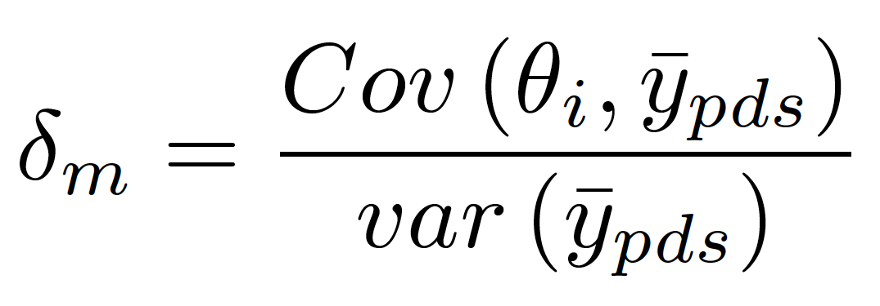
Estimating Exposure Effects in Observational Data
We estimate exposure effects by studying families that move across CZ’s with children at different ages in observational data
Of course, choice of neighborhood is likely to be correlated with children’s potential outcomes
  Ex: parents who move to a good area may have latent ability or wealth (θ_{i}) that produces better child outcomes
Estimating (1) in observational data yields a coefficient
where is a standard selection effect

Slide 16
Estimating Exposure Effects in Observational Data
But identification of exposure effects does not require that where people move is orthogonal to child’s potential outcomes
Instead, requires that timing of move to better area is orthogonal to child’s potential outcomes
Assumption 1. Selection effects do not vary with child’s age at move:
δ_{m} = δ for all m
Certainly plausible that this assumption could be violated
  Ex: parents who move to better areas when kids are young may have better unobservables
  First present baseline estimates and then evaluate this assumption in detail

Slide 17
Estimating Exposure Effects in Observational Data
To begin, consider subset of families who move with a child who is exactly 13 years old
Regress child’s income rank at age 26 y_{i} on predicted outcome of permanent residents in destination:
Include parent decile (q) by origin (o) by birth cohort (s) fixed effects to identify b_{m} purely from differences in destinations

Slide 18
Movers’ Outcomes vs. Predicted Outcomes Based on Residents in Destination
Child Age 13 at Time of Move, Income Measured at Age 24
4
2
0
Mean (Residual) Child Rank in National Income Distribution
Slope: b
= 0.615
13
(0.025)
-2
-4
-6
-4
-2
0
2
4
6
Predicted Diff. in Child Rank Based on Permanent Residents in Dest. vs. Orig.

Slide 19
Movers’ Outcomes vs. Predicted Outcomes Based on Residents in Destination
By Child’s Age at Move, Income Measured at Age 26
0.8
0.6
Coefficient on Predicted Rank in Destination
0.4
0.2
10
15
20
25
30
Age of Child when Parents Move
Income at Age 26

Slide 20
Movers’ Outcomes vs. Predicted Outcomes Based on Residents in Destination
By Child’s Age at Move, Income Measured at Age 26
0.8
0.6
Coefficient on Predicted Rank in Destination
b_{m} > 0 for m > 26: Selection Effects
0.4
b_{m} declining with m Exposure Effects
0.2
10
15
20
25
30
Age of Child when Parents Move
Income at Age 26

Slide 21
Movers’ Outcomes vs. Predicted Outcomes Based on Residents in Destination
By Child’s Age at Move, Income Measured at Ages 24, 26, 28, or 30
0.8
0.6
Coefficient on Predicted Rank in Destination
0.4
0.2
10
15
20
25
30
Age of Child when Parents Move
Income at Age 24
Income at Age 26

Slide 22
Movers’ Outcomes vs. Predicted Outcomes Based on Residents in Destination
By Child’s Age at Move, Income Measured at Ages 24, 26, 28, or 30
0.8
0.6
Coefficient on Predicted Rank in Destination
0.4
0.2
10
15
20
25
30
Age of Child when Parents Move
Income at Age 24
Income at Age 26
Income at Age 28

Slide 23
Movers’ Outcomes vs. Predicted Outcomes Based on Residents in Destination
By Child’s Age at Move, Income Measured at Ages 24, 26, 28, or 30
0.8
0.6
Coefficient on Predicted Rank in Destination
0.4
0.2
10
15
20
25
30
Age of Child when Parents Move
Income at Age 24
Income at Age 26
Income at Age 28
Income at Age 30

Slide 24
Movers’ Outcomes vs. Predicted Outcomes Based on Residents in Destination
By Child’s Age at Move, Income Measured at Age $=$ 24
0.8
0.6
δ: 0.226
Coefficient on Predicted Rank in Destination
Slope: -0.038
Slope: -0.002
(0.002)
(0.011)
0.4
0.2
10
15
20
25
30
Age of Child when Parents Move

Slide 25
Movers’ Outcomes vs. Predicted Outcomes Based on Residents in Destination
By Child’s Age at Move, Income Measured at Age $=$ 24
0.8
0.6
δ: 0.226
Coefficient on Predicted Rank in Destination
Slope: -0.038
Slope: -0.002
(0.002)
(0.011)
0.4
0.2
Assumption 1: δ_{m} = δ for all m
→ Causal effect of moving at age m is β_{m} = b_{m} – δ
10
15
20
25
30
Age of Child when Parents Move

Slide 26
Family Fixed Effects: Sibling Comparisons
0.8
0.6
0.4
Coefficient on Predicted Rank in Destination
δ (Age > 23): 0.008
Slope (Age ≤ 23): -0.043
Slope (Age > 23): -0.003
(0.003)
(0.013)
0.2
0
10
15
20
25
30
Age of Child when Parents Move

Slide 27
Family Fixed Effects: Sibling Comparisons
with Controls for Change in Income and Marital Status at Move
0.8
0.6
Coefficient on Predicted Rank in Destination
0.4
δ (Age > 23): 0.015
Slope (Age ≤ 23): -0.042
Slope (Age > 23): -0.003
(0.003)
(0.013)
0.2
0
10
15
20
25
30
Age of Child when Parents Move

Slide 28
Time-Varying Unobservables
Family fixed effects do not rule out time-varying unobservables (e.g. wealth shocks) that affect children in proportion to exposure time
Two approaches to evaluate such confounds:
  Outcome-based placebo (overidentification) tests
  Experimental/quasi-experimental variation from displacement shocks or randomized incentives to move

Slide 29
Outcome-Based Placebo Tests
General idea: exploit heterogeneity in place effects across subgroups to obtain overidentification tests of exposure effect model
Start with variation in place effects across birth cohorts
  Some areas are getting better over time, others are getting worse
  Causal effect of neighborhood on a child who moves in to an area should depend on properties of that area while he is growing up

Slide 30
Outcome-Based Placebo Tests
Parents choose neighborhoods based on their preferences and information set at time of move
  Difficult to predict high-frequency differences that are realized 15 years later → hard to sort on this dimension
Key assumption: if unobservables θ_{i} correlated with exposure effect for cohort s, then correlated with exposure effects for surrounding cohorts s′ as well
Under this assumption, selection effects will be manifested in correlation with place effects for surrounding cohorts

Slide 31
Estimates of Exposure Effects Based on Cross-Cohort Variation
0.04
0.03
0.02
Exposure Effect Estimate (β)
0.01
0
-0.01
-4
-2
0
2
4
Years Relative to Own Cohort
Separate

Slide 32
Estimates of Exposure Effects Based on Cross-Cohort Variation
0.04
0.03
0.02
Exposure Effect Estimate (β)
0.01
0
-0.01
-4
-2
0
2
4
Years Relative to Own Cohort
Simultaneous
Separate

Slide 33
Distributional Convergence
  Next, implement an analogous set of placebo tests by exploiting heterogeneity across realized distribution of incomes
  Areas differ not just in mean child outcomes but also across distribution
  For example, compare outcomes in Boston and San Francisco for children with parents at 25th percentile
    Mean expected rank is 46th percentile in both cities
    Probability of reaching top 10%: 7.3% in SF vs. 5.9% in Boston
    Probability of being in bottom 10%: 15.5% in SF vs. 11.7% in Boston

Slide 34
Distributional Convergence
  Exposure model predicts convergence to permanent residents’ outcomes not just on means but across entire distribution
    Children who move to SF at younger ages should be more likely to end up in tails than those who move to Boston
  Difficult to know exactly where in the income distribution your child will fall as an adult when moving with a 10 year old
    Also unlikely that unobserved factor θ_{i} would replicate distribution of outcomes in destination area in proportion to exposure time
  Does greater exposure to areas that produce stars increase probability of becoming a star, controlling for mean predicted rank?

Slide 35
Exposure Effects on Upper-Tail and Lower-Tail Outcomes
Comparisons of Impacts at P90 and Non-Employment
 | Dependent Variable
 | Child Rank in top 10% |  |  |  |  |  | Child Unemployed
 | (1) | (2) |  | (3) |  |  | (4) | (5) | (6)
Distributional Prediction | 0.043 |  |  | 0.040 |  |  | 0.041 |  | 0.043
 | (0.002) |  |  | (0.003) |  |  | (0.003) |  | (0.004)
Mean Rank Prediction |  | 0.024 |  | 0.003 |  |  |  | 0.018 | -0.002
(Placebo) |  | (0.002) |  | (0.003) |  |  |  | (0.002) | (0.003)

Slide 36
Gender Comparisons
  Finally, exploit heterogeneity across genders
  Construct separate predictions of expected income rank conditional on parent income for girls and boys in each CZ
    Correlation of male and female predictions across CZ’s is 0.90
  Low-income boys do worse than girls in areas with:
    More segregation (concentrated poverty)
    Higher rates of crime
    Lower marriage rates [Autor and Wasserman 2013]
  If unobservable input θ_{i} does not covary with gender-specific neighborhood effect, can use gender differences to conduct a placebo test

Slide 37
Exposure Effect Estimates: Gender-Specific Predictions
 | No Family Fixed Effects |  |  |  | Family Fixed Effects
 | (1) | (2) | (3) |  | (4)
Own Gender Prediction | 0.038 |  | 0.030 |  | 0.030
 | (0.002) |  | (0.003) |  | (0.007)
Other Gender Prediction (Placebo) |  | 0.031 | 0.010 |  | 0.009
 |  | (0.002) | (0.003) |  | (0.007)
Sample | Full Sample |  |  |  | 2-Gender HH

Slide 38
Neighborhood Effects on Other Outcomes
We also find similar exposure effects for other outcomes:
  College attendance (from 1098-T forms filed by colleges)
  Teenage birth (from birth certificate data)
  Teenage employment (from W-2 forms)
  Marriage

Slide 39
Exposure Effects for College Attendance, Ages 18-23
0.8
0.6
0.4
Coefficient on Predicted College Attendance Rate in Destination
d (Age = 23): 0.092
Slope (Age = 23): -0.037
Slope (Age = 23): -0.021
0.2
(0.003)
(0.011)
0
10
15
20
25
30
Age of Child when Parents Move

Slide 40
Exposure Effects for Marriage Rate, Age 26
0.8
0.7
Coefficient on Change in Predicted Marriage Rate
0.6
δ (Age > 23): 0.464
Slope (Age ≤ 23): -0.025
Slope (Age > 23): -0.002
(0.002)
(0.005)
0.5
0.4
10
15
20
25
30
Age of Child when Parents Move

Slide 41
Exposure Effects for Teenage Birth: Females and Males
0.6
0.4
Coefficient on Change in Predicted Teen Birth Rate
0.2
0
5
10
15
20
25
Age of Child when Parents Move
Female
Male

Slide 42
Identification of Exposure Effects: Summary
Any omitted variable θ_{i} that generates bias in the exposure effect estimates would have to:
  Operate within family in proportion to exposure time
  Be orthogonal to changes in parent income and marital status
  Replicate prior residents’ outcomes by birth cohort, quantile, and gender in proportion to exposure time
  Replicate impacts across outcomes (income, college attendance, teen labor, marriage)
→ We conclude that baseline design exploiting variation in timing of move
yields unbiased estimates of neighborhoods’ causal effects

Slide 43
Experimental Variation
We also validate this quasi-experimental design using experimental variation where we know what triggers the move
We consider two such subsets of moves:
  Displacement shocks such as plant closures and natural disasters
  Moving to Opportunity Experiment
Both induce families to move for reasons known to be unrelated to child’s age and potential outcomes
Focus on the MTO results here in the interest of time
  MTO also provides insights at finer geographies

Slide 44
Moving to Opportunity Experiment
HUD Moving to Opportunity Experiment implemented from 1994-1998
4,600 families at 5 sites: Baltimore, Boston, Chicago, LA, New York
Families randomly assigned to one of three groups:
  Experimental: housing vouchers restricted to low-poverty (<10%) Census tracts
  Section 8: conventional housing vouchers, no restrictions
  Control: public housing in high-poverty (50% at baseline) areas
48% of eligible households in experimental voucher group “complied” and took up voucher

Slide 45
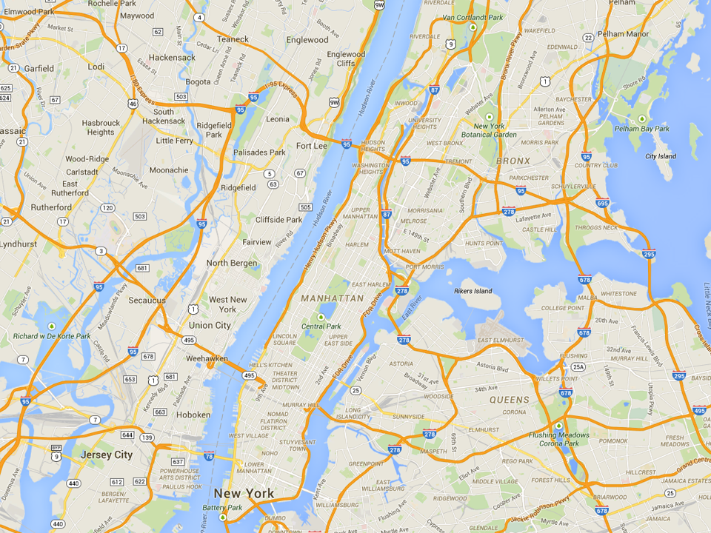
Most Common MTO Residential Locations in New York
Experimental
Wakefield Bronx
Section 8
Soundview Bronx
Control
King Towers
Harlem

Slide 46
MTO Experiment: Exposure Effects?
Prior research on MTO has found little impact of moving to a better area on earnings and other economic outcomes
  This work has focused on adults and older youth at point of move
  [e.g., Kling, Liebman, and Katz 2007]
In a companion paper (joint with Larry Katz), we test for childhood exposure effects in MTO experiment:
Chetty, Hendren, Katz. “The Effects of Exposure to Better Neighborhoods on Children: New Evidence from the Moving to Opportunity Experiment”
Does MTO improve outcomes for children who moved when young?
  Link MTO data to tax data to study children’s outcomes in mid-20’s

Slide 47
MTO vs. Quasi-Experiment
Differences between MTO and quasi-experimental designs:
Different set of compliers who identify LATE
  MTO identified from moves induced by vouchers
  Quasi-experiment from moves that families chose in equilibrium
Inclusion of disruption effects from move
  MTO compares movers to non-movers and therefore incorporates any disruption effect of move
  Quasi-experimental design compares effect of moving to better vs. worse areas conditional on moving → fixed cost of move netted out

Slide 48
Impacts of MTO on Children Below Age 13 at Random Assignment
(a) Individual Earnings (ITT)
(b) Individual Earnings (TOT)
17000
17000
15000
15000
13000
13000
Individual Income at Age ≥ 24 ($)
Individual Income at Age ≥ 24 ($)
11000
11000
9000
9000
$11,270
$12,380
$12,894
$11,270
$12,994
$14,747
7000
p = 0.101
p = 0.014
7000
p = 0.101
p = 0.014
5000
5000
Control
Section 8
Experimental
Voucher
Control
Section 8
Experimental
Voucher

Slide 49
Impacts of MTO on Children Below Age 13 at Random Assignment
(a) College Attendance (ITT)
(b) College Quality (ITT)
22000
20
21000
15
College Attendance, Ages 18-20 (%)
Mean College Quality, Ages 18-20 ($)
20000
10
5
16.5%
17.5%
19.0%
19000
$20,915
$21,547
$21,601
p = 0.435
p = 0.028
p = 0.014
p = 0.003
0
18000
Control
Section 8
Experimental
Voucher
Control
Section 8
Experimental
Voucher

Slide 50
Impacts of MTO on Children Below Age 13 at Random Assignment
(a) ZIP Poverty Share in Adulthood (ITT)
(b) Birth with no Father Present (ITT)
Females Only
25
50
23
37.5
21
Zip Poverty Share (%)
Birth with no Father on Birth Certificate (%)
25
19
17
23.8%
22.4%
22.2%
12.5
33.0%
31.7%
28.2%
p = 0.047
p = 0.008
p = 0.610
p = 0.042
15
0
Control
Section 8
Experimental
Voucher
Control
Section 8
Experimental
Voucher

Slide 51
Impacts of MTO on Children Age 13-18 at Random Assignment
(a) Individual Earnings (ITT)
(b) Individual Earnings (TOT)
17000
17000
15000
15000
13000
13000
Individual Income at Age ≥ 24 ($)
Individual Income at Age ≥ 24 ($)
11000
11000
9000
9000
$15,882
$14,749
$14,915
$15,882
$13,830
$13,455
7000
p = 0.219
p = 0.259
7000
p = 0.219
p = 0.259
5000
5000
Control
Section 8
Experimental
Voucher
Control
Section 8
Experimental
Voucher

Slide 52
Impacts of MTO on Children Age 13-18 at Random Assignment
(a) College Attendance (ITT)
(b) College Quality (ITT)
22000
20
21000
15
College Attendance, Ages 18-20 (%)
Mean College Quality, Ages 18-20 ($)
20000
10
5
11.4%
19000
$21,638
$21,041
15.6%
12.6%
$20,755
p = 0.091
p = 0.013
p = 0.168
p = 0.022
0
18000
Control
Section 8
Experimental
Voucher
Control
Section 8
Experimental
Voucher

Slide 53
Impacts of MTO on Children Age 13-18 at Random Assignment
(a) ZIP Poverty Share in Adulthood (ITT)
(b) Birth with no Father Present (ITT)
Females Only
25
50
23
37.5
21
Zip Poverty Share (%)
Birth No Father Present (%)
25
19
17
23.6%
22.7%
23.1%
12.5
41.4%
40.7%
45.6%
p = 0.184
p = 0.418
p = 0.857
p = 0.242
15
0
Control
Section 8
Experimental
Voucher
Control
Section 8
Experimental
Voucher

Slide 54
Impacts of Experimental Voucher by Age of Random Assignment
Household Income, Age ≥ 24 ($)
4000
2000
0
Experimental Vs. Control ITT on Income ($)
-2000
-4000
-6000
10
12
14
16
Age at Random Assignment

Slide 55
Conclusion: Policy Lessons
How can we improve neighborhood environments for disadvantaged youth?
  Short-term solution: Provide targeted housing vouchers at birth conditional on moving to better (e.g. mixed-income) areas
    MTO experimental vouchers increased tax revenue substantially → taxpayers may ultimately gain from this investment

Slide 56
Impacts of MTO on Annual Income Tax Revenue in Adulthood
for Children Below Age 13 at Random Assignment (TOT Estimates)
1200
1000
800
Annual Income Tax Revenue, Age ≥ 24 ($)
600
400
$447.5
$616.6
$841.1
200
p = 0.061
p = 0.004
0
Control
Section 8
Experimental
Voucher

Slide 57
Conclusion: Policy Lessons
How can we improve neighborhood environments for disadvantaged youth?
  Short-term solution: Provide targeted housing vouchers at birth conditional on moving to better (e.g. mixed-income) areas
    MTO experimental vouchers increased tax revenue substantially → taxpayers may ultimately gain from this investment
  Long-term solution: improve neighborhoods with poor outcomes, concentrating on factors that affect children

Slide 58
Conclusion: Policy Lessons
How can we improve neighborhood environments for disadvantaged youth?
  Short-term solution: Provide targeted housing vouchers at birth conditional on moving to better (e.g. mixed-income) areas
    MTO experimental vouchers increased tax revenue substantially → taxpayers may ultimately gain from this investment
  Long-term solution: improve neighborhoods with poor outcomes, concentrating on factors that affect children
Key input for both policies:
  What are the best and worst places to grow up?
  What are the characteristics of places that improve children’s outcomes?
  Developed in companion paper: “The Impacts of Neighborhoods on Intergenerational Mobility II: County-Level Estimates”

Slide 59

Download County-Level Data on Social Mobility in the U.S.
www.equality-of-opportunity.org/data

